Slide 1
ANDROID
Khongkidakorn worasan ID 503040764-8

Slide 2
OVERVIEW
Introduction To Android
Android Architecture
Conclusion

Slide 3
INTRODUCTION
TO
ANDROID

Slide 4
What is Android?
A complete & modern embedded operating system
A world-class software stack for building applications

Slide 5
Why Android Was Created?
Full phone software stack including applications
Android is open
Android is free
Community support
100% Java Phone

Slide 6
History
July 2005
Google acquired Android Inc.
5 Nov 2007
Open HandSet Alliance formed-
Google, HTC, Intel, Motorola, Qualcomm,T-Mobile
Android is the OHA first product
12 Nov 2007
OHA released a preview of the Android OHA

Slide 7
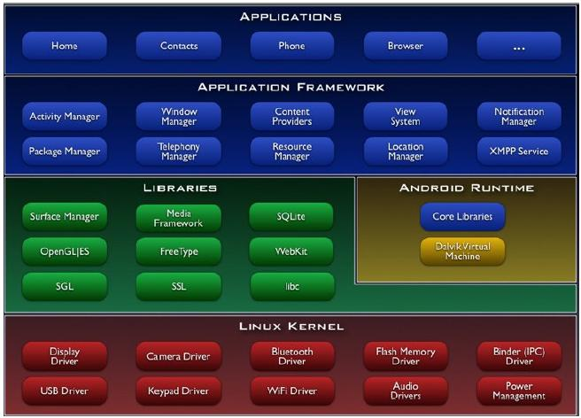
ANDROID ARCHITECTURE

Slide 8
Application Framework
Enable applications access data from other applications ,sharing
Providing access to non-code resources
Enables all applications to display alerts in the status bar
Manages the lifecycle of applications

Slide 9
Libraries
Written in C/C++ - System C Library(libc)
Display/Graphics(SGL)
Media Libraries
SQLite –RDB engine-light weight
LibWebCore–web browser engine–embeddable web view

Slide 10
Linux Kernel
Linux Version 2.6
Security, Memory & Process Management
Proven driver model
Efficient computing resource management
Stable and proven OS for mobile platform

Slide 11
Android Runtime
Includes a set of core libraries that provides most of the functionality-JAVA
Every Android application runs in its own process
Dalvik VM executes files in the (.dex) format
Device can run multiple VMs efficiently

Slide 12
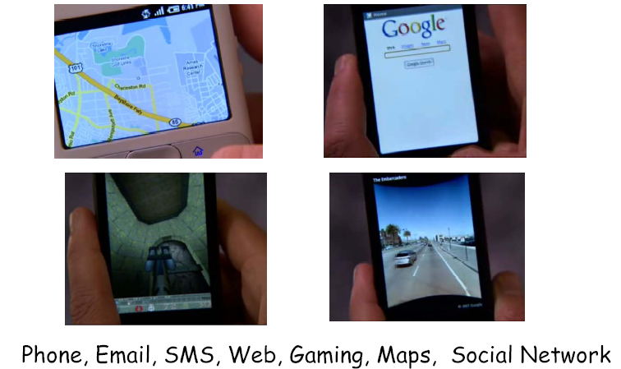
Applications

Slide 13
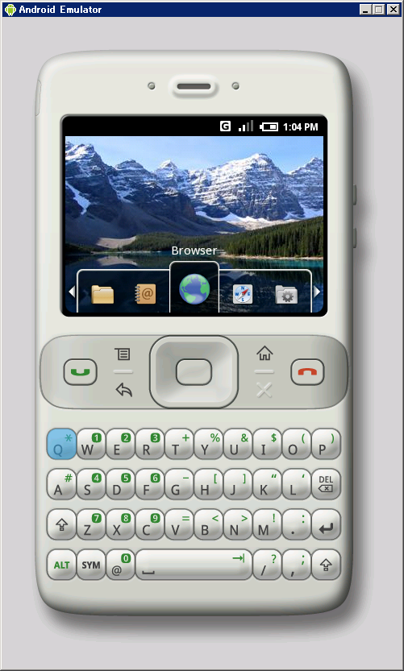
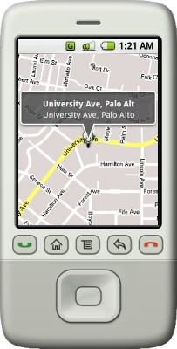
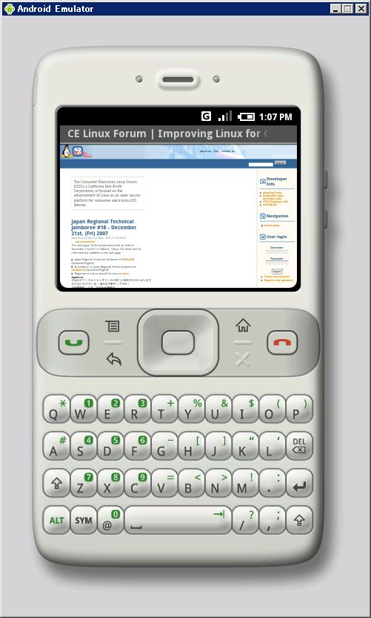
Initial screen
Map
Browser

Slide 14
conclusion
Android is open to all: industry, developers and users
Participating in many of the successful open source projects
Google Android is stepping into the next level of Mobile Internet

