Slide 1
Basic behind antibiotic use
Assoc.Prof.Pope Kosalaraksa

Slide 2
Content
Common term and meaning of the basic knowledge
Apply this knowledge with clinical care (choose appropriate antibiotic)
Case discussion

Slide 3
Behind decision in antibiotic use
Clinical syndrome
Hx, PE,
initial lab
epidemiology
lab
Most likely
causative organism
Minor, major infection
Severity
Appropriate antibiotic
type
dose, route
cost effective

Slide 4
Common terms and meaning
Minimal inhibitory/effective concentration (MIC, MEC)
Maximal therapeutic concentration
Time dependent, concentration dependent
Post antibiotic effect (PAE)
Bioavailability
Prophylactic/Pre-emptive/Empiric treatment
Step down, switch therapy
Escalation, De-escalation therapy

Slide 5
Minimal inhibitory/effective concentration (MIC, MEC)

Slide 6
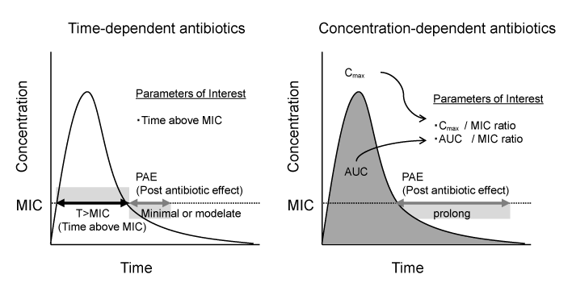
Antibiotics

Slide 8
Clinical implications
Aminoglycoside, quinolone, amphotericinB
: concentration dependent
: high dose, long interval
Beta-lactams, clindamycin, macrolide
: time dependent
: optimal duration of exposure

Slide 9
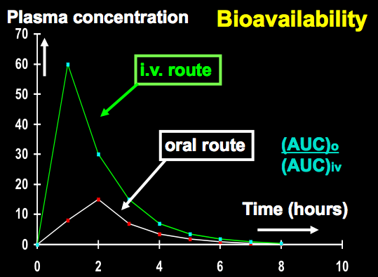
Bioavailability
fraction of an administered dose of unchanged drug that reaches systemic circulation

Slide 10
Antibiotics | Bioavailability (%)
Ampicillin | 30-55
Amoxicillin | 74-92
Dicloxacillin | 35-76
Cephalexin | 90-100
Azithromycin | 37
Clarithromycin | 55
MacGregor RR. CID 1997

Slide 11
Antibiotics with high bioavailability
Antibiotics | Bioavailability (%)
Doxycycline | >90 with food
Ciprofloxacin | 65-85
Ofloxacin | 98
Clindamycin | 90
Metronidazole | 80
Cotrimoxazole | 70-90
Cephalexin | 90-100
MacGregor RR. CID 1997

Slide 12
Switch therapy
From IV to oral
: cost effective (less expensive, indirect cost)
: discharge early
Step down therapy: use same drug
Sequential therapy: use different drug

Slide 13
Clinical implication- bioavailability
Switch or step down therapy
Select drug with good bioavailability
MSSA: cotrimoxazole, clindamycin, dicloxacillin
Gram negative: ciprofloxacin, ofloxacin
Anaerobe: metronidazole, clindamycin

Slide 14
MSSA infection
Pneumonia, osteomyelitis, septic arthritis
: cotrimoxazole, clindamycin, cephalexin
: dicloxacillin – high dose
Skin infection
: dicloxacillin, cephalexin, cotrimoxazole, clindamycin

Slide 15
Need to cover MSSA and gram -ve
Need to cover MSSA and anaerobe
Clindamycin
Cotrimoxazole
Cotrimoxazole + ciprofloxacin/ofloxacin
Need to cover anaerobe and gram -ve
Amoxi/clav
Cipro/Oflox + metronidazole

Slide 16
Prophylaxis/ Pre-emptive/ Empiric treatment
Prophylaxis
: has infectious risk, no symptom
Pre-emptive
: have marker of infection, no symptom
Empiric
: have symptom, no marker or organism not yet identified

Slide 17
Scenario
การให้ cotrimoxazole ในทารกที่คลอดจากมารดาที่ติดเชื้อเอชไอวี
การให้ amphotericin ใน febrile neutropenia ที่ไข้ไม่ลงและหาสาเหตุไม่พบหลังไข้เกิน 5 วัน
การให้ ampicillin + gentamicin ในทารกที่มีอาการหอบและมี pulmonary infiltration หลังคลอด
การให้ ganciclovir หลัง organ transplantation ในช่วงเวลาที่มักมี infection
การให้ amphotericinB ในผู้ติดเชื้อเอชไอวีที่ตรวจพบ cryptococcal antigen ในเลือด แต่ไม่มีอาการ
การให้ ampicillin ในทารกที่คลอดจากมารดาที่เคยมีลูกติดเชื้อ grB Steptococcal infection

Slide 18
Escalation/De-escalation therapy
De-escalation therapy
: broad spectrum >> narrow down or stop
: critical case
: to reduce unnecessary exposure to broad spectrum antibiotic >> drug resistant organism
Escalation therapy
: not too broad >> broader if not response
: non-critical case

