Slide 1
Assessment of Nutritive Value
A. Chemical composition analysis
B. Digestibility study
C. Energy values

Slide 2
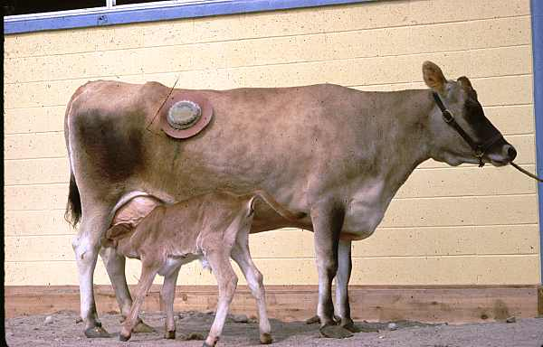
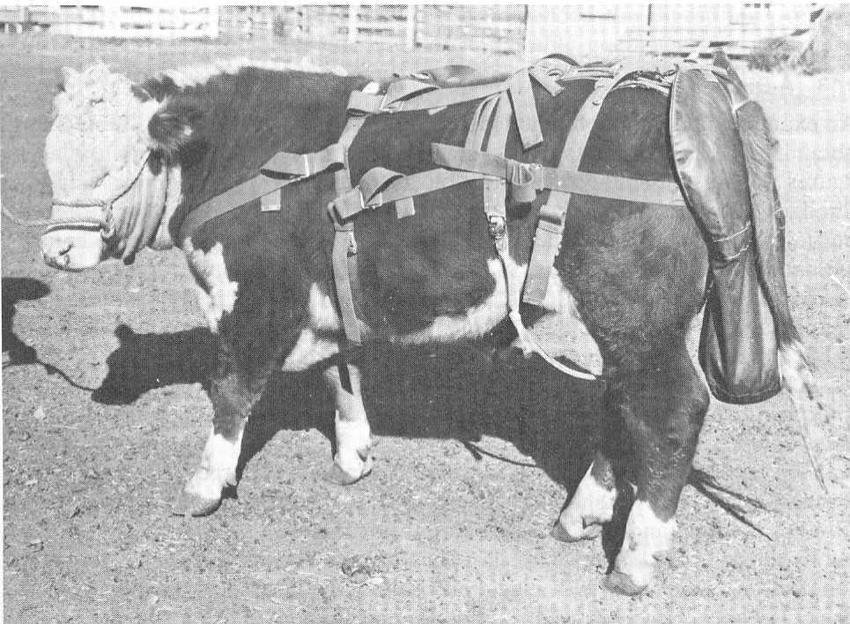
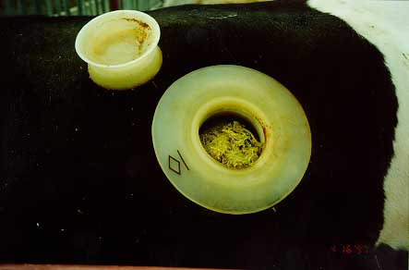
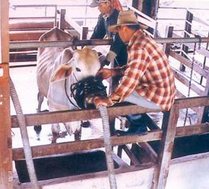
In sacco/ in vivo Digestibility

Slide 3
B. Digestibility study
In vitro digestion
Tilley-Terry (2 stages)
Rumen digestion 48 h incubation in rumen fluid at 39 C
Gastric digestion 48 h incubation of residue in pepsin solution at pH 2
In sacco digestion
Cloth bags
Requires fistulated animal
Measurement of rate of disappearance (= digestion) of a preweighed sample of feed in a bag usually dacron (pore size 30 μm) suspended in the rumen
In vivo digestion

Slide 4
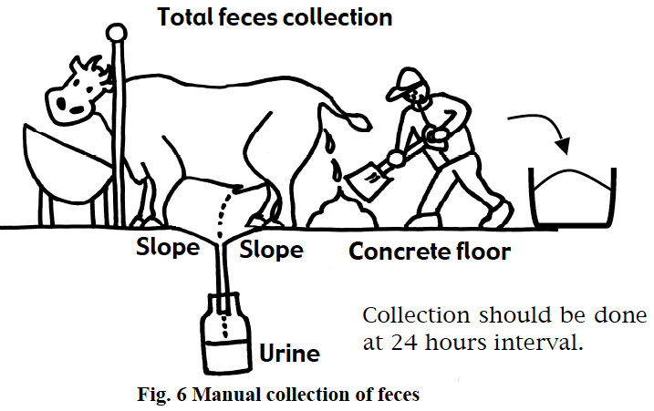
Total feces collection for in vivo digestibility study method
Notes:
Manual collection: Fig 6 shows manual collection of feces. Every time cattle produce feces, man takes feces to collect total feces in the container. Cleaner feces can be collected by this system. Besides, animals received less stress, because they do not have to wear harness and move to the strange place like a digestion stall. Therefore, the adaptation period can be shorter in the manual collection than in either the mechanical collection or fecal tube technique. But a lot of labor is required.

Slide 5


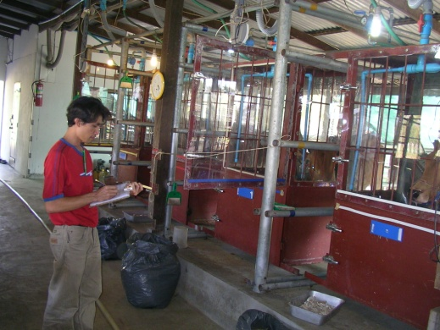
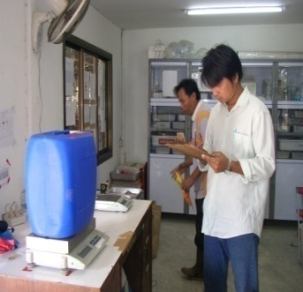
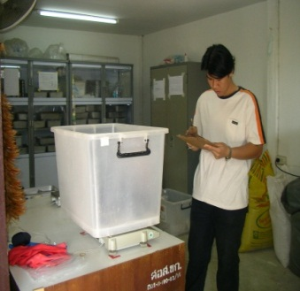
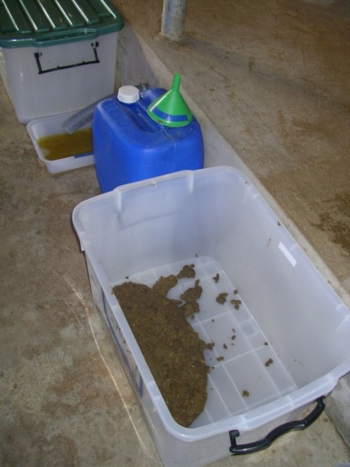
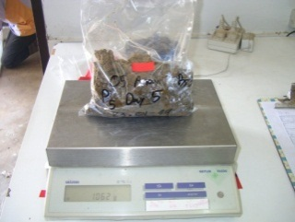
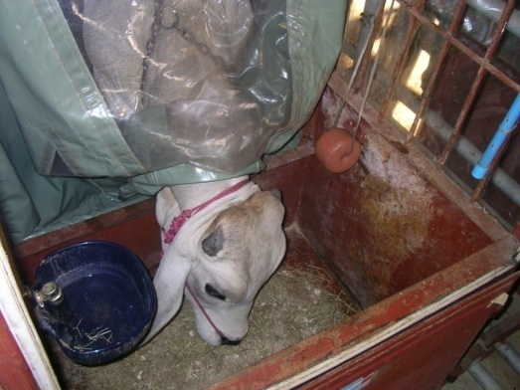
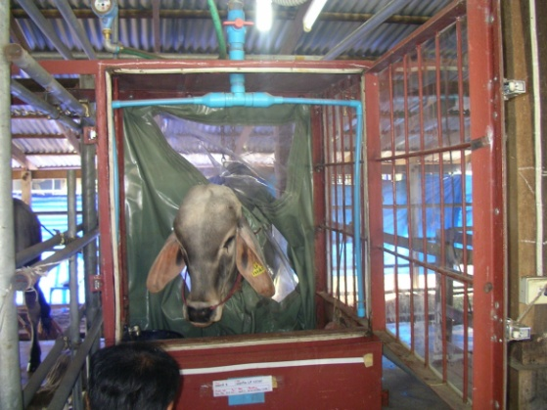
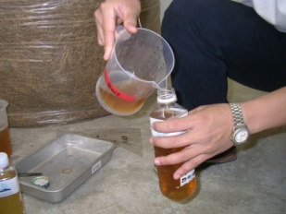
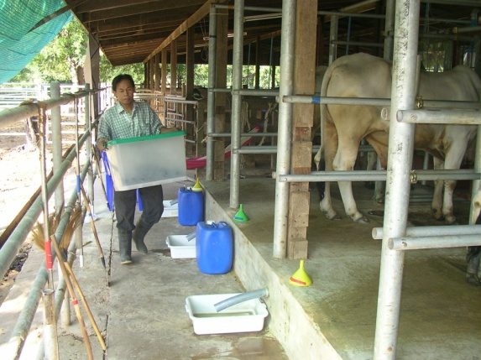
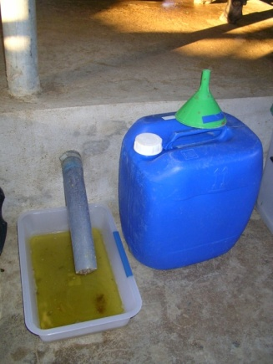
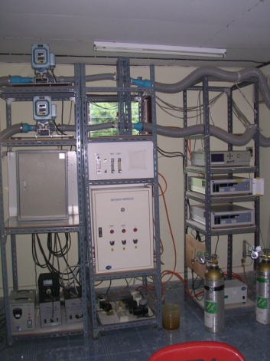
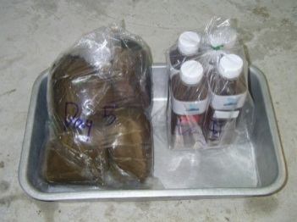
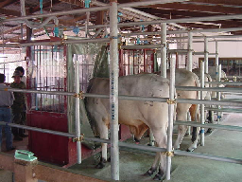
Materials and Methods
Sampling and data collection
Feed intake
Digestibility
Respiratory
gas exchange

Slide 6
Digestibility
Ability of animal to digest and absorb nutrients
Apparent
digestibility (%)
(dietary intake – fecal output)
dietary intake
=
x 100

Slide 7
Total Digestible Nutrients (TDN)
dCP = digestible CP
dCF = digestible CF
dNFE = digestible NFE
EE = digestible ether extract
TDN = dCP + dCF + dNFE + 2.25 dEE

Slide 8
Calculation of TDN
Nutrient | Total nutrients in 100 kg, kg | Digestion coefficients, % | Digestible nutrients, kg
CP CF NFE EE TDN | 20.11 16.25 40.99 3.34 | 75.0 73.9 80.6 53.9 (x2.25) | 15.08 12.01 33.03 4.04 64.16

Slide 9
C. Energy Value
Energy Value of Selected Feeds
Feed | Energy Content (Mcal/kg)
Alfalfa hay Barley grain Corn grain Soybean meal Timothy hay | 3.89 4.14 4.41 4.69 4.44

Slide 10
Net Energy System
Net
Energy
(NE)
Metabolizable
Energy
(ME)
Digestible
Energy (DE)
Gross
Energy
(GE)
Heat
Urinary &
Gaseous Energy
Fecal
Energy

Slide 11
What makes up energy in?
Simply, the amount of energy that we get from food.
4 kcal/g carbohydrate
4 kcal/g protein
9 kcal/g fat
7 kcal/g alcohol

Slide 12
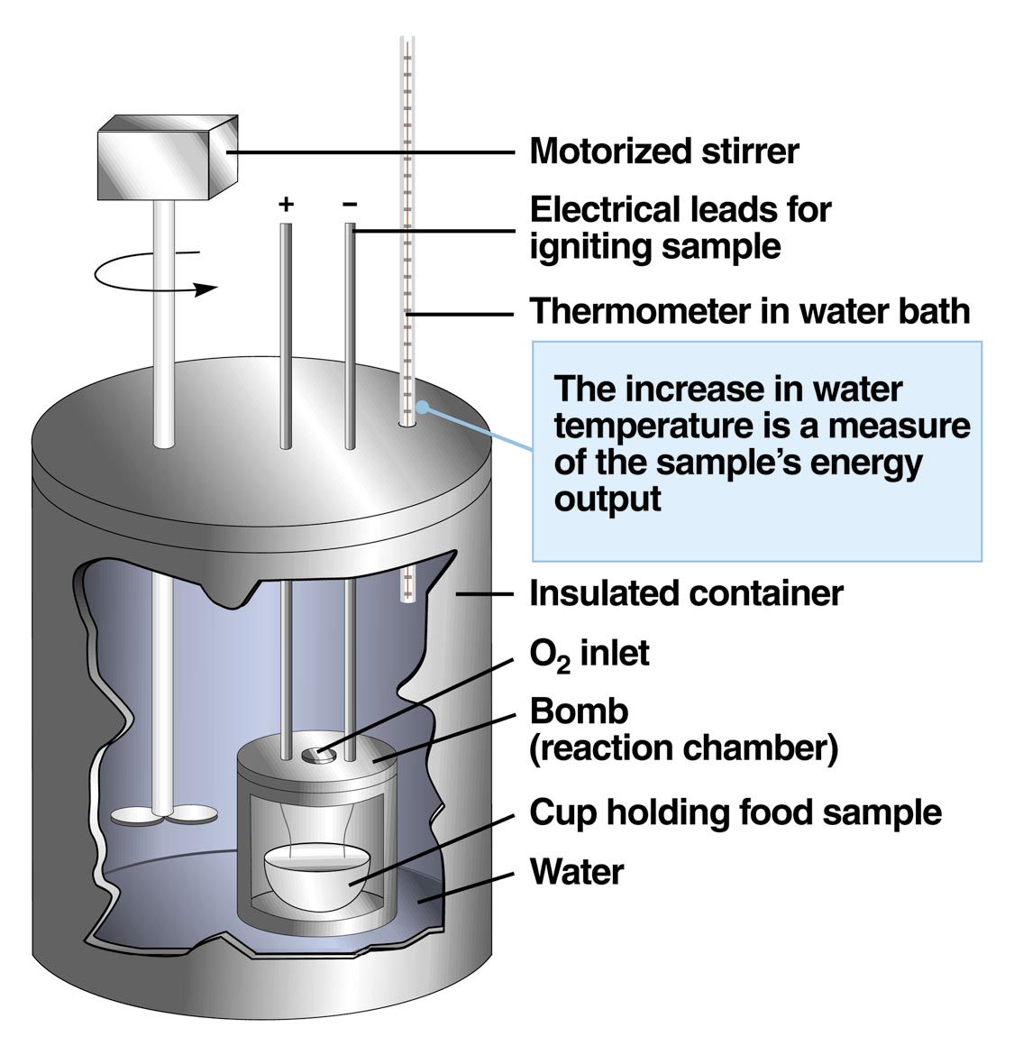
Calorimetry, cont.
1 calorie = amount of heat (energy) needed to raise 1 gram of water 1 degree Centigrade.

Slide 13
Energy Units
Joule
Joule = kg/(m^{2●}s²)
Older unit still used in the US is calorie (cal)
1 calorie = heat required to increase the temperature of one gram of water from 14.5 to 15.5°C
1 calorie = 4.184 J

Slide 14
The partition of food energy in the animal
Gross energy
(heat of combustion)
(energy of digested food)
Feces energy
Digestible energy
Urine energy
Metabolizable energy
Methane energy
Heat increment
Net energy
Heat production
Used for maintenance
Used for production
Notes:
This slide shows the partition of food energy in the animal. Gross energy of food, not all is available and useful to the animal. Some energy is lost from the animal in the form of the solid, liquid and gaseous excretions. Another fraction is lost as heat. Gross energy less the energy content of faeces gives the the category known as the digestible energy of the food.
The animal suffers further losses of energy-containing substances in its urine and, in the combustible gases leaving the digestive tract. The metabolizable energy of a food is the digestible energy less the energy lost in urine and combustible gases. The energy of urine is present in nitrogen-containing substances such as urea, hippuric acid, creatinine and allantoin.
The combustible gases lost from the rumen consist almost entirely of methane.
About the heat increment of foods, animals are continuously producing heat and losing it to their surroundings, either directly by radiation, conduction and convection, or indirectly by the evaporation of water. If a fasting animal is given food, within a few hours its heat production will increase above the level of basal metabolism.
The deduction of the heat increment of a food from its metabolizable energy gives the net energy value of the food.the net energy of a food is that energy which is available to the animal for useful purpose, for example for body maintenance and for the various forms of production.
Net energy used for maintenance is mainly used to perform work within the body, and will leave the animal as heat.

Slide 15
Net Energy System
Digestible energy (DE)
Gross
Energy (GE)
Fecal energy
Undigested feed residues
Metabolic products
Mucosa
Bacteria
Enzymes

Slide 16
Digestible Energy (DE)
“Apparent”
Contains mucosa and digestive fluids
Losses for cattle and sheep
40-50% for roughages
20-30% for grains
Losses for horses are 35-40%
Losses for pigs are 20%

Slide 17
Net Energy System
Metabolizable energy (ME)
Digestible
Energy (DE)
Urinary energy
N disposal
Gaseous energy
Gaseous products of fermentation
(CH₄)
b. Lost via belching or bowels

Slide 18
Metabolizable Energy (ME)
Gaseous energy
CH₄ is main form lost as gas
Hydrogen and hydrogen sulfide also
Greatest gaseous losses in ruminants
82% of DE
Gaseous losses so small that not considered for ME calculation in man, pigs, dogs and chickens
>95% of DE

Slide 19
Metabolizable Energy (ME)
Urinary energy
Urea in mammals
Uric acid in birds
2-3% of gross energy for pigs
4-5% of gross energy for cattle

Slide 20
Energy Value of Selected Feeds
Feed | GE | DE | ME
Alfalfa hay Barley grain Corn grain Soybean meal Timothy hay | 3.89 4.14 4.41 4.69 4.44 | 2.51 3.66 4.01 3.63 2.63 | 2.03 3.10 3.43 2.98 2.16

Slide 21
Net Energy System
Net energy (NE)
Metabolizable
Energy (ME)
Heat increment energy
Heat of digestive fermentations
and action
b. Heat of metabolism

Slide 22
Energy Value of Selected Feeds
Feed | GE | DE | ME | NE
Alfalfa hay Barley grain Corn grain Soybean meal Timothy hay | 3.89 4.14 4.41 4.69 4.44 | 2.51 3.66 4.01 3.63 2.63 | 2.03 3.10 3.43 2.98 2.16 | 1.35 2.13 2.28 1.93 1.26

Slide 23
Net Energy System
Production (NE_{g} or NE_{l})
Tissue growth
Stored in products
Work
Net
Energy (NE)
Maintenance (NE_{m})
Basal metabolism
Activity at maintenance
Sustaining body temperature

Slide 24
Net Energy System
Net
Energy
(NE)
Metabolizable
Energy
(ME)
Digestible
Energy (DE)
Gross
Energy
(GE)
Heat
Urinary &
Gaseous Energy
Fecal
Energy

