Slide 1

Chapter 3
Psychrometry
and Air-Conditioning
Reference: Cengel, Yunus A. and Boles, Michael A., THERMODYNAMICS: An Engineering Approach, 5th Edition, McGraw-Hill Inc
Assoc.Prof.Sommai Priprem, PhD.
Department of Mechanical Engineering
Khon Kaen University

Slide 2

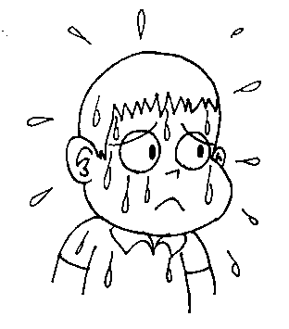
Cloud

Slide 3

Fog

Slide 4

Dew

Slide 5

Frost

Slide 6
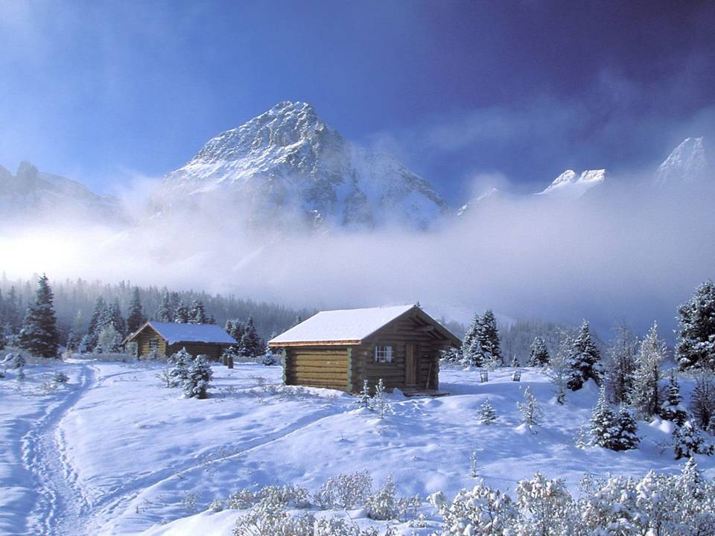
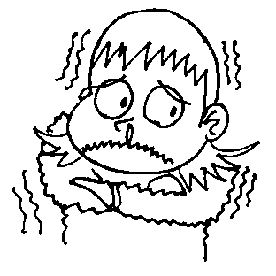
Snow

Slide 7

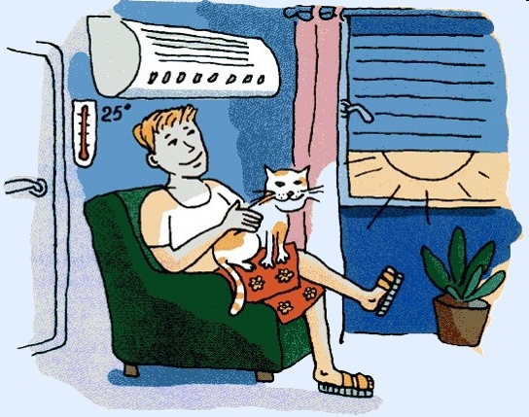

Slide 8


Slide 9
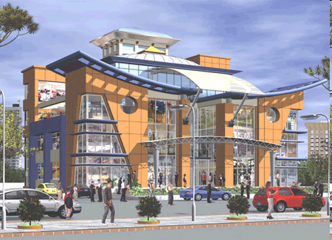

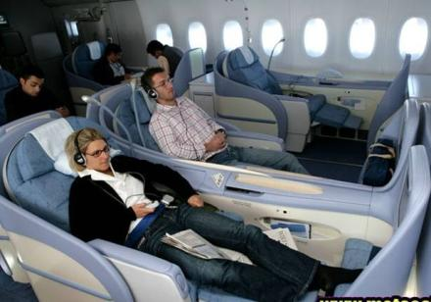

Slide 10
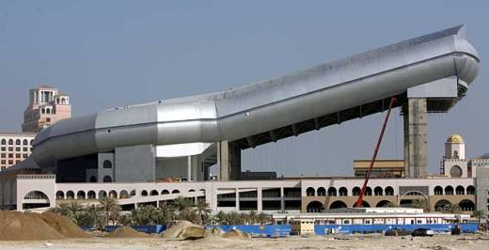
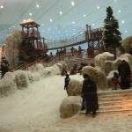


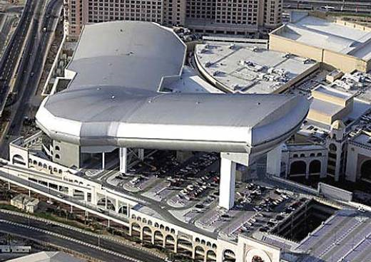
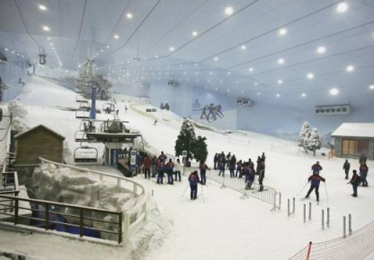
Ski Dubai (United Arab Emirates)

Slide 11
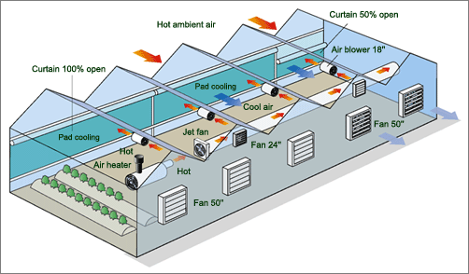
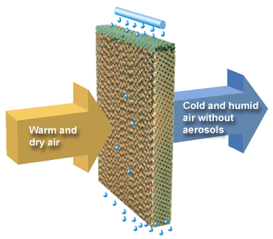
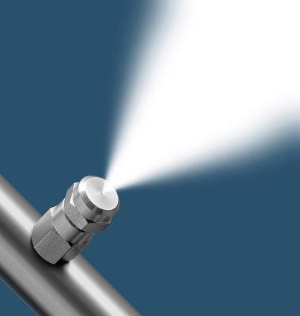
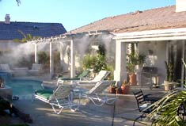
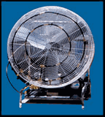
Applications of Evaporative Cooling

Slide 12
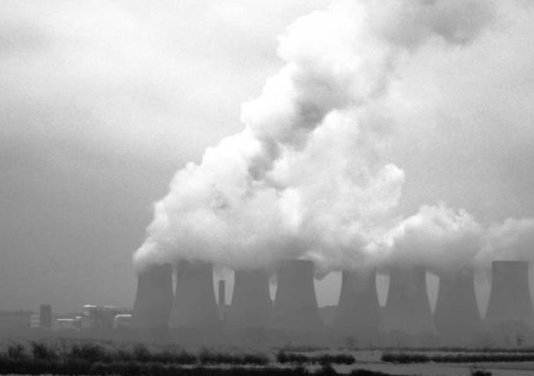
Cooling Tower

Slide 13
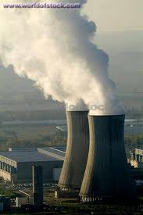
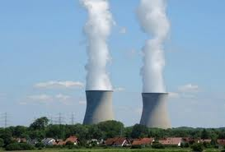
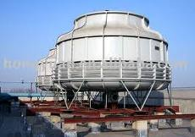
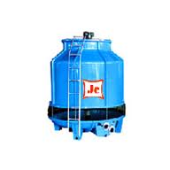
Cooling Tower

Slide 14
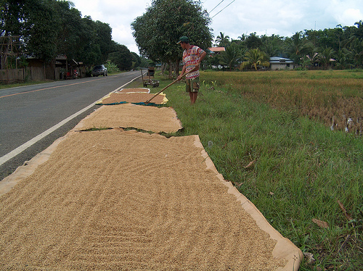
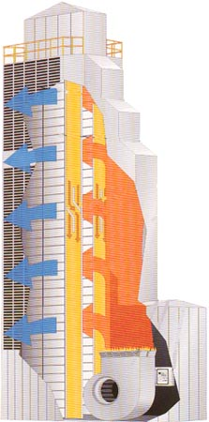
Drying

Slide 15
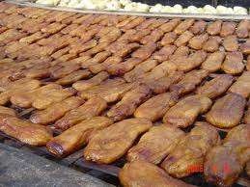
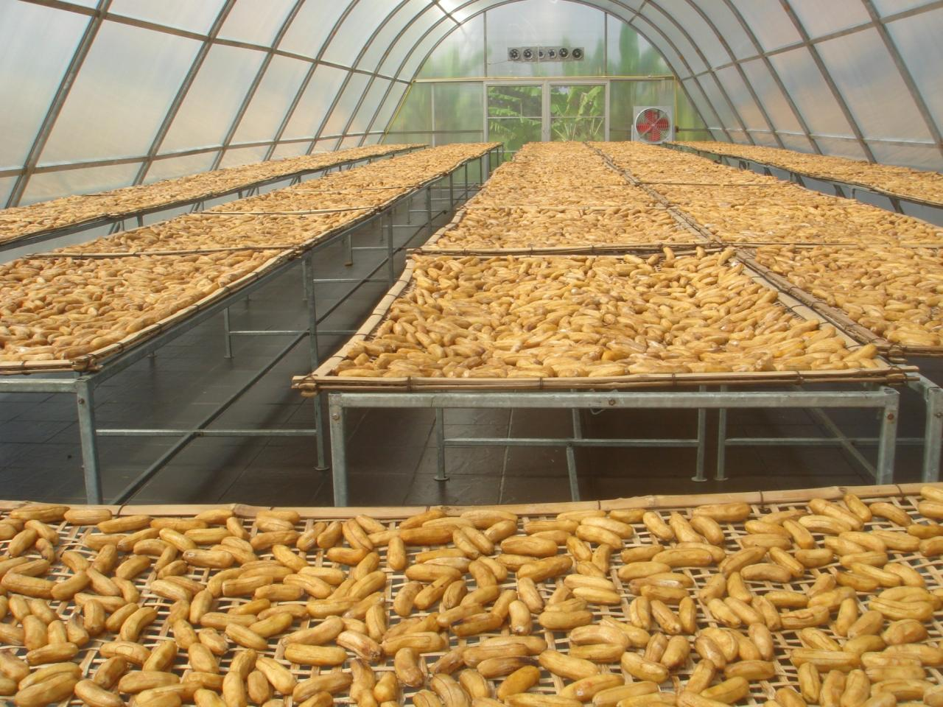
Drying

Slide 16
Objectives:
Differentiate between DRY AIR and ATMOSPHERIC AIR
Defined and calculate: specific and relative humidity of atmospheric air.
Calculate the DEW POINT temperature.
Relate the Adiabatic Saturation Temperature and Wet-Bulb Temperature.
Psychrometric Chart → Properties of atm .air.
Air Conditioning Processes.

Slide 17
Gas-Vapor Mixtures and Air-Conditioning
At T< T_{c} Gas is referred as “VAPOR”
Close to sat. → possibility of condensation
Last Chapter dealing only with Gas + Gas
Gas + Vapor ~ Condensation → Two Phase
In this chapter → Air + Water Vapor = “Psychrometry”.. ~ Air-Conditioning

Slide 18
14.1 Dry and Atmospheric Air
Atmospheric air =
[N₂ + O₂ + Other gases] +
Moisture (water vapor)
Dry air = No moisture
then: Air = mixture of Dry Air + Water Vapor

Slide 19
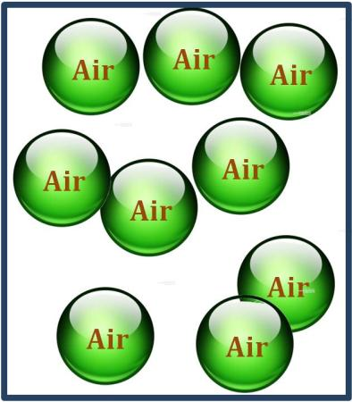
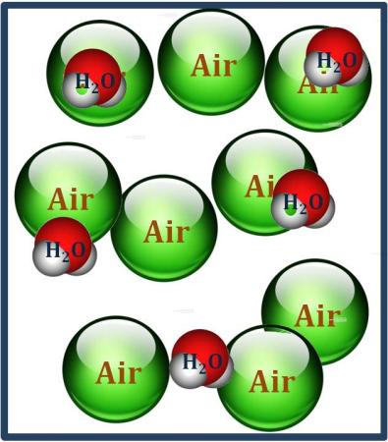
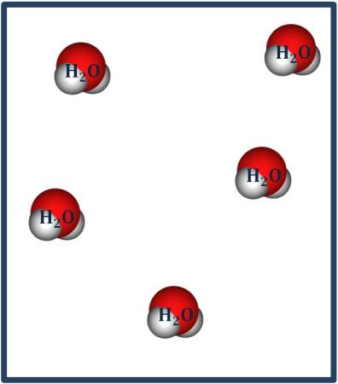
Dalton’s Law
อากาศแห้งและไอน้ำ
อากาศแห้ง
ไอน้ำ
Temperature, T
Volume, V
Pressure, P
Temperature, T
Volume, V
Pressure, P_{air}
Temperature, T
Volume, V
Pressure, P_{steam}

Slide 20
Moisture in the Atmospheric Air
Consider water: At 50ºC P_{sat} =12.3 kPa
At lower pressure Water Vapor ~ Ideal Gas with negligible error (<0.2%)
So, → Dry air + Water Vapor ➔ Ideal gas mixture
Dalton’ Law: P = P_{a} + P_{v} (14.2)
where P = Total Pressure
P_{a} = Partial Pressure of Dry Air
P_{v} = Partial Pressure of Water Vapor
(Vapor Pressure)

Slide 21
Specific Humidity and Relative Humidity of Air

Slide 22
Specific humidity, ω (or Absolute humidity or Humidity Ratio)
ω = Ratio of mass of water vapor to mass of Dry air

Slide 23
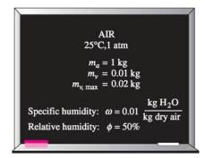
Relative humidity (Φ)
Φ = Ratio of mass of water vapor at the specified condition to mass of water vapor if saturated condition at the same temperature
If saturated at T_{air}
T
Actual vapor condition
P_{g}
T_{air}
P_{v}
v

Slide 24
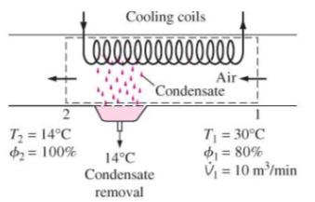
Air – Water Vapor Mixture, in
For an amount of moist air, the mass of dry air is not change but water vapor may condense causing mass of vapor change. Then PROPERTIES of moist air is expressed per unit mass of dry air instead of per unit mass of air-water vapor mixture.
Air – Water Vapor Mixture, out
Less mass of vaopr
but the same mass of dry air
Condensate (liquid water)
ตัวอย่างกระบวนการที่เกิดขึ้นในระบบปรับอากาศ

Slide 25
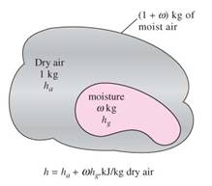
Enthalpy of Air – Water Vapor Mixture ( moist air)
For an amount of moist air, the mass of dry air is not change but water vapor may condense causing mass of vapor change. Then enthalpy of moist air is expressed per unit mass of dry air instead of per unit mass of air-water vapor mixture.

Slide 26
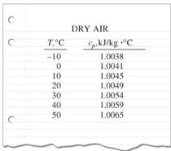
Enthalpy of Dry Air
For Air Conditioning
T ~ -10ºC – 50ºC;
dry air ~ Ideal gas
and C_{p} ~ 1.005 kJ/kg-K (error < 0.2%)
Take T_{reference} = 0ºC then
h_{dry air} = C_{p}(T - T_{ref}) = C_{p}T (14.1a)
(note T in ºC because T_{ref} = 0 ºC)
and Δh_{dry air} = Cp(T₂ –T₁) = C_{p}ΔT (14.1b)

Slide 27
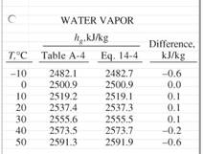
Enthalpy of water vapor – Ideal gas
For Air Conditioning T ~ -10ºC – 50ºC;
1. h_{v}(T, low P) ~ h_{g}(T) (14.3)
2. Take T_{reference} = 0ºC;
and Average C_{p} ~ 1.82 kJ/kg-K
h_{g}(T=0ºC) = 2,500.9 kJ/kg
eqn.(14.1):
h_{g} (T) = h_{g}(T₀=0ºC) + Cp(T –T₀)
h_{g} (T) = 2,500.9 + 1.82(T) (14.4)
(note T in ºC because T₀ = 0 ºC)

Slide 28
Specific Volume of Air – Water Vapor Mixture

Slide 29
Example 14.1 A 5-m x 5-m x 3-m room contains air at 25ºC and 100 kPa at a relative humidity of 75 percent. Determine (a) the partial pressure of dry air, (b) the specific humidity (c) the enthalpy per unit mass of dry air, and (d) the masses of dry air and water vapor in the room.
System: moist air, in a room
Analysis
Room
5mx5mx3m
T= 25 ºC
P= 100 kPa
Φ = 75%

Slide 31

How Dews happen?

Slide 32

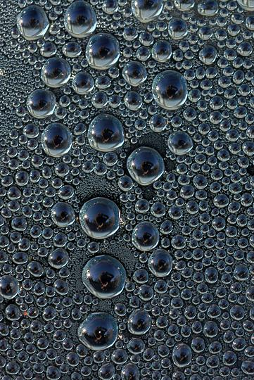
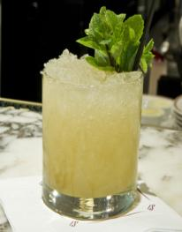
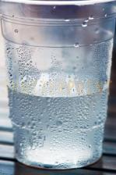

Slide 33
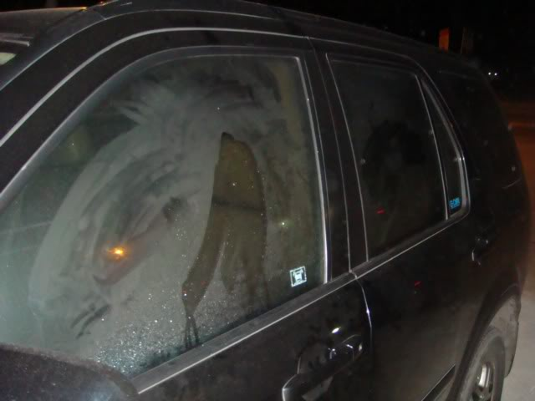

Slide 34
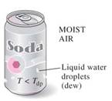
14.3 Dew Point Temperature
Dew-point temperature, T_{dp} = “the temperature at which condensation begins when the air is cooled at constant pressure.”
or in other words: T_{dp} is the saturation temperature of water corresponding to the vapor pressure.
T_{dp} = T_{sat@Pv} (14.13)
T
T_{air}
1
T_{dp}
P_{v}
2
s

Slide 35
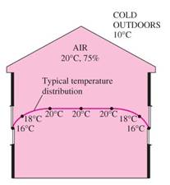
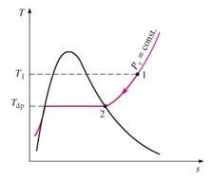
Example 14.2 Fogging of the windows in the house
In clod weather, condensation frequenty occures on the inner surfaces of the windows due to the lower air temperatures near the window surface. consider a house shown, that contains air at 20ºC and 75 percent relative humidity. At what window temperature will the moisture in the air start condensation on the inner surfaces of the windows?
Solution
T_{dp} = T_{sat@Pv}
P_{v} = ΦP_{g@20C}
T_{dp} = 15.4ºC
แล้วฝ้าที่เกิดที่กระจกรถยนต์หล่ะ เกิดอย่างไร-กำจัดอย่างไร

Slide 36
Moist Air
Dry Air
Water Vapor
Temperature, T
Volume, V
Pressure, P
Spec.Humidity, ω
ω = 0.622 P_{v}/P_{a}
Temperature, T
Volume, V
Pressure, P_{a}
mass, m_{a}
Temperature, T
Volume, V
Pressure, P_{v}
mass, m_{v}

Slide 37
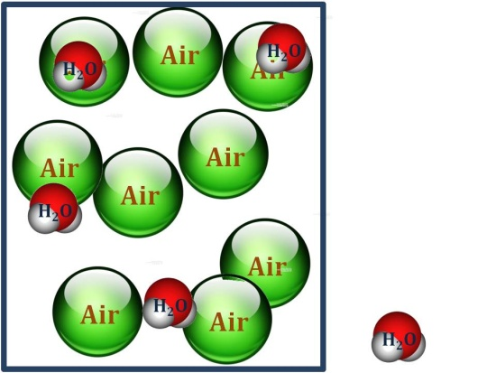
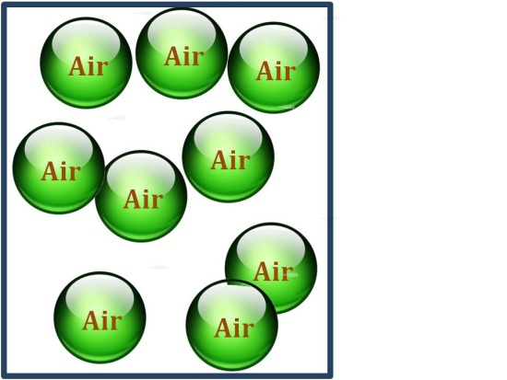
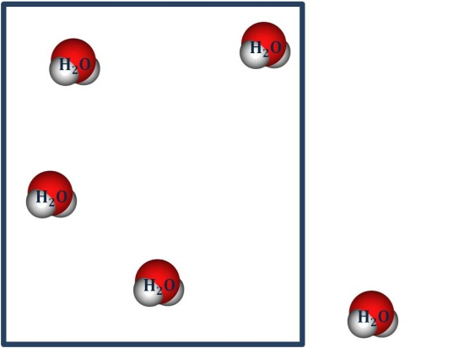
Moist Air
Dry Air
Water Vapor
State 1
T₁, P₁ , ω₁= 0.622 P_{v1}/P_{a1}
P₁ = P_{a1} = P_{v1}
T₁ P_{a1} m_{a1}
T₁ P_{v1} m_{v1}
State 2
T₂, P₂, ω₂= 0.622 P_{v2}/P_{a2}
P₂ = P_{a2} + P_{v2}
m_{a2} = m_{a1}
m_{v2} ≠ m_{v1}
ω₂ ≠ ω₁
T₂ P_{a2} m_{a2}
T₂ P_{v2} m_{v2}

Slide 38
14.4 Adiabatic Saturation Temperature and Wet-Bulb Temperature
Relative humidity, Φ and
Specific humidity, ω ใช้บ่อยมากแต่วัดยาก
(Φ = P_{v}/P_{g}, ω = m_{v}/m_{a} = 0.622 P_{v}/P_{a})
ดังนั้นต้องพยายามหาวิธีการหา Φ และ ω
โดยการวัดกับปริมาณที่วัดง่าย เช่น T, P

Slide 39
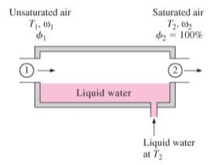
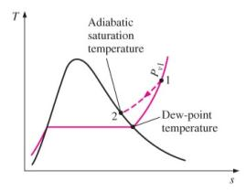
Consider an Adiabatic Saturation Process:
So, just measure T₁, T₂ and P_{total}, we can get ω₁

Slide 40
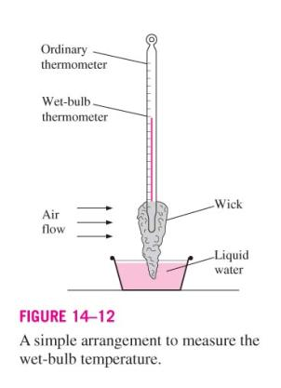
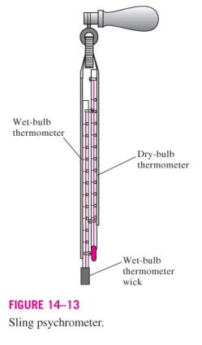
But to make exit stream saturate, it need a very long channel or spray mechanism.
Wet-Bulb Temperature is more practical approach.
At normal atmosperic Wet-Bulb Temperature and Adiabatic Saturation Temperature of air and water vapor mixture are approximately equal
Psychrometer มีกี่แบบ แต่ละแบบมีหลักการทำงานอย่างไร

Slide 41
Example 14.3 The Specific and Relative Humidity of Air
The dry-bulb and wet-bulb temperatures of atmospheric air at 1 atm (101.325 kPa) pressure are measured with a sling psychrometer and determined to be 25 and 15ºC, respectively. Determine (a) the specific humidity, (b) the relative humidity, and (c) the enthalpy of the air.
Solution J T_{db}=T₁ ; T_{wb}=T₂ ; P_{atm} = P₂
P_{g1}=P_{sat@Tdb}
P_{g2}=P_{sat@Twb}
h_{g1}=h_{g@Tdb}
h_{g2}=h_{g@Twb}

Slide 42
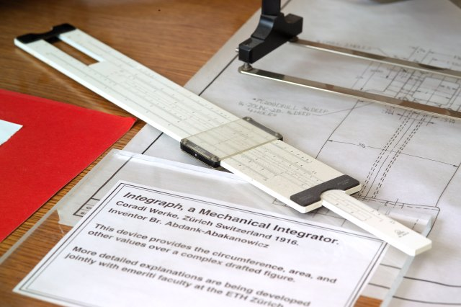
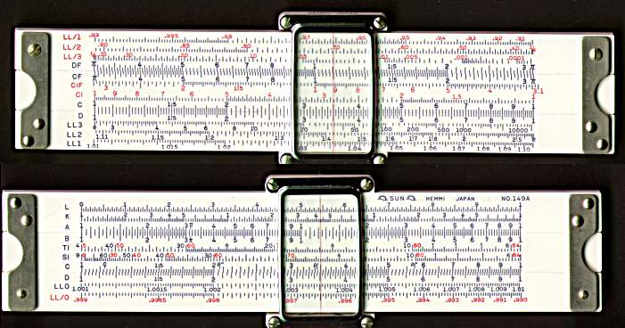
Slide Rule
the engineer’s calculation tool in the past century

Slide 43
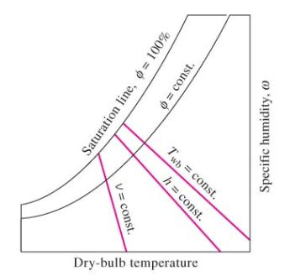
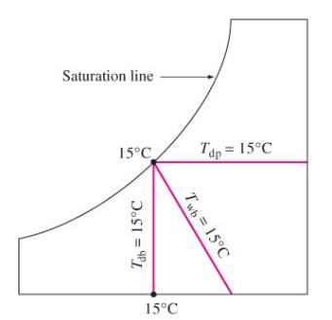
14.5 The Psychrometric Chart
2 independent properties ➔ State known ➔ other properties are known.
In air-conditioning problem involves numerous calculations.
Then ➔ Computer calculation ➔ easy to used CHART➔ Psychrometric Chart
ถ้าต้องสร้าง Psychrometric Chart เองจะทำอย่างไร

Slide 44

ω
E
C
D
G
H
A
F
T_{db}

Slide 45

Enthalpy at Saturation, h (kJ/kg dry air)
Wet Bulb Temperature, T_{wb} (ºC)
Humidity ratio, ω (kg H₂O/kg dry air)
Specific Volume, v (m³/kg dry air)
Dry Bulb Temperature, T_{db} (ºC)

Slide 46
Using Psychrometric Chart
Case 1
Known: Tdb and %RH
Enthalpy at Saturation, h (kJ/kg dry air)
h
Twb
Humidity ratio, ω (kg H₂O/kg dry air)
ω
Tdp
%RH
Tdb
Dry Bulb Temperature, T_{db} (ºC)
v

Slide 47
Using Psychrometric Chart
Case 2
Known: Tdb and Twb
Enthalpy at Saturation, h (kJ/kg dry air)
h
Twb
Humidity ratio, ω (kg H₂O/kg dry air)
ω
Tdp
%RH
Tdb
Dry Bulb Temperature, T_{db} (ºC)
v

Slide 48

Example 14.4 The Use of the Psychrometric Chart
Consider a room that contains air at 1 atm (101.325 kPa) 35ºC, and 40% relative humidity. Using the psychrometric chart, determine (a) the specific humidity, (b) the enthalpy (c) of wet-bulb temperature, (d) the dew-point temperature, and (e) the specific volume of the air
Solution
ω = 0.0142 kg water/kg.da.
h = 71.5 kJ/kg.da.
T_{wb} = 24 ºC
T_{dp} = 19.4 ºC
v = 0.893 m³/kg.da.

Slide 49
Example 14.4
Enthalpy at Saturation, h (kJ/kg dry air)
h
Twb
Humidity ratio, ω (kg H₂O/kg dry air)
ω
Tdp
%RH
Tdb
v
Dry Bulb Temperature, T_{db} (ºC)

Slide 50
ลองสร้างตารางคำนวณค่าต่างๆโดยใช้ Excel แทนการใช้ Psychrometry chart
เช่นวัดได้ค่า T_{dp} , T_{wb} (ºC) ต้องการคำนวณหาค่า Φ, ω, h, v. โดยไม่ต้องเปิดหาค่าอะไรอีกเลย
Method 1. Using data from steam table and find correlation between Saturated Pressure and Saturated Temperature.
….between 5 to 45 ºC (R² =0.9981)
P = (0.6834)*e^{0.0599T}
where T is temperature in ºC and P is pressure in kPa
(Prepared by: Assoc.Prof.Sommai Priprem, PhD.)
Method 2. Using correlation equation of Saturated Pressure and Saturated Temperature provided by the National Engineering Laboratory Steam Tables, 1964, which cover range of 0 to 100 ºC. (More accurate)
log P = 28.59051 -8.2 log(T+273.16) + 0.0024804(T+273.16) – (3,142.31)/(T+273.16)
where T is temperature in ºC and P is pressure in Bar ( 1 Bar = 101.325 kPa)
(Source: Jones, W.P., Air Conditioning Engineering, 2nd Ed., SI unit, Edward Arnold, 1973.
ดูตังอย่างใน Excel

Slide 51
14-6 Human Comfort and Air-Conditioning
Human wants:
Not hot, not cold, not humid, not dry ➔
just COMFORTABLE ➔ Air-conditioning.
Typical comfort conditions:
22 – 27ºC and 40 – 60 %RH
Air motion also effect human feeling (body heat loss)

Slide 52

14-7 Air-Conditioning Processes
Maintaining space desired Temp. and RH requires Air-Conditioning Process: Heating …Cooling…Humidifing (adding moisture)…. Dehumidifing (removed moisture)
two or more process may be needed
The processes are normally considered
as SSSF process;
* mass of dry air remains the same
* water vapor added/removed
* 1st law treat dry air and water vapor
separately.

Slide 53
Example 14.4
Enthalpy at Saturation, h (kJ/kg dry air)
Humidifying
Humidity ratio, ω (kg H₂O/kg dry air)
Cooling
Heating
Dehumidifying
Dry Bulb Temperature, T_{db} (ºC)

Slide 54
An Air Conditioning Model
Heating/Cooling + Humidifying/Dehumidifying
1
2

Slide 57


Simple Heating and cooling (ω = const.)
WHY Φ change and HOW

Slide 58


Heating with Humidification (ω = increases)

Slide 59

Example 14.5 Heating and Humidification of Air
An air-conditioning is to take in outdoor air at 10ºC, and 30% relative humidity at a steady rate of 45 m³/min and to condition it to 22ºC, and 60% relative humidity. The outdoor air is first heated to 22ºC in the heating section and then humidified by the injection of hot steam in the humidifying section. Assuming the entire process takes place at a pressure of 100 kPa, determine (a) the rate of heat supply in yhe heating section, and (b) the mass flow rate of the steam required in the humidifying section.
Solution
(a) = 673 kJ/min; (b) = 0.539 kg/min

Slide 60
Cooling with Dehumidification (ω = decreases)
สภาพอากาศ ร้อน-ชื้น (ประเทศแทบร้อน เช่น ไทย)
Temp สูง RH สูง ลดอุณหภูมิอย่างเดียว RH ยิ่งเพิ่ม ➔ RH สูงมากๆ .. ไม่สบายตัว..
ดังนั้นต้องลดความชื้นในอากาศลงด้วย
ลดความชื้นโดย ลดอุณหภูมิให้ต่ำกว่า Dew point ➔ Condensation (Dehumidification)
แล้วค่อยอุ่นอากาศนั้นขึ้นมาที่ Temp และ RH ที่ต้องการอีกที ซึ่งอาจทำโดยการผสมกับอากาศจากห้อง(return air - ซึ่งอุ่นกว่า)ในปริมาณที่เหมาะสม (ไม่ต้องให้ความร้อน)
กระบวนการแบบนี้ เกิดโดยทั่วไปในเครื่องปรับอากาศในประเทศไทย

Slide 61

Example 14.6 Cooling and Dehumidification of Air
Air enters a window type air conditioner at 1 atm, 30ºC, and 80% relative humidity at a rate of 10 m³/min and leaves as saturated air at 14ºC determine the rate of heat and moisture removal from the air.
Solution
(a) = 511 kJ/min; (b) = 0.131kg/min

Slide 62


Evaporative Cooling
อาบน้ำ–เย็นสบาย ทาแอลกอฮอร์–เย็นวาบ
น้ำในโองดินเผา หรือเหยือกดินเผา เย็นกว่าปกติ
พัดลมน้ำ ให้ลมที่เย็นกว่าพัดลมธรรมดา
Evaporative cooling process: As water evaporates, the laten heat of vaporisation is absorbed from the water body and the surrounding air. As a result, both of them are cooled.
Evaporative cooling process ~ Adiabatic saturation process:
T_{wb} ~ const, and h ~ const.

Slide 63
Adiabatic Saturation Process:

Slide 64



Slide 65
Applications of Evaporative Cooling

Slide 66


Example 14.7 Evaporative cooling
Air enters an evaporative cooler at 1 atm, 35ºC, and 20% relative humidity and it exits at 80% relative humidity determine (a) the exit temperature of air, and (b) the lowest temperature to which the air can becooled by this evaporative cooler.
Solution
(a) 21.3ºC (b) 18.9ºC

Slide 67
An Air Conditioning Model
Adiabatic Mixing
1
3
2

Slide 68

Adiabatic Mixing of Airstreams
Many air-conditioning applications require the mixing of two airstream.
ie. Fresh air + Return air.
Normally Q very small, no work, and ΔKE and ΔPE =0

Slide 69


Example 14.8 Mixing of Conditioned Air with Outdoor Air
Satureated air leaving the cooling section of an air conditioning system at 14ºC with a rate of 50 m³/min is mixed adiabatically with the outside air at 32ºC, and 60% relative humidity at a rate of 20 m³/min. Assuming that the mixing occure at 1 atm, determine, the specific humidity, the relative humidity, the dry-bulb temperature, and the volume flow rate of the mixture.
Solution
ω₃ = 0.0122 kg/kg da,
Φ₃ = 89%;
T_{bd3} = 19.0ºC ;
V₃ = 70.1 m³/min

Slide 70



Wet Cooling Tower
Power plant, large A-C system, some industrial process need to reject a large amount of waste heat.
A wet cooling tower ~ semi-closed evaporative cooling cooler.
Type of cooling tower: Mechanical draft (Induced, Forced), Natural draft
Other cooling method: Spray pond, Cooling pond

Slide 72


Steam Power Plant
1
Turbine
w_{t}
Boiler
2
Q_{B}
Pump
Condenser
4
Q_{c}
W_{p}
Cooling Tower
3

Slide 73


Slide 74
A Cooling Tower Model
3
2
1
4

Slide 77

Example 14.9 Cooling of a Power Plant by a Cooling Tower
Cooling water leaves the condenser of a power plant and enters a wet cooling tower at 35ºC at a rate of 100 kg/s. Water is cooled to 22ºC in the cooling tower by air that enters the tower at 1 atm, 20ºC, and 60% relative humidity and leaves satureted at 30ºC. Neglecting power input to the fan, determine (a) the volume flow rate
of the air into the cooling tower,
(b) the mass flow rate of
the required makeup water.
Solution
(a) V_{a} = 81.6 m³/s, (b) m_{f} = 1.80 kg/s
ทำไมต้องมี Makeup Water
น้ำเย็นลงได้อย่างไร ...อะไรคือ Mechanism ที่สำคัญ

Slide 78
2
Air out
3
Warm water in
Air in
1
4
5
Cold water out
Make up water

Slide 79
End of Chapter

