Slide 1
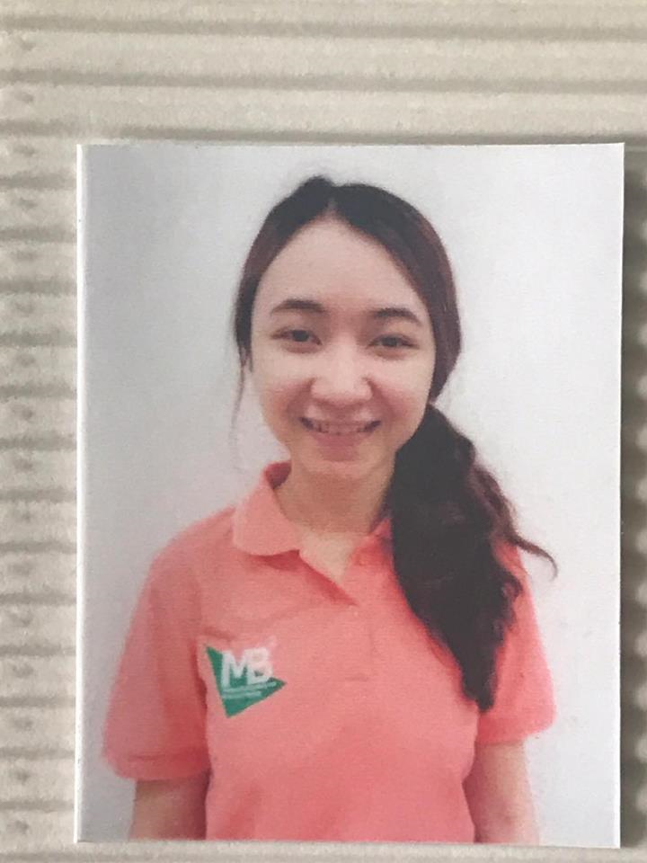
"The possible mechanisms of MSG-mediated alteration of urine pH to alkaline condition "
Kanokwan Nahok
Ph.D. student in Medical Biochemistry and Molecular Biology
Tuesday 12th September 2017, 11 a.m.-noon
Netrachaleo Meeting Room (530)

