Slide 1
Turbomachines
185238 Introduction to Thermodynamics and
Fluid Mechanics
ต้น 2554 จุฬาภรณ์ เบญจปิยะพร
Energy conversion in fluid machinery
Classification of Pump
Theory of Turbomachinery

Slide 2
Energy conversion in fluid machinery
Add energy to fluid – Pumps
Extract energy from fluid – Turbines
Connect of a rotating shaft – Turbomachinery
Pumping machine
  Liquid – pump (cavitation effect)
  Gases – fan, blower, compressor (compressible effect)

Slide 3
Classification of pump
Positive-displacement pump (PDPs)
  Reciprocating (piston, diaphragm)
  Rotary (Sliding vane, screw, gear, etc.)
Dynamic pumps
  Rotary (centrifugal, axial, mixed flows)
  Special designs (ejector, electromagnetic pump)

Slide 4
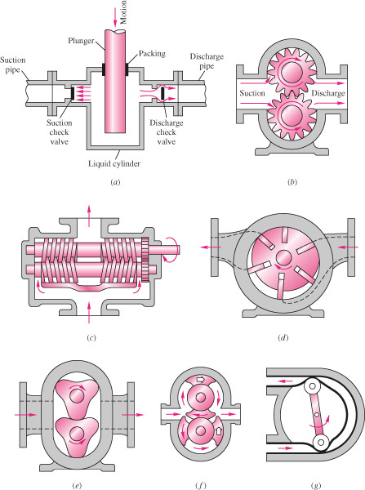
PDPs
(a) reciprocating piston
(b) external gear pump
(c) double screw pump
(d) sliding vane
(e) three-lobe pump
(f) double circumferential piston
(g) flexible tube squege

Slide 5
Dynamic pump: Centrifugal flow

Slide 6
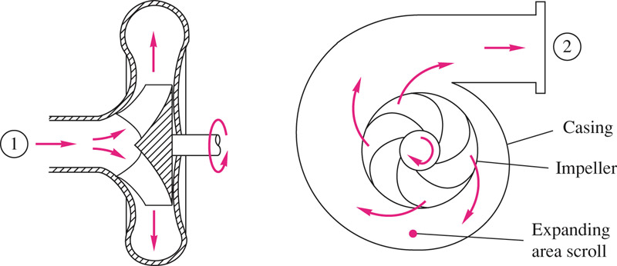
Impeller types

Slide 7
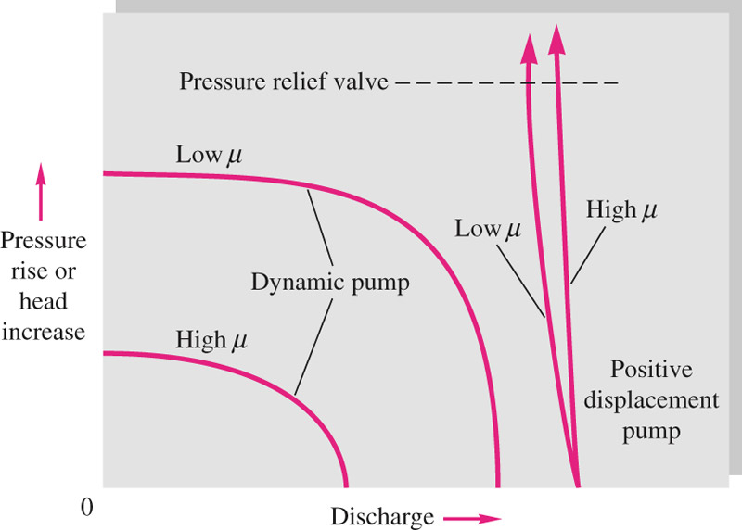
Dynamic pumps
High flow rate (Q)
Moderate pressure rise (Δp)
Steady discharge
Need priming
PDPs
Low flow rate (Q)
High pressure rise (Δp)
Handle high viscosity fluid
Self priming

Slide 8
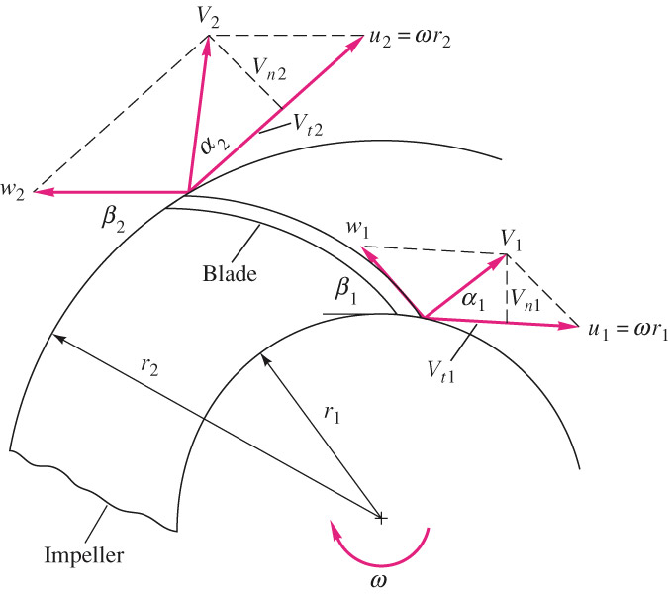
Theory of Turbomachinery
V = absolute velocity
w = relative velocity
u = blade velocity
Angular momentum
The blade does work on the fluid - Pump
The fluid does work on the blades - Turbine

Slide 9
Centrifugal Pump
For steady, incompressible pump flow

Slide 10
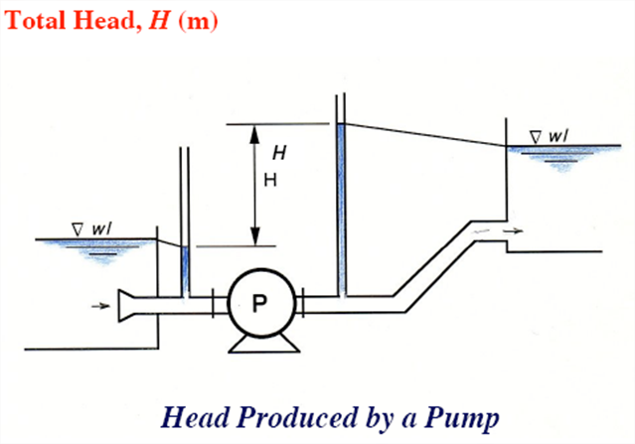
With loss: P_{w} < brake horsepower (bhp) = ωT

Slide 11
Efficiency
Volumetric efficiency
- Leakage in the impeller casing clearance
Hydraulic efficiency
Shock loss at the eye due to imperfect match
Friction losses in the blade passages
Mechanical efficiency
- Power loss due to mechanical friction in the bearing, packing glands, contact points

Slide 12
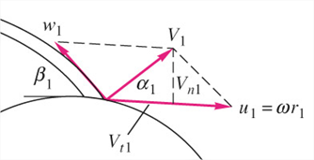
Euler Turbomachine equations
Assume no loss

Slide 13
Pump performance characteristics
Neglect inlet angular momentum (r₁V_{t1})
b = blade width
h_{ideal}
H
Other loss
Friction loss
h_{actual}
Q

Slide 14
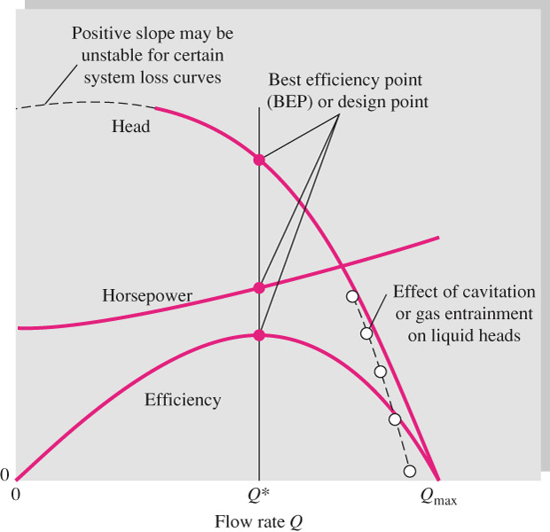
Pump performance characteristics
Shutoff head

Slide 15
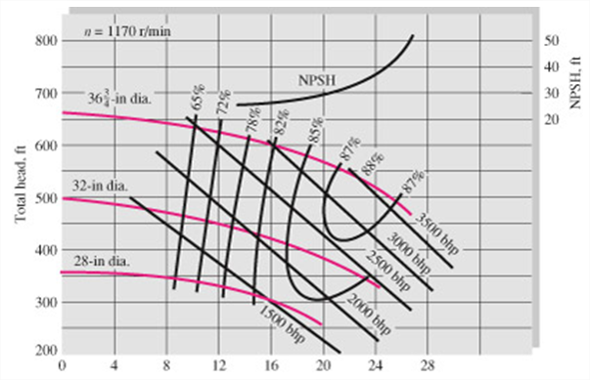
Actual performance data for a commercial centrifugal pump
Basic casing with three impeller sizes

Slide 16
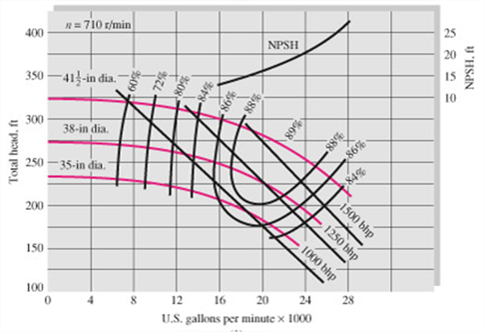
Actual performance data for a commercial centrifugal pump
20% larger casing with three larger impeller at slower speed

Slide 17
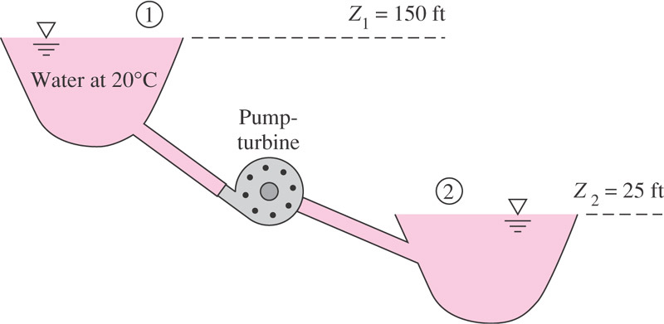
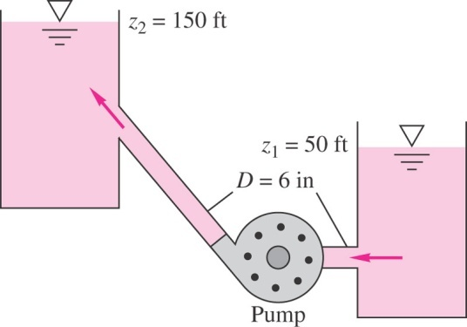
NPSH: Net Positive-Suction Head
Head required at the pump inlet to keep from cavitating.
If the pump inlet is placed at a height z_{i} above a reservoir where free surface is at pressure p_{a}.
-z_{i}
+z_{i}

Slide 18
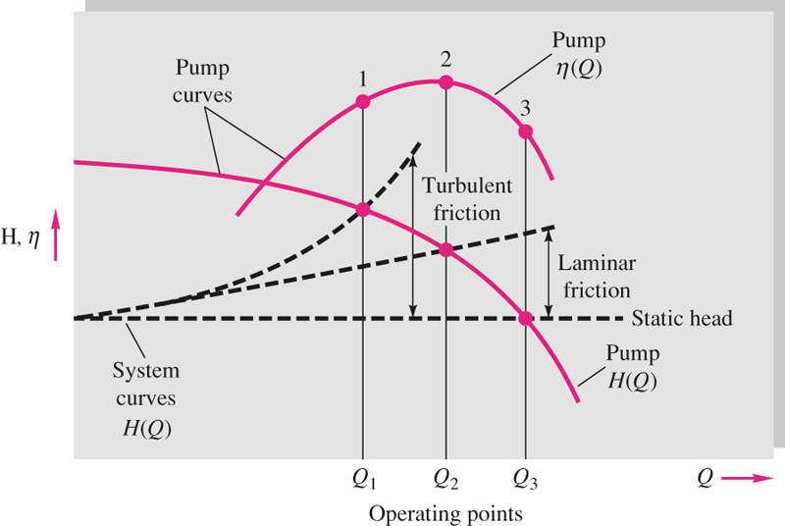
System characteristics & Pump selection
laminar
turbulent

Slide 20
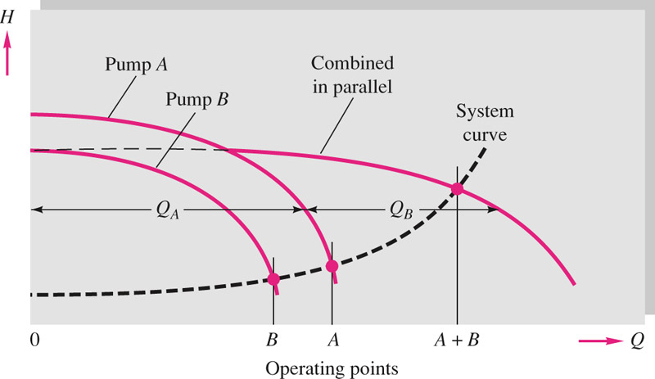

Slide 21
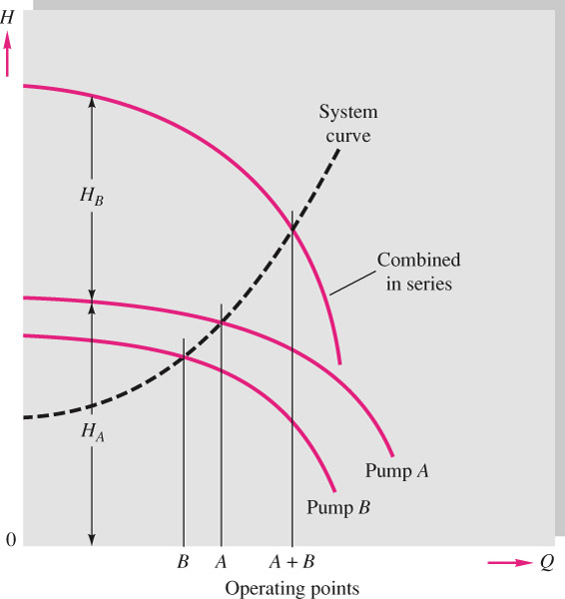

Slide 29
Pump Similarity Laws
Head coefficient
Flow coefficient
Power coefficient
Efficiency

Slide 30
Pump Scaling/Affinity Laws

Slide 31
Specific Speed
Dimensionless involving speed, discharge and head , not size
dimensional

