Slide 1
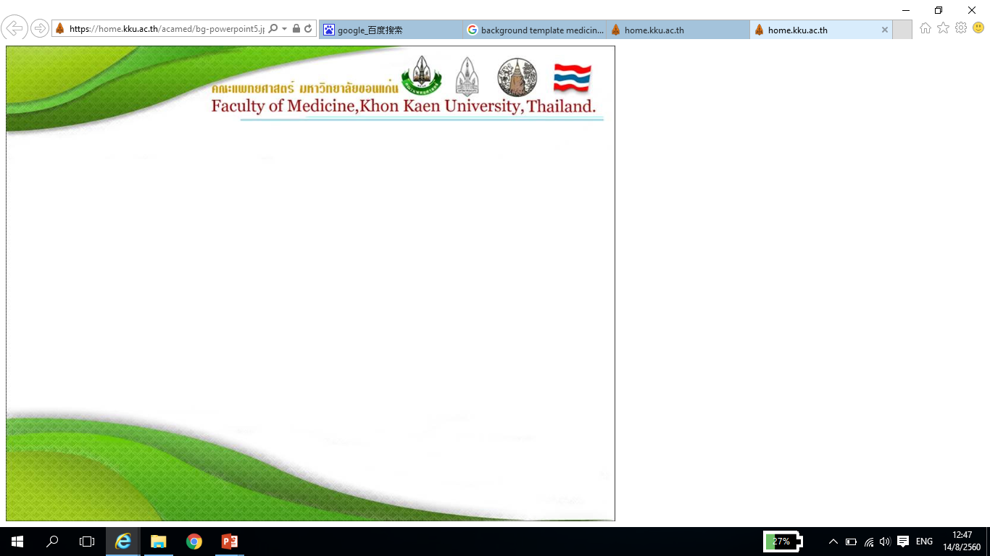
Neonatal Cholestasis
Assist Prof. Busara Charoenwat
Pediatric Gastroenterologist and Hepatologist
Pediatric Department, KKU

Slide 2
Pre-tests
A 5-week-old male infant presents with cholestatic jaundice.
A 6-week-old male infant presents with cholestatic jaundice.
A 4-week-old male infant presents with cholestatic jaundice.

Slide 3
Case 1
A 5-week-old male infant presents with cholestatic jaundice.
History of pale stool. His weight and height are appropriated.
Physical examination reveals marked icteric sclera, liver 2 cm below RCM, liver span 9 cm,
non palpable spleen
Investigations: TB/DB 17/15 mg/dl, ALT 170, AST 180, AP 280 U/L, INR 0.95
- Abdominal ultrasound: mild hepatomegaly, triangular cord sign is seen.

Slide 4
Case 2
A 6-week-old male infant presents with cholestatic jaundice.
History of pale stool. His weight and height are appropriated.
Physical examination reveals marked icteric sclera, non palpable liver and spleen
Investigation: TB/DB 15/11 mg/dl, ALT 190, AST 170, AP 250 U/L.
- Abdominal ultrasound: cystic or fusiform dilatation of the common bile duct

Slide 5
Case 3
A 4-week-old male infant presents with cholestatic jaundice.
History of pale stool. His weight and height are appropriated.
Physical examination reveals marked icteric sclera, non palpable liver and spleen
Investigation: TB/DB 7/5 mg/dl, ALT 153, AST 150, AP 290 U/L.
Abdominal ultrasound: mild parenchymatous change of liver
DISIDA scan: Impaired uptake, no excretion of tracer into small bowel

Slide 6
Lecture outlines
วัตถุประสงค์
1. นิยามและพยาธิสรีรวิทยาของภาวะตัวเหลืองที่เกิดจากน้ำดีคั่งในทารก
2. อาการและอาการแสดงของภาวะตัวเหลืองที่เกิดจากน้ำดีคั่งในทารก
3. การวินิจฉัยและการวินิจฉัยแยกโรคภาวะตัวเหลืองที่เกิดจากน้ำดีคั่งในทารก
4. การทางห้องปฏิบัติการอื่น ๆ
5. การรักษาภาวะตัวเหลืองที่เกิดจากน้ำดีคั่งในทารกรวมถึงการรักษาระยะยาว
- ทบทวนความรู้พื้นฐานหลังการเรียนด้วยวิธีถามตอบ
- แนะนำเอกสารอ้างอิง

Slide 7
Definition Pathophysiology Approach and diagnosis: - Clinical manifestation - Investigation Treatment Prognosis
Objectives

Slide 8
Conjugated hyperbilirubinemia - Conjugated bilirubin > 1mg/dL if TB < 5mg/dL - Conjugated bilirubin > 20% if TB is >5 mg/dL
Definition
Eur J Pediatr. 2011;170(3):279-84.

Slide 9
Pathophysiology
Biliary atresia*
Choledochal cyst
Neonatal hepatitis
Infections
* Time dependent, golden period 60 days for operation
Metabolic diseases
Endocrine diseases
Others

Slide 10
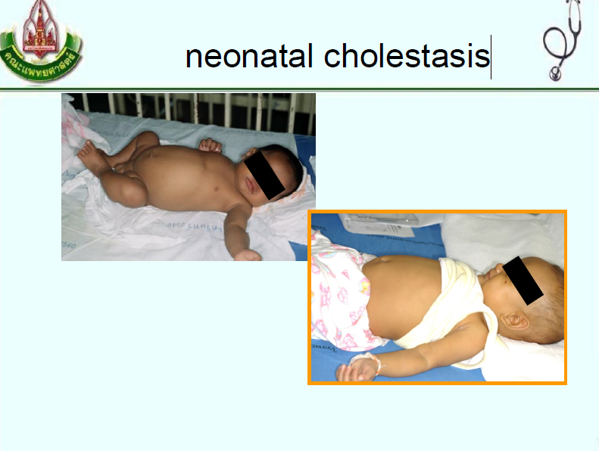
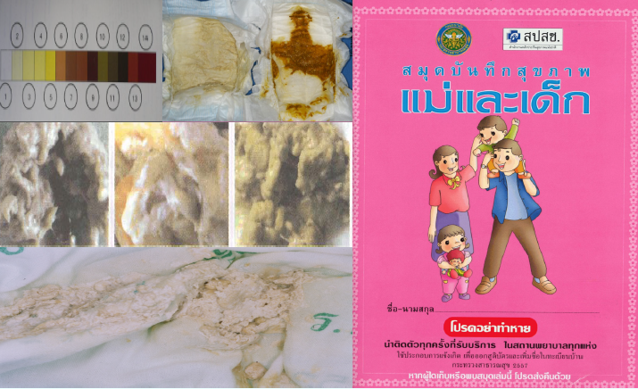
Cholestatic jaundice should be excluded in all infants with prolonged jaundice

Slide 11
Pathophysiology
Biliary atresia
Choledochal cyst
Neonatal hepatitis
Infections
Congenital: TORCH
Acquired: UTI etc.
Metabolic diseases
Endocrine diseases
Others

Slide 12
Pathophysiology
Biliary atresia
Choledochal cyst
Neonatal hepatitis
Infections
Metabolic diseases
Galactosemia
Neonatal intrahepatic cholestasis caused by citrin deficiency (NICCD)
Tyrosinemia
Alagille syndrome (arteriohepatic dysplasia)
Endocrine diseases
Others

Slide 13
Pathophysiology
Biliary atresia
Choledochal cyst
Neonatal hepatitis
Infections
Metabolic diseases
Endocrine diseases
Congenital hypothyroidism
Panhypopituitarism
Others

Slide 14
Pathophysiology
Biliary atresia
Choledochal cyst
Neonatal hepatitis
Infections
Metabolic diseases
Endocrine diseases
Others
TPN
Drug
Systemic diseases

Slide 15
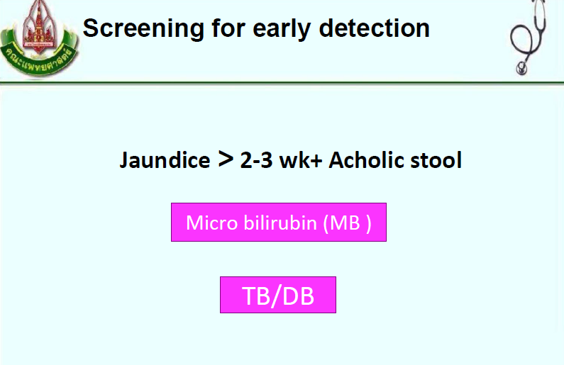

Slide 16
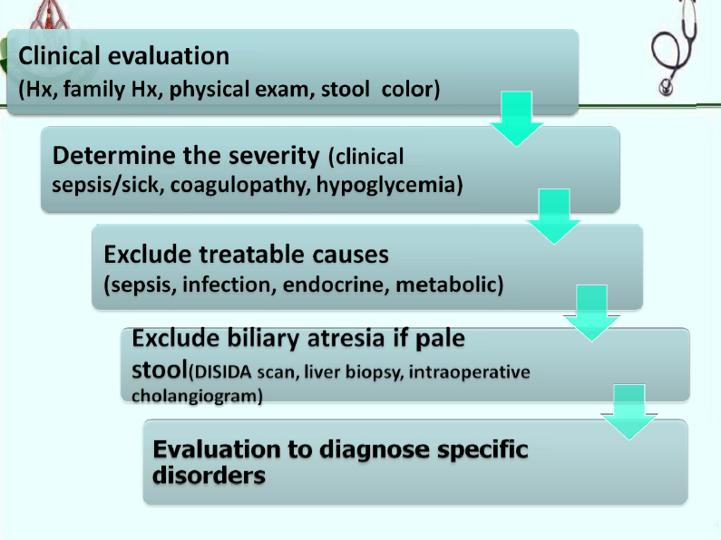

Slide 17
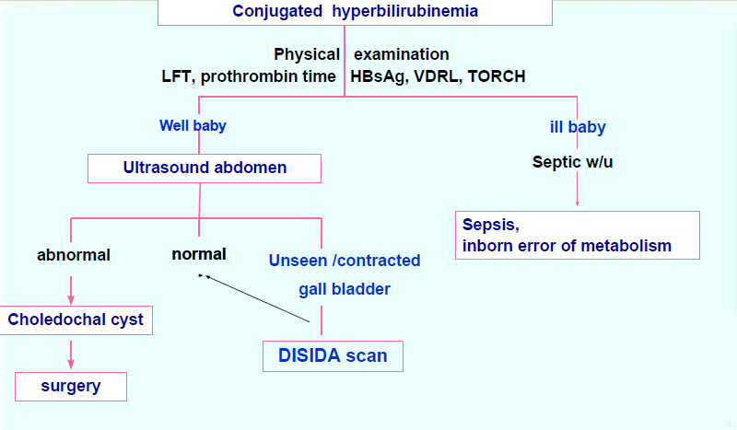
EVALUATION OF THE CHOLESTATIC NEONATE

Slide 18
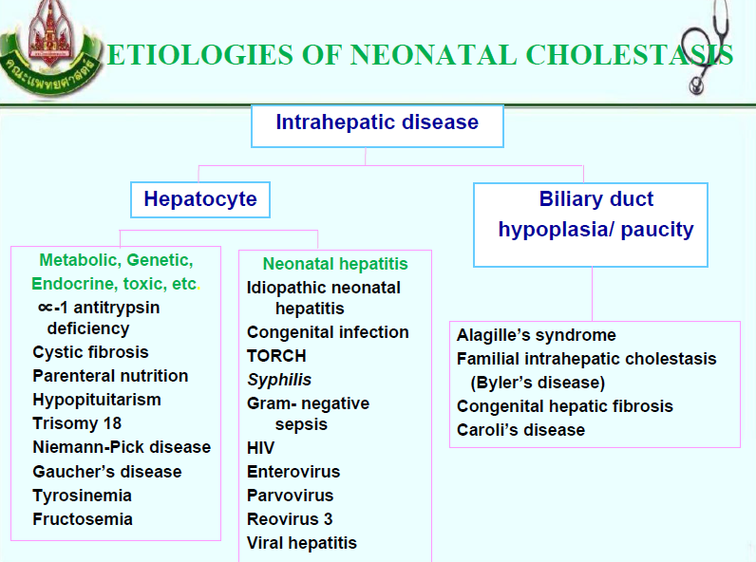

Slide 19
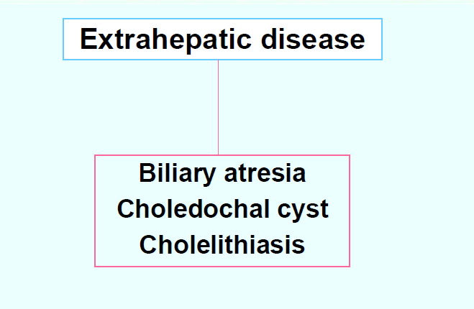

Slide 20
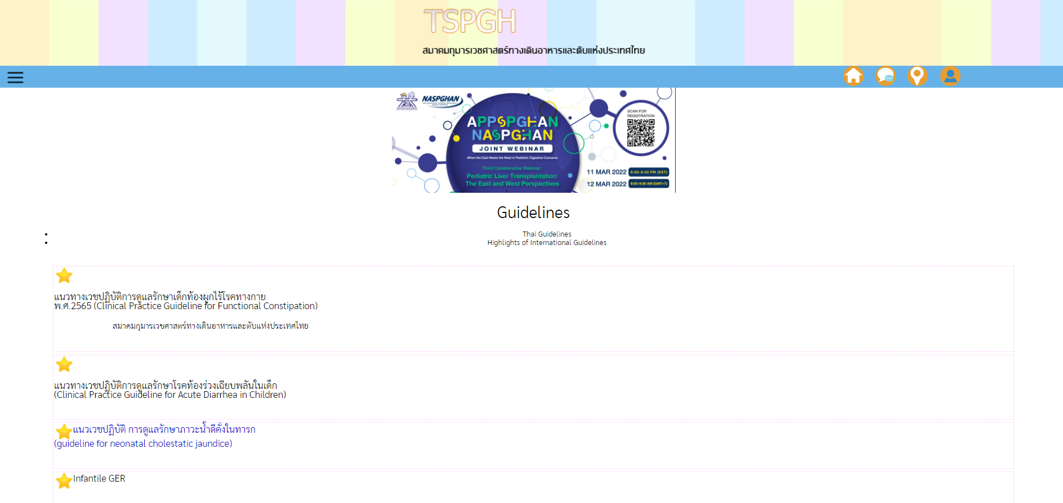
แนวเวชปฏิบัติ การดูแลรักษาภาวะน้ำดีคั่งในทารก (guideline for neonatal cholestatic jaundice)
https://www.pthaigastro.org/m.pthaigastro/Document_Preview.aspx?TID=115

Slide 21
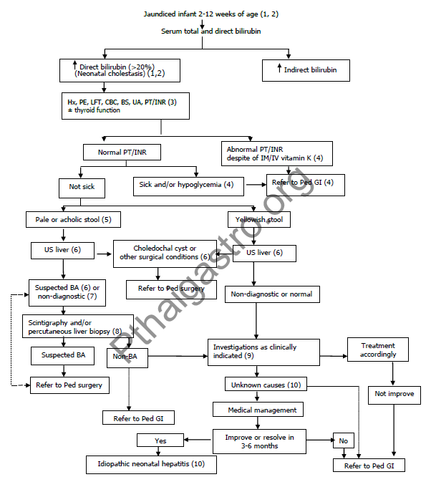
https://www.pthaigastro.org/m.pthaigastro/Document_Preview.aspx?TID=115

Slide 22
Evaluation
History
Physical examination
Family history
Prenatal history
Natal history
Investigation
Abdominal ultrasonography
Hepatobiliary scintigraphy (DISIDA scan)
Liver biopsy
intraoperative cholangiography

Slide 23
Family history
History | Disorder/ disease
Consanguinity | Autosomal recessive disorders
Neonatal cholestasis in the parents or siblings | CF, A1AT-deficiency, PFIC*, Alagille syndrome
History of repeated fetal loss or early demise | Gestational alloimmune liver disease
Spherocytosis and other hemolytic diseases | Known to aggravate conjugated hyperbilirubinemia
*CF: cystic fibrosis; CMV: cytomegalovirus; HIV: human immunodeficiency virus; PFIC: progressive familial intrahepatic cholestasis; PN: parenteral nutrition;
TJP: tight-junction protein; TORCH: Toxoplasma gondii, other viruses, rubella, cytomegalovirus, and herpes simplex virus
JPGN 2017;64: 154–168

Slide 24
Prenatal history
History | Disorder/ disease
Prenatal ultrasonography findings | Choledochal cyst, cholelithiasis, bowel anomalies or concern for syndrome
Cholestasis of pregnancy | PFIC gene mutations; mitochondrial disorder
Acute fatty liver of pregnancy | Neonatal long-chain 3-hydroxyacyl-coenzyme A dehydrogenase (LCHAD) deficiency
Maternal infections | TORCH infections
*CF: cystic fibrosis; CMV: cytomegalovirus; HIV: human immunodeficiency virus; PFIC: progressive familial intrahepatic cholestasis; PN: parenteral nutrition;
TJP: tight-junction protein; TORCH: Toxoplasma gondii, other viruses, rubella, cytomegalovirus, and herpes simplex virus
JPGN 2017;64: 154–168

Slide 25
Natal history
History | Disorder/ disease
SGA | TORCHS
Neonatal infection | Urinary tract infection, sepsis related cholestasis, CMV, HIV, syphilis
Source of nutrition: breast milk, formula, PN | Galactosemia, hereditary fructose intolerance, PN-associated liver disease
Growth | Genetic and metabolic disease
Vision | Septo-optic dysplasia
Hearing | PFIC1, TJP2
*CF: cystic fibrosis; CMV: cytomegalovirus; HIV: human immunodeficiency virus; PFIC: progressive familial intrahepatic cholestasis; PN: parenteral nutrition;
TJP: tight-junction protein; TORCH: Toxoplasma gondii, other viruses, rubella, cytomegalovirus, and herpes simplex virus
JPGN 2017;64: 154–168

Slide 26
Physical examination
Physical examination | Disorder/ disease
General appearance | Ill: appearance may indicate infection or metabolic disease Well: typically with biliary atresia
Growth | TORCHS Genetic and metabolic disease
Abnormal face | Alagille syndrome
Vision/slit lamp examination | Cataracts: rubella, galactosemia Cherry-red spot: Neimann-pick syndrome Chorioretinitis: CMV, toxoplasmosis Posterior embryotoxon: Alagille’s syndrome Nystagmus, blindnessซ septo-optic dysplasia
JPGN 2017;64: 154–168

Slide 27
Physical examination
Physical examination | Disorder/ disease
Hearing | TORCHS, PFIC1, TJP2 deficiency, mitochondrial disorders
Cardiac: murmur, signs of heart failure | Alagille syndrome, biliary atresia splenic malformation syndrome
Abdominen | Ascites; abdominal wall veins, liver size and consistency, spleen size and consistency, abdominal masses, umbilical hernia
Neurology | Muscle tone
Genitalia: micropenis | Panhypopituitarism
Stool | Acholic or hypopigmented stools: cholestasis or biliary obstruction
JPGN 2017;64: 154–168

Slide 28
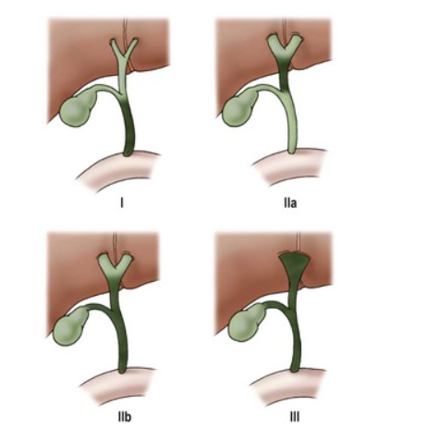
classification of biliary atresia
Clinical Gate

Slide 29
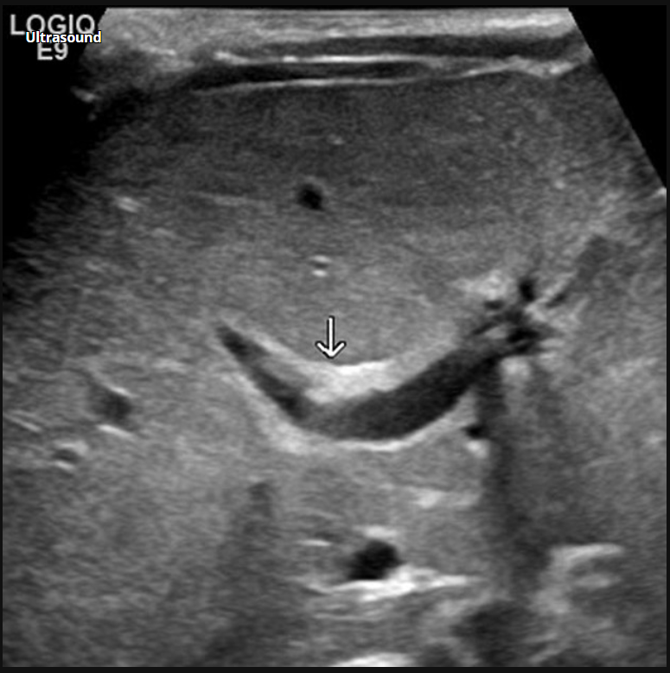
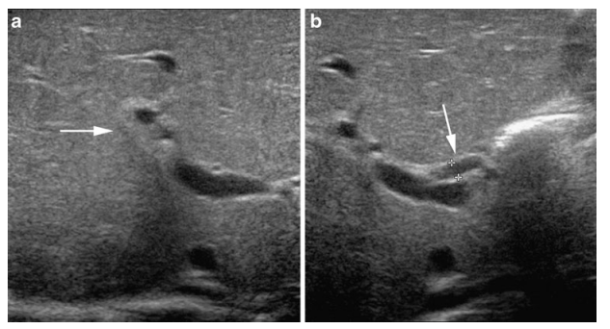
Investigation Abdominal ultrasonography
Triangular cord sign
Radiopedia
Pediatr Radiol.2011;41:55–75

Slide 30
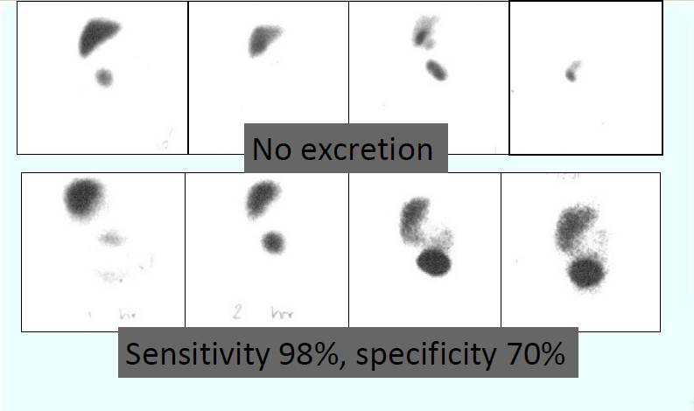
DISIDA scan (excretion)

Slide 31
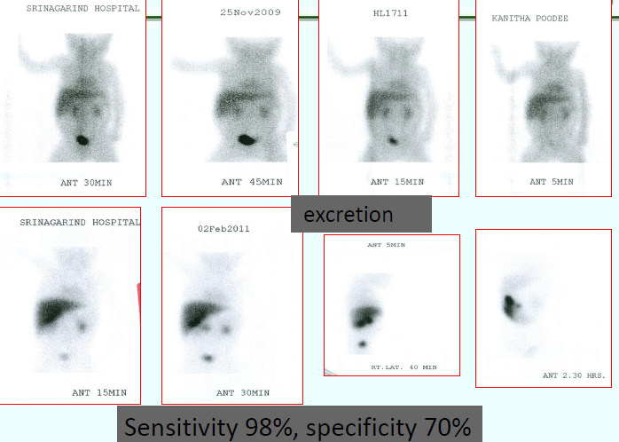
DISIDA scan (no excretion)
NO

Slide 32
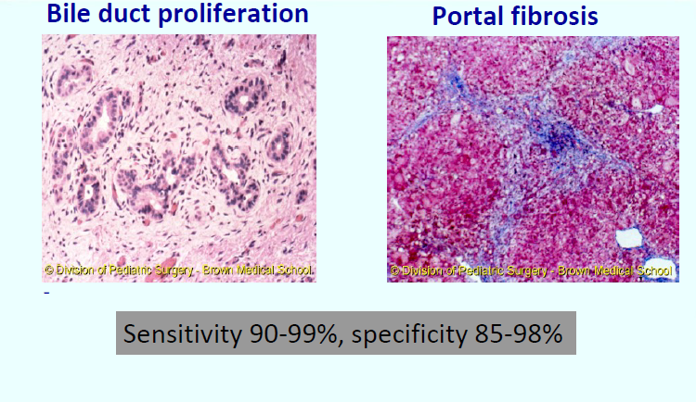
Liver biopsy in biliary atresia

Slide 33
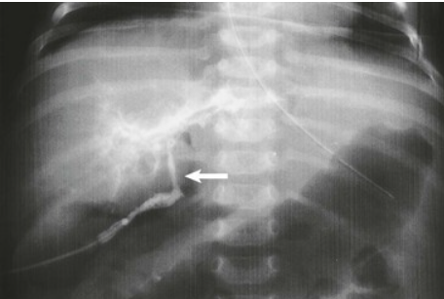
Intraoperative cholangiography
Atretic common bile duct
Clinical Gate

Slide 34
Investigation
Disorder/ disease | Investigation
Surgical condition
Biliary atresia | Abdominal ultrasonography, hepatobiliary scintigraphy, liver biopsy, IOC*
Choledochal cyst Spontaneous perforation of bile duct Inspissated bile syndrome Cholelithiasis | Abdominal ultrasonography
*IOC: intraoperative cholangiography
JPGN 2017;64: 154–168

Slide 35
Investigation
Disorder/ disease | Investigation
Infection
Sepsis, UTI, TORCH | Hemoculture, urine culture, viral profiles
JPGN 2017;64: 154–168

Slide 36
Investigation
Disorder/ disease | Investigation
Genetic and metabolic disease
Alagille’s syndrome | Eye exam, liver biopsy, film spine, echocardiogram, genetic analysis
Galactosemia | Urine reducing substance, G-1-P uridyl transferase activity in RBC ,genetic analysis
Hereditary fructose intolerance | Adolase activity, genetic analysis
Tyrosinemia | Plasma amino acid, urine succinyl acetone, AFP, genetic analysis
JPGN 2017;64: 154–168

Slide 37
Investigation
Disorder/ disease | Investigation
Genetic and metabolic disease
Inborn error of bile acid synthesis | Urine bile acid analysis
Mitochondrial disorders | Blood lactate/pyruvate, liver biopsy, genetic analysis
Alpha-1 antitrypsin deficiency | Alpha-1 antitrypsin level, genetic analysis
PFIC | GGT, genetic analysis
Neonatal hemochromatosis | Ferritin, abdominal MRI, buccal biopsy
JPGN 2017;64: 154–168

Slide 38
Treatment
Supportive treatment
Nutritional management
Fat soluble vitamins (A, D, E, and K)
Calories (adequate)
MCT
Supportive treatment
- Ursodeoxycholic acid (UDCA), cholestyramine, rifampicin, phenobarbital
Complication treatment and prevention
Portal hypertension, GI bleed: medical (non-selective beta blocker), endoscopic treatment
Ascites: aldosterone antagonist
Ascending cholangitis: antibiotic
Adjunctive treatment
- corticosteroid
JPGN 2017;64: 154–168

Slide 39
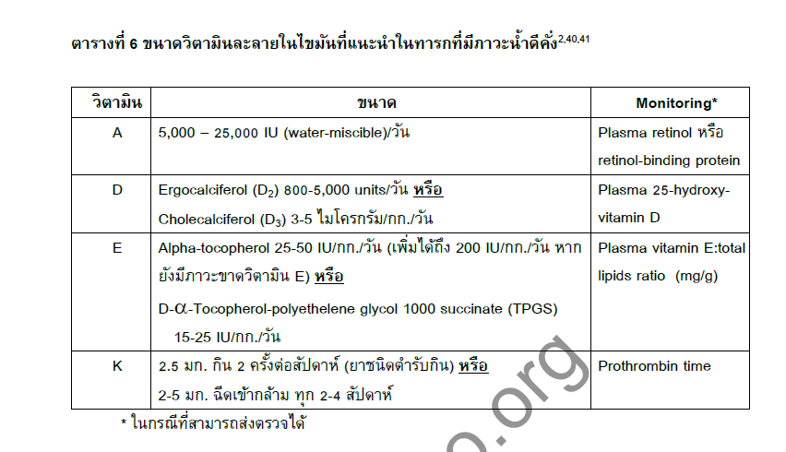
Medical supportive treatment
Ursodeoxycholic acid 10 mg/kg/dose b.i.d
https://www.pthaigastro.org/m.pthaigastro/Document_Preview.aspx?TID=115

Slide 40
Nutrition support in cholestasis
Calories 125 -130% requirement ( WT for HT of percentile 50)
• Protein 2-4 g/kg/day
• Medium chain triglyceride (MCT) 30-60% total fat
• Fat-soluble vitamins
• Water-soluble vitamins
• Zinc elemental Zn 1 mg/ kg /day

Slide 41
Specific treatment
Disorder/ disease | Treatment
Surgical condition
Biliary atresia | Kasai (hepatoportoenterostomy) operation (within 60 days)
Choledochal cyst | Hepaticojejunostomy
Spontaneous perforation of bile duct Inspissated bile syndrome Cholelithiasis | Endoscopic surgery
JPGN 2017;64: 154–168

Slide 42
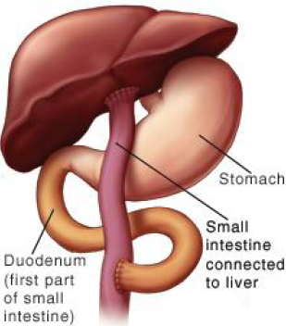
Hepatoportoenterostomy (Kasai) procedure

Slide 43
Specific treatment
Disorder/ disease | Investigation
Infection
Sepsis, UTI, TORCH | Antibiotics, antiviral medication
JPGN 2017;64: 154–168

Slide 44
Specific treatment
Disorder/ disease | Investigation
Genetic and metabolic disease
Alagille’s syndrome | Supportive, complication prevention
Galactosemia | Lactose avoidance
Hereditary fructose intolerance | Fructose avoidance
Tyrosinemia | Tyrosine, phenylalanine avoidance, NTBC*
JPGN 2017;64: 154–168

Slide 45
Specific treatment
Disorder/ disease | Investigation
Genetic and metabolic disease
Inborn error of bile acid synthesis | UDCA, bile acid supplement
Mitochondrial disorders | Enzyme replacement
Alpha-1 antitrypsin deficiency | Enzyme replacement
PFIC | UDCA, biliary diversion, liver transplant
Neonatal hemochromatosis | Iron chelation, antioxidant cocktail
Panhypopituitarism, hypothyroidsm | Hormone(s) replacement
JPGN 2017;64: 154–168

Slide 46
Specific treatment
Disorder/ disease | Investigation
Others
Parenteral nutrition associated liver disease | Enteral nutrition
Hemophagocytic lymphohistiocytosis | chemotherapy
Idiopathic neonatal hepatitis | Spontaneous recovery
JPGN 2017;64: 154–168

Slide 47
Prognosis
Etiologies
Timing to operation (biliary atresia)
Complication
Nutritional status
JPGN 2017;64: 154–168

Slide 48
PROGNOSIS OF BILIARY ATRESIA
After Kasai operation
⅓ normal liver
⅓ decrease liver function
⅓ not improve: liver transplantation
Non – operable patients
100 % dead in 1-2 yrs from cirrhosis

Slide 49
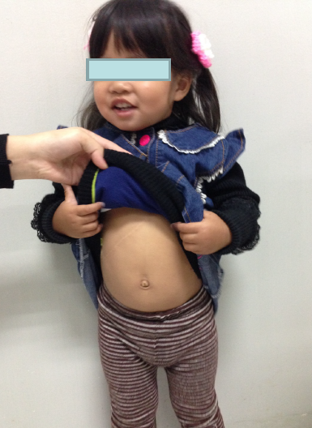
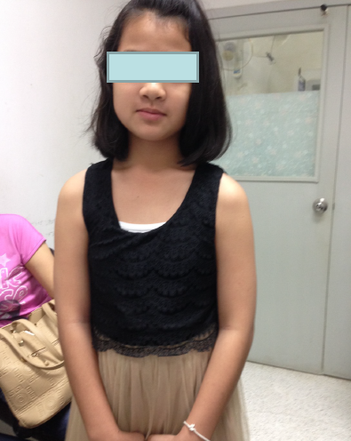
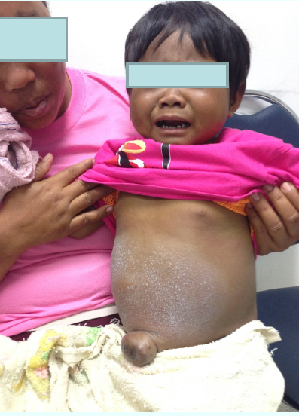
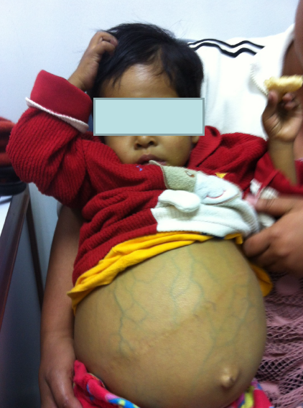
PROGNOSIS OF BILIARY ATRESIA

Slide 50
A 5-week-old male infant presents with cholestatic jaundice.
A 6-week-old male infant presents with cholestatic jaundice.
A 4-week-old male infant presents with cholestatic jaundice.

Slide 51
Case 1
A 5-week-old male infant presents with cholestatic jaundice.
History of pale stool. His weight and height are appropriated.
Physical examination reveals marked icteric sclera, liver 2 cm below RCM, liver span 9 cm, non palpable spleen
Investigations: TB/DB 17/15 mg/dl, ALT 170, AST 180, AP 280 U/L, INR 0.95
- Abdominal ultrasound: mild hepatomegaly, triangular cord sign is seen.

Slide 52
DISIDA scan
Homogenous radiotracer activity in liver without definite GB
Visualization no good evidence radiotracer activity in intestine.
IOC:
Nodular surface of liver parenchyma
Contrast can not pass to cystic duct, intrahepatic bile duct, and common bile duct
Diagnosis: biliary atresia
Procedure: Roux en –y hepaticoportoenterostomy
(Kasai operation )

Slide 53
Case 2
A 6-week-old male infant presents with cholestatic jaundice.
History of pale stool. His weight and height are appropriated.
Physical examination reveals marked icteric sclera, non palpable liver and spleen
Investigation: TB/DB 15/11 mg/dl, ALT 190, AST 170, AP 250 U/L.
- Abdominal ultrasound: cystic or fusiform dilatation of the common bile duct

Slide 54
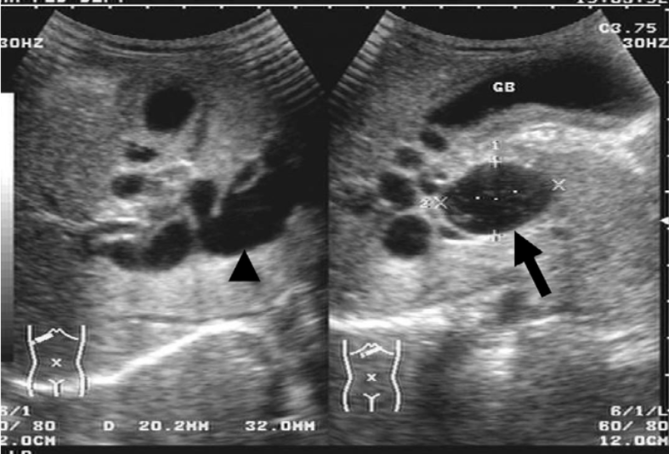
Abdominal ultrasound
Choledochal cyst
Hepaticojejunostomy
J Med Ultrasound 2007;15:191-6.

Slide 55
Case 3
A 4-week-old male infant presents with cholestatic jaundice.
History of pale stool. His weight and height are appropriated.
Physical examination reveals marked icteric sclera, non palpable liver and spleen
Investigation: TB/DB 7/5 mg/dl, ALT 153, AST 150, AP 290 U/L.
Abdominal ultrasound: mild parenchymatous change of liver
DISIDA scan: Impaired uptake, excretion of tracer into small bowel

Slide 56
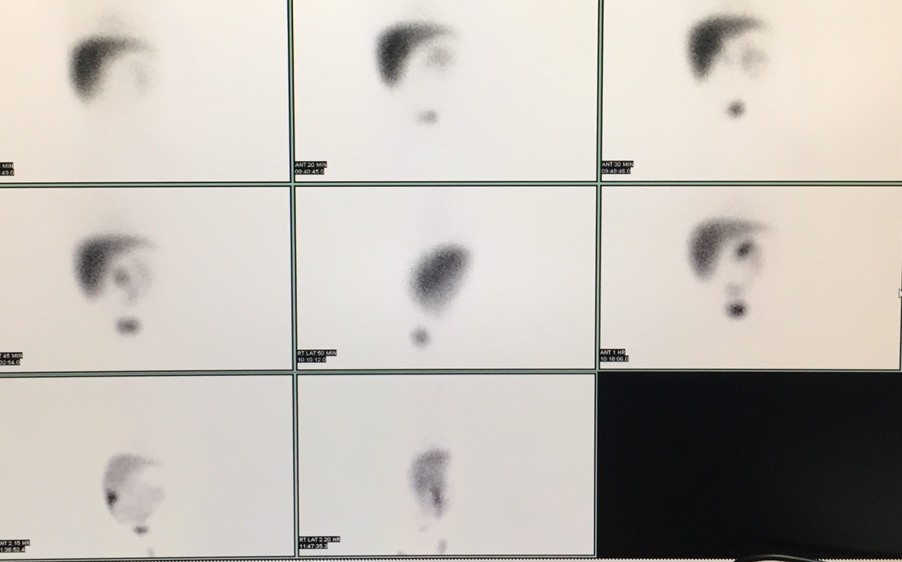
DISIDA scan
Neonatal hepatitis

Slide 57
 | Case 1 | Case 2 | Case 3
History | Cholestatic jaundice/ pale stool | Cholestatic jaundice/ pale stool | Cholestatic jaundice/ pale stool
Physical examination | Marked icteric sclera, liver 2 cm below RCM, liver span 9 cm, non palpable spleen | Marked icteric sclera, non palpable liver and spleen | Marked icteric sclera, non palpable liver and spleen

Slide 58
Investigations | Case 1 | Case 2 | Case 3
U/S | Liver parenchymatous change, triangular cord sign, atretic gall bladder | Seen choledochal cyst | Liver parenchymatous change, distended gall bladder
DISIDA scan | Good uptake, no excretion of tracer into small bowel | - | Impaired uptake, excretion of tracer into small bowel
IOC | No contrast pass (up) and into small bowel | - | -

Slide 59
 | Case 1 | Case 2 | Case 3
Diagnosis | Biliary atresia | Choledochal cyst | Neonatal hepatitis

Slide 60
ศึกษาเพิ่มเติมได้ที่
ณัฐพงษ์ อัครผล. Neonatal Cholestatic Jaundice. ใน: นภอร ภาวิจิตร,สุพร ตรีพงษ์กรุณา, เสกสิต โอสถากุล, พรเทพ ตั่นเผ่าพงษ์, เพ็ญศรี โควสุวรรณ, นิพัทธ์ สีมาขจร, บรรณาธิการ. แนวเวชปฎิบัติโรคทางเดินอาหารและตับในเด็ก ฉบับเรียบเรียงครั้งที่ 3. กรุงเทพฯ: บียอนด์ เอ็นทอร์ไพรซ์; 2558. หน้า 192-202.
De Bruyne R, Van Biervliet S, Vande Velde S, Van Winckel M. Clinical practice: neonatal cholestasis. Eur J Pediatr. 2011;170(3):279-84.
Feldman AG, Mack CL. Biliary Atresia: Clinical Lessons Learned. J Pediatr Gastroenterol Nutr. 2015;61(2):167-75.
วรนุช จงศรีสัวสดิ์. Neonatal Cholestasis. ใน: วรนุช จงศรีสัวสดิ์, บรรณาธิการ. โรคตับในเด็ก. กรุงเทพฯ: โรงพิมพ์แห่งจุฬาลงกรณ์มหาวิทยาลัย; 2561. หน้า 74-95.

Slide 61
ศึกษาเพิ่มเติมได้ที่
แนวเวชปฏิบัติ การดูแลรักษาภาวะน้ำดีคั่งในทารก (internet). 2557 [เมษายน พ.ศ. 2557/ Available from: https://www.pthaigastro.org/Guideline.aspx]
Fawaz R, Baumann U, Ekong U, Fischler B, Hadzic N, Mack CL, et al. Guideline for the Evaluation of Cholestatic Jaundice in Infants: Joint Recommendations of the North American Society for Pediatric Gastroenterology, Hepatology, and Nutrition and the European Society for Pediatric Gastroenterology, Hepatology, and Nutrition. J Pediatr Gastroenterol Nutr. 2017;64:154–68.
Bezerra JA, Spino C, Magee JC, Shneider BL, Rosenthal P, Wang KS, et al. Use of corticosteroids after hepatoportoenterostomy for bile drainage in infants with biliary atresia: the START randomized clinical trial. JAMA. 2014;311(17):1750-9.
Jimenez-Rivera C, Jolin-Dahel KS, Fortinsky KJ, Gozdyra P, Benchimol EI. International incidence and outcomes of biliary atresia. J Pediatr Gastroenterol Nutr. 2013 ;56(4):344-54

Slide 62
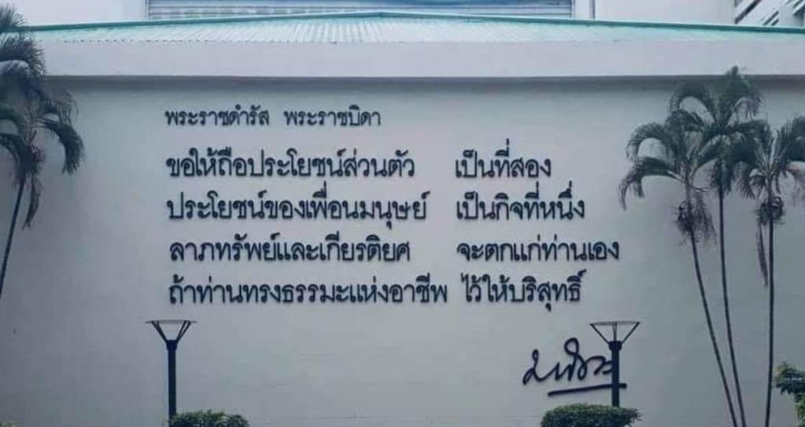
Thank you

