Slide 1

The First Law of Thermodynamics For Closed Systems
Assoc.Prof.Dr.Sommai Priprem
Department of Mechanical Engineering
Khon Kaen University

Slide 2
1st Law = Energy Conservation
“Energy can be neither created nor destroyed; it can only change forms”
Forms of Energy:
  Heat, Q
  Work, W
  Total Energy (in a fluid), E
  etc.

Slide 3

Heat, Q
“Heat is a form of energy that is transformed between two system by virtue of a temperature difference.”
What inside the bodyis Energy not HEAT but its Internal Energy
HEAT flow from higher Temp. to Lower Temp. body
When the temperatures are the same, heat transfer stops.

Slide 4
3-Ways of Heat Transfer
Conduction, heat moves across molecule of the medium
Convection, molecules of the medium recieves heat and they move, carrying the energy within.
Radiation, no medium needed
Unit of heat: amount; Q = J or Btu, q = kJ/kg or Btu/lbm
rate: Q^{o =} J/s = kW or Btu/s

Slide 5
Work, W
If the energy crossing the boundary of a closed system is not heat, it must be WORK
mass
mass
Piston
P
Unit of work: amount; W= J or Btu, q = kJ/kg or ft-lbf,
rate = POWER : Wº = J/s = kW or (ft-lbf)/s, or HP

Slide 6
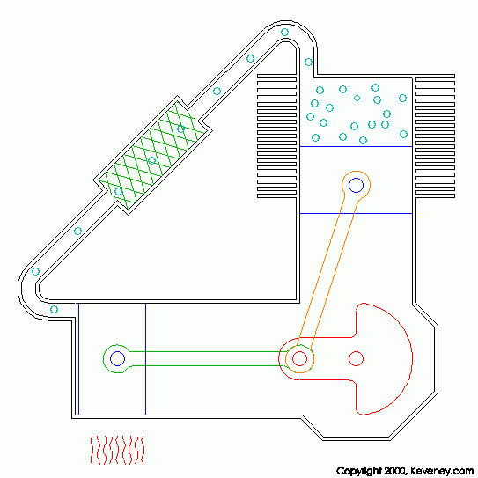
Work & Heat both of them:-
Occur at boundary.
Transfer Phenomena.
Associate with PROCESS not State Point.
Path Function
No W₁, W₂ but W₁₂ No Q₁, Q₂ but Q₁₂

Slide 7
Form of work
Electrical Work
Mechanical work
  Moving boundary work
  Gravitational Work
  Accelerational work
  Shaft work
  Spring work
Others; i.e. magnetic work

Slide 8
Electrical Work
I
V

Slide 9
Mechanical Work
F
dS

Slide 10

Moving Boundary Work
P
1
Process path
P
2
dv
v
v₁
v₂
P

Slide 11
Work is a PATH function
P
Amount of work involved depends not only on the initial and final state of the working fluid but also on the PROCESS as well.
In this example, the beginning and final states are the same but W_{A}>W_{B}>W_{C}
1
A
B
C
2
v
v₁
v₂
P

Slide 12
Isobaric Process (Constant Pressure)
P
1
2
P₁=P₂
v
v₁
v₂
P

Slide 13
Isothermal Process (const.Temp.)
P
Critical Point
Ideal Gas Zone
Superheated Vapour Region
Compressed Liquid Region
T₂ >T₁
Saturated Vapour Line
Saturated Liquid Line
Saturated
Liquid-Vapour Region
T₁
v

Slide 14
Isothermal Process (const.Temp.) of an IDEAL GAS
P
1
Temp = Const
2
v
v₁
v₂
P

Slide 15
Polytropic Process (Pv^{n} = Const)
P
1
P₁
Pv^{n} = Const
2
P₂
v
v₁
v₂
P

Slide 16
Example 3-9
A piston-cylinder device initially contains 0.4 m³ of air at 100 kPa and 80ºC. The air is now compressed to 0.1 m³ in such a way that the temperature inside the cylinder remains constant. Determine the work done during this process.
P
F
1
2
F
T=Const=80ºC
Air
0.4 m³
100 kPa
80ºC.
T=Const
0.1 m³
v₂
v₁
v

Slide 17
Spring Work
δW_{spring} = Fdx
For linear spring
F = kx
W_{spring} = 1/2k(x₂²-x₁²)
dx
F

Slide 18
Example 3-10
A piston-cylinder device contains 0.05 m³ of a gas initially at 200 kPa. At this state, a linear spring that has a spring constant of 150 kN/m is touching the piston but exerting no force on it. Now heat is transferred to the gas, causing the piston to rise and to compress the spring until the volume inside the cylinder doubles. If the cross-sectional area of the piston is 0.25 m² , determine
    (a) the initial pressure inside the cylinder,
    (b) the total work done by the gas, and
    (c) the fraction of this work done against the spring to compress it.

Slide 19
Example 3-10 Schematic Diagram
1
2
A=0.25 m²
+Q
V₂=2V₁
gas
0.05m³
200 kPa

Slide 20
Example 3-10 Analysis
State 1-2
State 1
P = P₁ + P_{s}
F_{s} = k(x – x₁) = k(V – V₁)/A = (k/A)(V – V₁)
P_{s} = F_{s} /A = (k/A²)(V – V₁)
₁W₂ = ∫₁² PdV = ∫₁² (P₁ + P_{s})dV
₁W₂ = ∫₁² {P₁ + [k/A²(V – V₁)]}dV
₁W₂ = [P₁ (V₂ – V₁)]
+ [(k/2A²){(V₂ – V₁)² - (V₁ – V₁)²}]
₁W₂ = {P₁ (V₂ – V₁)} + {(k/2A²)(V₂ – V₁)²}
x
F_{p}
F_{s}
F_{p}
x₁
P/A
P1/A
P
P₂
P₁
P = P₁ +P_{s}
v₁
v₂
v

Slide 21

1st Law = Energy Conservation
“Energy can be neither created nor destroyed; it can only change forms”
I’m using my Spider Internal ENERGY

Slide 22
The First Law of Thermodynamics : The Principle of Energy Conservation
State 1 Begining
Between
State 2 Final
1 unit of Energy
E₁ + ΣE_{in} = E₂ + ΣE_{out}
ΣE_{in} - ΣE_{out} = E₂- E₁ = ΔE

Slide 23

The First Law of Thermodynamics : For a Closed System
Heat Engine Model
Add heat to system, Q_{in} → +ve
System gives WORK, W_{out}→ +ve
From
ΣE_{in} - ΣE_{out} = E₂- E₁
ΣEin = ΣQin +ΣWin
ΣEout = ΣQout + ΣWout
Let Q = Σ(Qin - Qout)
W =Σ(Wout-Win)
Q – W = ΔE
q - w = Δe
+Q
+W

Slide 24
Q – W = ΔE
[Net energy transfer to (or from) the system as heat and work]
[Net increase (or decrease) in the total energy of the system
=
Total Energy, E of a system consists of 3 parts :-
E = U + KE + PE
  Internal Energy, U
  Kinetic Energy, KE = ½ mV2
  Potential Energy, PE = mgz
  Δ E = ΔU + ΔKE + ΔPE

Slide 25
From
Q – W = ΔE
Q – W = ΔU + ΔKE + ΔPE
If the system does not move with a velocity and has no change in elevation, the conservation of energy equation reduces to
Q – W = ΔU

Slide 26
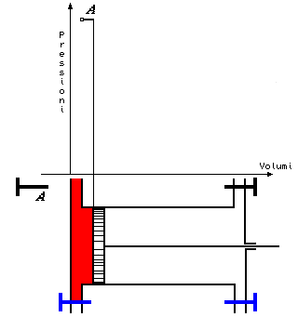
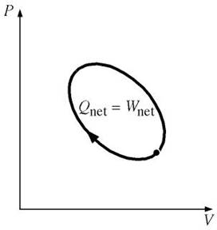
Closed System First Law for a Cycle
The properties of working fluid change while undergoes processes and finally back to the initial state point ➔
ΔU = U₁-U₁ =0

Slide 27
3-70 A closed system undergoes a cycle consisting of two process During the first process, 40 kJ of heat is transferred to the system while the system does 60 kJ of work. During the second process, 45 kJ of work is done on the system.
(a) Determine the heat transfer during the second process.
(b) Calculate the net work and net heat transfer for the cycle.
Answers: (a) -25kJ; (b) 15kJ, 15kJ

Slide 28
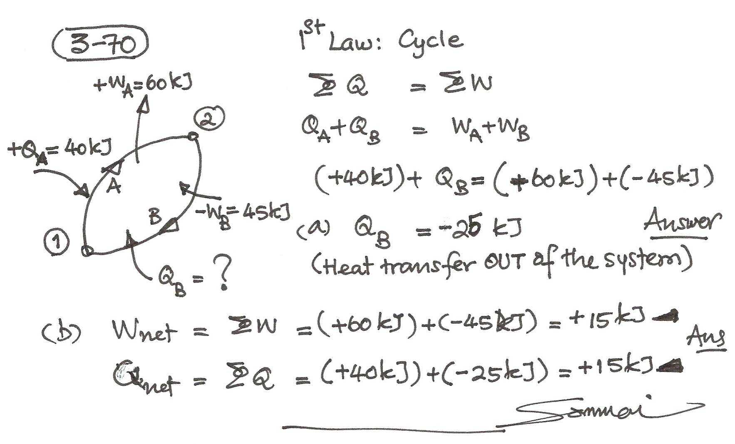

Slide 29
3-73 The radiator of a steam heating system has a volume of 20 L and is filled with superheated vapor at 300 kPa and 250ºC. At this moment b01 the inlet and exit valves to the radiator are closed. Determine the amount of heat that will be transfer to the room when the pressure drop to 100 kPa. Also show the process on a P-v diagram with respect to saturation line.
Answer - 33.4 kJ

Slide 30
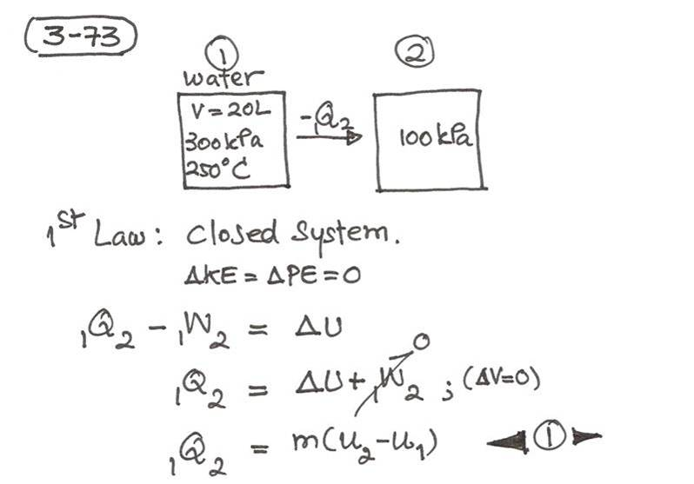

Slide 31
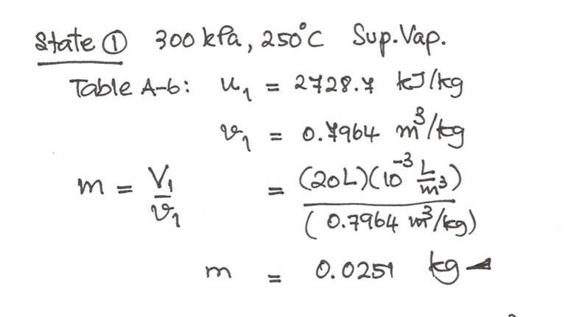

Slide 32
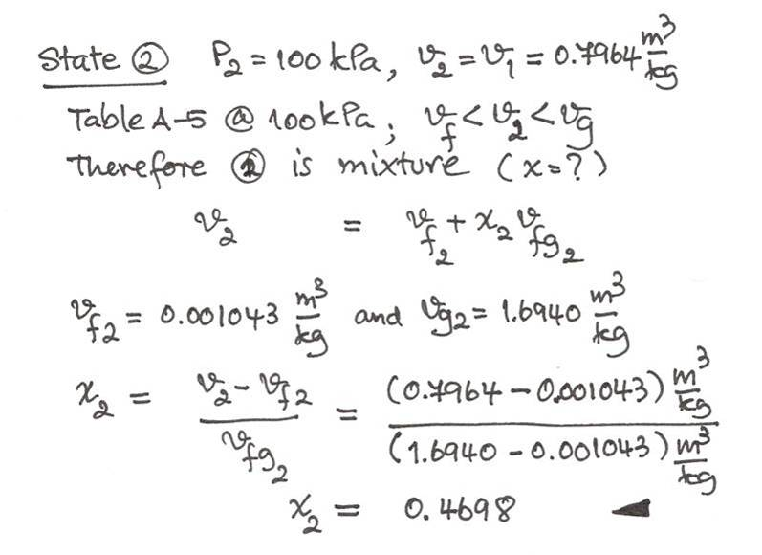

Slide 33
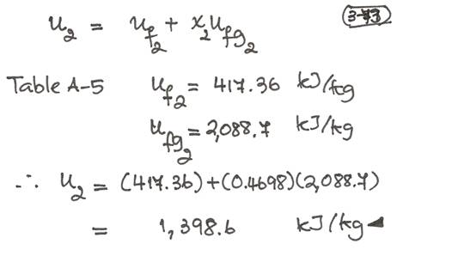

Slide 34
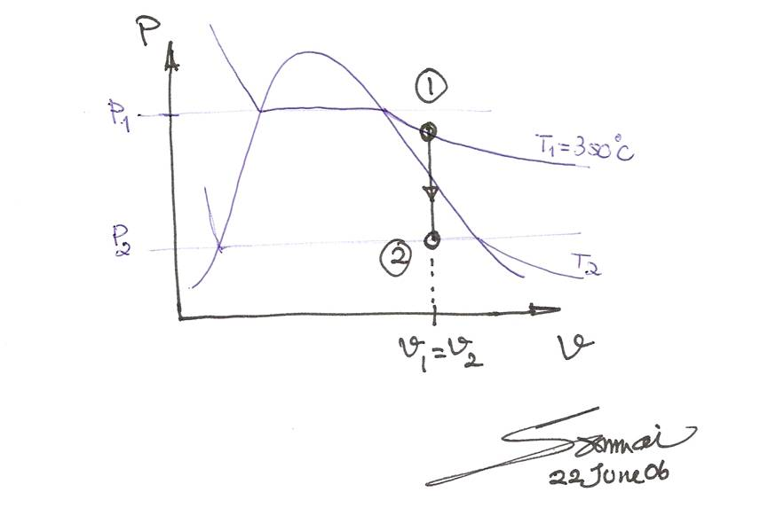

Slide 36
Specific Heat
is defined as “the energy required to raise the temperature of a unit mass of a substance by one degree.”
For fluids there are two different specific heat:
Specific heat at constant volume,
Specific heat at constant pressure,

Slide 37
Prove C_{v}
Consider a constant volume process
1st Law for a closed system
δq – δw = du
δw=0; δq = du
From definition
: δq = C_{v}dT
Therefore; du = C_{v}dT
q
v=const

Slide 38
Prove C_{p}
Consider a constant pressure process
1st Law for a closed system
δq – δw = du
δw = Pdv ; δq = du + Pdv
δq = dh
From definition
: δq = C_{p}dT
Therefore; dh = C_{p}dT
q
P=const

Slide 39
Internal Energy, Enthalpy, and Specific Heat of Ideal Gases
Sp.Heat @ v; du = C_{v}dT
Sp.Heat @ p; dh = C_{p}dT

Slide 40
To determine Δu and Δh of Ideal Gases
3- Ways
Δu = u₂ – u₁ (Table)
Δu = C_{v,av}ΔT
Δh ➔ similar ways

Slide 41
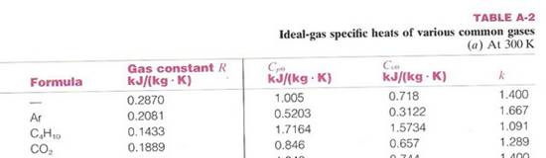
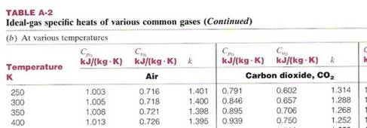
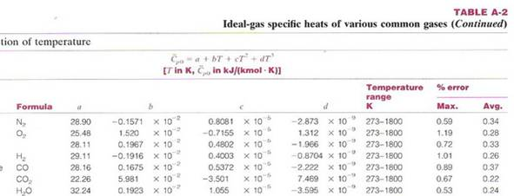

Slide 42
Specific Heat Relations of Ideal Gases
Ideal gases: Pv = RT
Sp.Heat @ v; du = C_{v}dT
Sp.Heat @ p; dh = C_{p}dT
Enthalpy; h = u + Pv = u +RT
dh = du + RdT
C_{p}dT = C_{v}dT + RdT
C_{p} = C_{v} + R
And defined Specific Heat Ratio;

Slide 43
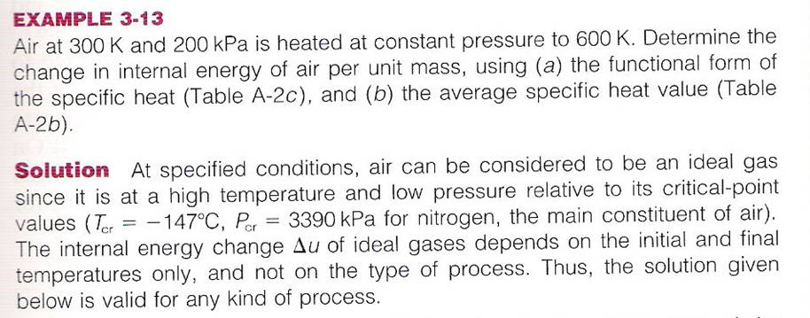

Slide 44
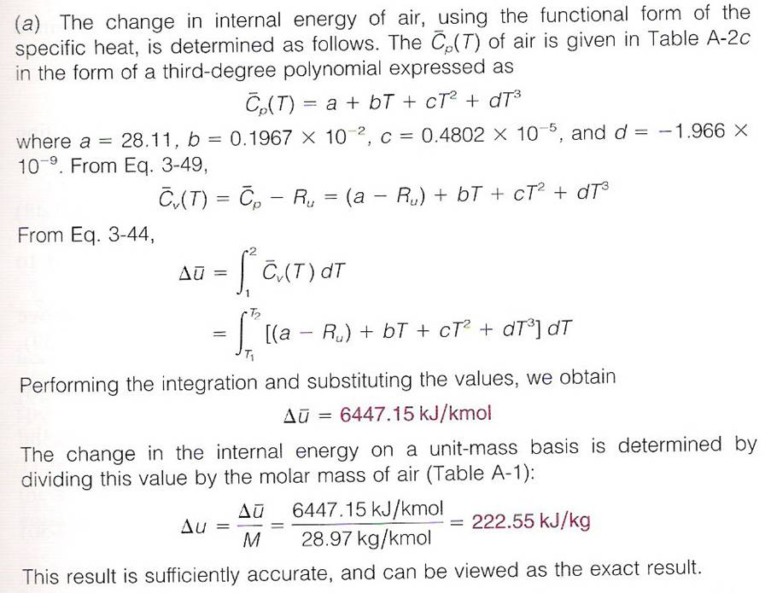

Slide 45
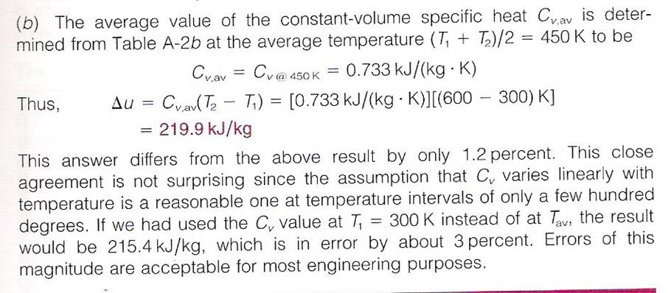
Ex 3-13 Cont

Slide 46
Example 3-16
A piston-cylinder device iniyially contains air at 150 kPa and 27 ºC. At this state, the piston is rest on a pair of stops, as shown in the figure below, and the enclosed volume is 400 L. The mass of the piston is such that a 350-kPa pressure is required to move it. The air is now heated until its volume is doubled. Determine
(a) the final temperature,
(b) the work done by the air, and
(c) The total heat added
Air
V₁ =400 L
P₁ = 150 kPa
T₁ = 27 ºC

Slide 47
Example 3-16 Schematic and Process diagram
1
2
3
P, kPa
2
3
P₂=350
V = C
P= C
Air
V₁ =400 L
P₁ = 150 kPa
T₁ = 27 ºC
Air
V₂ =400 L
P₂ = 350 kPa
Air
V₃ = 2V₂
P₃ = 350 kPa
P₁=150
1
q₁₂
q₂₃
v₁
v₃
V
(a) T₃=? (b) W₁₃=? (c) Q₁₃=?
Process 1-2 Before air could lift the piston, V=const, P rises up to 350 kPa.
Process 2-3 After the piston “Floated” , P = const, V increase to V₃

Slide 48
Why we can assume Ideal Gas Bahavior?
System = Air ➔ Closed System ➔ m = const
Assume ideal gas, constant Sp. Heat
(a) T₃=? , State 1 and 3,
Known: V₃ = 2V₁, (V₂ = V₁)
P₁ = 150 kPa and P₃ = 350 kPa
P₁V₁ = mRT₁ and P₃V₃ = mRT₃
P₁V₁/T₁ = P₃V₃ /T₃
T₃ = P₃V₃ T₁ /P₁V₁
T₃ = 1,400 K answer

Slide 49
(b) W₁₃=?
W₂₃ = P₂(2V₂ – V₂) = P₂v₂
= (350kPa)(0.4m³) = 140 kJ
W₁₃ = 140 kJ answer

Slide 50
(c) Q₁₃=? ;
1st law for a closed system
Assume both ΔKE and ΔPE =0
Q – W = ΔU + ΔKE + ΔPE
Q₁₃ = ΔU + W₁₃
ΔU = U₃ – U₁ = mC_{v}(T₃ – T₁)
m = P₁V₁/RT₁ = 0.697 kg
Average temp = (1400+300)/2 = 850K ➔
Interporation from Table A2, C_{v} = 0.823 kJ/kgK
Q₁₃ = 771 kJ answer

Slide 51
Conclusion of Importance Equations
Boundary Work; w =∫ Pdv ...........(1)
1st Law
general ΣE_{in} - ΣE_{out} = ΔE ................(2)
Closed System; Q – W = ΔU + ΔKE + ΔPE ...(3)
Enthalpy (defined) h = u + Pv ...........(4)
Specific Heat: du = C_{v}dT ......(5)
dh = C_{p}dT ......(6)
for Ideal gases: Cp = Cv + R ...........(7)
k = C_{p}/C_{v} ......(8)

Slide 52
End of Chapter 3

