Slide 1
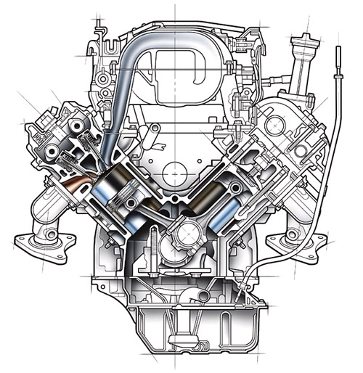
Chapter 8 Gas Power cycle
Part 2
Reciprocating Engines,
Air Standard Otto Cycle
Assoc.Prof.Sommai Priprem,Ph.D.
Department of Mechanical Engineering
Khon Kaen University

Slide 2
Over View on Reciprocating Engines
Top Dead Center (TDC) : Upper most position
Bottom Dead Center (BDC) : Lower most position
Stroke : Length of piston travel
Bore : Diameter of the cylinder
Clearance Volume (V_{c}) : V where piston is at TDC
Displacement Volume (V_{d}) :Swept Volume (V_{max}-V_{min})
Compression Ratio (r_{v}) = (V_{max}/V_{min}) = (V_{BDC}/V_{TDC})
Mean Effective Pressure (MEP) :
W_{net} = (MEP) x (Displacement Volume)
Intake
valve
Exhaust
valve
TDC
Stroke
Bore
BDC
Reciprocating Engine is INTERNAL COMBUSTION ENGINE, and is Classified into 2 types:
Spark Ignition: Gasoline Engine, Mixing air-fuel outside cylinder, ignites by a spark plug
Compression Ignition: Diesel engine, fuel is injected into the cylinder, self ignited as a result of compression.

Slide 3
Mean Effective Pressure, MEP Concept
Actual Processes
P
P
Equivalent by MEP
Equivalent
W_{net}
MEP
W_{net}
v_{min}
v_{max}
v
v_{min}
v
v_{max}
TDC
BDC
W_{net} = (MEP) x (Displacement Volume)
= (MEP) x (V_{max}-V_{min})

Slide 4
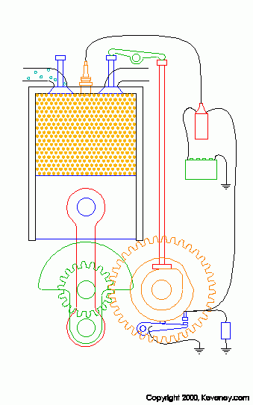
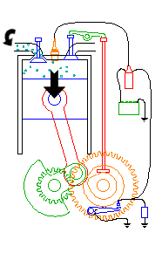
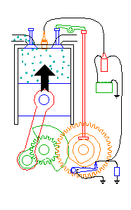
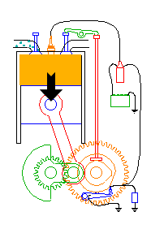
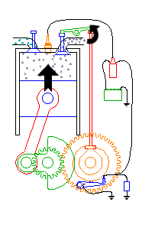
Four Stroke Engine
Intake
Compression
Power
Exhaust
1. Intake Stroke piston moves from TDC to BDC, drawing in fresh air-fuel mixture.
2. Compression Stroke piston moves from BDC to TDC, compress air-fuel mixture.
3. Power Stroke piston at TDC, spark plug ignite the air-fuel mixture. the combustion occur very fast that, in theory, the piston still at TDC. After that the piston is pushed to BDC.
4. Exhaust Stroke piston moves from BDC to TDC, pushes the combustion gases out.

Slide 5
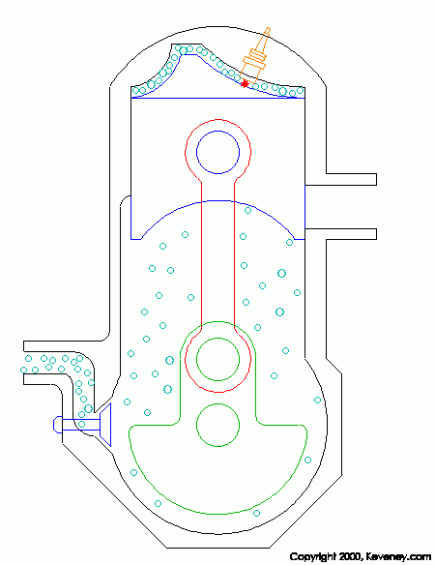
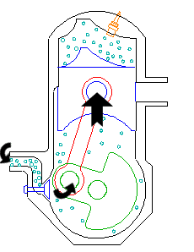
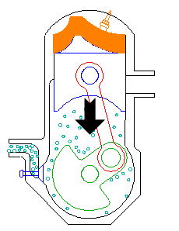
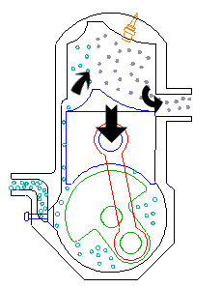
Two Stroke Engine
Power
Intake & Exhaust
Compression
1. Compression Stroke piston moves from BDC to TDC, compress air-fuel mixture.
2. Power Stroke piston at TDC, spark plug ignite the air-fuel mixture. After the piston is pushed to BDC. Meanwhile, about half way, combustion gases are discharged and fresh air-fuel mixture is drawing in .

Slide 6
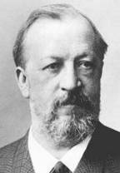
Air Standard Otto Cycle
Ideal cycle of spark ignition engine, comprises of 4- Process:
Process 1-2 Isentropic Compression (piston moves from BDC to TDC)
Process 2-3 v = constant, heat added (piston stays still, represents combustion)
Process 3-4 Isentropic expansion (piston moves from TDC to BDC gives POWER)
Process 4-1 v = constant, heat rejection (piston stays still, represents EXHAUST and INTAKE stroke)
There are only 2-stroke of all 4-processes,
P
3
T
3
q_{in}
Pv^{k} = c
w_{out}
v = const.
2
4
2
4
Pv^{k} = c
w_{in}
1
1
v = const.
q_{out}
v₂=v₃
v₁=v₄
v
s₁=s₂
s
s₃=s₄
TDC
BDC
What is the different of Otto cycle from Carnot cycle, the most efficient cycle
Draw the T-s and P-v diagrams by yourself > 5 times

Slide 7
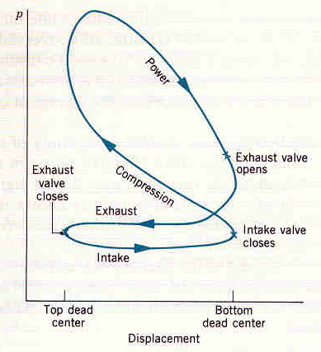
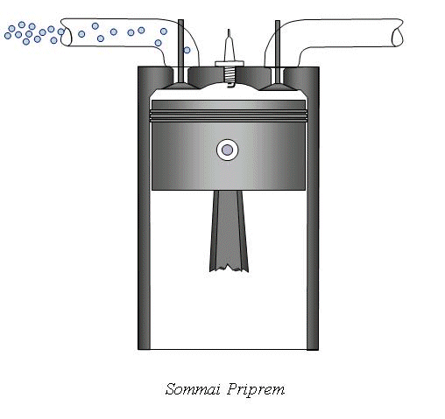
Otto Cycle VS 4-Stroke Engine
ไม่มีจังหวะ ดูด และจังหวะคาย
แทนด้วยการถ่ายเทความร้อน 4-1
Otto จึงเหลือแค่ 2 stroke คือ อัด และ power เท่านั้น
P
Otto Cycle
4-Stroke Engine
3
Pv^{k} = c
w_{out}
2
4
Pv^{k} = c
w_{in}
1
v₂=v₃
v₁=v₄
v
TDC
BDC

Slide 8
Analysis of Air Standard Otto Cycle Review of equations used:

Slide 9
1. The higher r_{v} the higher thermal eff.
2. The higher r_{v} cause Self-Ignition ➔ engine knock
3. Higher Octane Number of fuel used retard the self-ignition
4. Typical r_{v} of gasoline engine ~ 9.0 – 10.0
5. Thermal efficiency of actual spark ignition engine ~ 25-30%

Slide 10
Table A-17 Ideal gas properties of AIR
เพื่อความง่ายในการคำนวณหาค่าคุณสมบัติที่เปลี่ยนแปลงใน isentropic process of ideal gas
จึงได้มีการกำหนดค่า :
Relative Pressure, P_{r}
Relative Volume, v_{r}
Table A-17
T | h | P_{r} | u | v_{r} | sº
Tyyy
T1 | h₁ | P_{r1} | u₁ | v_{r1}
Txxx
T2 | h₂ | P_{r2} | u₂ | v_{r2}

Slide 11
Example 8.2 An ideal Otto cycle has a compression ratio of 8. At the begining of the compression process, the air is at 100 kPa and 17ºC, and 800 kJ/kg of heat is transfered to air during the heat addition proceed. Accounting for the variation of specific heats of air with temperature, determine, (a) the maximum temperature and pressure which occur during the cycle, (b) the net work out put, (c) the thermal efficiency, and (d) the mean effective pressure of the cycle
P
3
T
Given:
r_{v} = 8.0
P₁= 100 kPa and T₁=17ºC
q_{H} = 800 kJ/kg
variation of specific heats
Determine:
T_{max}
w_{net}
η_{th}
MEP
q_{in}
3
Pv^{k} = c
w_{out}
v = const.
2
4
2
4
Pv^{k} = c
w_{in}
1
1
v = const.
q_{out}
v₂=v₃
v₁=v₄
v
s
s₁=s₂
s₃=s₄

Slide 12
ทำโดย Assume constant specific heat

Slide 13
T_{max} = T₃ :find state 2 and then 3 using Ideal gas eqn.
and Table A-17
Table A-17 ; T₁ = 290 K ➔ u₁ = 206.91 kJ/kg, and v_{r} = 676.1
1-2 Isentropic proc. v_{r2}/v_{r1} = v₂/v₁ , v₂/v₁ = 1/r_{v} = 1/8,
➔ v_{r2} = v_{r1}/r_{v} = 676.1/8.0 = 84.51
Table A-17 : at v_{r2} = 84.51 ➔ T₂ = 652.4 K and u₂ = 475.11 kJ/kg,
P₂v₂ /T₂ = P₁v₁/T₁ ,
P₂ = P₁(v₁/v₂ )(T₂/T₁ ) = (100 kPa)(8.0)(652.4/290) = 1799.7 kPa
2-3 Constant volume heat added,
1st law q₂₃ = w₂₃ + u₃ –u₂ ; w₂₃ = 0
q₂₃ = u₃ –u₂ ; 800 kJ/kg = u₃ – 475.11
➔ u₃ =1275.11 kJ/kg ➔ table A-17: T₃ = 1575.1 K and v_{r3} = 6.108
P₃v₃/T₃ = P₂v₂ /T₂ ,
P₃ = P₂(v₂/v₃ )(T₃/T₂ ) = (1799.7 kPa)(1/8.0)(1575.1/652.4) = 543.4 kPa
T_{max} = T₃ = 1575.1 K answer

Slide 14
(b) w_{net} = q_{H} – q_{L} , similar to q₂₃ ; -q_{L} = q₄₁ = u₁ –u₄
3-4 Isentropic proc.
v_{r4}/v_{r3} = v₄/v₃ , v₄/v₃ = r_{v} = 8, ➔ v_{r4} = v_{r3}r_{v} = 6.108*8.0 = 48.864
Table A-17 : at v_{r4} = 48.864 ➔ T₂ = 795.6 K and u₄ =588.74 kJ/kg,
4-1 Constant volume heat rejected,
1st law q₄₁ = w₄₁ + u₁ –u₄ ; w₄₁ = 0
q₄₁ = u₁ –u₄ = 206.91 - 588.74 = -381.83 kJ/kg
q_{L} = -q₄₁ = 381.83 kJ/kg
w_{net} = q_{H} – q_{L} = 800 – 381.83 = 418.17 kJ/kg answer
(c) η_{th} = w_{net} /q_{H} = 418.83/800 = 0.523 or 52.3 % answer
(d) MEP = w_{net} /(v₁-v₂ ) ; P₁v₁ = RT₁
➔ v₁ = 0.832 m³/kg , v₂ = v₁/8,
MEP = 574.4 kPa answer

Slide 15
Problems
8-10C What is the difference between the clearance volume and the displacement volume of reciprocating engines?
8-11C Define the compression ratio for reciprocating engines.
8-12C How is the mean effective pressure for reciprocating engines defined?
8-13C Can the mean effective pressure of an automobile engine in operation be less than the atmospheric pressure?
8-14C As a car gets older, will its compression ratio change? How about the mean effective pressure?
8-15C What is the difference between spark-ignition and compression­ignition engines?
8-16C Define the following terms related to reciprocating engines: stroke, bore, top dead center, and clearance volume.

Slide 16
Otto Cycle
8-27C What four processes make the ideal OTTO cycle?
8-29C How is the rpm (revolutions per minute) of an actual four-stroke. gasoline engine related to the number of thermodynamic cycles? What would your answer be for a two-stroke engine?
8-30C Are the processes which make up the Otto cycle analyzed as closed-system or steady-flow processes? Why?
8-31C How does the thermal efficiency of an ideal Otto cycle change with the compression ratio of the engine and the specific heat ratio of the working fluid?
8-32C Why are high compression ratios not used in spark-ignition engines?
8-33C An ideal Otto cycle with a specified compression ratio is executed using (a) air, (b) argon, and (c) ethane as the working fluid. For which case will the thermal efficiency be the highest? Why?
8-34C What is the difference between fuel-injected gasoline engines and diesel engines?

Slide 17
8-35 An ideal Otto cycle has a compression ratio of 8. At the beginning of the compression process, air is at 25 kPa and 27°C, and 750 kJ /kg of heat is transferred to air during the constant-volume heat addition process. Taking into account the variation of specific heats with temperature, determine (a) the pressure and temperature at the end of the heat addition process, (b) the net work output, (c) the thermal efficiency, and (d) the mean effective pressure for the cycle. Answers: (a) 3898 kPa, 1539 K; (b) 392.4 kJ /kg; (c) 52.3 percent; (d) 495 kPa
8-36 Repeat Prob. 8-35 using constant specific heats at room temperature.
8-37 The compression ratio of an air-standard Otto cycle is 9.5. Prior to the isentropic compression process, the air is at 100 kPa, 17°C, and 600 cm³. The temperature at the end of the isentropic expansion process is 800 K. Using specific heat values at room temperature, determine (a) the highest temperature and pressure in the cycle, (b) the amount of heat transferred, in kJ, (c) the thermal efficiency, and (d) the mean effective pressure. Answers: (a) 1969 K, 6449 kPa; (b) 0.65 kJ; (c) 59.4 percent; (d) 719 kPa

Slide 18
End of Part 1
อยากรู้จักเครื่องยนต์ให้มากขึ้นมั๊ย..........ไปดูที่นี่เลย
Web Links:
1. http://en.wikipedia.org/wiki/Four-stroke_cycle
2. http://library.thinkquest.org/C006011/english/sites/index.php3?v=2
3. http://auto.howstuffworks.com/diesel1.htm

