Slide 1
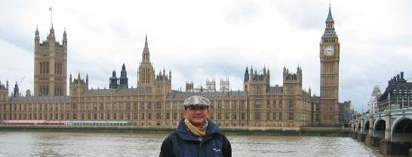
Chapter 10 Refrigeration Cycle
References:
Reference: Cengel, Yunus A. and Michael A. Boles, Thermodynamics: An Engineering Approach, 5th ed., New York, McGraw-Hill: 2006
Sonntag R.E., and Van Wylen G.J., Introduction to Thermodynamics: Classical and Statistical, 3rd Ed., John Wiley & Sons, 1991
Assoc.Prof.Sommai Priprem, PhD.
Department of Mechanical Engineering
Khon Kaen University
Westminster, London, UK

Slide 2
Introduction
Refrigeration Cycle is a kind of Heat Pump.
There are many type of refrigeration device, ie.:
Vapor Compression refrigeration
Gas refrigeration
Absorbtion refrigeration
Thermoelectric refrigeration
Vapor Compression Refrigeration is commonly used now a day
1834 Jacob Perkins patented “ Ice Machine”
1850 Alexander Twining commercial “Ice Machine”

Slide 3
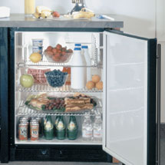
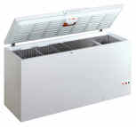
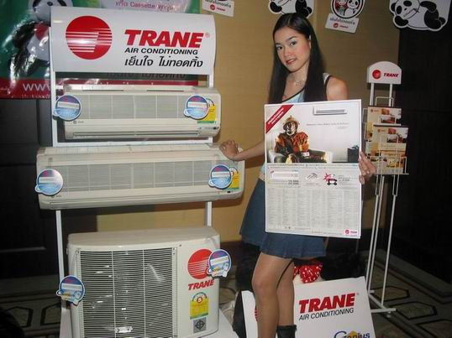
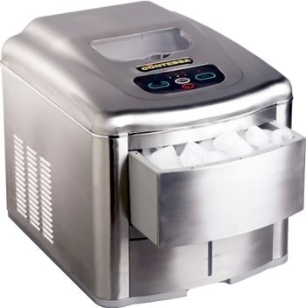
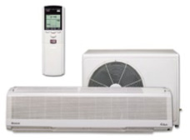
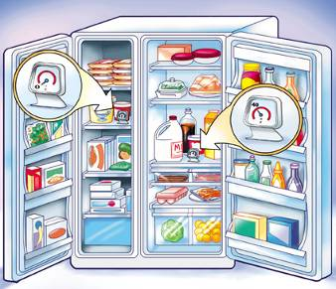
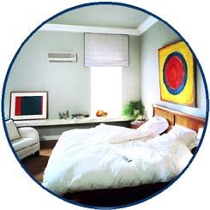
Application in domestic used
A Freezer
A Refrigerator
An Ice Maker
A Refrigerator with Freezer

Slide 4
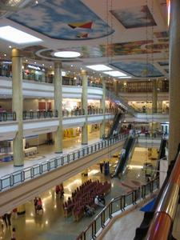
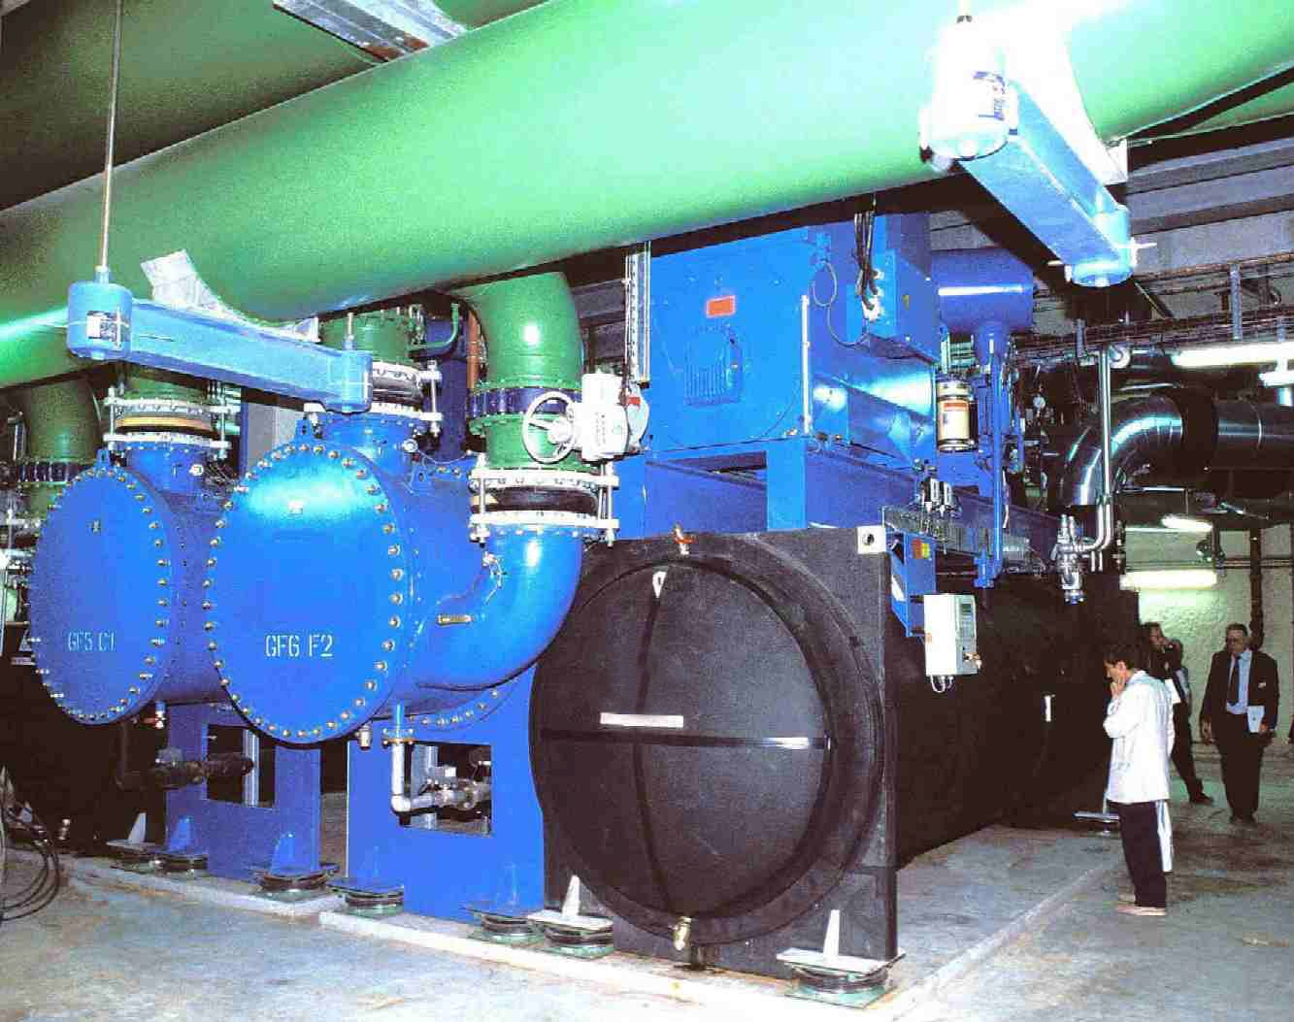
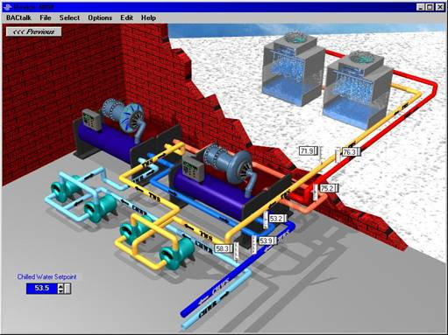
Chillers
of a Central Air Conditioning System

Slide 5
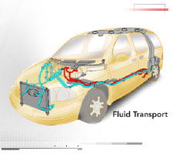
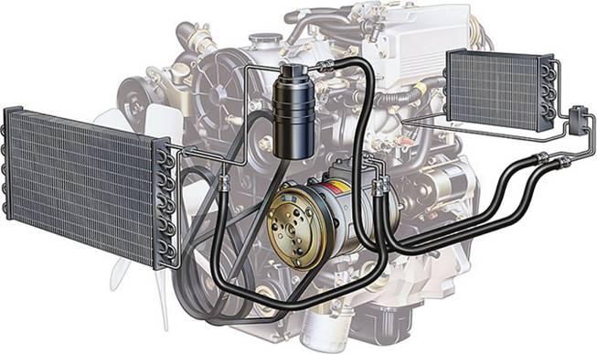
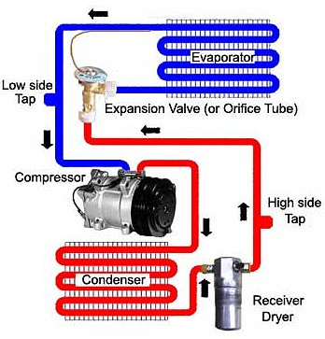
Automobiles Air Conditioning System

Slide 6
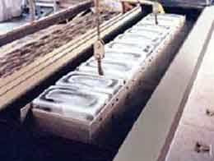
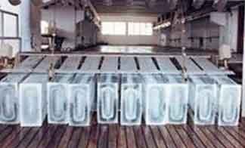
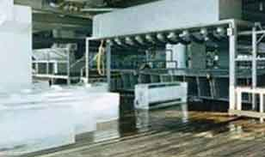
Ice Block Machine Plant

Slide 7
Some Important Terms
Air Conditioner, Refrigerator, Freezer, Ice Maker, Heat Pump
Refrigerants: CFCs: R-12, R-22, R-134a,...
NH₃, Hydrocarbons: propane, ethane, ethelene...CO₂ Air, Water
Coefficient of performance, COP. Energy Efficiency Ratio, EER (Btu/W-hr)
1 Ton of Refrigeration = Q_{remove} from 1 ton(2,000 lb) of WATER at 32 F to be ICE at 32 F in 24 hr
1 Ton = 12,000 Btu/h = 3.517 kW

Slide 8
Recall
from chapter 5
The Second Law of Thermodynamics

Slide 9
Refrigerator and Heat Pump
A Simple Vapor-Compression Refrigeration has 4 devices and performs 4 processes in a cycle:
Compressor: compress vapor to high Press.(HP)
Condenser: condense HP vapor to HP liq.
Expansion Valve: reduces pressure of HP liq. to LP
Evaporator: receive heat from low temp body ➔ LP liq. vaporizes to LP vap.
Environment
Q_{H}
Condenser
Expansion Valve
W_{in}
Compressor
Evaporator
Q_{L}
Refrigerated Space

Slide 10
Refrigerator and Heat Pump
Condenser
3
2
Expansion Valve
Compressor
4
1
Evaporator

Slide 11
House-cooling using
an air-conditioner
House-heating using
a heat pump
Environment
Heating at 20 ºC
40 ºC
Q_{H}
Q_{H}
50 ºC
Condenser
30 ºC
80 ºC
Condenser
80 ºC
Expansion Valve
Expansion Valve
W_{in}
W_{in}
Compressor
Compressor
Evaporator
15 ºC
Evaporator
0 ºC
10 ºC
-20 ºC
Q_{L}
Q_{L}
-10 ºC
Out dooe space
Air Conditioned, 25ºC

Slide 12
Coefficient of Performance
COP = desired output = Q_{useful}
required input W_{in}
COP_{R} = Q_{L} = Q_{L} = 1 . (5.5)
W_{in} Q_{H}-Q_{L} Q_{H}/Q_{L}- 1
COP_{HP} = Q_{H} = Q_{H} = 1 . (5.6)
W_{in} Q_{H}-Q_{L} 1-Q_{L}/Q_{H}

Slide 13
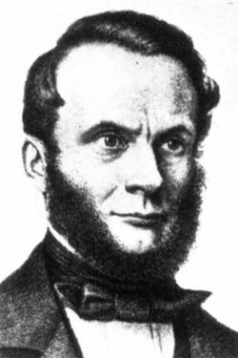
The Second Law of Thermodynamics: Clausuis Statement
It is impossible to construct a device that operates in a cycle and produces no effect other than the transfer of heat from a lower-temperature body to a higher-temperature body.
High-Temp. Body, T_{H}
High-Temp. Body, T_{H}
meaning: W > 0
from COP = Q
W
No heat pump can have a COP of ∞
Q_{H}
Q
W
Heat Pump
Q_{L}
Low-Temp. Body, T_{L}
Low-Temp. Body, T_{L}



Slide 14
Reverse Carnot Cycle = Carnot Heat Pump
T-s Diagram
WARM medium at T_{H}
T
P₂
3
Q_{H}
2
Q_{H}
Condenser
3
2
Turbine
Compressor
P₁
W_{in}
4
4
1
1
Q_{L}
Evaporator
Q_{L}
s
COLD medium at T_{L}

Slide 15
Vapor Compression Refrigeration Cycle
The cycle widely used in the world for cooling, freezing, and heating

Slide 16
4 - Processes
Process 1-2 Isentropic Compression Process, s=const.: Compressor, sat.vap → superheat vapor
Process 2-3 P = const. Heat Rejection Process: Condenser, superheat vapor → sat.liquid
Process 3-4 Throttling Process, h=const.: Expansion Valve, sat. liquid → mixture
Process 4-1 P = const. Heat Addition Process : Evaporator, Mixture → sat. vapor
Schematic Diagram
Environment
T-s Diagram
T
Q_{H}
P₂
Condenser
2
3
2
W_{in}
Q_{H}
3
P₁
Expansion Valve
Compressor
W_{in}
4
4
1
1
Evaporator
Q_{L}
Q_{L}
s
Refrigerated Space

Slide 17
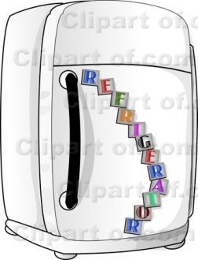
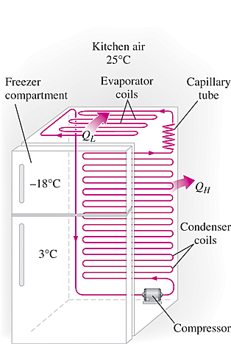
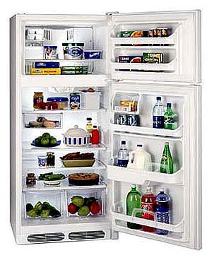
Household Refrigerator

Slide 18
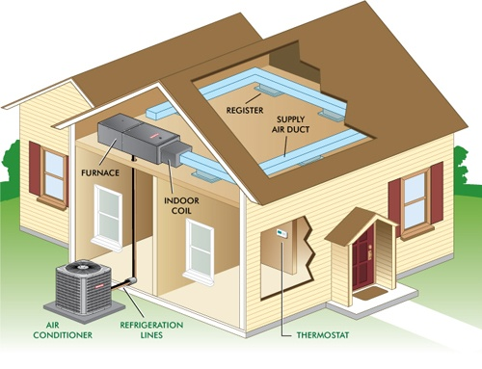
Household Air-Conditioner

Slide 19
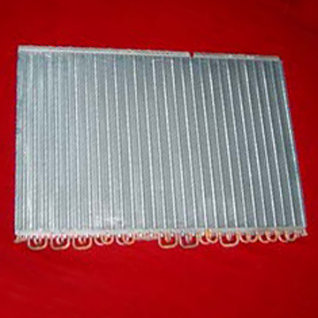
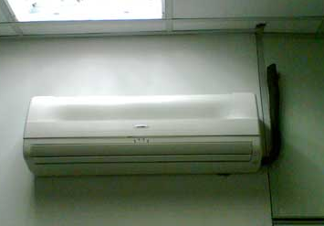
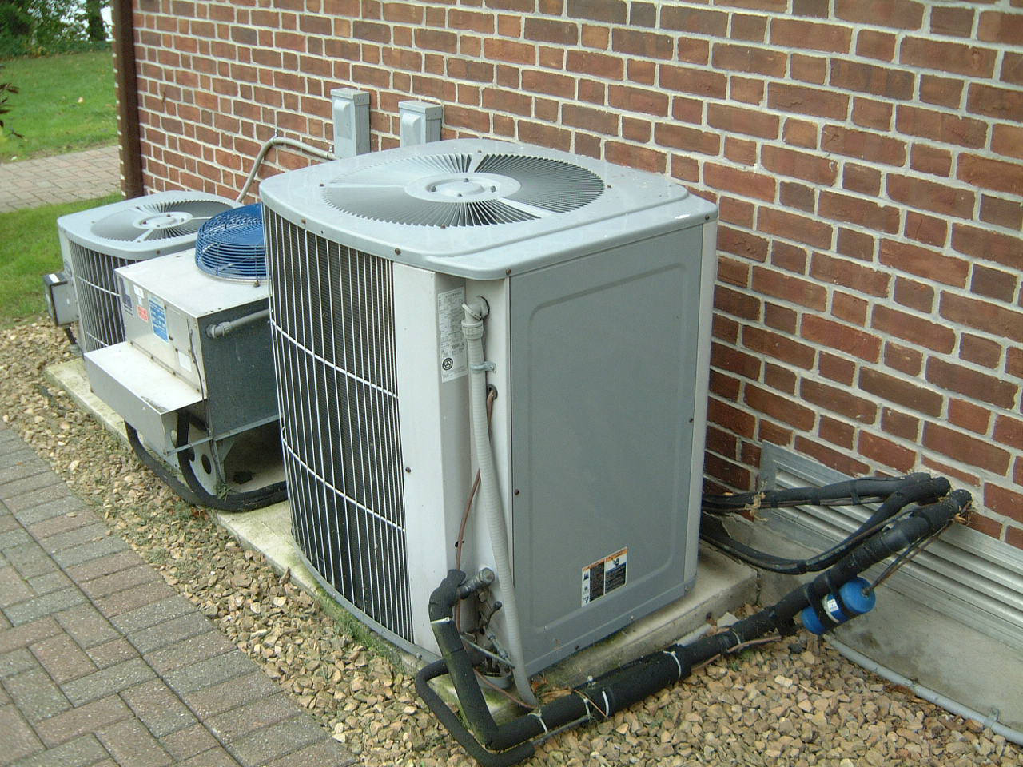
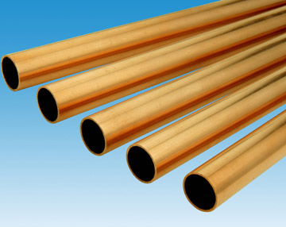
Fan Coil Unit
Evaporator Tube
Condensing Unit

Slide 20
P-h Diagram is more appropriate than P-v dia.
T-s Diagram
P
P-h Diagram
T
P₂
2
W_{in}
3
Q_{H}
2
Q_{H}
P₂
3
P₁
W_{in}
4
1
P₁
4
Q_{L}
1
Q_{L}
s
h
h₄= h₁
h₁
h₂

Slide 21
Example 10-1 A refrigerator uses refrigerant-12 as the working fluid and operates on an ideal vapor-compression refrigeration cycle between 0.14 and 0.8 MPa. The mass flow rate of the refrigerant is 0.05 kg/sec. Show the cycle on a T-s diagram with respect to saturation lines. Determine (a) the rate of heat removal from the refrigerated space and the power input to the compressor, (b) the rate of heat rejection to the environment and (c) the coefficient of performance.
T
T-s Diagram
Environment
P₂
2
Q_{H}
Q_{H}
W_{in}
Condenser
3
2
3
0.8 MPa
P₁
Expansion Valve
Compressor
W_{in}
0.14 MPa
4
Evaporator
1
4
1
Q_{L}
m_{dot} = 0.05 kg/s
Q_{L}
s
Refrigerated Space
R-12 Property: Table A-11 – A-12
State 1 sat. vap. @ P₁ = 0.14 MPa → h₁ = h_{g@P1} = 177.87 kJ/kg, s₁ = s_{g} = 0.7102 kJ/kg-K
State 2 P₂ = 0.8 MPa and s₂ = s₁ = 0.7102 kJ/kg-K, h₂ = 208.65 kJ/kg (T2 = 43.5 C)
State 3 sat.liq. and P₃ = P₂= 0.8 MPa, h₃ = h_{f@P3} = 67.3 kJ/kg
State 4 h₄ = h₃ = 67.3 kJ/kg (Throttling Process)
3
Expansion Valve
4

Slide 22
4
1
Evaporator
Q_{L}
2
Compressor
W_{in}
1
3
Q_{H}
2
Condenser

Slide 23
Example 10-2 Refrigerant-12 enters the compressor of a refrigerator as superheated vapor at 0.14 MPa
and 50 ºC. The refrigerant is cooled in the condenser to 26 ºC and 0.72 MPa, and is throttled to 0.15 MPa. Disregarding any heat transfer and pressure drops in the connecting lines between the components, determine (a) the rate of heat removal from the refrigerated space and the power input to the compressor, (b) the adiabatic efficiency of the compressor, and (c) the coefficient of performance of the refrigerator.
T-s Diagram
R-12 Property: Table A-11 – A-12
State 1 superheated. vap.
P₁ = 0.14 MPa and T₁ = -20 C→ h₁ = 179.01 kJ/kg
State 2 superheated. vap.
P₂ = 0.8 MPa and T₂ = 50 C→ h₂ = 213.45 kJ/kg
State 3 Compressed.liq.
P₃ = 0.72 MPa,and T₃ = 26 C →
h₃ = h_{f@26C} = 60.68 kJ/kg
State 4 h₄ = h₃ = 60.68 kJ/kg (Throttling Process)
T
2
P₂ = 0.8 MPa
T₂ = 50 ºC
2s
P₃ = 0.72 MPa
T₃ = 26 ºC
Q_{H}
W_{in}
3
P₄ = 0.15 MPa
P₁ = 0.14 MPa
T₁ = -20 ºC
4
1
Q_{L}
s

Slide 24
4
1
Evaporator
Q_{L}
2
Compressor
W_{in}
1

Slide 25
ระบบทำความเย็นแบบอื่นๆ

Slide 26

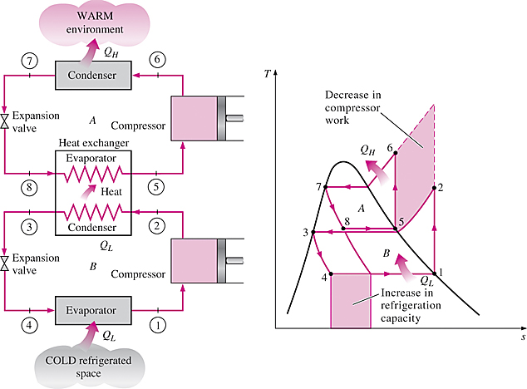
Cascade Refrigeration Systems
Some industrial applications require moderately low temperatures, and the
temperature range they involve may be too large for a single vapor-compression
refrigeration cycle to be practical. The solution is cascading.
Cascading improves the COP of a refrigeration system.
Some systems use three or four stages of cascading.
A two-stage cascade refrigeration system with the same refrigerant in both stages.

Slide 27
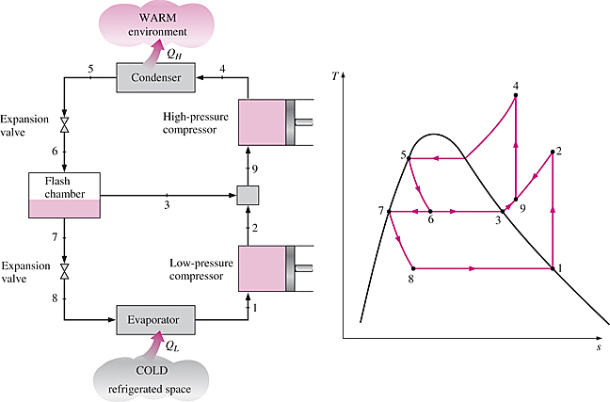
Multistage Compression Refrigeration Systems
When the fluid used throughout the cascade refrigeration system is the same, the heat exchanger between the stages can be replaced by a mixing chamber (called a flash chamber) since it has better heat transfer characteristics.
A two-stage compression refrigeration system with a flash chamber.

Slide 28
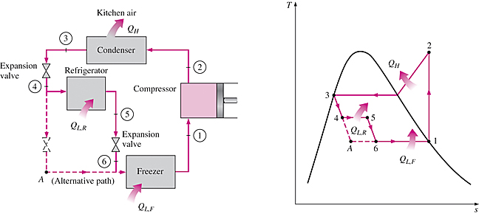
Multipurpose Refrigeration Systems with a Single Compressor
Some applications require refrigeration at more than one temperature. A practical and economical approach is to route all the exit streams from the evaporators to a single compressor and let it handle the compression process for the entire system.
Schematic and T-s diagram for a refrigerator–freezer unit with one compressor.

Slide 29
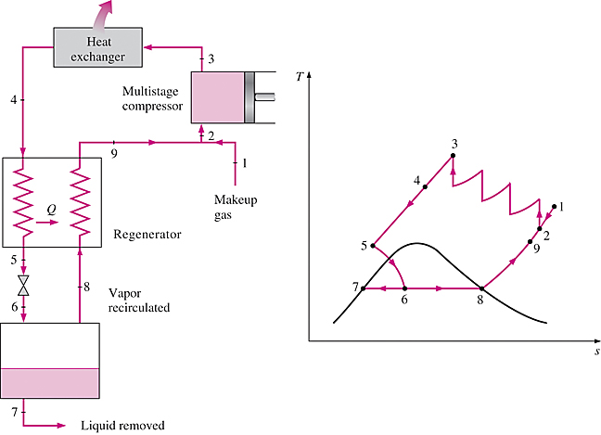
Liquefaction of Gases
Many important scientific and engineering processes at cryogenic temperatures (below about 100°C) depend on liquefied gases including the separation of oxygen and nitrogen from air, preparation of liquid propellants for rockets, the study of material properties at low temperatures, and the study of superconductivity.
The storage (i.e., hydrogen) and transportation of some gases (i.e., natural gas) are done after they are liquefied at very low temperatures. Several innovative cycles are used for the liquefaction of gases.
Linde-Hampson system for liquefying gases.

Slide 30
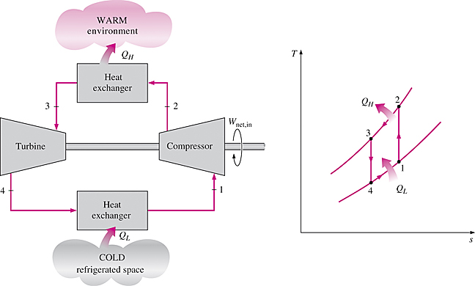
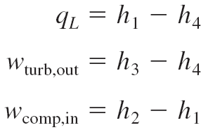
GAS REFRIGERATION CYCLES
The reversed Brayton cycle (the gas refrigeration cycle) can be used for refrigeration.
Simple gas refrigeration cycle.

Slide 31
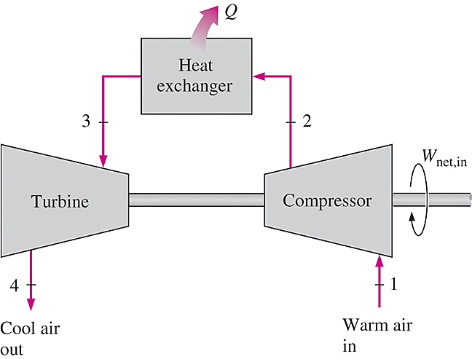
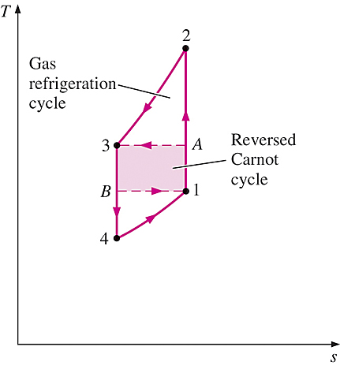
The gas refrigeration cycles have lower COPs relative to the vapor-compression refrigeration cycles or the reversed Carnot cycle.
The reversed Carnot cycle consumes a fraction of the net work (area 1A3B) but produces a greater amount of refrigeration (triangular area under B1).
An open-cycle aircraft cooling system.
Despite their relatively low COPs, the gas refrigeration cycles involve simple, lighter components, which make them suitable for aircraft cooling, and they can incorporate regeneration

Slide 32
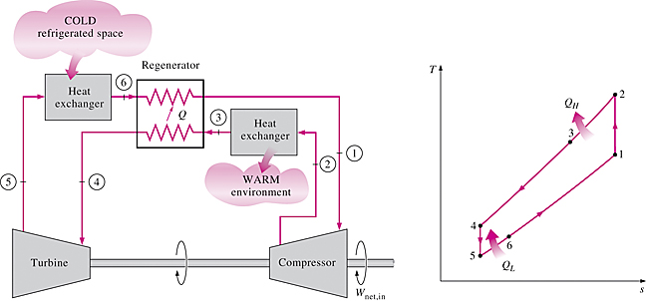
Without regeneration, the lowest turbine inlet temperature is T₀, the temperature of the surroundings or any other cooling medium.
With regeneration, the high-pressure gas is further cooled to T₄ before expanding in the turbine.
Lowering the turbine inlet temperature automatically lowers the turbine exit temperature, which is the minimum temperature in the cycle.
Extremely low temperatures can be achieved by repeating regeneration process.
Gas refrigeration cycle with regeneration.

Slide 33
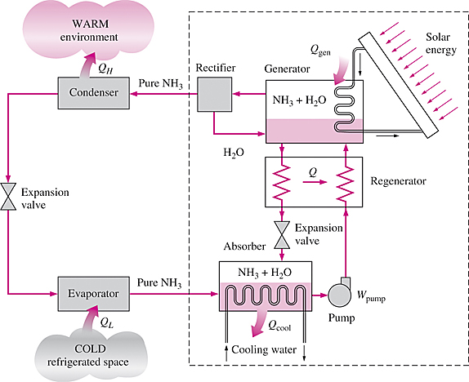
ABSORPTION REFRIGERATION SYSTEMS
When there is a source of inexpensive thermal energy at a temperature of 100 to 200°C is absorption refrigeration.
Some examples include geothermal energy, solar energy, and waste heat from cogeneration or process steam plants, and even natural gas when it is at a relatively low price.
Ammonia absorption refrigeration cycle.

Slide 34
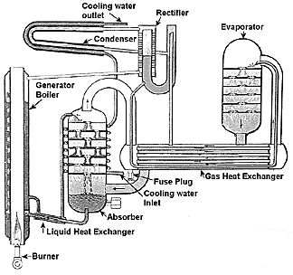
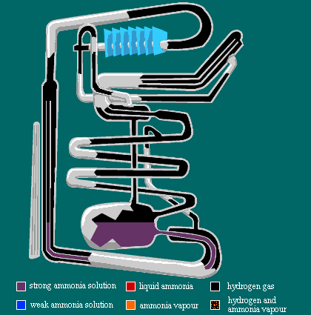
ระบบตู้เย็น น้ำมันก๊าซ

Slide 35
Some Selected Problems

Slide 36
The Reverse Carnot Cycle
10-5 Refrigerant-12 enters the condenser of a steady-flow Carnot refrigerator as a saturated vapor at 800 kPa and leaves with a quality of 0.05. The heat absorption from the refrigerated space takes place at 140 kPa. Show the cycle on a T -s diagram relative to saturation lines, and determine (a) the coefficient of performance, (b) the quality at the beginning of the heat absorption process, and (c) the net work input. Answers: (a) 4.59, (b) 0.317, (c) 22.7kJ/kg
Ideal and Actual Vapor-Compression Refrigeration Cycles
10-6C Does the ideal vapor-compression refrigeration cycle involve any
internal irreversibilities?
10-7C Why is the throttling valve not replaced by an isentropic turbine in the ideal vapor-compression refrigeration cycle?
10-8C It is proposed to use water instead of refrigerant-12 as the working fluid in air conditioning applications, where the minimum temperature never falls below the freezing point. Would you support this proposal? Explain.
10-9C In a refrigeration system, would you recommend condensing the refrigerant-12 at a pressure of 0.7 or 1.0 MPa if heat is to be rejected to a cooling medium at 15°C? Why?

Slide 37
10-10C Does the area enclosed by the cycle on a T-s diagram represent the net work input for the reversed Carnot cycle? How about for the ideal vapor-compression refrigeration cycle?
10-11C Consider two vapor-compression refrigeration cycles. The refrigerant enters the throttling valve as a saturated liquid at 30°C in one cycle and as sub cooled liquid at 30°C in the other one. The evaporator pressure for both cycles is the same. Which cycle do you think will have a higher COP?
10-l2C The COP of vapor-compression refrigeration cycles improves when the refrigerant is subcooled before it enters the throttling valve. Can the refrigerant be subcooled indefinitely to maximize this effect, or is there a lower limit? Explain.
10-13 A refrigerator uses refrigerant-12 as the working fluid and operates on an ideal vapor-compression refrigeration cycle between 0.12 and 0.7 MPa. The mass flow rate of the refrigerant is 0.05 kg/sec Show the cycle on a T-s diagram with respect to saturation lines. Determine (a) the rate of heat removal from the refrigerated space and the power input to the compressor, (b) the rate of heat rejection to the environment and (c) the coefficient of performance. answer: (0) 5.68 kW, 1.55 kW; (b) 7.24 kW; (c) 3.67

Slide 38
10-14 If the throttling valve in Prob. 10-13 is replaced by an isentropic turbine. determine the percentage increase in the COP and in the rate of heat removal from the refrigerated space. answers:, 4.6 percent
10-15 Consider a 300 kJ/min refrigeration system which operates on an ideal vapor-compression refrigeration cycle with refrigerant-12 as the working fluid. The refrigerant enters the compressor as saturated vapor at 140 kPa and is compressed to 800 kPa. Show the cycle on a T-s diagram with respect to saturation lines, and determine (a) the quality of the refrigerant at the end of the throttling process, (b) the coefficient of performance, and (c) the power input to the compressor.
10-16 Repeat Prob. 10-15 assuming an adiabatic efficiency of 85 percent for the compressor. Also determine the irreversibility rate associated with the compression process in this case. Take T_{o} = 298 K.

Slide 39
10-17 Refrigerant-12 enters the compressor of a refrigerator as superheated vapor at 0.14 MPa and -20°C at a rate of 0.04 kg/s, and it leaves at 0.7 MPa and 50°C. The refrigerant is cooled in the condenser to 24°C and 0.65 MPa, and it is throttled to 0.15 MPa. Disregarding any heat transfer and pressure drops in the connecting lines between the components. show the cycle on a T-s diagram with respect to saturation lines, and determine (a) the rate of heat removal from the refrigerated space and the power input to the compressor, (b) the adiabatic efficiency of the compressor. and (c) the COP of the refrigerator.
Answer: (a) 4.81 kW, 1.44 kW; (b) 79.4 percent; (c) 3.34
10-18 An ice-making machine operates on the ideal vapor-compression cycle using refrigerant-12. The refrigerant enters the compressor as saturated vapor at 160 kPa and leaves the condenser as saturated liquid at 700 kPa. Water enters the ice machine at 15°C and leaves as ice at -5°C. For an ice production rate of 12 kg/h, determine the power input to the ice maker (384 kJ of heat needs to be removed from each kilogram of water at 15°C to turn it into ice at -5°C). Answer: 0.284 kW

Slide 40
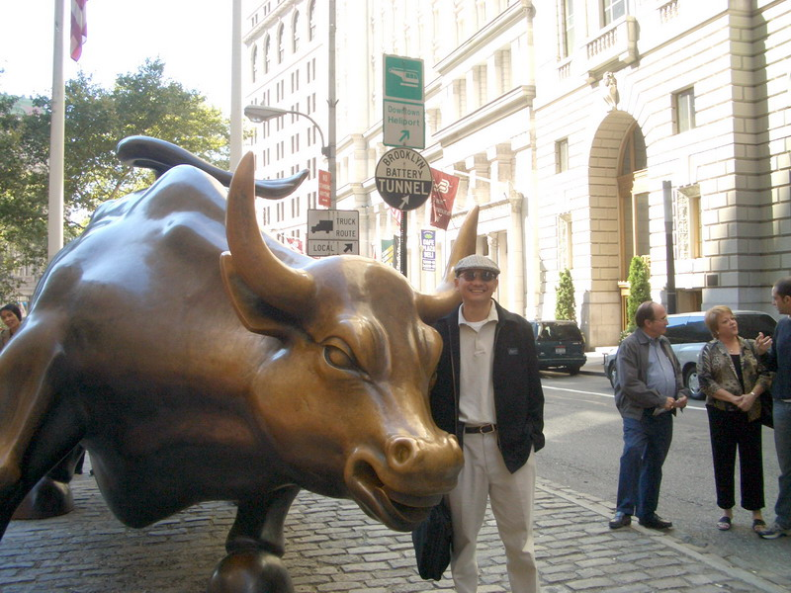
End of Chapter 10
ขอให้ทุกคนทำได้ ดีดี ในการสอบไล่
End of Thermodynamics 1
Wall Street, New York, USA

