Slide 1
Chapter 6 ENTROPY
Reference: Sonntag R.E., and Van Wylen G.J., Introduction to Thermodynamics: Classical and Statistical, 3rd Ed., John Wiley & Sons, 1991
Assoc.Prof.Sommai Priprem, PhD.
Department of Mechanical Engineering
Khon Kaen University

Slide 2
Introduction
Last chapter: 2nd Law apply to CYCLE
This chapter: 2nd Law apply to PROCESS
1st law deal with Energy and its Conservation
2nd law deal with Entropy, it is not conserved

Slide 3
Topics
Inequality of Clausius
Entropy
Entropy of pure substances
Entropy Change during Reversible Process
Two Important thermodynamic Relations
Principle of Increase of Entropy
Entropy change of solids and Liquids
Entropy change of ideal gases
Isentropic Process of Ideal Gases
Second Law Efficiency and Isentropic Efficiency

Slide 4
Inequality of CLAUSIUS
Consider a Reversible Heat Engine
Theory: Q_{L} > 0; Q_{H}-Q_{L}= W_{rev}
T_{H} and T_{L} = constant
Source, T_{H}
Q_{H}
Heat Engine
W_{rev}
Q_{L}
Sink, T_{L}

Slide 5
Now consider an Irreversible Heat Engine which operates between the same T_{H} and T_{L} and receives the same Q_{H} but rejects Q_{L}’ and produce W_{irr}
Theory: Carnot Principle: η_{irr}<η_{rev}
Then W_{irr} <W_{rev} ;from Q_{H}-Q’_{L}= W_{irr ;} therefore Q’_{L} > Q_{L}
Source, T_{H}
Q_{H}
Heat Engine
W_{irr}
Q’_{L}
Sink, T_{L}

Slide 6
ENTROPY: A Property of a System
1
Consider Two Reversible Cycles A-B and A-C
A
B
C
2

Slide 7
Notes regarding eqn 6.2
สมการนี้ ใช้ได้กับ Reversible Process เท่านั้น ส่วนIrreversible process จะหา entropy change จากสมการนี้ไม่ได้
ค่าที่คำนวณได้เป็น entropy change ระห่าง state point 1 และ 2
Process ที่เปลี่ยนแปลงระหว่าง State 1-2 entropy change ย่อมเท่ากันไม่ว่า Process จะเป็น Reversible หรือ Irreversible Process ทั้งนี้เพราะ Entropy เป็น Property (ขึ้นกับ State Point เท่านั้น)

Slide 8
Entropy Change of a System during Irreversible Process
Consider Two Cycles
A-B = Reversible Cycle and A-C = Irreversible Cycle
1
A
B
C
2

Slide 9
The Entropy of a Pure Substance
reference value : assigned s_{f}
Water s_{f} = 0 at 0.01ºC
Refrigerants s_{f} = 0 at -40ºC
Determine values the same way as Other properties; u, h
See Tables
Mollier diagram: T-s and h-s diag.

Slide 10
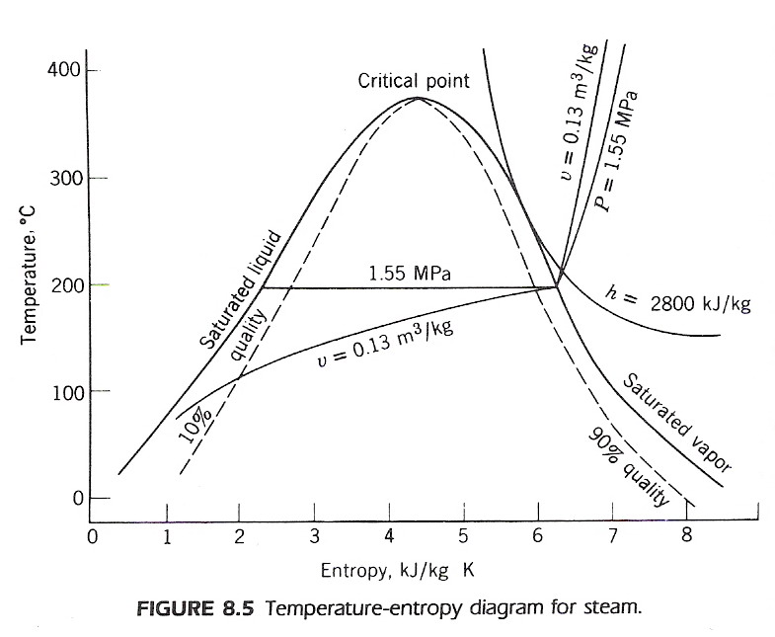
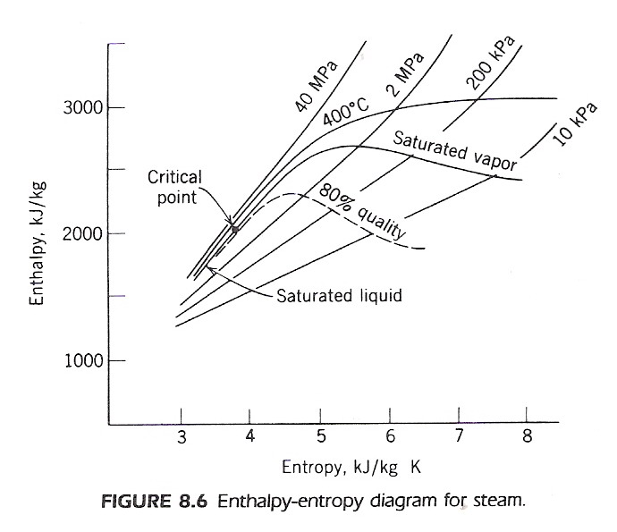
Mollier diagram
T-s diagram
h-s diagram

Slide 11
T-s Diagram
For reversible process:
Q = ∫Tds
Therefore,
AREA under T-s diagram
represented ₁Q₂
But not for an irreversible process
T
2
1
s₁
s₂
s

Slide 12
Entropy Change in Reverseible Process
T
3
1
2
P
Example: Heating sat. liquid ➔ superheated vapor
Process 1-2 phase change sat.liq ➔ sat.vap., T = constant
Integrate and apply 1st law ➔
q = h₂-h₁ = h_{fg}
Process 2-3 sat. vapor ➔ superheated vapor, T not constant, need relation between T and Q to perform integration
s₁
s₂
s₃
s

Slide 13
Example 8.1 Consider a cylinder fitted with a piston that contains saturate R-12 vapor at -10C. Let this vapor be compressed in a reversible adiabatic process until the pressure is 1.6 MPa. Determine the work per kilogram of R-12 for this process.
System: R-12.
Initial state: T₁> saturated vapor; state fixed. Final state: P₂ known.
Process: Reversible and adiabatic.
Model: R-12 tables.
Analysis:
First law, adiabatic:
₁q₂ = u₂ – u₁ + ₁w₂ = 0
₁w₂= u₁-u₂
Second law, reversible and adiabatic:
s₁ = s₂
T
2
P₂
P₁
1
s₁=s₂
s

Slide 14
Solution
From the R-12 tables,
u₁ = 166.40 kJ/kg
s₁ = s₂ = 0.7014 kJ/kgK
P₂ = 1.6 MPa
Therefore, from the superheat tables for R-12,
T₂ = 72.2°C, u₂ = 200.57 kJ/kg.
₁w₂ = u₁ – u₂ = 166.40 - 200.57 kJ/kg
= - 34.17 kJ/kg

Slide 15
Two Important Thermodynamics Relations
Consider a internally reversible CLOSED system; 1st Law
δQ = dU + δW
TdS = dU +PdV
T ds = du + Pdv .........(6.4)
but h = u + Pv ➔ dh = du + d(Pv)
dh = du + Pdv + vdP
substitute in (6.4)
Tds = dh – vdP .........(6.5)

Slide 16
Principle of Increase of Entropy
Surroundings,
temperature = T₀
δQ
System,
temperature = T
δW

Slide 17
Principle of
Increase of Entropy
Surroundings, T₀
Q
System, 1→2

Slide 18
Some Remarks about Entropy
Processes will occur only if ΔS_{total} ≥ 0
(Principle of Increase of Entropy)
Entropy is a nonconserved property;
increases for all ACTUAL process
S_{generation} ~ measure of magnitude of irreversibility

Slide 19
Principle of Increase of Entropy
ΔS_{isolated} ≥ 0
S_{gen}=ΔS_{total}=ΔS_{system}+ΔS_{surroundings} ≥ 0
> 0 ➔ Irreversible process
= 0 ➔ Reversible process
< 0 ➔ Impossible

Slide 20
ΔS = (∫δQ/T)_{rev.} สำหรับ reversible process
ΔS ≥ (∫δQ/T) สำหรับ irreversible process
ΔS = (∫δQ/T) + S_{gen} สำหรับ irreversible process
(∫δQ/T) = Entropy Transfer เกิดเมื่อมีการส่งผ่านความร้อน
S_{gen} = Entropy Generation เกิดเนื่องาก Irreversibility of process
Q = Heat transfer during the process
T = absolute Temp. @ boundary

Slide 21
EXAMPLE 8.2 Suppose that 1 kg of saturated water vapor at 100°C is condensed to a saturated liquid at 100°C in a constant-pressure process by heat transfer to the surrounding air, which is at 25°C. What is the net increase in entropy of the system plus surroundings?
Solution
For the system, from the steam tables,
ΔS_{system} = -ms_{fg} = -1 x 6.0480 = -6.0480 kJ/K
Concerning the surroundings, we have
Q _{to surroundings} = mh_{fg} = 1 x 2257.0 = 2257 kJ
ΔS_{surr} = Q/T_{o} = 298.15/298.15 = 7.5700 kJ/K
ΔS_{net} = ΔS_{system}+ΔS_{surr} = -6.0480 + 7.5700
= 1.5220 kJ/K
This increase in entropy is in accordance with the principle of the increase of entropy, and tells us, as does our experience, that this process can take place.

Slide 22
Entropy Change of a Solid or Liquid
Solid & Liquid ➔
Specific Heat = Constant
ΔV very small ➔ Δh~Δu ~ q
ds = (δQ/T)_{rev} ≅ du/T ≅ CdT/T
s₂-s₁ ≅ C ln(T₂/T₁)

Slide 23
EXAMPLE 8.3 One kilogram of liquid water is heated from 20°C to 90°C. Calculate the entropy change, assuming constant specific heat, and compare the result with that found when using the steam tables.
System: Water. Initial and final states: Known. Model: Constant specific heat, value at room temperature.
Solution
For constant specific heat,
s₂-s₁ = 4.184 ln (363.2/293.2) = 0.8958 kJ/kgK
Comparing calculation from value from table:
s₂-s₁ = s_{f@90C}-s_{f@20C}= 1.1925 – 0.2966
= 0.8958 kJ/kgK

Slide 24
Entropy Change of an Ideal Gas

Slide 25
1. To intrgrate Eqn.(6.10) and (6.12) we must know relations between Specific Heat and Temperature [See Table A.2(c)]
2. In case of CONSTANT SPECIFIC HEAT, they can be integrate:
3. Get sº from table : (sº = Δs at T with reference to T₀) ie, table A-17 to A-25 and the calculate from eqn.(6.16)

Slide 26
EXAMPLE 8.4 Consider Example 5.6, in which oxygen is heated from 300 to 1500 K. Assume that during this process the pressure dropped from 200 to 150 kPa. Calculate the change in entropy per kilogram.
Solution
Method 1. The most accurate answer for the entropy change, assuming ideal-gas behavior, would be from the ideal-gas tables, Table A.19. This result is, using Eq. 6.16, (ค่าที่ได้จากตารางจากต่างแหล่งอาจต่างกันได้เล็กน้อย)
S2 - S1 = (258.068 - 205.329) - 8.3144 ln(150/200)
= 52.739 + 2.392 = 55.131 kJ/kmolK
s₂-s₁ = 55.131/32 = 1.7228 kJ/kgK
Method 2. The empirical equation from Table A.2(c) should give a good approximation to this result. Integrating Eq. 6.12, we have
..................
S2 - S1 = 55.118 kJ/kmolK
s₂-s₁ = 55.118/32 = 1.7224 kJ/kgK (แตกต่างจาก แบบแรกเพียง 0.1 % เท่านั้น)

Slide 27
Method 3. For constant Cp at 300K Table A.2(a)
using Eq. 6.14, we have
s₂-s₁ = 0.9216 ln(1500/300) – 0.25983 ln(150/200)
= 1.4833+0.0747 = 1.558 kJ/kgK (low by 9% from Method 1)
Method 4. For constant Cp at 900K (avg.temp.) Table A.2(b)
using Eq. 6.14, we have
s₂-s₁ = 1.0714 ln(1500/300) – 0.25983 ln(150/200)
= 1.7991 kJ/kgK (high by 4.4% from Method 1)

Slide 28
EXAMPLE 8.5 Calculate the change in entropy per kilogram as air is heated from 300 to 600 K while pressure drops from 400 to 300 kPa. Assume: 1. Constant specific heat. 2. Variable specific heat.

Slide 29
Isentropic Process of Ideal Gases

Slide 30
Isentropic Process of Ideal Gases

Slide 32
Table A-17
for isentropic process of ideal gas only
Relative Pressure, P_{r}
Relative Volume, v_{r}

Slide 33
Reversible Polytropic Process of Ideal Gases

Slide 34
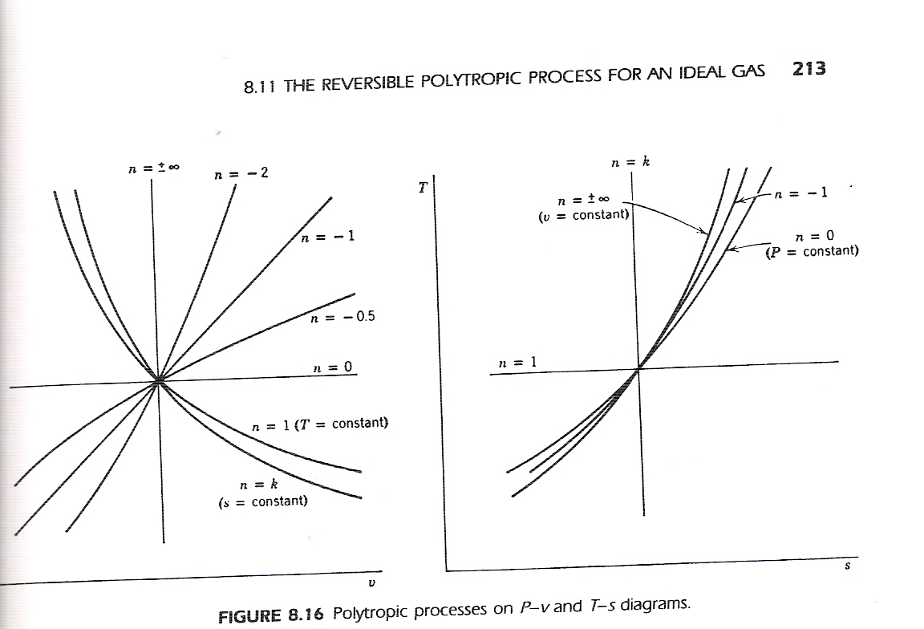
P

Slide 35
Example 8.7 In a reversible process nitrogen is compressed in a cylinder from 100 kPa, 20°C to 500 kPa. During the compression process the relation between pressure and volume is PV^{1.3} = constant. Calculate the work and heat transfer per kilogram, and show this process on P-v and T -s diagrams.
System: Nitrogen.
Assumption: Ideal gas
constant specific heat-value at 300 K.
Given:
Initial state: P₁ , T₁ ; state 1 known.
Final state: P₂ known
Process: Reversible, polytropic with exponent n =1.3
Diagram: P-v, T-s
Analysis: Boundary movement work. W=∫PdV
First law: ₁q₁ = u₂-u₁+₁w₁

Slide 36
P
T
2
Solution
polytropic process Pv^{n}=c ➔ (T₂/T₁) = (P₂/P₁)^{(n-1)/n}
T₂ = 293.2 ( 500/100)^{(1.3-1)/1.3} = 425 K
Boundary work for polytropic process of ideal gas;
₁w₂ = ∫Pdv =(P₂v₂ -P₂v₂)/(1-n) = R(T₂ -T₂)/(1-n)
= (0.2968kJ/kgK)(425-293.2)K/(1-1.3)
= -130.4 kJ/kg answer
First law: ₁q₁ = u₂-u₁+₁w₂ = C_{v}(T₂ -T₂) + ₁w₂
= 0.7448kJ/kgK(425-293.2)K + (-130.4)kJ/kg
= -32.2 kJ/kg answer
2
Area = Heat
Transfer
Area = Work
1
1
v
s

Slide 37
Second Law Efficiency

Slide 38
Isentropic Efficiency of Compressors
w
Compressor
h
P₂
T
P₂
2
2
h₂
T₂
2_{s}
Actual Process
2_{s}
Actual Process
h_{2s}
T_{2s}
w_{a}
Isentropic Process
w_{s}
P₁
Isentropic Process
P₁
h₁
T₁
1
1
s₁=s_{2s}
s₂
s
s₁=s_{2s}
s₂
s

Slide 39
Isentropic Efficiency of Turbines
T
P₁
Isentropic Process
2s
T₁
Actual Process
w
Turbine
P₂
T₂
T_{2s}
2
1
s₁=s_{2s}
s₂
s

Slide 40
Example 6-18 Steam enters an adiabatic turbine steadily at 3 MPa and 400C and leaves at 50 kPa and 100C. if the power output of the turbine is 2 MW and ΔKE and ΔPE are negligible, determine (a) the isentropic efficiency of the turbine and (b) the mass flow rate of the steam flowing through the turbine.
Solution
(a) η_{isen} = w_{a}/w_{s}
w_{a} = h₁- h₂
w_{s} = h₁- h_{2s}
state 1: P₁, T₁ known ➔ superheat
then h₁, s₁ known
state 2: P₂, T₂ known ➔ superheat
then h₂ known
state 2s: T₂ known
and isentropic process ➔ s_{2s} = s₁
➔ mixture
then h₂, known
........................
(b) from W_{dot} = m_{dot} w_{a}
P₁= 3 MPa
T₁= 400ºC
η_{isen} = ?
m_{dot} = ?
Turbine
w
P₂= 50 kPa
T₂= 100ºC
T ºC
1
400
P₁= 3 MPa
2
100
2_{s}
P₂= 50 kPa
s₁=s_{2s}
s₂
s

Slide 41
Example 6-19 Air is compressed by an adiabatic compressor from 100 kPa and 12C and to a pressur of 800 kPa at a stead rate of 0.2 kg/s. If the the adiabatic efficiency of the compressor is 80%, determine (a) the exit temperature and (b) the required power input to the compressor.
P₂= 800 kPa
T₂= ?
Solution
Assume Ideal gas : Pv = RT
Isentropic process : Pv^{k} = constant
k = C_{p}/C_{v}
Compressor
η_{isen} = 80%
m_{dot} = 0.2 kg/s
w_{dot} =?
P₁= 100 kPa
T₁= 12ºC
T
P₂
2
T₂
2_{s}
Actual Process
T_{2s}
Isentropic Process
P₁
T₁
1
s₁=s_{2s}
s₂
s

Slide 42
Summary

Slide 43
Inequality of CLAUSIUS
Source, T_{H}
Q_{H}
Heat Engine
W_{rev}
Q_{L}
Sink, T_{L}

Slide 44
ENTROPY

Slide 45
Two Important Thermodynamics Relations
Tds = du + Pdv
Tds = dh – vdP

Slide 46
Principle of Increase of Entropy
Surroundings,
temperature = T₀
Q
System,
temperature = T
W

Slide 47
Entropy Change of a Solid or Liquid
s₂-s₁ ≅ C ln(T₂/T₁)

Slide 48
Entropy Change of an Ideal Gas

Slide 49
Isentropic Process of Ideal Gases

Slide 50
Reversible Polytropic Process of Ideal Gases

Slide 51
Second Law Efficiency

Slide 52
Some Selected Problems

Slide 53
8.1 Consider a Carnot-cycle heat engine with water as the working fluid. The heat transfer to the working fluid takes place at 300°C; during this process the water changes from saturated liquid to saturated vapor. Heat is rejected from the working fluid at 40°C.
(a) Show this cycle on a T -s diagram.
(b) Calculate the quality of the working fluid at the beginning and at the end of the isothermal heat rejection process.
(c) Determine the net work output per kilogram of water and the thermal efficiency of the cycle.
8.2 Consider a Carnot-cycle heat pump with R-22 as the working fluid. Heat is rejected from the working fluid at 40°C. During this process the R-12 changes from saturated vapor to saturated liquid. Heat is transferred to the R-22 at O°C.
(a) Show this cycle on a T -s diagram.
(b) Calculate the quality of the working fluid at the beginning and at the end of
the isothermal heat addition process at O°C.
(c) Determine the coefficient of performance for the cycle.
8.3 A cylinder fitted with a frictionless piston contains ammonia at 50°C, 20 percent quality, and under these conditions the cylinder volume is 1 L. The ammonia expands slowly, and during this process heat is transferred to the system to maintain a constant temperature. The process continues until all the liquid is gone. Determine the work and heat transfer for this process.

Slide 54
8.4 An insulated cylinder fitted with a frictionless piston contains 0.1 kg of water at 100°C, 90 percent quality. The piston is moved, compressing the water until it reaches a pressure of 1.2 MPa. How much work is required in this process?
8.5 A cylinder containing R-22 at 10°C, 100 kPa, has an initial volume of 20 L. A piston compresses the R-22 in a reversible, isothermal process until it reaches the saturated vapor point. Calculate the required work and heat transfer needed to accomplish this change of state.
8.6 One kilogram of water at 300°C expands against a piston in a cylinder unril is reaches ambient pressure, 100 kPa, at which point the water has a quality of 90 percent. It may be assumed that the expansion is reversible and adiabatic.
(a) What was the initial pressure in the cylinder?
(b) How much work is done by the water?
8.7 A heavily insulated cylinder fitted with a piston contains ammonia at 10oC. The piston is moved, compressing the ammonia in a reversible process until the pressure reaches 2 MPa; at this point the temperature is 70°C. During the process 400 kJ of work is done on the system. What was the initial volume of the cylinder?

Slide 55
8.8 A rigid, insulated vessel contains superheated vapor steam at 1.8 MPa, 35OºC . A valve on the vessel is opened, allowing steam to escape. It may be assumed that at any instant the steam remaining inside the vessel has undergone a reversible, adiabatic expansion. Determine the fraction of steam that has escaped when the steam remaining inside the vessel reaches the saturated vapor line.
8.9 An insulated cylinder fitted with a frictionless piston contains 0.1 kg of superheated vapor steam. The steam expands to ambient pressure, 100 kPa, at which point the temperature of the steam inside the cylinder is 150°C. The steam does 50 kJ of work against the piston during this expansion. What were the initial pressure and temperature?
8.12 We wish to cool a given quantity of material rapidly to a temperature of l0°C. The process requires a heat rejection of 2000 kJ. One possibility is to immerse the material in a mixture of ice and water, allowing heat transfer from the material to the ice, which melts the ice. Another possibility is to cool the material by evaporating R¬22 at -20°C. The heat transfer to the R-22 changes it from a saturated liquid to a saturated vapor. A third possibility is to evaporate liquid nitrogen at 101.3-kPa pressure.
(a) Calculate the change of entropy of the cooling medium for each of the three
cooling techniques.
(b) Discuss the significance of these results.

Slide 56
6-105 Nitrogen gas is compressed from 80 kPa and 27°C to 480 kPa by a 10-kW compressor. Determine the mass flow rate of nitrogen through the compressor, assuming the compression process to be (a) isentropic. (b) polytropic with n = 1.3, (c) isothermal, and (d) ideal two-stage polytropic with n = 1.3.
Answers: (a) 0.048 kg/s, (b) 0.05 kg/s, (c) 0.063 kg/s, (d) 0.058 kg/s
Adiabatic Efficiencies of Steady-Flow Devices
6-106C Describe the ideal process for an (a) adiabatic turbine. (b) adiabatic compressor, and (c) adiabatic nozzle, and define the adiabatic efficiency for each device.
6-107C Is the isentropic process a suitable model for compressors that are cooled intentionally? Explain.
6-108C On a T-s diagram, does the actual exit state (state 2) of an adiabatic turbine have to be on the right-hand side of the isentropic exit state (state 2s)? Why?

Slide 57
6-109 Steam enters an adiabatic turbine at 8 MPa and 500°C with a mass flow rate of 3 kg/s and leaves at 30 kPa. The adiabatic efficiency of the turbine is 0.90. Neglecting the kinetic energy change of the steam, determine (a) the temperature at the turbine exit and (b) the power output of the turbine. Answers: (a) 69.1 QC, (b) 3052 kW
6-110 Steam enters an adiabatic turbine at 6 MPa, 600°C, and 80 m/s and leaves at 50 kPa, 100°C, and 140 m/s. If the power output of the turbine is 5 MW, determine (a) the mass flow rate of the steam flowing through the turbine and (b) the adiabatic efficiency of the turbine.
Answers: (a) 5.16 kg/s, (b) 83.7 percent
6-111 Argon gas enters an adiabatic turbine at 800°C and 1.5 MP at a rate of 80 kg/min and exhausts at 200 kPa. If the power output of the turbine is 370 kW, determine the adiabatic efficiency of the turbine.
6-113 Refrigerant-12 enters an adiabatic compressor as saturated vapor at 120 kPa at a rate of 0.3 m3/min and exits at 1-MPa pressure. If the adiabatic efficiency of the compressor is 80 percent, determine (a) the temperature of the refrigerant at the exit of the compressor and (b) the power input, in kW. Also show the process on a T-s diagram with respect to saturation lines. Answers: (a)67.1°C, (b) 1.75 kW

Slide 58
6-114 Air enters an adiabatic compressor at 100 kPa and 17°C at a rate of 1.2 m3/s, and it exits at 257°C. The compressor has an adiabatic efficiency of 84 percent. Neglecting the changes in kinetic and potential energies, determine (a) the exit pressure of air and (b) the power required to drive the compressor.
6-115 Air is compressed by an adiabatic compressor from 95 kPa and 27C to 600 kPa and 277°C. Assuming variable specific heats and neglecting the changes in kinetic and potential energies, determine (a) the adiabatic efficiency of the compressor and (b) the exit temperature of air if the process were reversible.
Answers: (a) 81.9 percent, (b) 505.5 K
6-116 Argon gas enters an adiabatic compressor at 120 kPa and 30°C with a velocity of 20 m/s, and it exits at 1.2 MPa and 80 m/so If the adiabatic efficiency of the compressor is 85 percent, determine (a) the
exit temperature of the argon and (b) the work input to the compressor.

Slide 59
End of Chapter 6

