Slide 1
VIRTUAL REALITY (ความเป็นจริงเสมือน)
Pitipong Pimpiset

Slide 2
Lecture 03 Basic knowledge of virtual reality environments
VIRTUAL REALITY

Slide 3
What do we learn today?
Types of Virtual Reality
Hardware (Virtual Reality Devices)
Software
Application

Slide 4
Types of Virtual Reality
Adventure games, MUD/MOO
Textually described virtual worlds where the user perceives the virtual environment through mental images based on the words read (like reading a novel).
Desktop
3D virtual environment graphically displayed on a desktop computer monitor.

Slide 5
Types of Virtual Reality
Projected
3D environment projected onto a screen. It enables a single user to demonstrate concepts to a group of people. A CAVE(tm), where several screens are used to surround the user with images, is the most advanced form of projected VR in use today.

Slide 6
Types of Virtual Reality
Semi-immersive
Most advanced flight, ship and vehicle simulators are semi-immersive. The cockpit, bridge, or driving seat is a physical model, whereas the view of the world outside is computer-generated (typically projected).

Slide 7
Types of Virtual Reality
Immersive
It is the 3D environment seen through a head-mounted display (HMD). In a completely immersive system the user feels part of the environment (experiences a feeling of 'presence'). The user has no visual contact with the physical world.

Slide 8
Hardware devices used in VR
VR requires more resources than standard desktop systems do. Additional input and output hardware devices and special drivers for them are needed for enhanced user interaction. But we have to keep in mind that extra hardware will not create and immersive VR system. Special considerations by making a project of such systems and special software are also required [1]

Slide 9
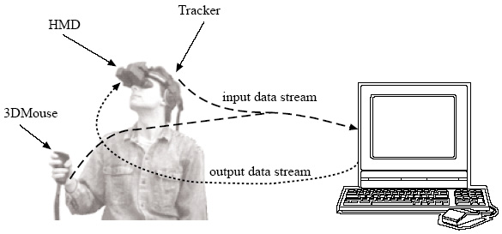
Hardware devices used in VR

Slide 10
Input and output
Considered input are
update rate – defines how many measurements per second (measured in Hz) are made.
Higher update rate values support smoother tracking of movements, but require more processing.
latency – the amount of time (usually measured in ms) between the user’s real (physical)
action and the beginning of transmission of the report that represents this action. Lower
values contribute to better performance.
accuracy – the measure of error in the reported position and orientation. Defined generally
in absolute values (e.g., in mm for position, or in degrees for orientation). Smaller values
mean better accuracy.
resolution – smallest change in position and orientation that can be detected by the tracker.
Measured like accuracy in absolute values. Smaller values mean better performance.
range – working volume, within which the tracker can measure position and orientation
with its specified accuracy and resolution, and the angular coverage of the tracker. Beside
these properties, some other aspects cannot be forgotten like the ease of use, size and
weight etc. of the device. These characteristics will be further used to determine the quality
and usefulness of different kinds of trackers.

Slide 11
Input and output
Most favorite output are…
CRT – cathode ray tube display
LCD – liquid crystal display
LED – light emitted diode

Slide 12
Most often used displays in VR
3D glasses
Surround displays
Binocular Omni Oriented Monitors (BOOM)
Head Mounted (Couples) Displays (HDM)
Haptic displays

Slide 13
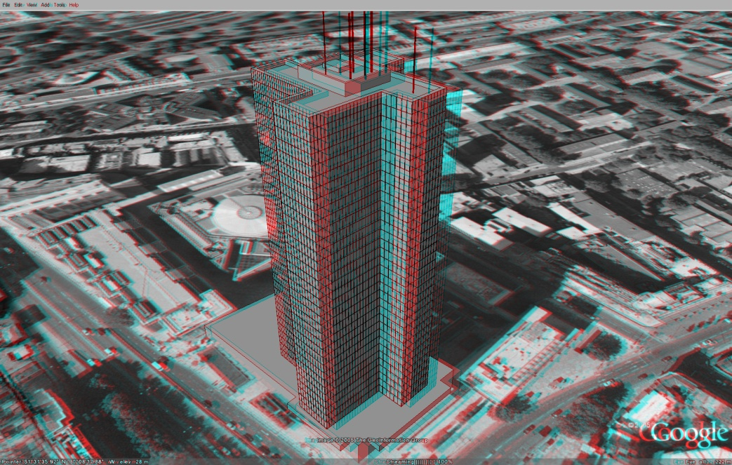
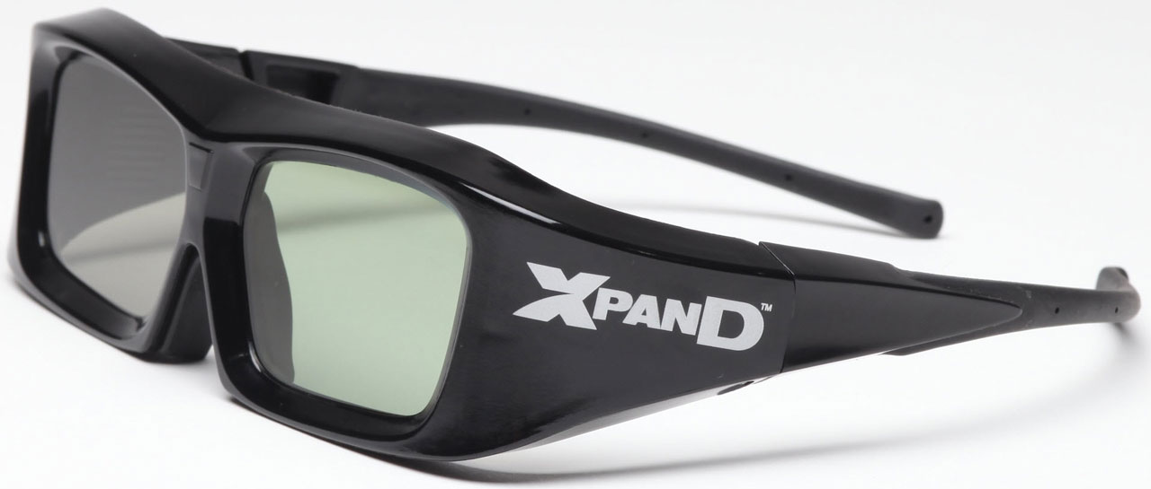
3D glasses

Slide 14
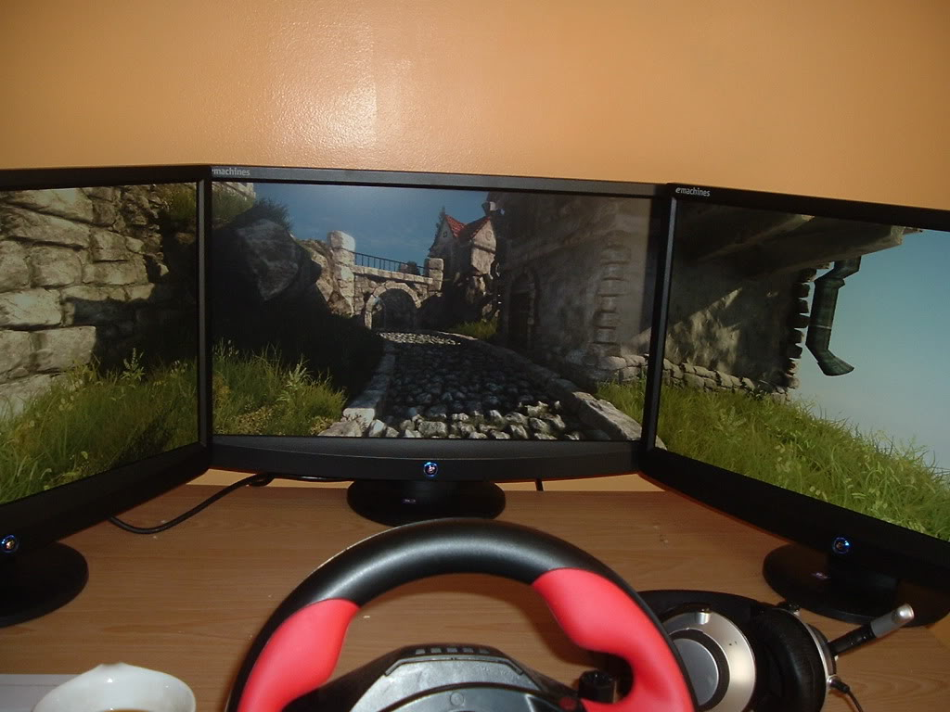
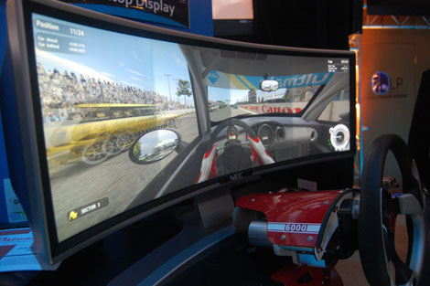
Surround displays

Slide 15
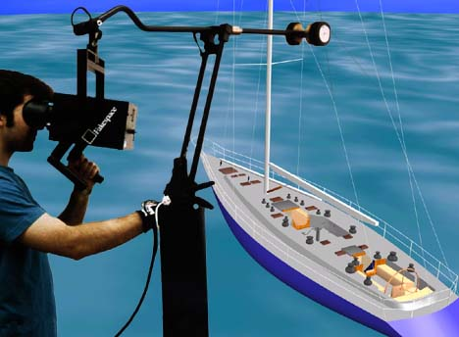
Binocular Omni Oriented Monitors (BOOM)
Boom supports both mechanical tracking and stereoscopic displaying technology. Two visual displays (for stereo view) are placed in a box mounted to a mechanical arm. The box can be grabbed by the user and the monitors can be watched through two holes. As the mechanical construction supports usually counter-balance, the displays used in the BOOMs need to be neither small nor lightweight.

Slide 16
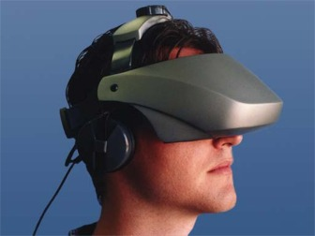
Head Mounted (Couples) Displays (HDM)
HMDs are headsets incorporating two small CRT or LCD monitors placed in front of the user’s eyes. The images are presented to the user based on his/her current position and orientation measured by a tracker.

Slide 17
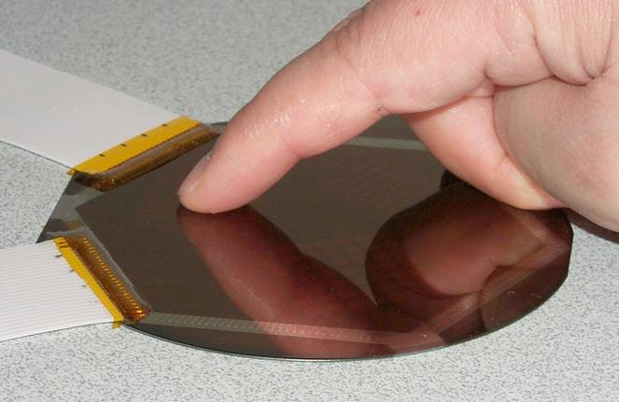
Haptic sensations perceived by humans can be divided into two main groups [2]
1. kinesthetic (force) feedback – forces sensed by the muscles, joints and tendons.
2. tactile feedback – includes feedback through the skin, like sense of touch, temperature,
texture or pressure on the skin surface

Slide 18
References
[1] Mazuryk, T. - Gervautz, M.: Virtual Reality: History, Applications, Technology and Future. Vienna University of Technology, Vienna.
[2] Austakalnis, S. - Blatner, D.: Real about Virtual Reality. Jota, Brno, 1994 (in Czech).

Slide 19
But before we leave….
Today’s activity is…

