Slide 1
VIRTUAL REALITY (ความเป็นจริงเสมือน)
Pitipong Pimpiset

Slide 2
Lecture 0 VRML - Virtual reality Modeling language
VIRTUAL REALITY

Slide 3
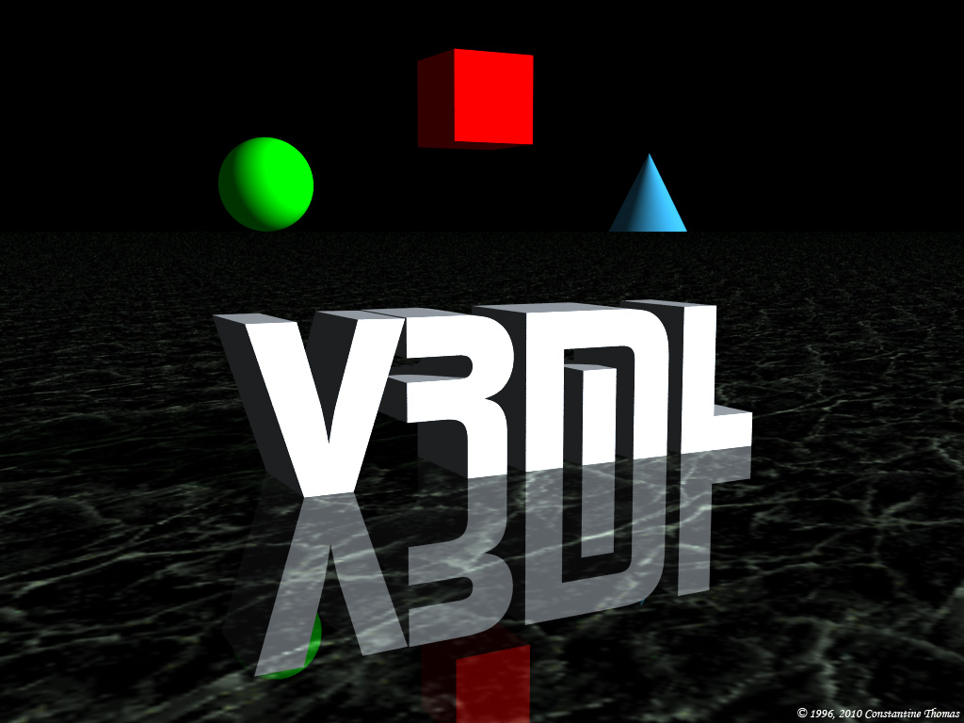
VRML - Virtual reality Modeling language

Slide 4
What is VRML?
VRML (Virtual Reality Modeling Language)
is a language for describing multi-participant interactive simulations -- virtual worlds networked via the global Internet and hyperlinked with the World Wide Web. All aspects of virtual world display, interaction and internetworking can be specified using VRML.

Slide 5
VRML History
http://www.scintillatinggraphics.com.au/VRMLmagic/VRMLInfo.html#history

Slide 6
It sounds like HTML, what’s the different?
HTML (Hypertext Markup Language)
HTML is a language for describing web pages.
HTML stands for Hyper Text Markup Language
HTML is a markup language
A markup language is a set of markup tags
The tags describes document content
HTML documents contain HTML tags and plain text
HTML documents are also called web pages
http://www.w3schools.com

Slide 7
But…
VRML is more than an extension of HTML.
Because…
It was created for different purpose.

Slide 8
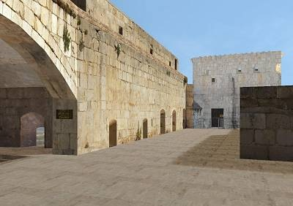
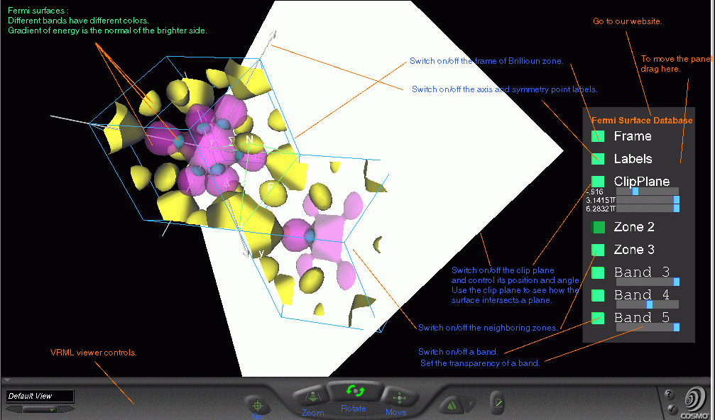
VRML
Purpose: The Virtual Reality Modeling Language is a file format for describing interactive 3D objects and worlds. VRML is designed to be used on the Internet, intranets, and local client systems. VRML is also intended to be a universal interchange format for integrated 3D graphics and multimedia.

Slide 9
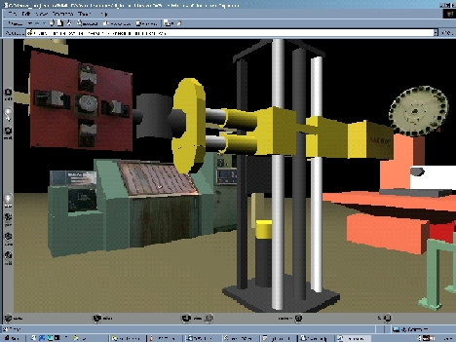
VRML
Use: VRML may be used in a variety of application areas such as engineering and scientific visualization, multimedia presentations, entertainment and educational titles, web pages, and shared virtual worlds.

Slide 10
Examples
http://www.youtube.com/watch?v=XLvblD6QQdk
http://www.youtube.com/watch?v=fmY1Oqc54ro&feature=related
And more on YouTube !

Slide 11
To be honest…
VRML is an outdated technology !

Slide 12
But…
We are not going to do anything with VRML because this is just an introduction to get you to know what VRML is ☺

Slide 13
So…
What shall we do then?

Slide 14
Activity
Today’s activity…
Imagine if you are the best VRML coder in this century and you want to invent the best Virtual Reality. What do you want to do?
Write down or draw your idea into an A4 paper (please make it easy to understand/read ☺)

