Slide 1
VIRTUAL REALITY (ความเป็นจริงเสมือน)
Pitipong Pimpiset

Slide 2
Lecture 0 Motion CAPTURE
VIRTUAL REALITY

Slide 3
Watch this !
Final Fantasy spirits within

Slide 4
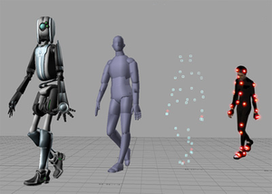
Motion Capture

Slide 5
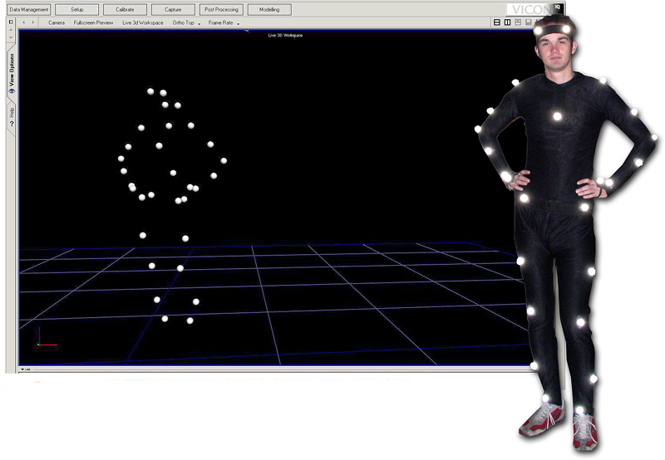
What is Motion Capture?
Motion Capture
is the specific way to capture motion of (human) actor such as,
Whole body
Upper body
Face

Slide 6
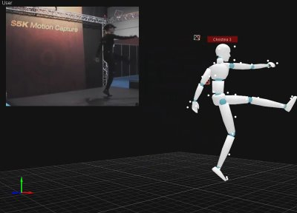
More generally…
Motion Capture or Mocap is the process of recording the movement of objects or people. It is used in various industries like entertainment (film making, game), sports or medical applications.

Slide 7
History of Mocap
The idea of copying human motion for animated characters is not new. In the late 1970’s, Disney’s Snow White was the first movie that traced animation over film footage of live actors playing out the scenes. This method, called “rotoscoping” has been successfully used for human characters ever since. For more in-depth information
http://www.siggraph.org/education/materials/HyperGraph/animation/character_animation/motion_capture/history1.htm

Slide 8
Principle
Capture movements or postures in the real world
actor (body, hands, face)
puppet (body)
Extract relevant data
Use data
Map the movements to a synthetic creature
Execute commands

Slide 9
How it works
This workflow based on the Mocap system from Motion Analysis http://www.motionanalysis.com/
Set up the system (Camera, performing area)
Calibrate the system (avoid any reflectable surface, light source)
Create template for any motion
Clean up the captured data and save as a useable format
Start mocaping !

Slide 10
Then…
Import it to Motion Builder
Import your character and make some adjustment to both data and character
Finally you will get the lively character !
http://www.youtube.com/watch?v=1wK1Ixr-UmM

Slide 11
Types of Mocap
Magnetic
Mechanical
Optical

Slide 12
Magnetic

Slide 13
How it works?
Source and sensors
emit and receive magnetic fields
Electronic control unit
computes positions and orientations
Server/driver
sends the data to the computer(s)
one channel/sensor
Tracks (one/variable)

Slide 14
Magnetic
This approach has a central magnet with several receivers attached to the actor’s body. The receivers capture and record the actors movements and save them to the computer. This motion capture method can be hindered by nearby metal objects if they are large enough and depending on the power of magnets being used.

Slide 15
Advantages & Disadvantages
Advantages
Disadvantages
Position and orientation
Minimal device calibration
Real-time
Cheap ($40000)
Limited range
10-15 m2
Sensitivity to metal
Encumbrance
Sampling rate

Slide 16
Mechanical Motion Capture

Slide 17
Mechanical Motion Capture
Subject wears an exoskeleton
No interference from light or magnetic field
No marker confusions
No range limit
Some restriction of movement
Absolute position is unknown

Slide 18
Optical
Use retro-reflective markers
circular stickers
small spheres
Cameras
facial animation: 1
body animation: 2-6
Postprocessing of images

Slide 19
Optical body tracking: practice
20-30 markers
Points of interest
hips, elbows, knees,...
head (3 markers)
Images are postprocessed (tracking)

Slide 20
Advantages & Disadvantages
Advantages
Disadvantages
Large active area
Unemcumbered actor
Markers are passive
High enough sampling rates
Cost ($150,00 - 250,000)
Sensitivity to light
Sensitivity to reflections
Marker occlusions
Tracking time
Positions only
Sensitivity to calibration

Slide 21
Production Pipeline of Motion Capture
Sensor Calibration
Subject Calibration
Record Movements
Compute the position and orientation of camera/transmitter
Place markers on body, compute skeleton structure(lengths of links)
Marker positions (and orientations) varying over time
Convert to Joint Angles
Marker Data Cleanup
Mapping to characters
Occlusion and correspondence problems
Direct Mapping or retargetting
Occlusion and correspondence problems

Slide 22
Sources of errors
Magnetic sensors
Calibration
Trackers not rigidly fixed

Slide 23
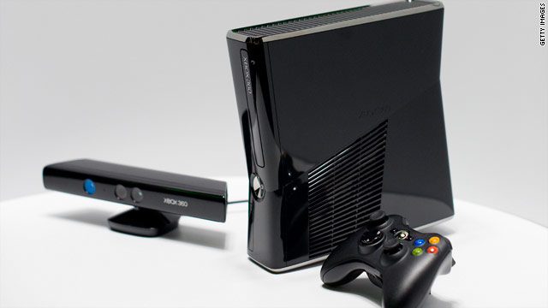
So… what if you want to play with Mocap
http://www.youtube.com/watch?v=p2qlHoxPioM
http://www.youtube.com/watch?v=pPt_944t9Lcb
http://www.youtube.com/watch?v=pEreBbkL3fU

Slide 24
References
www.siggraph.org
www.motioncapturesociety.com
www.motion-capture-system.com

Slide 25
Activity
Today’s activity…
Watch a provided video about Mocap and make a summarize about it.
What do think of this technology? Does it help us to create animation easier?
If you are able to use this technology to create something, what will you do?

