Slide 1
VIRTUAL REALITY (ความเป็นจริงเสมือน)
Pitipong Pimpiset

Slide 2
Lecture 0
3d animtion & Virtual reality
VIRTUAL REALITY

Slide 3
What this video
http://www.youtube.com/watch?v=GGdWs90J4Qg
Then have a look at http://pitipongp.daportfolio.com/

Slide 4
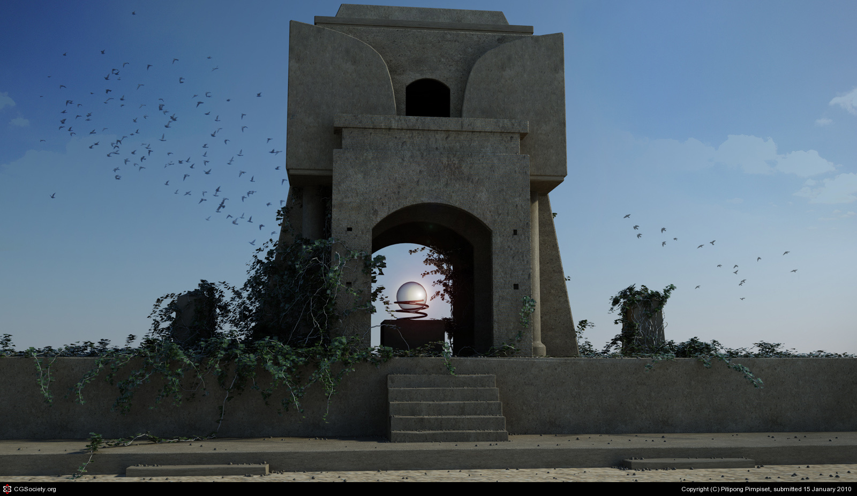
3D & VR

Slide 5
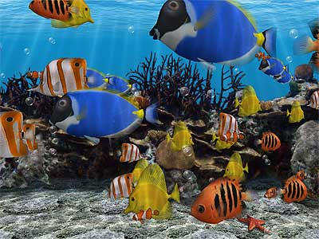
What is 3D?
Lets imagine we are looking through the front face of a cubic fish tank, with some goldfish swimming inside. The other sides, the top and the bottom of the tank are covered up. Our view into the tank shows the goldfish swimming up and down, turning, going behind a rock and moving behind and in front of one another.

Slide 6
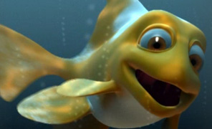
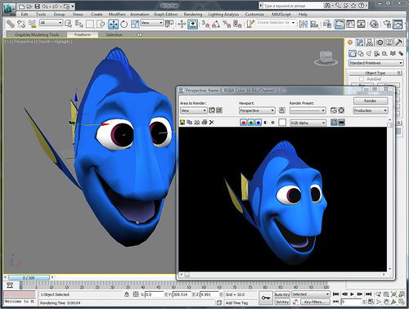
What is 3D?
As a fish turns we can see its left side and then its right side. If we are going to make an animation of the goldfish in the tank we need to know what the fish looks like from the left side, the right side and from any other point of view we care to choose.

Slide 7
Imagine if…
We are about to create a virtual environment without three-dimensional.
It is possible, but it is also impossible too !
That is why creating 3D becomes necessary in VR !

Slide 8
Okay, so what shall we doo then?
Let’s learn and do it !
But…
How do we begin?

Slide 9
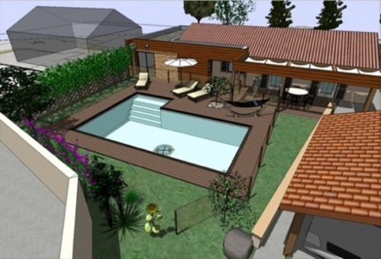
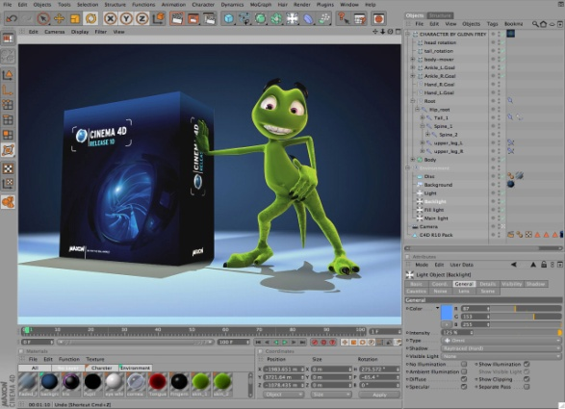

How do we begin?
Using appropriate tool such as
Autodesk 3ds max
Autodesk Maya
Cinema 4D
Blender (Free opensource)
Google SketchUp (Available for free download)
And more…

Slide 10
Let’s get to know these 3d software !

Slide 11
Alias Maya (Autodesk Maya)
3D conputer graphics software
Runs on Window, Mac OS and Linux
Originally developed by Alias systems coporation (formerly Alias|Wavefront) but currently owned and developed by Autodesk, inc.
It is used to create interactive 3D applications, including video games, animated film, TV series, or visual effects.
The product is named after the Sanskrit word Maya (माया māyā), the Hindu concept of illusion.

Slide 12


Maya

Slide 13
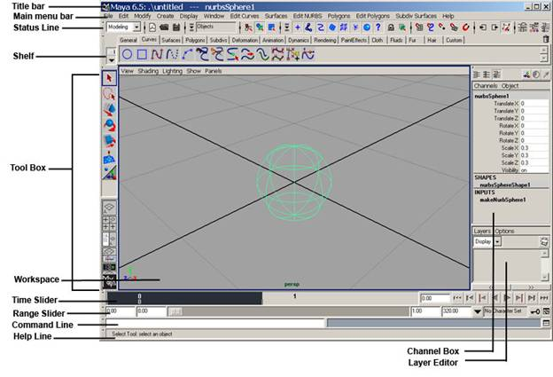
UI

Slide 14

Cinema4D
Free version available at http://www.maxon.net/products/general-information/general-information/student-versions.html

Slide 15
3D modeling, animation and rendering application
Developed by MAXON Computer, Germany
It is capable of procedural and polygonal/subD modeling, animating, lighting, texturing, rendering, and common features found in 3d modelling applications

Slide 16
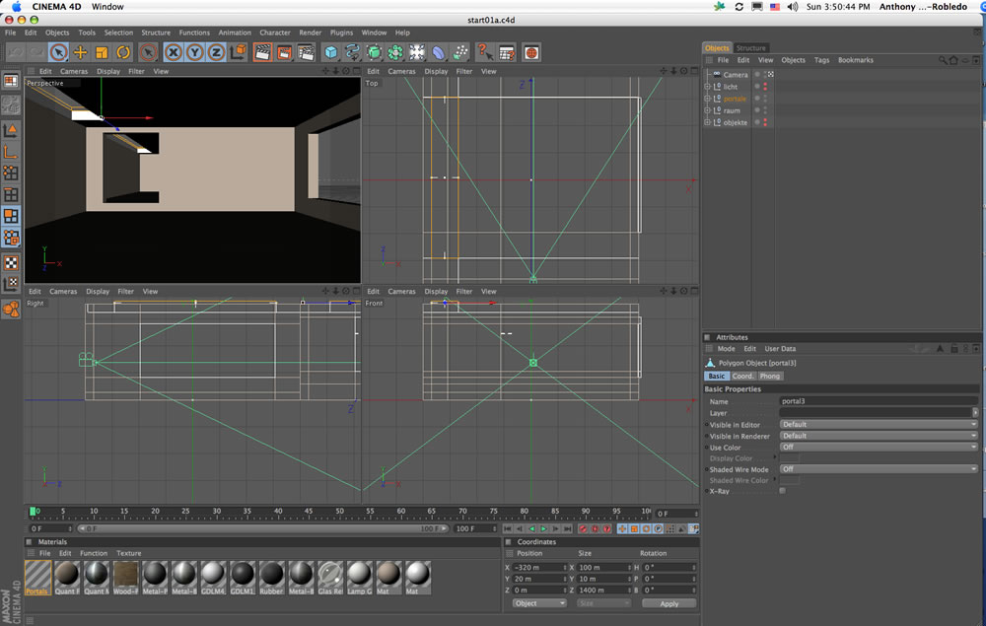
UI

Slide 17
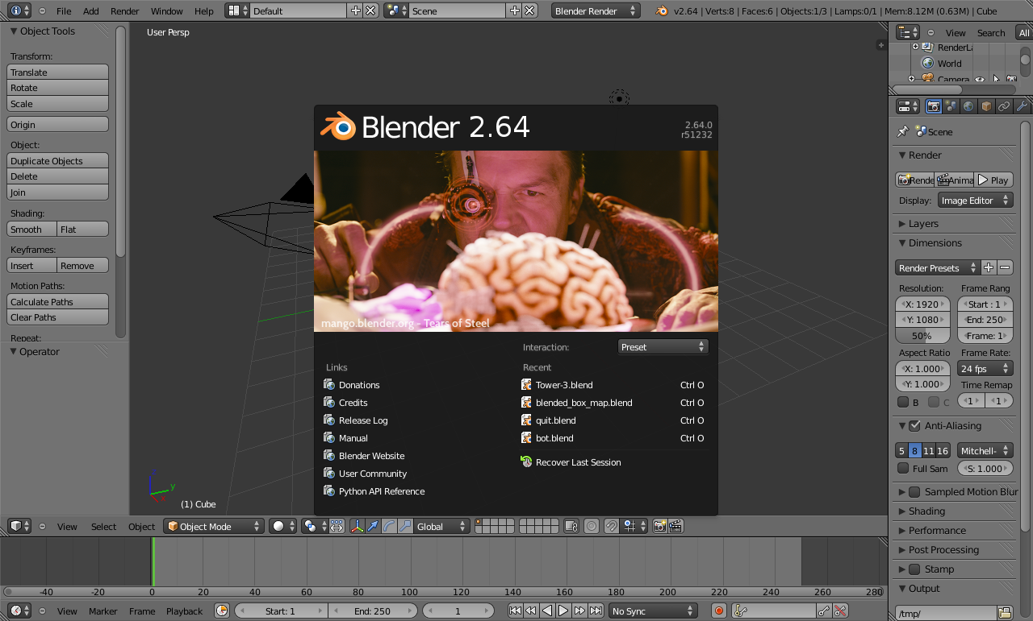
Blender
Free and it’s a full version! http://www.blender.org/

Slide 18
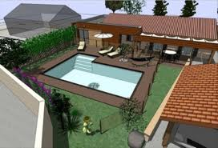
Google SketchUp
3D for Everyone!

Slide 19
Google SketchUp
Free version
Pro version
Re-imagine your living space
Model buildings for Google Earth
Use SketchUp for free
Build precise 3D models on the fly
Exchange files with other software
Create compelling 2D design documents
Generate reports, PDFs and more

Slide 20

We are about to learn…

Slide 21
What is Autodesk 3ds max?
Autodesk 3ds Max provides a comprehensive, integrated 3D modeling, animation, rendering, and compositing solution for game developers, visual effects artists, and motion graphics artists along with other creative professionals working in the media design industry.

Slide 22
Core features
Powerful 3D modeling—With an extensive polygon modeling and texture mapping toolset, you can create compelling characters, props, and environments more quickly and effectively.
Advanced character rigging and animation—The fully integrated Character Animation Toolkit (CAT) provides an out-of-the-box advanced rigging and animation system.

Slide 23
Core features
Accelerated rendering options—Create highly realistic or stylized looks at faster speeds with unlimited batch mental ray® rendering, interactive GPU hardware rendering with Quicksilver, and the NVIDIA® iray® renderer.
Extensible pipeline support—Customize, extend, and integrate 3ds Max into existing pipelines with support for C++ and .NET.
Adobe software interoperability—If you’re a creative professional in the media design industry who uses Adobe® After Effects® or Adobe® Photoshop® software, you can enjoy a level of interoperability that sets a higher standard for 2D/3D data exchange.
More in http://usa.autodesk.com/3ds-max/

Slide 24
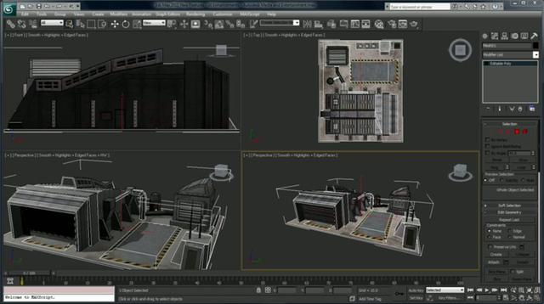
3Ds Max

Slide 25

So…
What are we waiting for?
Let’s have fun with 3ds max !!!
** Thanks for “Line” emoticon ☺

Slide 26
What we
See some works examples of mine at http://pitipongp.daportfolio.com
See provided 3ds max online tutorials.

Slide 27
Activity
Today’s activity…
  Explore 3ds max’s user interface.
  Learn how to control perspective/camera movements in 3ds max
  Learn how to create simple geometries such as box, sphere, cone and etc.
  Be able to create simple scene/character

