Slide 1
Groups and teams
Ashira Hiruntrakul Ph.D.

Slide 2
What is a Group?
Definition:
Two or more individuals who are connected to one another by social relationships.
Size: dyads and triads to large collectives (this class, mobs, audiences)
Connected: members are linked, networked
Social, interpersonal connection: not categorical

Slide 3
What is a Group or Team?
Group
a collection of people who follow similar work rules and norms and work towards a common, specific, and measurable goal

Slide 4
Types of Groups
Perceiving groups: people intuitively draw distinctions between intimate groups, task-focused groups, loose associations, and more general social categories.
Billions of groups in the world, but they can be classified into basic categories, or clusters
How are groups classified?

Slide 5
Types of Groups
Cooley (1909) drew a distinction between primary and secondary groups
Types of groups:
Primary
Secondary
Planned (concocted and founded)
Emergent (circumstantial and self-organizing)

Slide 6
Types of Groups (cont’d)
Type of Group
Characteristics
Examples
Primary groups
Small, long-term groups characterized by face-to-face interaction & high levels of cohesiveness, solidarity, & member identification
Families, close friends, tight-knit peer groups, gangs, elite military squads
Secondary groups
Larger, less intimate, more goal-focused groups typical of more complex societies
Congregations, work groups, unions, professional associations
(Cooley, 1909)

Slide 7
Types of Groups (cont’d)
Arrow and her colleagues (2000) offer a more fine-grained analysis
planned vs. emergent
Concocted
Founded
Circumstantial
Self-Organizing

Slide 8
What are some common characteristics of groups?
Interaction: task and relationship
Interdependence: sequential, reciprocal, mutual
Structure: roles, norms, relations
Goals: generating, choosing, negotiating, executing

Slide 9
Characteristics of Groups - Interaction
Groups are systems that create, organize, and sustain interaction among members
Task Interaction – actions performed by individuals pertaining to group’s tasks and goals
Relationship Interaction – actions performed by the group relating to emotional and interpersonal bonds

Slide 10
Characteristics of Groups - Interdependence
Experiences are determined by other members of the group and vice versa
Sequential – influence of one member to the next.
Reciprocal – two or more members may influence each other
Multilevel – the outcome of larger groups are influenced by the activities of smaller groups

Slide 11
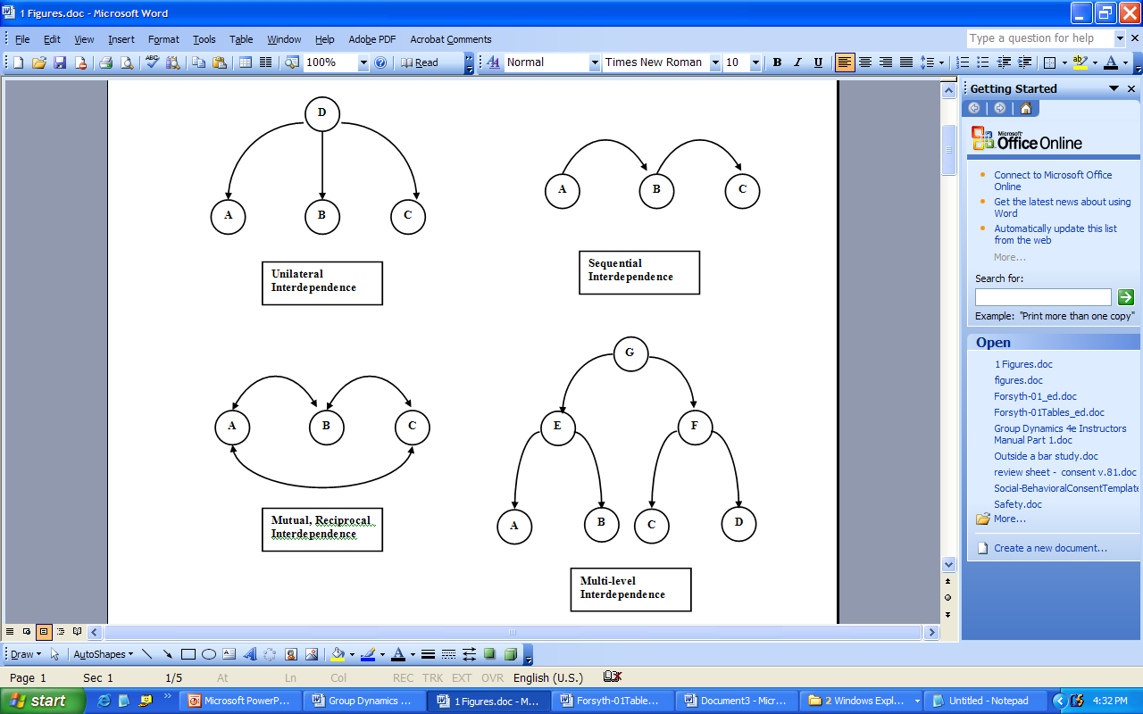
Interdependence Diagram

Slide 12
Characteristics of Groups - Structure
Groups’ structure are often organized in predictable patterns
Roles – set of behaviours expected of people who occupy certain positions
Norms – a consensual standard that describes what behaviours should and should not be performed in a given context

Slide 13
Characteristics of Groups - Goals
Groups often strive towards some common outcome
McGrath’s Circumplex Model of Group Tasks
Generating
Choosing
Negotiation
Executing

Slide 14
Cohesiveness
Group Cohesion: the strength of the bonds linking individuals to the group
Attraction to specific group members and efforts to achieve goals
Entitativity is perceived groupness rather than an aggregation of independent, unrelated individuals

Slide 15
Cohesiveness
Campbell’s Theory of Entitativity (1958)
Common Fate – do individuals experience the same outcomes?
Similarity – do individual perform similar behaviours or resemble one another
Proximity – how close together are the individuals in the group

Slide 16
Group Development
Groups are living systems: Tuckman's (1965) theory of group development
forming
storming
norming
performing
adjourning

Slide 17
Stages in Group Development
Forming
before individuals see themselves as a team
feels difficult, anxious, unsure
Storming
challenge the leader
Hostility, aggression, emotions high
Norming
organise tasks
co-operating, secure, comfortable
Performing
work surges ahead, people perform well
openness, mutual trust and support, enthusiasm, inspiration

Slide 18
Performing
Task
Norming
Storming
Adjourning
Forming

Slide 19
Team Processes: Stages of Development
Norming
Performing
Adjourning

Slide 20
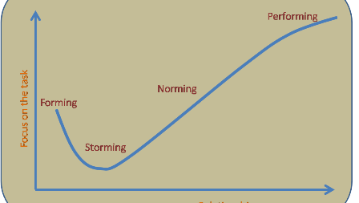
Stages of group formation

Slide 21

Group Development Process
Stage 1: Forming
Group members tend to be uncertain and anxious about their roles, the people in charge and the group’s goals
Mutual trust is low
Notes:
Stage 1: Forming
Group members tend to be uncertain and anxious about their roles, the people in charge and the group’s goals
Mutual trust is low

Slide 22
Group Development Process
Stage 2: Storming
Time of testing
Individuals try to determine how they fit into the power structure
Procrastination may occur
Notes:
Stage 2: Storming
Time of testing
Individuals try to determine how they fit into the power structure
Procrastination may occur

Slide 23
Group Development Process
Stage 3: Norming
Questions about authority and power are resolved through unemotional, matter-of-fact group discussion
Group cohesiveness
a “we feeling” binding group members together
Notes:
Stage 3: Norming
Questions about authority and power are resolved through unemotional, matter-of-fact group discussion
Group cohesiveness
a “we feeling” binding group members together

Slide 24
Group Development Process
Stage 4: Performing
Activity focused on solving task problems
Climate of open communication, strong cooperation, and lots of helping behavior
Notes:
Stage 4: Performing
Activity focused on solving task problems
Climate of open communication, strong cooperation, and lots of helping behavior

Slide 25

Group Development Process
Stage 5: Adjourning
Work is done
Time to move on to other things
Notes:
Stage 5: Adjourning
Work is done
Time to move on to other things

Slide 26
Group Member Roles
Roles
expected behaviors for a given position
Task roles
Enable the group to define, clarify, and pursue a common purpose
Maintenance roles
Foster supportive and constructive interpersonal relationships
Keep the group together
Notes:
Roles
expected behaviors for a given position
Task roles
Enable the group to define, clarify, and pursue a common purpose
Maintenance roles
Foster supportive and constructive interpersonal relationships
Keep the group together

Slide 27
Group Dynamics
… the "field of inquiry dedicated to advancing knowledge about the nature of groups"
(Cartwright & Zander, 1968)

Slide 28
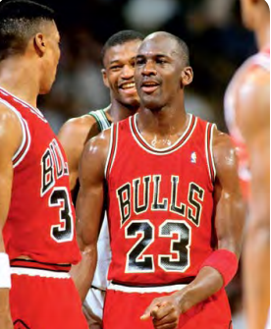
Group Dynamics
Michael Jordan once said ‘Talent wins
games; teamwork and intelligence wins
championships’. What do you think his opinion is on the importance of team cohesion

Slide 29
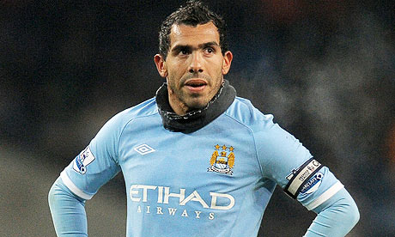
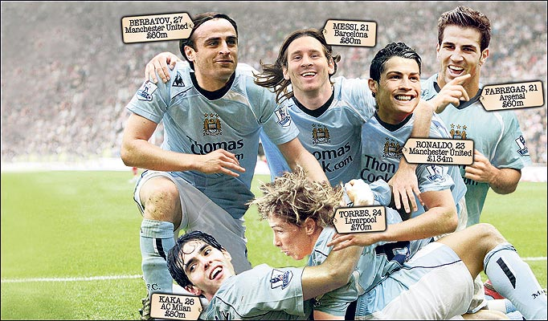
Stages of Group Dynamics
1. Forming
Group members familiarise themselves with other group members, get to know each other and try to decide if they belong in that group. In this stage you will work out members strengths and weaknesses, an will start to develop roles within the group. Formal leaders in the group tend to be directive during the forming stage.
2. Storming
Conflict begins to develop between individuals in group. It is common for individual or cliques to start to question the position and authority of the leader, and will start to resist control. The leader will help the team to move towards what is expected in terms of professional behaviour.
For Example:
Manchester City have publically gone through the stages of group development. New management, investment of money, new players, new captain etc
Notes:
7 netball
U14 basketball
U16 football

Slide 30
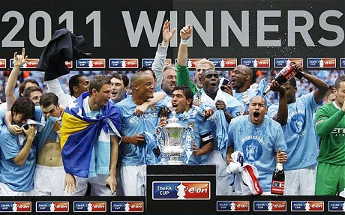
Stages of Group Dynamics
3. Norming:
The hostilities experienced in the storming stage is replaced by cooperation and cohesion . Group members start to work towards common goals rather than focusing on individual agendas and group cohesion begins to develop. As cohesion improves so does performance and group satisfaction because they will be achieving success.
4. Performing:
The team will be functioning effectively as a unit. The group works without conflict towards the achievement of shard goals and objectives. The group are more motivated and take responsibility for themselves.
TASK:
Explain how groups are formed.
Give a sports example to help with your explanation.

Slide 31
Steiner’s Model
ACTUAL = POTENTIAL - LOSSES DUE TO
PRODUCTIVITY PRODUCTIVITY FAULTY PROCESSES
(AP) (PP) (FP)
The team performance at any given time (due to successful interaction)
The maximum capability of the group when cohesiveness is strongest
Factors that go wrong in team performance which impede/ prevent group cohesion e.g. co-ordination losses & motivational losses
GROUP COHESION IS THE FORCE THAT BINDS A GROUP TOGETHER, HELPING TO PREVENT FAULTY PROCESSES.

Slide 32
Group Performance
Steiner presented a model to explain the relationship between an interactive group and it’s performance in sport.
Actual
Productivity
Potential
Productivity
Losses due to Faulty
Processes

Slide 33
Actual Productivity
is the result of group achievement – eg. the actual score of the game
Potential Productivity
is the group’s best possible performance given the resources & task demands. Eg. A tall basketball team should beat a smaller set of players.
Faulty Processes
Faulty processes are things that go pear shaped! It relates to the factors that can go wrong in team performance, which will impede or even prevent group cohesion and detract from the collective potential of the team

Slide 34
Group Problems!
The group’s performance usually falls short of its potential because it is hard to get a perfect performance.
The key to success is to minimise these faulty processes, which include coordination losses & motivational problems.
There are 2 faulty processes that bring about losses in potential productivity.
1 - Co-ordination Losses (The Ringlemann Effect)
2 - Motivation Losses (Social Loafing)

Slide 35
Teams
Team
a small number of people with complementary skills who are committed to a common purpose, performance goals, and approach for which they hold themselves mutually accountable
Task groups that have matured to the performing stage
Notes:
Team
a small number of people with complementary skills who are committed to a common purpose, performance goals, and approach for which they hold themselves mutually accountable
Task groups that have matured to the performing stage

Slide 36
What is a Group or Team?
Team
a group of people who are jointly responsible for creating, managing, and changing work rules and norms to find better ways to achieve current and future goals

Slide 37
Teams
A group becomes a team when:
Leadership becomes a shared activity
Accountability shifts from strictly individual to both individual and collective
The group develops its own purpose or mission
Problem solving becomes a way of life, not a part-time activity
Effectiveness is measured by the group’s collective outcomes and products
Notes:
A group becomes a team when:
Leadership becomes a shared activity
Accountability shifts from strictly individual to both individual and collective
The group develops its own purpose or mission
Problem solving becomes a way of life, not a part-time activity
Effectiveness is measured by the group’s collective outcomes and products

Slide 38
Types of Groups and Teams
Functional team
people grouped together by virtue of their expertise, typically, by departments
Cross-functional team
a group of people from a company’s various functions who pool their talents to increase the organization’s efficiency and effectiveness

Slide 39
Types of Groups and Teams
Top management team
a group consisting of the top managers of a company’s major functions or business units
Virtual teams
teams whose members are connected by e-mail, the Internet, instant messaging, wireless laptops, and video conferencing

Slide 40
Team Building
Team building
catchall term for a host of techniques aimed at improving the internal functioning of work groups
Team-building workshops strive for greater cooperation, better communication, and less dysfunctional conflict.
Notes:
Team building
catchall term for a host of techniques aimed at improving the internal functioning of work groups
Team-building workshops strive for greater cooperation, better communication, and less dysfunctional conflict.

Slide 41
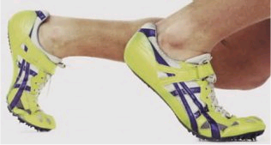
Introduction, History and Development
In social psychology, the heyday of experimental intragroup research ended by the 1980s
Primary topics included role differentiation, group structures and performance, social influence, communication and decision-making
Defining a Team:
Two or more interdependent individuals who influence one another through social interaction
Along with Interaction, teams defined by - Structure; Cohesiveness; Social Identity; Common Goals
Team tasks: Additive, Disjunctive, Conjunctive, Complementary, Discretionary
Primary distinction - Interactive vs. Co-active Sports

Slide 42
Introduction, History and Development
Individual performance in teams:
Dynamogism or social facilitation (Triplett, 1898)
Social loafing (Ringelmann, 1913)
Team dynamics:
Team cohesion (Carron, 1988)
Task vs social cohesion
Team maturity
Team identity

Slide 43
Introduction, History and Development
Teams in context:
Home vs Away
Home advantage may disappear later in competitions
Dependent on various factors (e.g. crowd size, noise, type of sport, evaluation)
Team roles:
Leadership roles
Playing position
Coaching styles
Role conflict & role ambiguity

Slide 44
Theories and
Models
Individual performance in teams
Social Facilitation
Various explanations, including Zajonc’s drive theory (mere presence), Cottrell (evaluation) & Baron (conflict)
Social Loafing
Competing theories, including Latane’s social impact theory
Integration
Harkins & Szymanski (1987); Mullen & Baumeister (1987) - both phenomena are related
Karau & Williams (2001) - collective effort model
Based on VIE theory, individual effort maximised with high personal involvement, evaluation, valued and well defined goals, unified team, collective efficacy

Slide 45
Theories and Models
Team dynamics
Defining:
Task cohesion (group integration) & Social cohesion (individual attraction)
More recently - perceptions of: group integration (task / social) and individual attractions to the group (task / social)
Cota et al (1995) - also include normative values, position on team
Antecedents:
4 sets of factors contribute to a highly cohesive team - situational, personal, leadership and team Consequences:
Need to consider not only team success but also individual perceptions
Conflicting research - cohesion may predict success but so may conflict
Task cohesion best predicts success not social cohesion

Slide 46
Theories and Models
Consequences:
Need to consider not only team success but also individual perceptions
Conflicting research - cohesion may predict success but so may conflict
Task cohesion best predicts success not social cohesion
Team maturity:
Stage model (forming, storming, norming, performing) (Tuckman, 1965)
More latterly, cycles of change (Arrow, 1997)

Slide 47
Theories and Models
Teams in Context
Home bias research largely atheoretical
More recently, explained with reference to self-attention and evaluation
Crowd density (not size) - collective effort model

Slide 48
Theories and Models
Team Roles
Contingency models of leadership, including:
Fiedler’s Contingency Model (situational control)
Vroom and Yetton’s Normative Model (decision making)
Hersey & Blanchard’s Situational leadership Theory (maturity of followers)
House’s Path-Goal Theory (motivation)
Chelladurai’s Multidimensional Model (sport specific)
Behaviour required of coach depends on sport, goals and environment
Actual behaviour depends on ability, knowledge and interpersonal skill
Preferred behaviour depends on characteristics of followers and situation

Slide 49
Theories and Models
Smith & Smoll’s Medianational Model
Relationship between coach behaviour, players’ perceptions and player response
Effects mediated by individual differences (gender, age, anxiety, confidence, etc) and situational factors (sport, competition, team success, cohesion)
Role Episode Model in Sport (Kahn et al)
Contextual and personal factors determine the relationship between role ambiguity and performance
Dynamic interplay between role sender (coach/captain) and focal person (athlete)

Slide 50
Methods and Measures
Individual performance in teams
Audiences: inactive or reactive
Co-actors (players) and regulators (officials): interactive or non-interactive
Team dynamics
Sport speciific scales include SCQ - 7 item; TCQ - 13 item; MCSI - 4 factors
Group Environment Questionnaire (GEQ) most popular
18 items, measuring 4 dimensions:
Attraction to the group (social) ATG-social
Attraction to the group (task) ATG-task
Group integration (social) GI-social
Group integration (task) GI-task

Slide 51
Methods and Measures
Teams in context
Input measures include audience characteristics, venue, sport type, stage of competition, team quality
Outcome measures include score configuration, assertiveness, aggression, fouling, sport-specific statistics
Team roles
Various measures of coach behaviour include:
Coaching Decision Style Questionnaire (CDSQ, based on Vroom & Yetton’s decision tree)
Coach Behaviour Description Questionnaire (CBDQ 20 items, 8 categories - training, initiation, interpersonal team operations, social behaviour, representation behaviour, organised communication, recognition, general excitement)

Slide 52
Methods and Measures
Team roles cont.
Leadership Scale for Sports (LSS 40 items, 5 subscales - training & instruction, autocratic behaviour, democratic behaviour, social support, positive feedback)
LSS administered in 2 forms (My coach is …; I prefer my coach to ….)
Individual differences (gender, age) reflect in preferred styles
Coaching Behaviour Assessment System (CBAS, 12 categories, 2 groups - reactive behaviour and spontaneous behaviour)
Children’s self-esteem shown to relate to preferred coaching styles
Arizona State Univ. Observation Instrument (ASUOI, 13 categories)

Slide 53

Social Loafing
Social Loafing
tendency for individual effort to decline as group size increases
Notes:
Social Loafing
tendency for individual effort to decline as group size increases

Slide 54
Reasons for Social Loafing
Equity of effort
Loss of personal accountability
Motivational loss due to sharing of rewards
Coordination loss as more people perform the task
Notes:
A number of
reasons explain this phenomenon, such as: (1) equity of effort (“Everyone else is goofing off, so why shouldn’t I?”), (2) loss of personal accountability (“I’m lost in the
crowd, so who cares?”), (3) motivational loss due to the sharing of rewards (“Why should
I work harder than the others when everyone gets the same reward?”), and (4) coordination
loss as more people perform the task (“We’re getting in each other’s way.”).

Slide 55
Social Loafing and Free Riding: Motivation Loss In Groups
The tendency for group members to exert less individual effort as the size of the group increases. Less effort found on:
Performance Task: A type of group task in which the coordinated efforts of several people are added together to form the group’s product
Adding performance of multiple people to compute department sales.
--Cognitive Tasks: Thinking of large number of solutions to a problem when working in a group—Brainstorming in a group
--Perceptual Tasks: Number of people watching a radar screen for hostile planes
--Problem Solving Tasks: Evaluation of a problem and generating a solution. Where to locate the new plant.

Slide 56
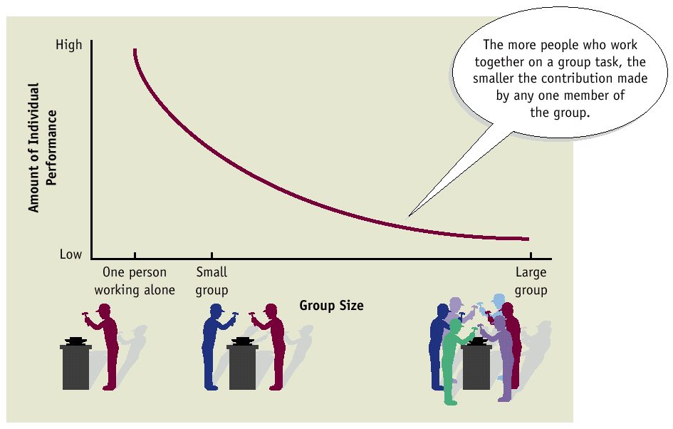
Antecedents of Social Loafing: Group Size

Slide 57
Free Riding—A person can receive the benefits of being in a team without exerting the effort.
A members of project group does not contribute but receives the same grade as the other members of the team, contributions to KERA.
On a disjunctive task-performance is determined by the best member of the team, other people free ride, example, expertise of team members well known, low expertise loaf.
On a conjunctive task, performance is determined by the low ability or skill member, people with more expertise will reduce their effort –interdependent task

Slide 58
Why Do People Loaf and Free Ride
Lack of Identifiability: When people share responsibility for a task and team member efforts are pooled together into a single group solution, it may be difficult to identify the contributions of each team member.
Diffusion of responsibility (less personal responsibility)
Rational analysis of cost of one’s effort and potential rewards.

Slide 59
Dispensability of Effort: feelings that my efforts are not important to the team, can not make a contribution—my perception or team member’s behavior

Slide 60
Other Reasons For Self-limiting Behavior- Low Motivation: Raising The White Flag
Compelling argument that is accepted
Meaningless decision—unimportant decision or disingenuous (no one listening)
Lacking confidence in one’s ability to communicate or accuracy of one judgments
Strong pressures from others to conform-not appear like a deviant, not lose approval
Other team members appear indifferent, unwilling to commitment themselves
Cycle of failure

Slide 61
Overcoming Social Loafing, Free Riding, Self Limiting Behavior
Make each team member’s contributions identifiable
Make individuals feel efforts are indispensable-personal responsibility
How do you do this?
Make work tasks more important and interesting
Reward individuals for contributing to their group’s performance

Slide 62
Overcoming Social Loafing, Free Riding, and Self-Limiting Behavior
Use group goal setting
Use a contract to bind team members
Increase cohesiveness of group—team members feel a sense of obligation
Notes:
in addition, performance has to be comparable to others, or against some standard in addition, performance has to be comparable to others, or against some standard
Members feel efforts are indispensable- make important contributions to the group effort.

Slide 63
Have the task provide team members with the chance to evaluate their performance or receive some feedback against some standard.
Increase Fairness of Decision of Making Processes
Pay Attention to Size of the Group
Monitor People (Accountable) and the Process (Problems)

Slide 64
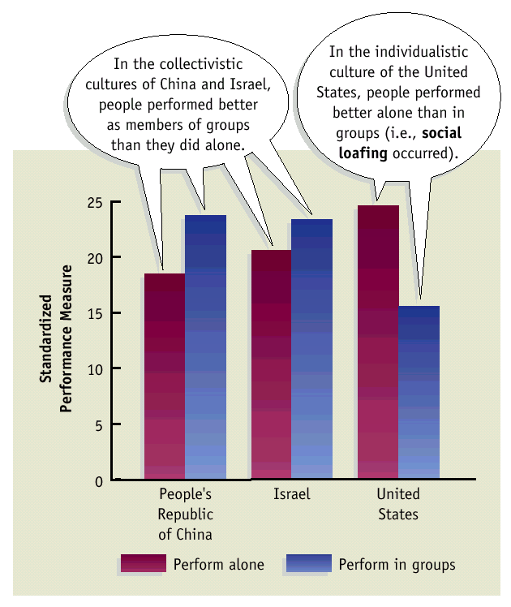
Social Loafing and Culture
Individualistic Cultures: National groups whose members place a high value on individual accomplishments and personal success.
Collectivistic Cultures: National groups whose members place a high value on shared responsibility and the collective good of all.

Slide 65
Social Loafing
Ways to avoid it:
Individual results
Fun jobs
Reward and evaluate individuals
Participation in goal creation
Etc…
…is only a problem when intrinsic motivation is low

Slide 66
Expectancy Theory & Social Loafing
Expectancy X Instrumentality X Valence
Effort Performance
Performance Outcome
Outcome Valence
These links are weaker on group tasks.

Slide 67
Reducing Social Loafing
Evaluation Potential
Task Meaningfulness or Importance
Cohesion
Group-Level Comparison Standards
Uniqueness of Personal Contribution
Task Difficulty
Smaller Group Size
Females Loaf Less
Eastern Cultures Loaf Less

Slide 68
Co-ordination Losses: The Ringleman Effect
Coordination losses involve bad timing or poor strategies.
The synchronisation of teamwork breaks down
Activities that require interaction are more prone to coordination problems.
More likely to occur as team numbers increase i.e. a basketball team is more likely to operate together successfully than a rugby union team
Excessive competition in sport can reduce the enjoyment & lead to a lack of coordination.
Ringlemann studied rope pulling & found that a group of 8 did not pull their rope 8 times as hard as 1 person.
There is less effort exerted when working with others.

Slide 69
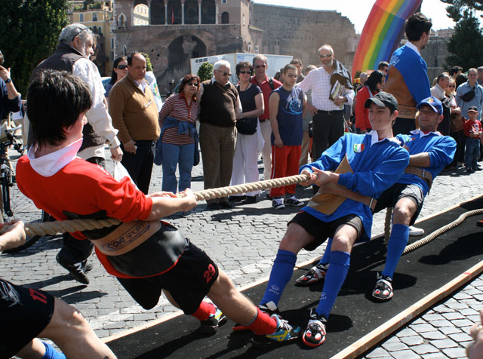
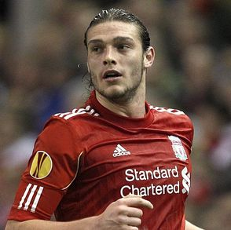
Motivational Losses (Social loafing)
Social loafing is the tendency of individual’s to drop their effort & hide within the group.
It is an individual motivation loss due to lack of performance identification.
Laziest Man alive!!!

Slide 70
Social loafing is caused by:
A belief that you effort won’t change the result
A perception that others are not trying, so why should you?
A belief that others will cover for your lack of effort
Individual effort not being recognised
Lack of reinforcement from others
Low confidence
Perceived low ability – Links to avoidance behaviour
Low arousal/motivation
Poor leadership
Negative attitudes
NOTE. . .
You need to be aware that social loafing is dysfunctional behaviour because it prevents effective teamwork. Notice the link between causes of social loafing, low self-confidence, negative attribution and avoidance behaviour.

Slide 71
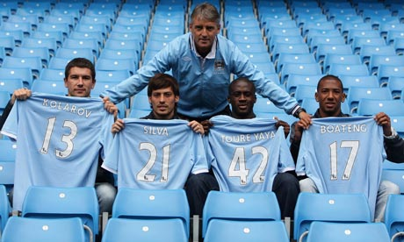
What can Coaches Do?
Highlighting individual performances
Monitoring individuals with feedback
Using positive reinforcement when possible
Promoting cohesion within the team
Setting individual goals
Giving specific roles
Support & encouragement of each other
Maintain team interest in common goals

Slide 72
Interactive & Coactive Groups
Interactive teams require team members to work with each other in order to achieve successful performance. Their successful performance is dependent on interaction and co-ordination between members.
Coactive teams require individuals to achieve success in their individual games, evens or performances to achieve overall team success. There is no direct interaction between team members during the performance.

Slide 73
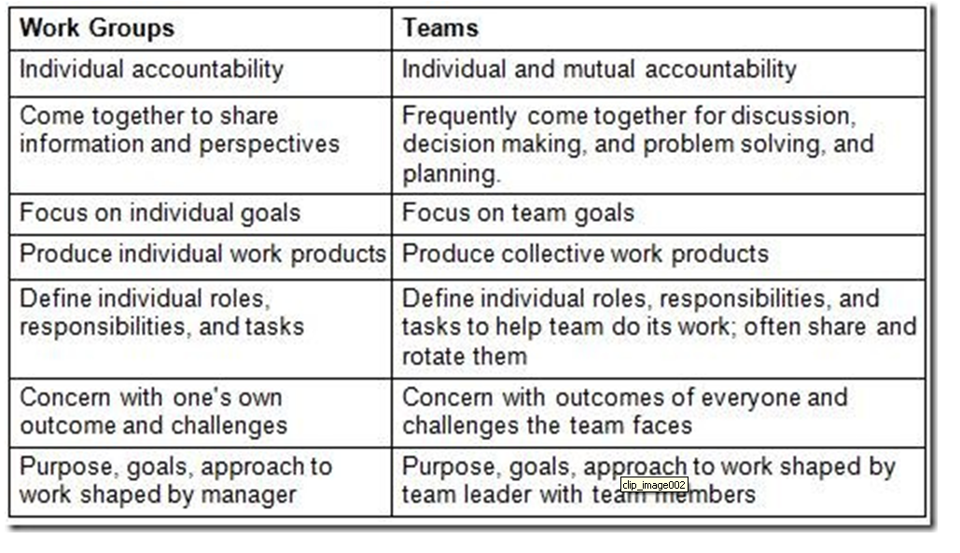
The Difference between Work Groups and Teams

Slide 74
6 Differences team/group
TEAM
GROUP
SIZE LIMITED MEDIUM or LARGE
SELECTION CRUCIAL IMMATERIAL
LEADERSHIP SHARED or ROTATING SOLO
PERCEPTION MUTUAL KNOWLEDGE FOCUS ON
UNDERSTANDING LEADER
STYLE ROLE SPREAD CONVERGENCE
CO-ORDINATION CONFORMISM
SPIRIT DYNAMIC INTERACTION TOGETHERNESS
PERSECUTION OF
OPPONENTS
Notes:
This slide can generate a lot of discussion within a country team. It’s main use is to point out that ‘shared or rotating’ leadership is a good thing. Many RCs still convene and chair every meeting of the CT - this should be discouraged and this slide can be used just to bring that out.
Similarly, in ‘Style’ the ‘role spread’ and ‘co-ordination’ is useful to point out that teams share these responsibilities.
As to ‘size’, Belbin maintains that a team can have a maximum of 15 members- anything more means you have a group. He also states that in sport, this is the largest number (rugby) for any team.

Slide 75
Team Processes: Socialization
Socialization: process of mutual adjustment that produces changes over time in the relationship between a person and a team.
How socialization works (Moreland & Levine, 2001):
Evaluation
Commitment
Role transition and phases of membership (investigation, socialization, maintenance, resocialization, remembrance)

Slide 76
Team Processes: Interpersonal Processes
Communication
Conflict
Cohesion
Trust

Slide 77
Team Processes: Shared Mental Models
Shared Mental Model:the cognitive processes held in common by members of a team regarding how they acquire information, analyze it, and respond to it.
What is shared (Cannon-Bowers & Salas, 2001)?
Task-specific knowledge
Task-related knowledge
Knowledge of teammates
Shared attitudes and beliefs

Slide 78
Team Processes: Shared Mental Models
Groupthink:a phenomenon associated with team decision making in which members feel threatened by forces external to the team, resulting in a deterioration in the cognitive processing of information.
3 Causes:
High level of cohesion
Structural organizational flaw
Proactive situational context

Slide 79
Groupthink Example
A board of directors of an international air freight service must decide whether the company should enter a cost-cutting war with their competitors. The board begins its decision-making meeting with the chairperson’s loaded questions: “Should we enter into this foolish price war or just keep rates the way they are?”

Slide 80
Team Processes: Decision Making
Multi-level theory of team decision making (Hollenbeck, LePine, & Ilgen, 1996):
Team informity
Staff validity
Dyadic sensitivity

Slide 81
Improving Team Decision Making
Assign the devil’s advocate role
Be open to dissenting points of view
Seek outside opinions
Break up into smaller groups
Rethink issues before making final decision
Use brainstorming

Slide 82
Virtual Teams
Virtual teams: Task-focused teams that meet without being physically present or working at the same time.
Defining Characteristics (Avolio et al., 2001):
Communication takes place electronically
Team members are dispersed geographically
Members may interact synchronously or asynchronously

Slide 83
Virtual Teams
Challenges:
Development of shared mental models
Evaluation of team results
Achievement of team cohesion
Problems with leadership

Slide 84
Intergroup Conflict
Causes:
Lack of resources
Goal incompatibility
Time compatibility
Influence tactics

Slide 85
Intergroup Conflict
Consequences:
Conflict changes group members’ perceptions of each other
Group becomes more cohesive
Strained interaction between the two groups
Argumentative behavior
Attitudes passed on to new members
Goals focus inward, away from organization as a whole

Slide 86
Overcoming Intergroup Conflict
Superordinate Goals: goals that both groups endorse and that often require cooperative intergroup behavior to be achieved
Getting 2 conflicting groups together by itself will not reduce conflict
Conflict can be reduced if members cooperate to achieve superordinate goals.

Slide 87
Overcoming Intergroup Conflict
One problem occurs in conflicting groups is that they do not communicate.
One strategy to overcome the conflict is to plan a negotiation between the 2 groups.
Negotiation:facilitates communication and is usually seen a a fair method of dispute resolution.

Slide 88
Overcoming Intergroup Conflict
Member exchanges: members of conflicting groups role play each other.
Intergroup team development: team activities to improve relationships between groups.

Slide 89
Overcoming Intergroup Conflict
Reducing need for intergroup interaction:
Create conditions in which two groups have little or no need to interact
Reduce interdependence among groups
The resource allocation process:
Ensure groups have similar resources
Allocate resources fairly

