Slide 1
Leadership
Ashira Hiruntrakul

Slide 2
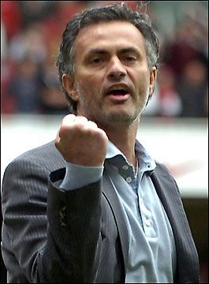
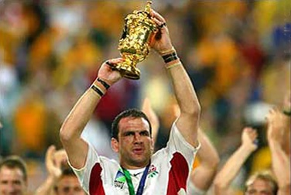
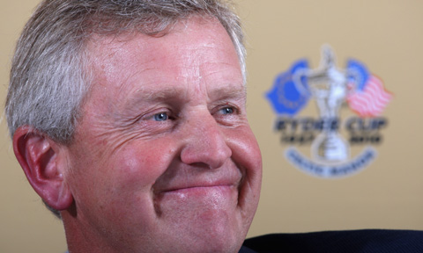
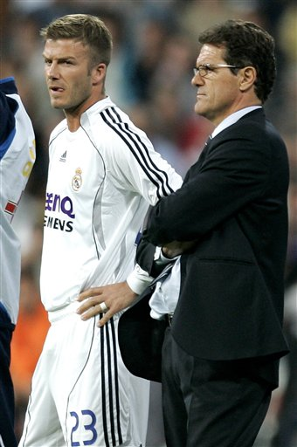
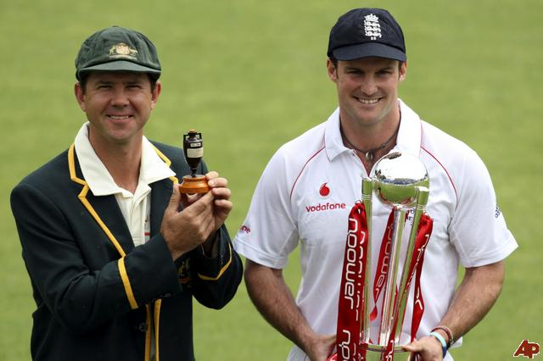
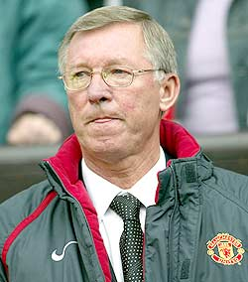
Leadership

Slide 3
Think of a leader in sport
What characteristics does this leader have?
Good Communicator | Good Decision Maker | Understands the needs of others
Experience | Vision | Ambition
Determination | Motivator | Highly skilled

Slide 4
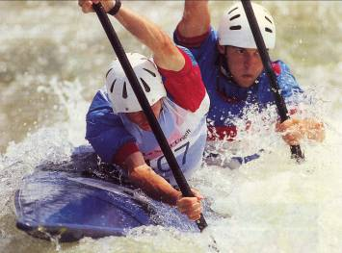
What is Leadership?
Leaders help groups set goals, envision the possibilities and make commitments
Leaders can have a positive influence on the lives and behaviours of others
Leaders are not necessarily people who do great things but rather people who inspire others to do great things

Slide 5
Define leadership
“The behavioural process of influencing individuals and groups towards set goals” Barrow (1977)
Leadership is the ability to facilitate action and guide change
Leadership is the process by which a person influences others or directs an organization
Leadership is inspiring others to know, to do, or to be.

Slide 6
Leadership versus Management
Managers
Direct or control operation or performance
Are concerned with logistics
Leaders
Set the overall vision and inspire
Influence interpersonal relationships and motivation
May show management ability
“Leadership is the knack of getting somebody to do something you want done because he wants to do it.”
Dwight D. Eisenhower

Slide 7
The Importance of Effective Leadership…
Successful teams have strong leaders.
Leadership is very clear in interactive games but less obvious in co-active situations.
Leaders have a dual function in ensuring player satisfaction while steering the group to success i.e. Fabio Capello.
What are the qualities of a leader?

Slide 8
Quality Leadership is a team sport
Successful leaders realize they can’t do it alone.
They create a shared vision
Teamwork can only be sustained when leaders promote mutual reliance.
Successful leaders act as a coach
They enable others to act
They realize there will be bumps in the road, but a team can overcome those obstacles

Slide 9
QUALITIES ASSOCIATED WITH LEADERS IN SPORT
Good decision maker
Good interpersonal qualities such as communication skills
A motivator
Tactful and diplomatic
Confident
Show initiative
Organised
Gives good advice, direction etc.

Slide 10
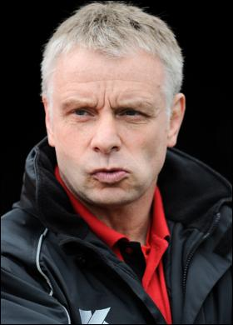
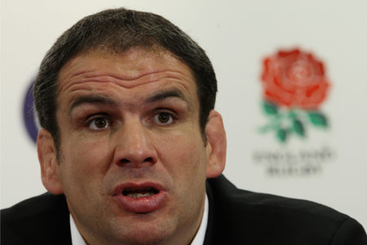
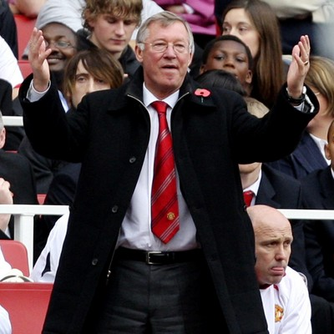
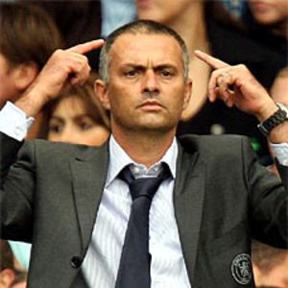

Slide 11
Selection of a Leader
EMERGENT LEADERS: Already belongs to the group & selection is made formally, e.g. by vote or interview.
PRECRIBED LEADERS: Selected from outside of the group and is known as an external appointment.

Slide 12
Styles of Leadership
Autocratic Leaders (task orientated):
Tend to make all decisions (dictate)
Motivated to complete a task as quickly and effectively as possible
Authoritarian style – they do not take into account the groups opinions
Does not share responsibility
Democratic Leaders (social/personal orientated):
Shares decisions and responsibilities with group
Interested in developing inter-personal relationships within the team
Laisser-faire Leaders:
Leader stands aside and allows the group to make their own decisions
Adopts a passive role

Slide 13
When is the leadership style most effective?
 | Autocratic | Democratic | Laissez-faire
Most effective when… | Involves large numbers Decisions have to be made quickly Task is complex or dangerous | Performers are more experienced Good relationships Not a dangerous situation | ? If left alone they usually become aggressive towards one another, do little work and give up
A leader should actually assess the situation and then tailor their leadership style.

Slide 14
Autocratic Leader:
Makes ALL the decisions and is motivated to
complete the task as quickly and effectively as
possible. This leadership style does not take into
account the opinions or preferences of the group.
This style would be most effective when quick
decisions are needed for large groups of people,
and in potentially dangerous situations that could
be life threatening.

Slide 15
The Autocratic Leader…
Autocratic leaders are TASK ORIENTATED.
These leaders make all the decisions.
They are AUTHORITARIAN and do not take into account the feelings of others.
They do not delegate responsibility.
They focus on group performance and achieving goals.
This is most effective when quick decisions are needed i.e. interactive games.
They are suitable for DANGEROUS or POTENTIALLY life-threatening situations i.e. outdoor education etc.

Slide 16
Autocratic Leaders
Very inflexible, make all the decisions and rarely get involved on a personal level with team members. Very task orientated. Better in most and least favourable situations.

Slide 17
Democratic Leader:
Shares the decisions with the group and is often
ready to share responsibility. This type of leader
believes in consultation and is interested in
developing meaningful inter-personal relationships
within the team.
This style would be effective in co-active games
with no time constraints and where personal
support may be required.

Slide 18
The Democratic Leader…
Shares decisions with the group and delegates responsibility.
They consult others and are interested in developing meaningful interpersonal relationships.
They believe in giving the performers “Ownership” of the task to each individual… Why?
Work harder?
Develop unity
Common purpose
Effective in a co-active situation or when time is not an issue.

Slide 19
Democratic Leaders
Only makes decisions after consulting the group. More informal, relaxed and active within the group. They usually show a keen interest in the various people within the group. Performer centered. Better in moderately favourable situations.

Slide 20
A comparison between Autocratic and Democratic leaders…
Autocratic leadership is preferable: | Democratic leadership is preferable:
When groups are hostile- discipline? | Groups are friendly/ warm relations
If groups are large | Groups are small
Team players who prefer instructions | Activities which require interpersonal communication
Early or cognitive stage learning | Autonomous stage of learning
In dangerous situations | No threat or danger
Time constraints | No time constraints
Leaders personality is authoritative | Leaders personality is democratic
Men prefer autocratic male leaders | Women prefer democratic female leaders

Slide 21
Laissez-Faire Leadership…
The leader stands aside to allow the group to make their own decisions.
Loss of direction can happen if the leader is inadequate.
Lewin (1985) found that certain groups who were subjected to this style were more inclined to aggression towards each other whilst giving up easily when mistakes occur.

Slide 22
LAISSEZ – FAIRE LEADERS
Leaves the group to ‘get on’ by themselves. Does not interfere. Generally being unsure of the task they tend to not make any evaluations. Acts as a consultant. Group determines the work to be done and the pace of it.
The leader will stand aside and allow the group to make its own decisions.
This style can be self-implementing if the leader is lacking confidence or motivation

Slide 23
Leadership Theories
IS A LEADER BORN OR MADE?
TRAIT APPROACH: Leaders are born with the skills necessary to take charge……however, although certain traits may be helpful in leadership, they are not essential, so this theory is NOT A GOOD PREDICTOR OF BEHAVIOUR.
SOCIAL LEARNING THEORY: The skills of leadership can be acquired by copying others and then developed through experiences. Copying successful role models is called ‘vicarious reinforcement.’ This DOES NOT TAKE INTO ACCOUNT THE TRAIT PERSPECTIVE.
INTERACTIONIST THEORY: Leaders emerge because of inherited abilities (traits) and learned skills. Interactionist theory gives a MORE REALISTIC EXPLANATION OF HUMAN BEHAVIOURS IN SPORT.

Slide 24
Theories of Leadership
Trait Approach :
Leaders are born with the skills necessary to take charge
Great leaders have personality traits that make them ideally suited for leadership in any situation.
Leadership traits are relatively stable personality dispositions such as intelligence, assertiveness, self-confidence and independence.
ALTHOUGH CERTAIN TRAITS MAY BE HELFPUL IN LEADERSHIP,
THEY ARE NOT ESSENTIAL AND SO TRAIT THEORY IS NOT A
GOOD PREDICTOR OF BEHAVIOUR.

Slide 25
Social Learning Theory
Behaviours are LEARNED and the learning comes through contact with strong environmental forces. Eg, when an aspiring captain judges a situation to have been handled well by an experienced leader, the method will be remembered and copied should a similar situation arise.
When leadership skills are imitated/copied from a role model this is called VICARIOUS REINFORCEMENT

Slide 26
Interactional Approach
Leadership competencies emerge because
of inherited abilities AND learned skills. Gill
(2000) indicated that interactionist theories
give a more realistic explanation of human
behaviours in sport

Slide 27
Fiedler’s Contingency Model
Suggested the effectiveness of a leader is dependent on a combination of personality traits and the situation. Fielder identified two types of leadership style:
Task centred / task orientated
Relationship centred / person orientated

Slide 28
Fiedler’s Contingency Model
According to Fiedler, the correct style of leadership to adopt depends on the ‘favourableness’ of the situation.
Highly favourable situation | Highly unfavourable situation
Leaders position is strong | Leaders position is weak
Task is simple with clear structure | Task is complex with vague structure
Warm group and leader relations | Hostile group and leader relations
AUTOCRATIC LEADERS are more effective in both the MOST FAVOURABLE and the LEAST FVOURABLE situations.
DEMOCRATIC LEADERS are more effective in MODERATELY FAVOURABLE situations.

Slide 29
According to Fiedler, the correct style of leadership to adopt depends on the “FAVOURABLENESS” of the situation.
A highly favourable situation | A highly Unfavourable situation
Leader’s position is strong | Leader’s position is weak
Task is simple with clear structure | Task is complex with vague structure
Warm group and leader relations | Hostile group and leader relations
Autocratic style
Autocratic style
Democratic style
Group
Performance effectiveness
Most favourable
Moderately
favourable
Least favourable

Slide 30
Chelladurai’s model
It is specific to sporting situations
States that optimum performance and enhanced satisfaction are more likely to occur when a leader’s required, preferred and actual behaviours are consistent

Slide 31
Multidimensional model of sport leadership
Chellanduria (1978) stated that three factors interact to determine the behaviour adopted by the leader. These initial factors are termed antecedents.

Slide 32
Antecedents
Situational characteristics: Examples of these are environmental conditions such as whether the group is involved in interactive or co-active sports. The numbers involved in the team is another important factor, as would be the time constraints of the play or overall match. Considerations about the strengths of the opposition would also be part of the situation .
Leader characteristics: This includes the skill, personality and experience of the leader. In addition, the inclination the leader has towards a person or a task-orientated style would be a significant characteristic.
Group Member characteristics: The factors relating to members would involve, age, gender, motivation, competence and experience.

Slide 33
Chellanduria also recognises three types of leader behaviours that would be guided by the antecedants
Required Behaviour: This involves what ought to be done by the leader in certain situations. The leader’s behaviour may be dictated by a strategy or organisation system.
Actual Behaviour: is what the leader chooses to do as the best course of action in the given situation. Actual behaviour is greatly influenced by the competence of the leader.
Preferred Behaviour: concerns what the group or athlete wants the leader to do. The leadership style preferred by the group is usually determined by the member characteristics.

Slide 34
Chelladurai’s multidimensional model of leadership

Slide 35
The Lombardi Leadership Model (2001)
Character
Belief
Habit
Courage
Responsibility
Sacrifice
Hard work
Willpower
Mental Toughness
Discipline
Which of these leadership traits are the hardest for you?

Slide 36
Team Leadership

Slide 37
Team Leadership
Team leadership is the most rapidly growing area of current research
Effective team performance begins with the leader’s mental model of the situation. This model consists of both the problem confronting the team and the environment.

Slide 38
Team Leadership
A good team leader is flexible and has a wide repertoire of actions or skills to meet the team’s diverse needs.
The leader has special responsibility for functioning in a manner that will help the group achieve effectiveness. Leadership behavior is seen as team based problem solving by analyzing the internal and external situation and then selecting the appropriate behaviors to ensure team effectiveness.

Slide 40
Team Leadership
1st decision – take action or observe
2nd decision – determine the general task or relational function of the intervention that is needed.
Final decision – intervene at the internal level (with the team itself) or external level (the team’s environment)

Slide 41
Team Leadership
Internal Task Leadership Actions
Goal focusing
Structuring for results (planning, visioning, organizing, clarifying roles, delegating)
Facilitating decision making
Training team members in task completion
Maintaining standards of excellence (assessing team and individual performance, confronting inadequate performance)

Slide 42
Team Leadership
External Environment Leadership Actions
Networking and forming alliances in environment
Advocating and representing team to environment
Negotiation upward to secure necessary resources, support and recognition for team
Buffering team members from environmental distractions
Assessing environmental indicators of team’s effectiveness
Sharing relevant environmental information with the team

Slide 43
Team Leadership

