Slide 1
Self-confidence
Ashira Hiruntrakul

Slide 2
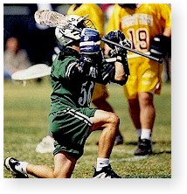
Confidence
Self Confidence – The state or quality of being certain in oneself or one’s abilities.
Self confidence is one of the most frequently cited psychological factors thought to effect sport performance (Covassin,2005).

Slide 3
(+)’s for Possessing Athletic Confidence
Enhances personal well being.
Acquire belief in themselves
Approach difficult tasks as a challenge.
Maintain strong commitment to goals.

Slide 4
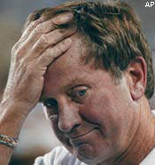
(-)’s for Lacking Athletic Confidence
Doubt their capabilities
When faced with difficult tasks, they swell on their personal deficiencies
Give in more easily
Slower to recover from failures and setbacks
Easily fall victim to stress and depression

Slide 5
Models of Self-Confidence
Bandura’s Theory of Self-Efficacy
Harter’s Competence Motivation Theory
Vealey’s Sport Confidence Model

Slide 6
Bandura’s Self–Efficacy Theory
Self-efficacy provides a model to study the effects of self-confidence on sport performance, persistence, and behavior.
Self-efficacy is important when one
has the requisite skills and sufficient motivation.

Slide 7
Bandura’s Self–Efficacy Theory
Self-efficacy affects an athlete’s
choice of activities, level of effort,
and persistence.
Although self-efficacy is task-specific,
it generalizes to other similar skills
and situations.
High self-efficacy people set more challenging goals.

Slide 8
Developing Self-Confidence
1. Successful performance
2. Vicarious experience (participatory modeling)
3. Verbal persuasion
4. Emotional arousal
Bandura, 1977, 1982, 1997

Slide 9
Bandura’s 4 component Model of Self Efficacy
Performance Accomplishments:
Highlight past successful performances
This has the most powerful effect on Self Efficacy
Vicarious Experiences:
Show the performer a demonstration of the required performance
This will persuade the performer that the task is achievable

Slide 10
Verbal Persuasion
Verbally encourage performer
Coach/teacher should tell performer that they have the ability to suceed
Emotional Arousal
Get the perfomer to feel confident about his/her level of arousal
To alter the level of arousal to achieve the optimum level

Slide 11
SELF-EFFICACY - BANDURA’S MODEL
PERFORMANCE ACCOMPLISHMENTS
consist of past experiences
example : previously performed skill at dribbling a soccer ball
if this is successful
then this leads to greater self-efficacy
at this particular task
in the future
VICARIOUS EXPERIENCES
consist of what has been observed in others
performing a similar skill
example : observing another player in your team dribbling a soccer ball
if the model is of similar age / ability
and is successful
then this may lead to greater self-efficacy

Slide 12
SELF-EFFICACY - BANDURA’S MODEL
VERBAL PERSUASION
encouragement can lead to greater self-efficacy
if the person giving encouragement is of high status
compared with the performer
EMOTIONAL AROUSAL
if arousal is too high
  state anxiety - A-state
this could lead to low self-efficacy
mental rehearsal / physical relaxation could
  lead to greater confidence
  and a calmer approach

Slide 13

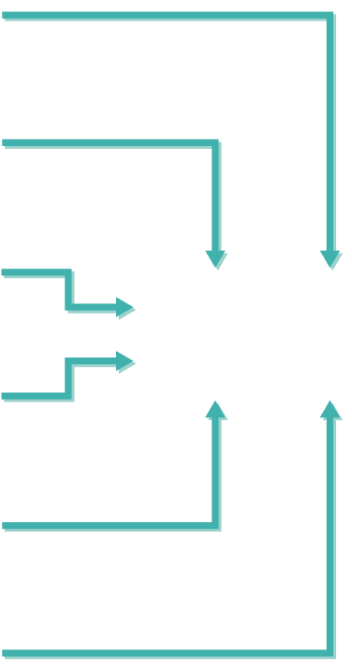
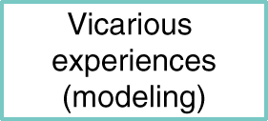


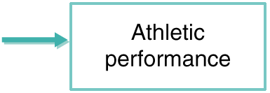



Self–Efficacy Sources
Notes:
Physiological states influence self-efficacy when they are associated with aversive physiological arousal, poor performance, and perceived failure.
Emotions or moods are a source of efficacy information

Slide 14
Harter’s Competence Motivation Theory
Based on an individual’s feelings of personal competence
Individuals are innately motivated to be competent in all areas of human achievement

Slide 15
High Competence
Motivation
Self-Efficacy, Positive Affect and Feelings of Competence
Low Competence
Motivation
Negative
Affect
Fewer Mastery
Attempts
Successful
Performance
Unsuccessful
Performance
Sports
Drop-out
Innate Motivation to be Competent in Sports: Mastery Attempts
Harter’s Competence Motivation Theory

Slide 16
Vealey’s Sport-Specific Model of Sport Confidence
Sport confidence is the belief or degree of certainty individuals possess about their ability to be successful in sport

Slide 17
Sports Confidence Theory…
Vealey (1986) stated that there are 2 factors in sports confidence…
TRAIT SPORT CONFIDENCE (SC Trait)
STATE SPORT CONFIDENCE (SC State)

Slide 18
Trait vs. State
Global self-confidence: A predisposition to feel confident in many situations
Situation-specific self-confidence: The belief that you can succeed in situation at hand

Slide 19
Trait Sports Confidence…
Is innate and a natural disposition
It is relatively stable.
Trait sports confidence is concerned with how a performer rates their own ability to perform across a wide range of sports.

Slide 20
State Sports Confidence…
State sports confidence can be developed through learning.
At that ends it can be changed.
State confidence is concerned with…
  …how a performer rates their own ability to perform at one particular moment.

Slide 21
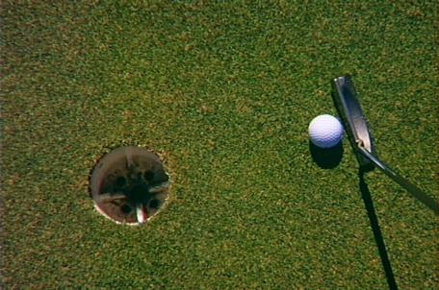
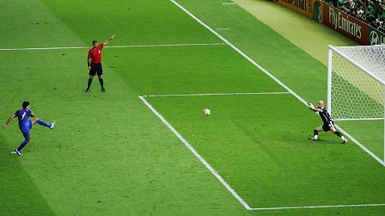
State Sports Confidence in Action…
This determines the quality of how a skill is performed e.g.
A Putt in Golf.
A Penalty in Football/Rugby.
At this ends State Sports confidence is influenced by…

Slide 23
Vealey’s Model of Sports Confidence…

Slide 24
Effects of Variation in Levels of Trait Sports Confidence…
Decrease in SC Trait and Competitiveness… | Increase in SC Trait and Competitiveness…
Depress SC State | Elevate SC State
Reduce Self-Efficacy | Increase Self-Efficacy
Make the performer less confident | Make the performer more confident
Avoidance Behaviours | Approach Behaviours

Slide 25
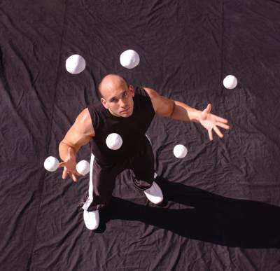
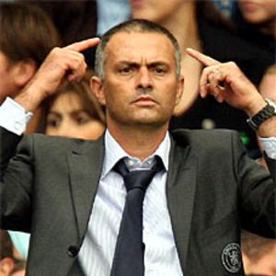
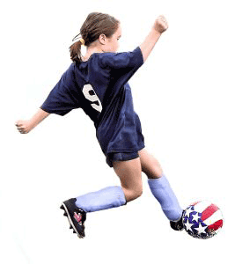
How do we improve SC State?
Mastery of Skill: When a skill has been acquired and the performer perceives that progress has been made.
Styling: Confidence will increase if the performer can demonstrate the skill to significant others.
Physical and Mental Preparation: Increases the likelihood of a successful performer.
Social Reinforcement: Praise and approval by significant others, within strong team cohesion situation, will raise confidence.
Effective Leadership: Promotes confidence within team members.
Environmental Comfort: People who lack self confidence will be helped if the working conditions are suitable i.e. novices should not be too closely observed- elite performers at home?

Slide 26
Benefits of Self–Confidence
Arouses positive emotions
Facilitates concentration
Affects the setting and pursuit
of challenging goals
Increases effort
Affects game strategies (play to
win versus play to lose)
Affects psychological momentum

Slide 27
Levels of Confidence
Optimal confidence
Lack of confidence
Overconfidence

Slide 28
SELF-CONFIDENCE
CONFIDENCE
arouses positive emotions
allows the athlete to
  remain calm under pressure
  be assertive when required
facilitates concentration
enables focus on the important aspects of a task
enables the setting of challenging but realistic goals
increases effort
affects game strategies
  a confident player plays to win even if it means taking risks
affects psychological momentum
  a confident athlete take each point or play at a time
  and never gives up
  even when defeat is imminent

Slide 29
SELF-CONFIDENCE
LACK OF CONFIDENCE
causes stress under pressure
causes concentration on outside stressors
  mistakes
  spectators
causes the setting of goals which are either too easy or too hard
causes the athlete to try to avoid mistakes
non-confident athletes find it difficult to reverse negative psychological momentum
  once things start to go wrong
  it is difficult to think positively
OVERCONFIDENCE OR FALSE CONFIDENCE
is dangerous because it can lead to
  inadequate preparation
  low motivation
  low arousal
which are difficult to correct when competition is under way

Slide 30
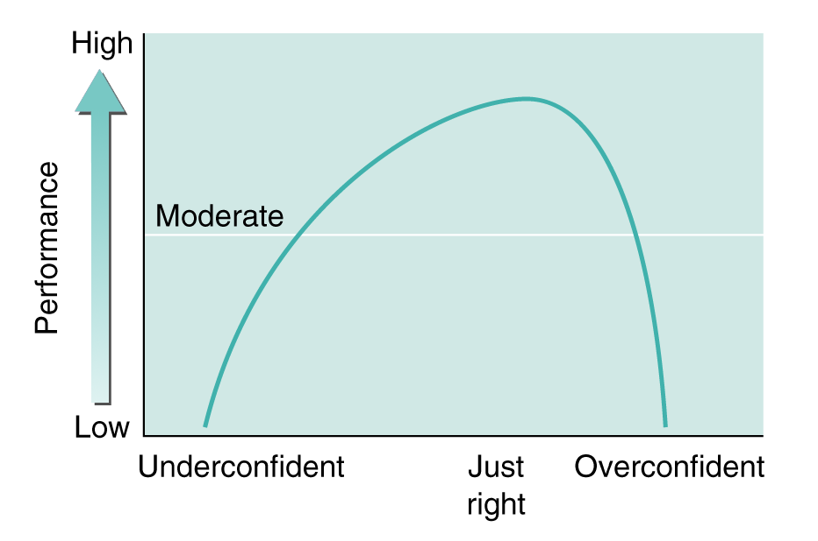
Optimal Confidence, Under–
confidence, and Overconfidence
The inverted-U illustrating the confidence-performance relationship

Slide 31
Building Self-confidence
Realistic/Attainable goals
Repeated successes
Praise & encouragement
Learn from your mistakes
Practice
Sharpen the saw
Social support
Verbal persuasion
Modeling
Self-talk

Slide 32
Ways to build Self Confidence
Self Talk
Be an actor
Mistakes happen
Trust yourself

Slide 33
Self Talk
There is a direct connection between how athletes think about things or how they talk to themselves during competition which can determine how well they will perform .

Slide 34
Negative Thoughts (self Talk)
When athletes judge themselves unfairly, evaluate performances in critical ways, or speak to themselves in negative ways, they are setting themselves up for negative outcomes and failure.

Slide 35
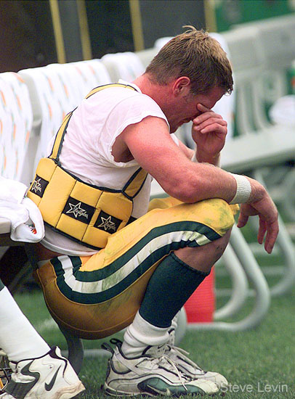
Negative Thoughts (Self Talk)
Don’t mess up
Don’t let the coach down
Don’t let the team down
Your going to lose your position

Slide 36
Positive thoughts
(Self Talk)
Team/coach believes in you
Past successful experiences
Worked hard for your position

Slide 37
Be an Actor
Act in a confident manner
Takes mind off of anxiety
Helps visualize successful performance
Assists in building confidence

Slide 38
Mistakes Happen
Athletes can experience “off days.”
Don’t let a bad performance shatter an athletes self belief in their abilities

Slide 39
Trust Yourself
Athletes know themselves better than anyone else.
      Don’t doubt your abilities, be confident
Don’t give up when things go wrong
Learn from mistakes

Slide 40
Building Self–Confidence
Ensure performance accomplishments.
Successful behavior increases confidence and leads to further successful behavior.
Include good technical, and tactical instruction.
Use game-pressure simulations.
Act confidently.
Instructors-coaches should display confidence.
Teach athletes to display confidence.

Slide 41
Building Self–Confidence
Use imagery.
Imagine yourself as confident and successful.
Train for superior physical conditioning.
Fatigue erodes confidence & performance
Prepare
Develop performance plans and routines; plans
give you confidence because _______________________________________

Slide 42
Building Self–Confidence
Above all else…Think confidently.
Focus on instruction and motivating thoughts.
Avoid judgmental thoughts.

