Slide 1
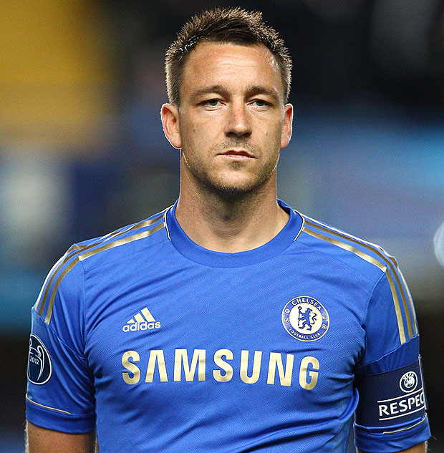
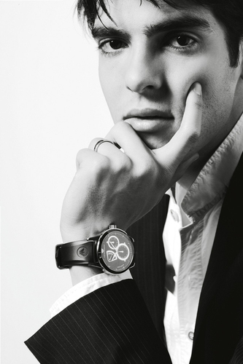
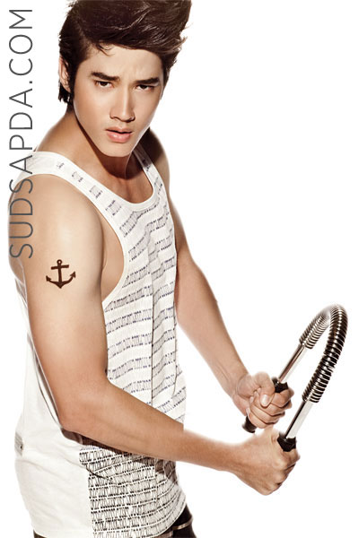
Personality

Slide 2
INTRODUCTION
You do not need to be a psychologist to speculate
about personality. In our everyday conversations
we refer to the personality traits of people we
know. Novels, playwrights and ﬁlmmakers make
constant use of the personality of key ﬁgures in
their stories, and this is one of the great attractions of popular ﬁction. The term ‘personality’ is
now part of everyday language, and theories of
personality are generated by all of us every time
we answer the question.

Slide 3
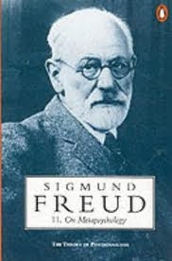
TRAIT THEORIES – ASPECTS OF PERSONALITY (THEORIES – FREUD AND BEYOND)
Freud’s models of the mind In the wake of Fred.
-HUMANISTIC THEORIES – INDIVIDUALITY
The drive to fulﬁl potential Understanding our own psychological world

Slide 4
Learning Objectives
-personality theorists are concerned with identifying generaliztions that can be made about consistent individual
differences between people’s behaviour and the causes and onsequences of these differences.
-Sigmund Freud developed a psychoanalytic approach that emphasized the role of the unconscious in regulating
Behaviour.

Slide 5
(Structure of personality).
1.Said (Id or libido) refers to a physically strong person directed to act different.
2. Ego (Ego) refers to spiritual realization. Formation on child growth and development. Is related to perception.
3. Super ego (Superego) refers to the third element of the spiritual personality.

Slide 6
Types of Personality Traits
There are many different personality types, and it is sometimes difficult to classify a person into a single type as there are many different personality traits you can possess.
Personality traits are simply:
-Actions
-Attitudes
-Behaviors you possess

Slide 7
SOCIAL THEORIES
1.Encodings – or how we perceive events
2.Expectancies and the importance of self-efﬁcacy
3.Affects – how we feel
4.Goals, values and the effects of reward
Competencies and self-regulatory plans

Slide 8
How Do I Create My Personality?
Your personality is entirely up to you. It is in the actions you take and the decisions you make. Either you are a patient person, or not; a responsible person or not. The only way to change your personality is to take active steps to become the person you want to be.

Slide 9
How Can My Personality Affect Others?
Being positive and upbeat can influence everyone around you, and so can negativity. For example, a friendly smile to a stranger can brighten up their day, as a glare can frighten them and cause their mood to drop. Like the famous quote, “Do unto others as you would have them do to you”.

Slide 10
Determining Personality Types
Your personality type can be determined by many factors. You can approach it the scientific way, by testing yourself and having a psychologist analysis you. A personality test is rather simple. By answering a few questions about your likes and dislikes and where you would like to go in life, a professional can give you a report detailing the type of personality you have.

Slide 11
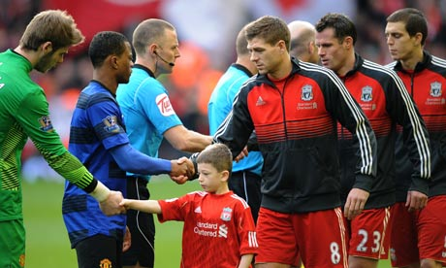
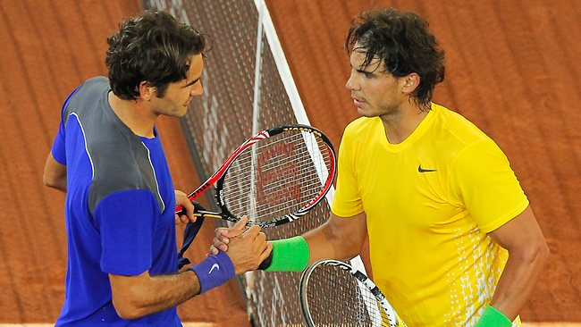
Positive Personality Traits (Some personality traits are positive)
-Being honest no matter what the consequences are is one personality trait people should aspire to.
-Having responsibility for all of your actions and being a little bit of a perfectionism are also personality traits.
-Adaptability and compatibility are great and can help you get along with others.
-Patience is a virtue and also another trait.

Slide 12
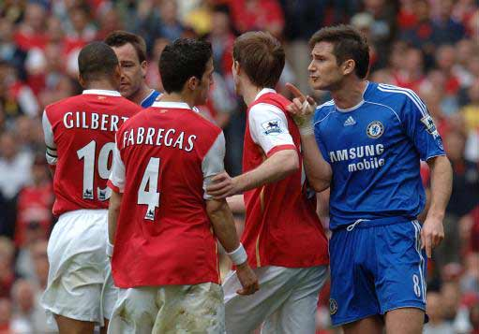
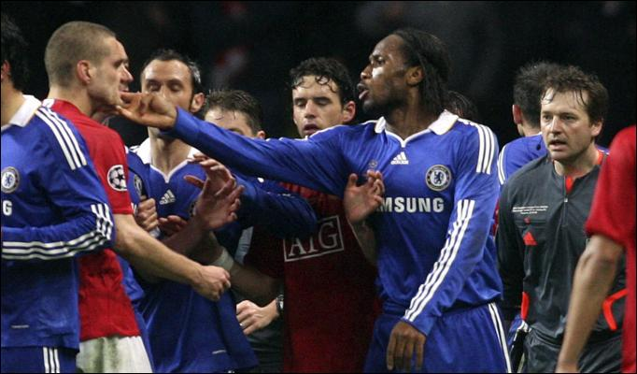
Negative Personality Traits (Other personality traits are negative. For example)
-Laziness
-Picky
-Sullen
-Dishonesty
-Finicky
-Sarcastic
-Pompous
-Arrogant
-Cowardly
-Sneaky
-Rude

Slide 13
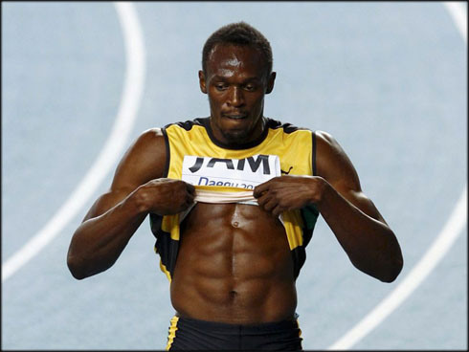
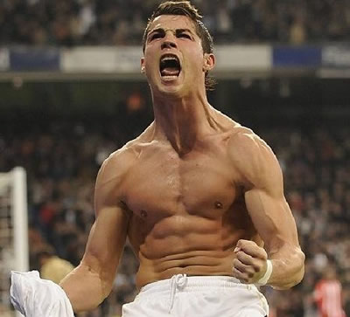
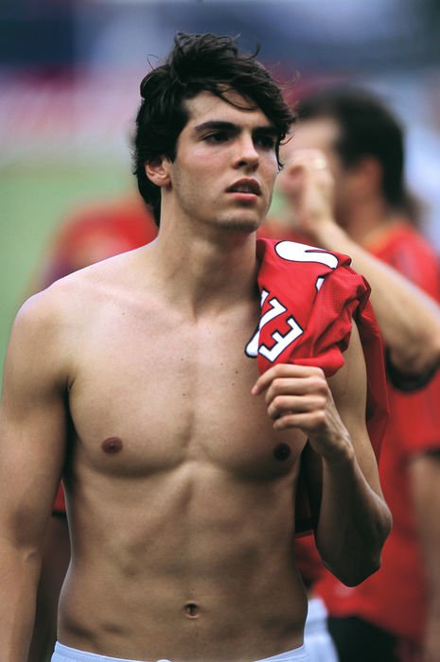
Personality Test.
There are three types of
personality tests.

Slide 14
1. Essential work characteristic. (In the basic personality).
- The social interaction.
- Emotional stability and handling of the situation.
- Strong mental and emotional sensitivity.
- Their own. And reliance on others.
- self-control to follow the rules.

Slide 15
2. Global characteristic traits (the personality as a whole).
- The social interaction.
Emotional stability to deal with the stress and pressure.
- Strong mental and emotional sensitivity.
- Their own. And reliance on others.
- self-control to follow the rules.

Slide 16
3. Global characteristic traits and Leadership potential. (The overall personality and leadership).
- The social interaction.
- Emotional stability to deal with the stress and pressure.
- Strong mental and emotional sensitivity.
- Their own. And reliance on others.
- self-control to follow the rules.
- Potential for leadership.
- Shared with others. And teamwork.
- Way of thinking and decision making.
- Initiative.
- The ability to adapt to stressful situations. Or pressure.

Slide 17
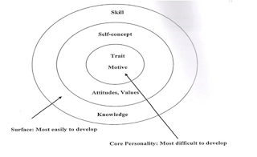
Iceberg theory

Slide 18
1. Motivation is what a person thinks or needs. Which will be the driving force in the direction or choice of a person to express their behavior. Or responding to the subject or to fall out of those things. 2. Personalized features. The physical attributes of the person and the person's response to a situation or face. 3. Ideas of their own. It is about attitudes, values ​​and image of the party.Self-motivation, which is causing the behavior and to predict the behavior of individuals on the situation in the short term it. 4. knowledge of the scope of the specific information or material in the possession of any person. 5. Skill is the ability to perform physical tasks, both related to the use Minds and hearts of the people in the class who can think critically. To determine the reason or knowledge.Planning to manage. And at the same time, it recognizes the complexity of the data.

Slide 19
รายชื่อสมาชิก
นายราชัน ภูกาบเพ็ชร์ 553230559-6
นายกิตติศักดิ์ พวงแก้ว 553230283-1
นายวชิรชา วัฒนชานันท์ 553230291-2
นางสาวผกามาศ คำขวา 553230557-0
นางสาวณิศาชล สัจเขต 553230285-7

