Slide 1
Chapter 1
Basic Concepts of Thermodynamics
1-1 Thermodynamics and Energy
1-2 Dimensions and Units
1-3 Thermodynamics System
1-4 Properties of a System
1-5 State and Equilibrium
1-6 Processes and Cycles
1-7 Forms of Energy
1-8 Temperature and the Zeroth Law of Thermodynamics
1-9 Pressure
Edited from : Assoc.Prof.Ratchaphon Santiwarakorn

Slide 2
1-1 Thermodynamics and Energy (1)
Themodynamics === therme (Heat) + dynamis (Power)
Thermodynamics can be defined as the science of energy.
Energy can be viewed as the ability to cause changes.
Conservation of energy principle ➔ During an interaction,
energy can change from one form to another but the total
amount of energy remains constant.
Energy cannot be created or destroyed.

Slide 3
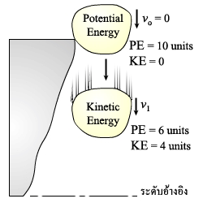
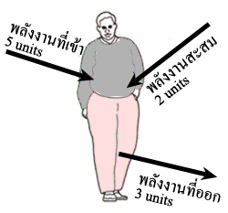
1-1 Thermodynamics and Energy (2)
Example : A rock falling off a cliff.
: The change in the energy content of a body.
The change in the energy is equal to the difference between the
energy input and the energy out put.

Slide 4
1-2 Dimensions and Units
Dimension : Any physical quantity.
Primary or Fundamental dimensions => mass m, length L
time t, temperature T
Secondary or Derived dimensions => velocity V, energy E
Unit : Magnitudes assigned to the dimension.
English system : pound-mass (lbm), foot (ft), second (s)
SI system : kilogram (Kg), meter (m), second (s)
1 lbm = 0.45359 Kg
1 ft = 0.3048 m
(มิติ)
(หน่วย)

Slide 5
1-2 Dimensions and Units
Fundamental dimensions in thermodynamics
Length (m), Mass (kg), Time (s), Temperature (K)
Always written in small letters except refer to someone
Sir Isaac Newton (N)
Lord Kelvin (William Thomson) (K)
James Watt (W)
James Prescott Joule (J)
Written in full, No capital letter
5 newtons
273 kelvins
50 joules
Written in full, can be plural not in abbreviated
5 meters
2 seconds
5 newtons
5 m
2 s
5 N

Slide 6
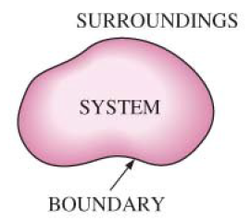
1-3 Thermodynamics System (1)
System : a quantity of matter or region in space chosen for study.
Surroundings : the mass or region outside the system.
Boundary : the real or imaginary surface that seperates the
system from its surroundings
ระบบ
สิ่งแวดล้อม
ขอบเขต

Slide 7
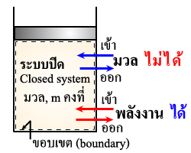
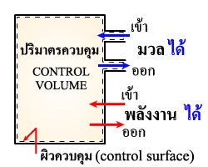
1-3 Thermodynamics System (2)
Mass
Energy
Closed system ( Control mass)
Isolated system
Open system ( Control volume)
X O
X X
O O

Slide 8
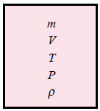
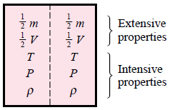
1-4 Properties of a System
Intensive properties : independent of the size of a system ;
temperature, pressure and density.
Extensive properties : depend on the size of the system ;
mass, volume and total energy
(คุณสมบัติเฉพาะตัว)
(คุณสมบัติอิงมวล)

Slide 9
1-4 Properties of a System
Extensive properties per unit mass are called specific properties.
-Density = mass per unit volume
-Specific gravity = the ratio of the density of a substance to the density of some standard substance
-Specific volume = volume per unit mass

Slide 10
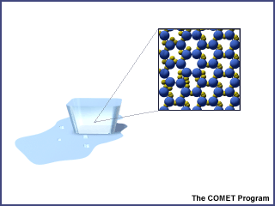
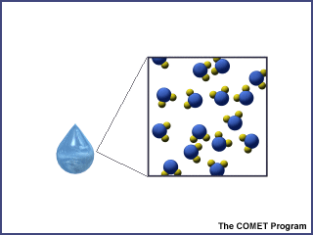
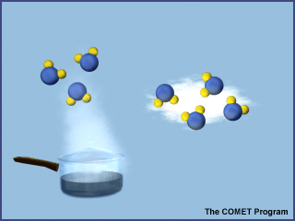
1-5 State and Equilibrium
State : Set of properties that describes the condition of the system.
0ºC
0.1 MPa
0ºC
0.1 MPa
1st State
2nd State
3rd State
100ºC
0.1 MPa
https://www.ucar.edu/learn/1_1_2_3t.htm

Slide 11
1-5 State and Equilibrium
Equilibrium : a state of balance
- Thermal equilibrium : the temperature is the same throughout
the entire system
Mechanical equilibrium : there is no change in pressure at any
point of the system with time.
Phase equilibrium : the mass of each phase reaches an
equilibrium level and stays there.
Chemical equilibrium : chemical composition does not change
with time, no chemical reactions occur.

Slide 12
1-6 Processes and Cycles (1)
Process : any change that a system undergoes from one equilibrium
state to another.
Quasi-equilibrium process : slow process
: remains close to an equilibrium state
at all time
(กระบวนการสมดุลเป็นช่วง)

Slide 13
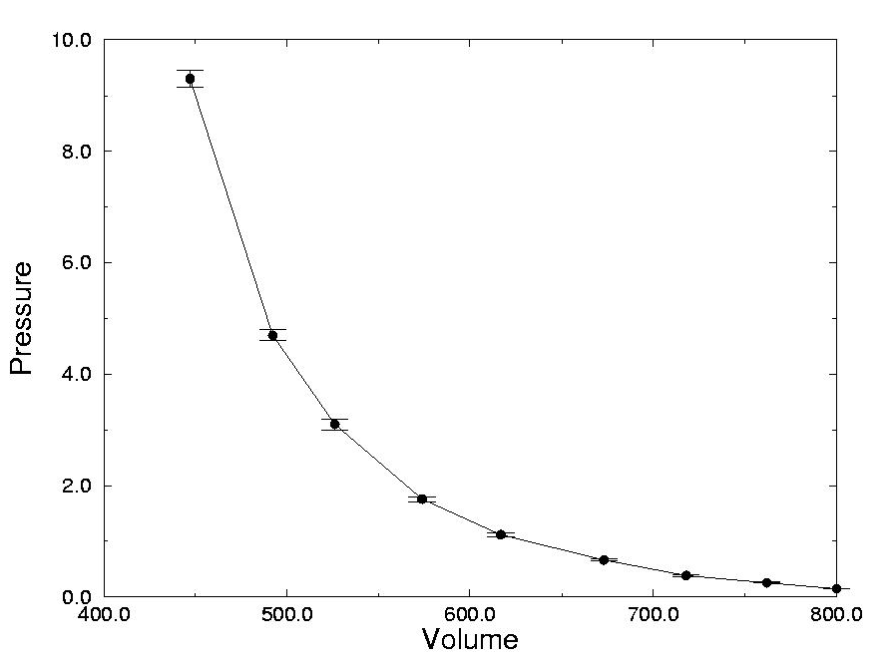
1-6 Processes and Cycles (2)
Quasi-equilibrium process
Weight
Piston
Gas

Slide 14
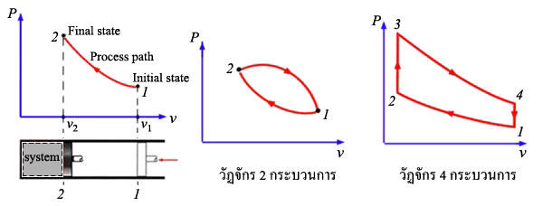
1-6 Processes and Cycles (3)
Process diagrams is plotted by employing thermodynamic properties
as coordinates.
- Isothermal process ( T ) - Isobaric process ( P )
- Isometric process ( v ) - Isentropic process ( Entropy )
- Adiabatic Process ( Heat )
Cycles : a system return to its initial state at the end of the process.
: the initial and final states are identical.

Slide 15
1-7 Forms of Energy (1)
Energy can exist in numerous forms such as thermal, mechanical,
kinetic, potential, electric, magnetic, chemical and nuclear.
Total energy of a system
: on a unit mass
Macroscopic form of energy : respect to some outside reference.
Kinetic energy
Potential energy
or
or

Slide 16
1-7 Forms of Energy (2)
Microscopic forms of energy : related to the molecular structure
of a system.
Internal energy
U
Total energy
: on a unit mass basis ;

Slide 17
1-8 Temperature and Zeroth Law of Thermodynamics (1)
The Zeroth law of thermodynamics
: if two bodies are in thermal equilibrium with a third body, they are
also in thermal equilibrium with each other.
: two bodies are in thermal equilibrium if both have the same
temperature reading even if they are not in contact.
Temperature scale
SI unit : Celsius scale
: Kelvin scale
English system : Fahrenheit scale
: Rankine scale

Slide 18
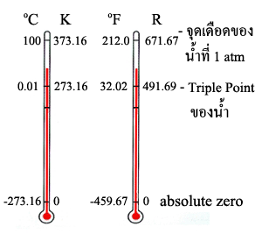
1-8 Temperature and Zeroth Law of Thermodynamics (2)

Slide 19
1-9 Pressure (1)
Pressure : force per unit area. Unit : N/m² or Pascal (Pa)
1 Pa = 1 N/m²
100,000 Pa = 1 bar
101,325 Pa = 1 atm
Atmospheric presuure ( ) : 101,325 Pa
Absolute pressure ( ) : the actual pressure
Gage pressure ( ) : the difference between and
Vacumm pressure ( ) : the difference between and

Slide 20
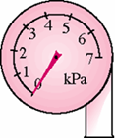
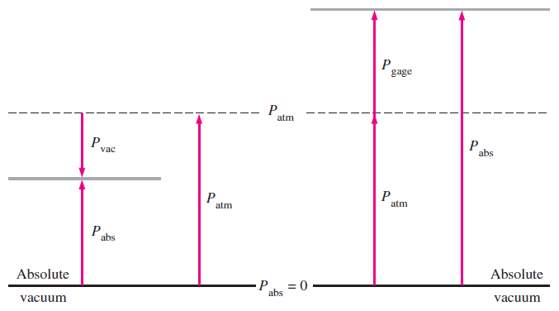
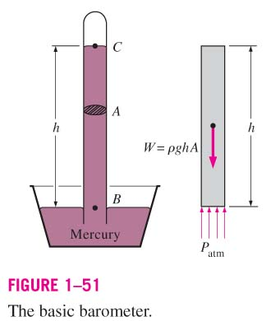
1-9 Pressure (2)
Atmospheric Pressure
Gage Pressure
Absolute Pressure

Slide 21
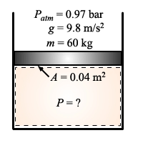
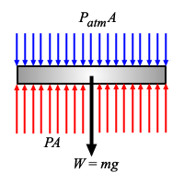
1-9 Pressure (3)
Example 1
The piston of a piston-cylinder device containing a gas has a mass of 60 kg
and a cross-sectional area of 0.04 m², as shown in figure. The local atmospheric
pressure is 0.97 bar, and the gravitational acceleration is 9.8 m/s². Determine the
pressure inside the cylinder.
Solution
bar

