Slide 1
Chapter 2
Properties of Pure Substances
2-1 Pure Substance (สารบริสุทธิ์)
2-2 Phase-change Processes of Pure Substances (การเปลี่ยนสถานะ)
2-3 Property Diagrams for Phase-change Processes (แผนภาพฯ)
2-4 Property Table (ตารางคุณสมบัติ)
2-5 The Ideal-gas Equation of State (สมการสภาวะของแก๊สในอุดมคติ)
Edited from : Assoc.Prof.Ratchaphon Santiwarakorn

Slide 2
2-1 Pure Substance
Pure Substance : a substance that has a fixed chemical
composition throughout. For example,
water, nitrogen, helium …
: a mixture of various chemical elements which
is homogeneous. For example, air.
: a mixture of two or more phase of a pure
substance which all phases have the same
chemical composition. For example, water.
3 Phases of a pure substance ➔ Solid, liquid and gas
Simple compressible substance : a pure substance which is
related to a work caused by
a change of volume.
(สารบริสุทธิ์)
(สารยุบตัวธรรมดา)

Slide 3
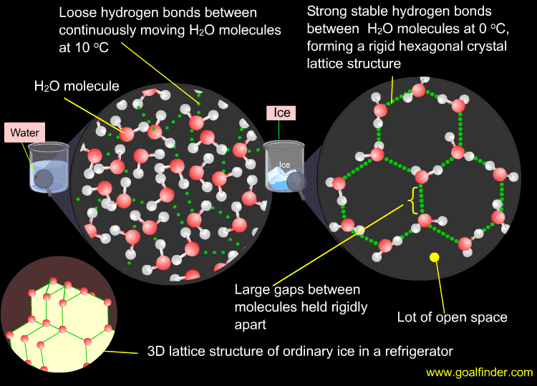
http://www.physicalgeography.net/fundamentals/8a.html

Slide 4
2-2 Phase-change Processes of Pure Substance (1)
There are many practical situations where two phases of a
pure substance co-exist in equilibrium. Water exists as a
mixture of liquid and vapor in the boiler and the condenser
of a steam power plant. The refrigerant turns from liquid to
vapor in freezer of a refrigerator.
This section is focused on the liquid and vapor phases and
the mixture of these two.
As a familiar substance, water will be used to demonstrate
the basic principle involved.
All pure substances exhibit the same general behavior.

Slide 5
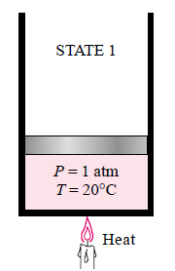
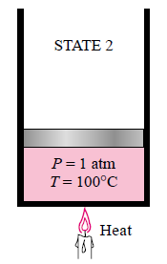
2-2 Phase-change Processes of Pure Substance (2)
Compressed liquid and Saturated liquid
Compressed or subcooled liquid
(ของเหลวอัด หรือของเหลวเย็นเยือก)
Water exists in the liquid phase.
Saturated liquid
(ของเหลวอิ่มตัว)
A liquid that is about to vaporize

Slide 6
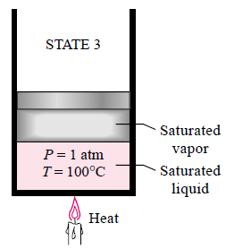
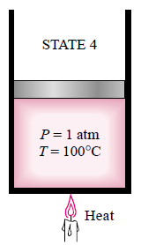
2-2 Phase-change Processes of Pure Substance (3)
Saturated liquid-vapor mixture and Saturated vapor
Saturated liquid-vapor mixture
(ของผสมอิ่มตัว)
Water exists in both liquid and vapor phase.
Saturated vapor
(ไออิ่มตัว)
A vapor that is about to condense.

Slide 7
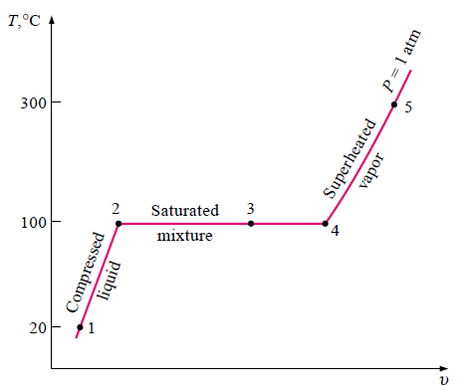
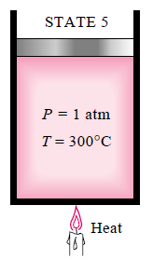
2-2 Phase-change Processes of Pure Substance (4)
Superheated vapor
Superheat vapor
(ไอดง)
A vapor that is not about to condense.
T-v diagram
Need 2 independent properties to know each state properties

Slide 8
2-2 Phase-change Processes of Pure Substance (5)
State1 : Compressed liquid
State2 : Saturated liquid
State3 : Saturated mixture
State4 : Saturated vapor
State5 : Superheated vapor
P = Constant = 1 atm = 101.3 kPa
T₂ = T₃ = T₄ = 100 ºC → T_{sat}
T-v diagram
ถ้าวางน้ำหนักบนลูกสูบ 100 kg ผลการทดลองจะเปลี่ยนไป?

Slide 9
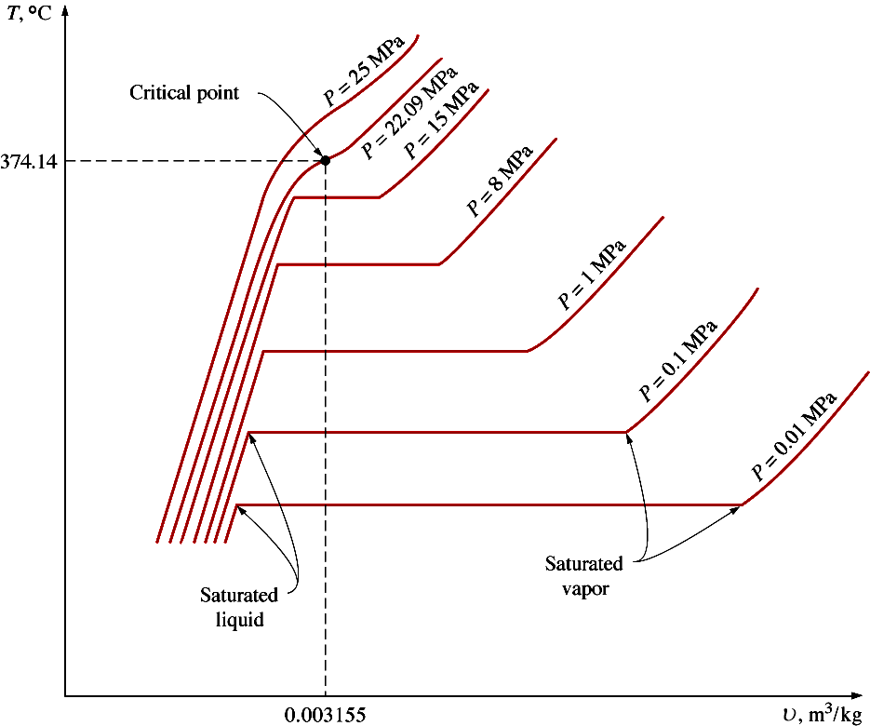
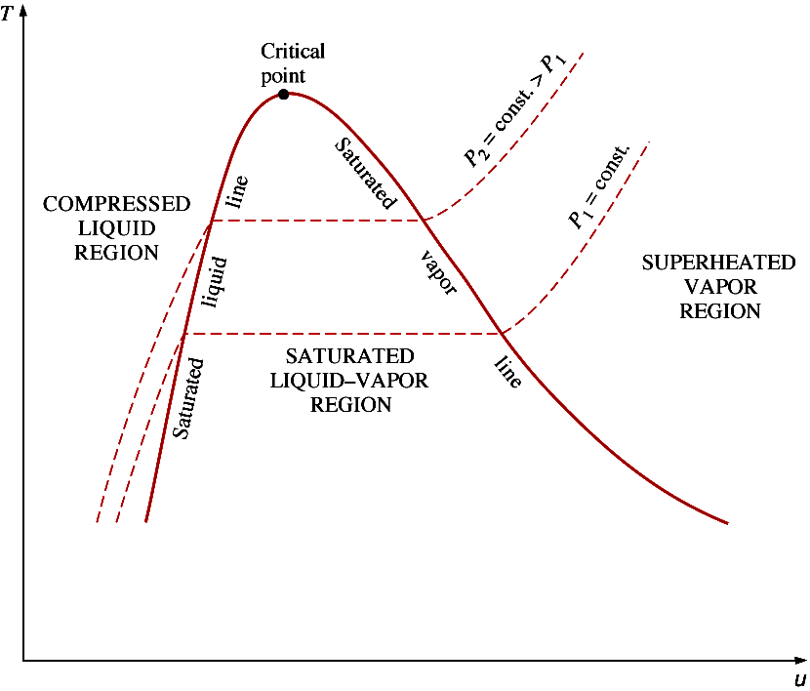
2-2 Phase-change Processes of Pure Substance (6)
T-v diagram
T-v diagram

Slide 10
2-3 Property Diagrams for Phase-Change Processes (1)
The variations of properties during phase-change proesses are best understood with the help of property diagrams.
The T-v Diagram
The P-v Diagram
The P-T Diagram
The P-v-T Surface

Slide 11
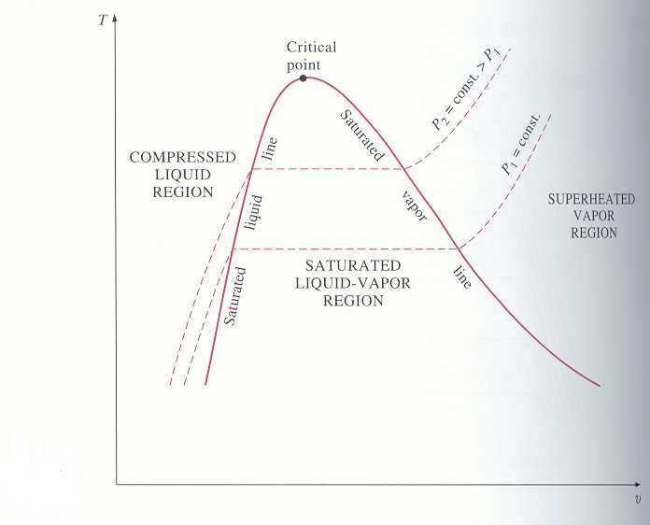
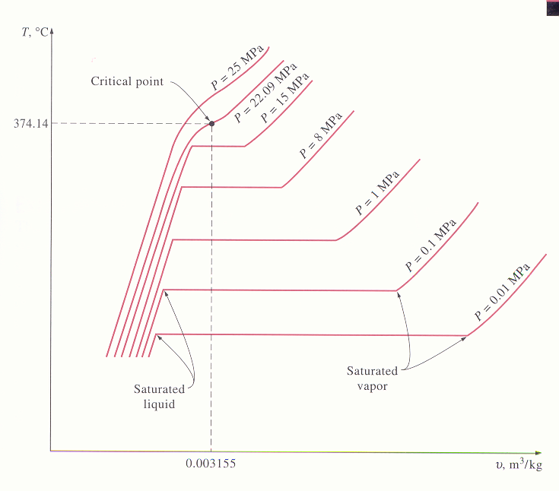
2-3 Property Diagrams for Phase-Change Processes (2)
The T-v Diagram
Critical point / Critical temperature / Critical pressure / Critical specific volume / Saturated liquid line / Saturated vapor line
Critical Point : Point at which the sat. liquid
and sat. vapor states are identical.
P T _{sat.} v_{f} v_{g}

Slide 12
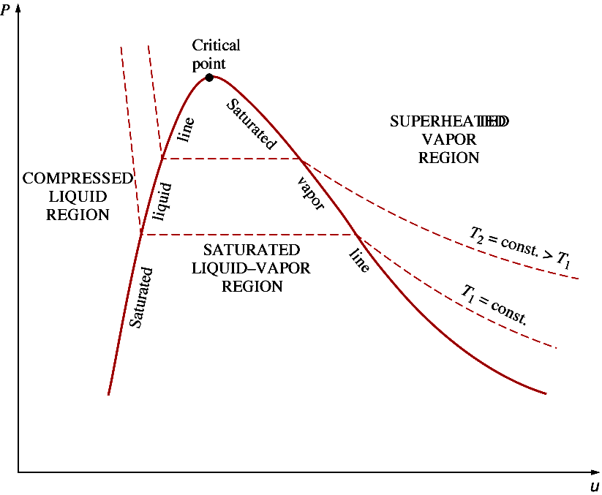
2-3 Property Diagrams for Phase-Change Processes (2)
The P-v Diagram

Slide 13
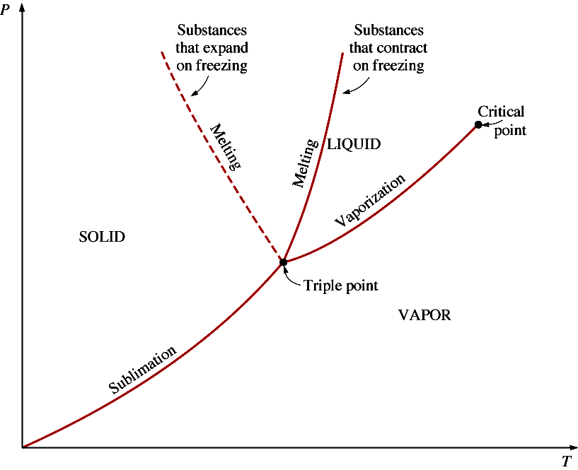
2-3 Property Diagrams for Phase-Change Processes (3)
The P-T Diagram = Phase Diagram
เส้นหลอมเหลว
เส้นหลอมเหลว
เส้นระเหย
จุดสามสถานะ
เส้นระเหิด

Slide 14
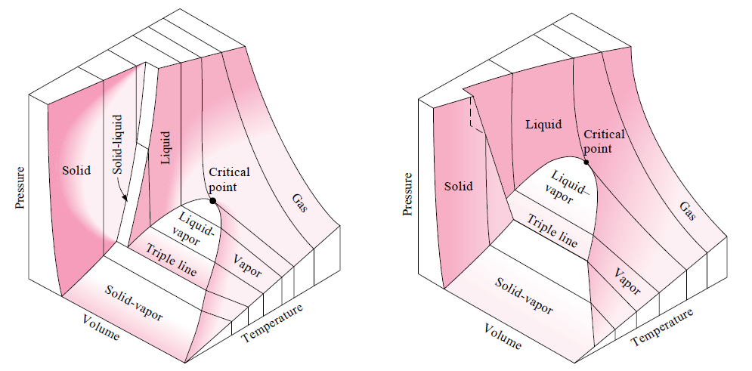
2-3 Property Diagrams for Phase-Change Processes (4)
The P-v-T Surface
P-T
P-T
Substance that contracts on freezing
Substance that expands on freezing

Slide 15
2-4 Property Tables
Properties Relationship are too COMPLEX
Not simple EQUATIONS can be represented
Therefore, TABLEs are more convenion
Each substance; more than one table,
Each table for each REGION ie.;
  Compressed Liquid
  Saturated Liquid and Saturated Vapour (2 = T table & P table)
  Superheated Vapour
  No table for Mixture ➔ Calculate using Saturated Table + x
Ref: Assoc.Prof.Sommai Priprem

Slide 16
2-4 Property Tables
Critical Constants Table
T
Superheated Vapor
Table
Saturated Vapour Line
Compressed Liquid Table
Saturated Liquid Line
Saturated
Table
Ref: Assoc.Prof.Sommai Priprem

Slide 17
2-4 Property Tables
Property Name | Symbol | Unit (SI)
Pressure | P | Pa + Prefix
Temperature | T | K
Specific Volume | v | m³/kg
Specific Internal Energy | u | kJ/kg
Specific Enthalpy | h | kJ/kg
Specific Entropy | s | kJ/kg-K
Ref: Assoc.Prof.Sommai Priprem

Slide 18
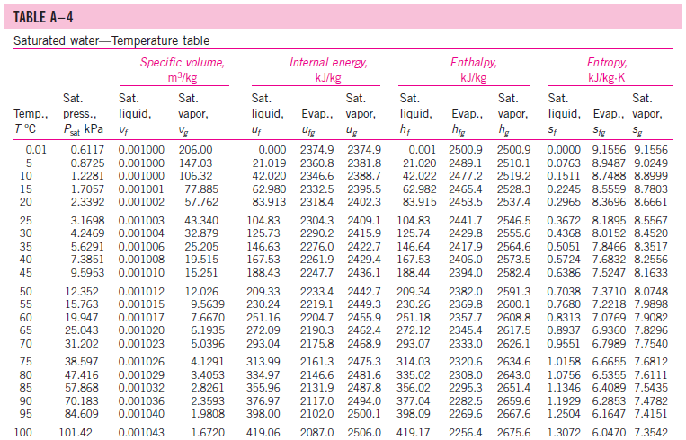
2-4 Property Tables

Slide 19
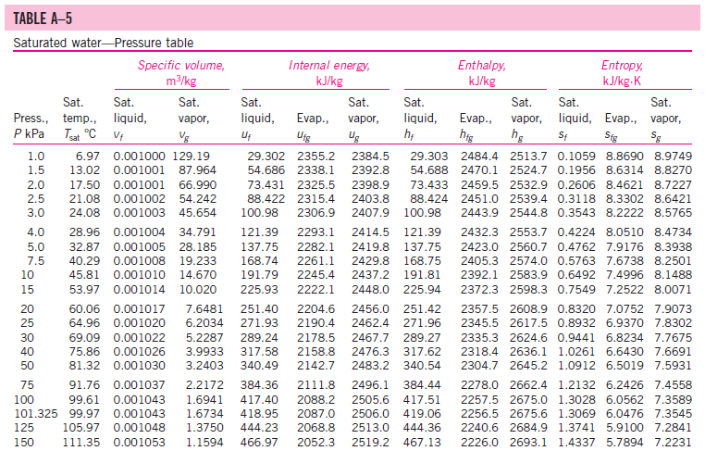
2-4 Property Tables

Slide 20
2-4 Property Tables
Before we get into the discussion of property tables, we define
a new property called enthapy.
Enthapy
For the sake of simplicity and convenience, the combination of
U+PV is defined as enthapy, and given the symbol H.
or per unit mass

Slide 21
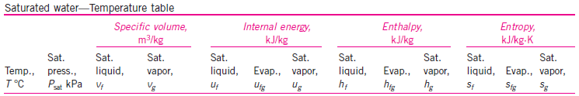
2-4 Property Tables
a) Saturated liquid and saturated vapor states
The property table is listed under temperature and pressure.
= specific volume of saturated liquid
= specific volume of saturated vapor
= difference between and
= enthalpy of vaporization ( It represents the amount of
energy needed to vaporize a unit mass of saturated
liquid at a given temperature or pressure )

Slide 22
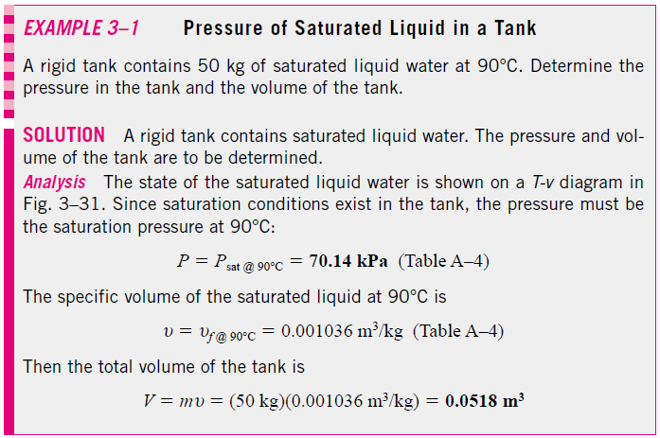
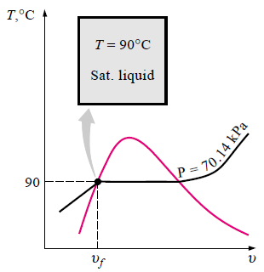

Slide 23
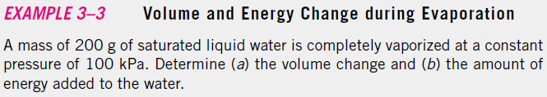
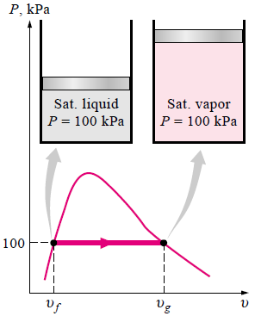
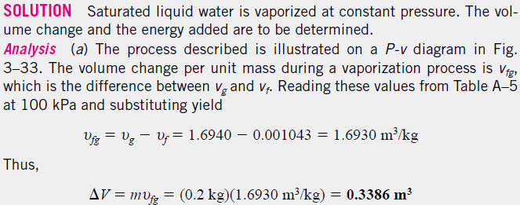
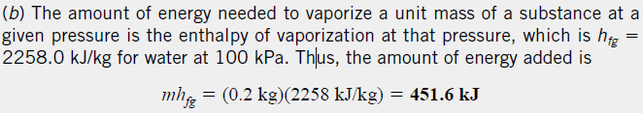

Slide 24
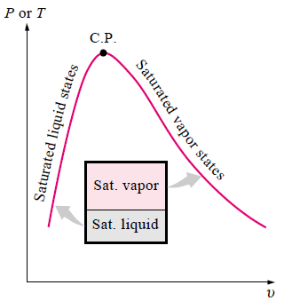
2-4 Property Tables
b) Saturated liquid-vapor mixture
Quality : the ratio of the mass of
vapor to the total mass of mixture.
where,
The quality of a system consisting of saturated liquid.
The quality of a system consisting of saturated vapor.

Slide 25
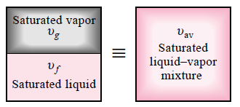
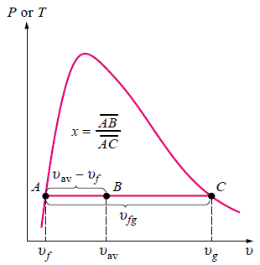
2-4 Property Tables
Consider a tank that contains a saturated liquid-vapor mixture.
Dividing by

Slide 26
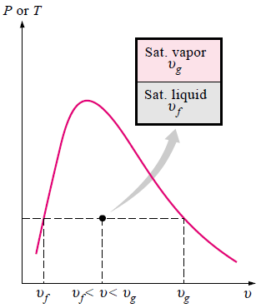
2-4 Property Tables
The analysis given above can be repeated for internal energy and
enthalpy with the following results:
All the results are of the same
format, and they can be summarized
in a single equation as
where y is v, u, or h.
The values of average properties (the subscript “av” ) of the mixture
are always between the values of the saturated liquid and the saturated
vapor properties.

Slide 27
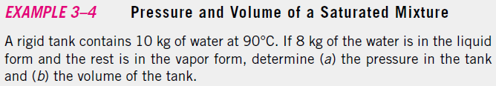
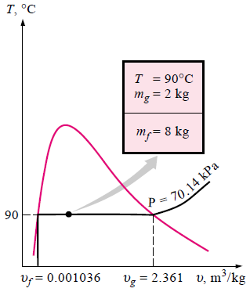
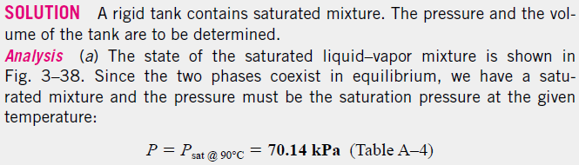
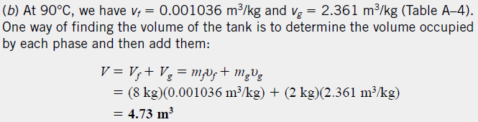

Slide 28
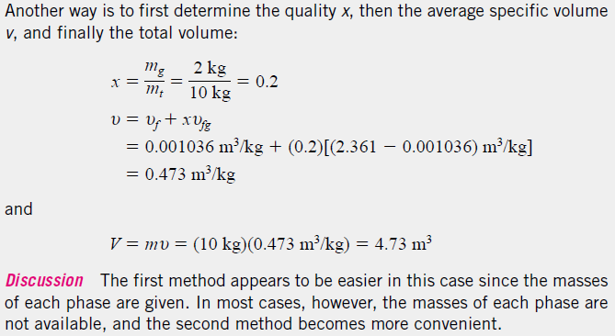

Slide 29
2-4 Property Tables
c) Superheated vapor
In the region to the right of the saturated vapor line.
Superheated vapor is characterized by
Lower pressures ( P < P_{sat} at a given T )
Higher temperatures ( T > T_{sat} at a given P )
Higher specific volumes ( v > v_{g} at a given P or T )
Higher internal energies ( u > u_{g} at a given P or T )
Higher enthalpies ( h > h_{g} at a given P or T )

Slide 30


Slide 31
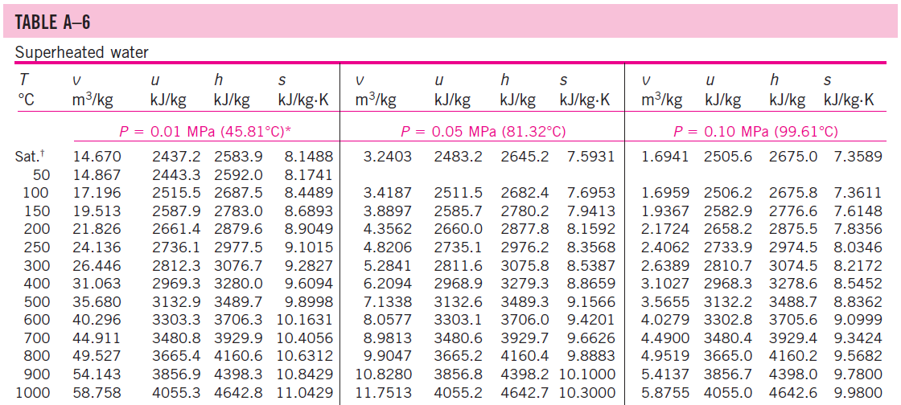

Slide 32
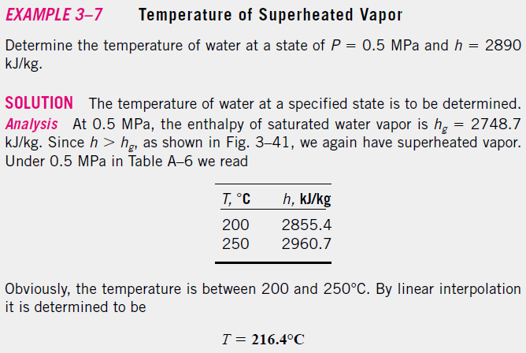
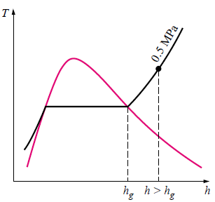

Slide 33
2-4 Property Tables
d) Compressed liquid
In the absence of compressed liquid data, a general approximation
is to treat compressed liquid as saturated liquid at a given temperature.
This is because the compressed liquid properties depend on temperature
much more than they do on pressure. Thus,
In general, a compressed liquid is characterized by
Lower pressures ( P > P_{sat} at a given T )
Higher temperatures ( T < T_{sat} at a given P )
Higher specific volumes ( v < v_{g} at a given P or T )
Higher internal energies ( u < u_{g} at a given P or T )
Higher enthalpies ( h < h_{g} at a given P or T )

Slide 34
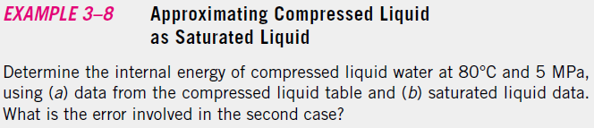
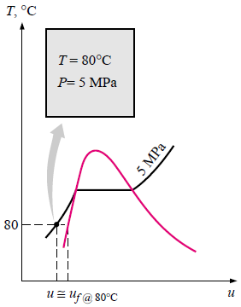
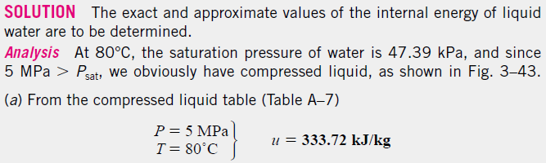
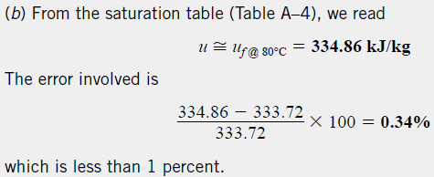

Slide 35
2-5 The Ideal-Gas Equation of State (1)
Equation of state : any equation that relates the pressure, temperature,
and specific volume of a substance.
Gas and vapor : the vapor phase of a substance is called a gas when it is
above the critical temperature. Vapor usually implies a
gas that is not far from a state of condensation.
The Ideal-gas equation : at low pressure
R = gas constant. It is different for each gas and is determined from
( kJ/kg·K)

Slide 36
2-5 The Ideal-Gas Equation of State (2)
R_{u} = universal gas constant. It is the same for all substances.
R_{u} = 8.314 kJ/kmol·K
M = normal mass. It is the mass of one mole. The mass of system m
is equal to the product of its molar mass M and the mole number N
An ideal gas is an imaginary substance that obeys the relation Pv = RT.
At low pressures and high temperatures, the density of a gas decreases,
and the gas behaves as an ideal gas under these conditions.

Slide 37
2-5 The Ideal-Gas Equation of State (3)
The ideal-gas equation of state can be written in several different forms:
An ideal-gas at two different states are related to each other by

Slide 38
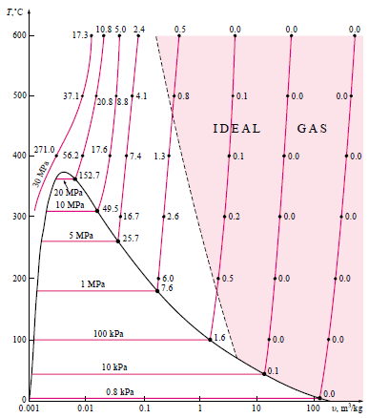
2-5 The Ideal-Gas Equation of State (4)
Air, nitrogen, oxygen,
hydrogen, helium, argon,
neon, krypton, and even
heavier gases such as carbon
dioxid can be treated as
ideal gases with negligible.
Denses gases such as
water vapor in steam power
plants and refrigerant
vapor in refrigerator should
not be treated as ideal gases.

Slide 39
2-5 The Ideal-Gas Equation of State (5)
This deviation from ideal-gas behavior at a given temperature and
pressure can accurately be accounted for by the introduction of a
correction factor called the compressibility factor Z
or
where, and Z = 1 for ideal gases. For real gases, Z >1 or
Z < 1.
Gases behave differently at a given temperature and pressure, but they behave very much the same at temperatures and pressures normalized with respect to their temperatures and pressures.

Slide 40
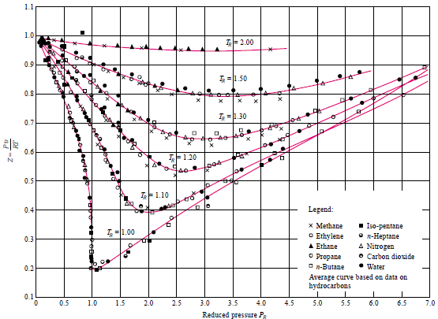
2-5 The Ideal-Gas Equation of State (6)
The normalization is done as
Here P_{R} : reduced pressure and
T_{R} : reduced temperature.
The Z factor for all gases is
approximately the same at the
same reduced pressure and
temperature. This is called
the principle of corresponding
states.
or
-At very low pressure (P_{R} <<1)
-At high temperature (T_{R} >2)
-The greatest deviation of gas from ideal gas
Is in the vicinity of the critical point(P_{R} =1)

