Slide 1
Chapter 3
Work and Heat
3-1 Heat
3-2 Work
3-3 Work in Compressible System
3-4 Gravitational Work
3-5 Acceleration Work
3-6 Shaft Work
3-7 Spring Work
Edited from : Assoc.Prof.Ratchaphon Santiwarakorn

Slide 2
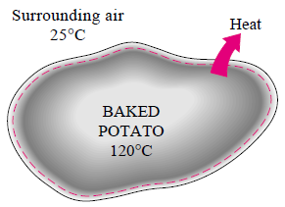
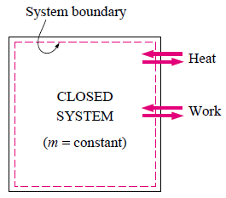
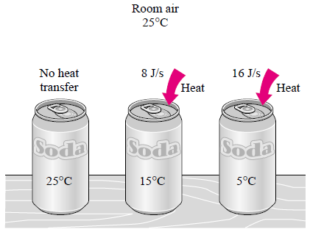
3-1 Heat (1)
Energy can cross the boundary of
a closed system in two distinct forms :
Heat and Work.

Slide 3
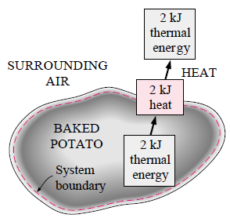
3-1 Heat (2)
The direction of energy transfer is always from the higher temperature
body to lower temperature one. Once the temperature equality
is established, energy transfer stops.
Heat : the form of energy that is transferred between two systems
(or a system and its surroundings) by virtue of a temperature difference
Energy is recognized as
heat transfer only as it crosses
the boundary of a system.

Slide 4
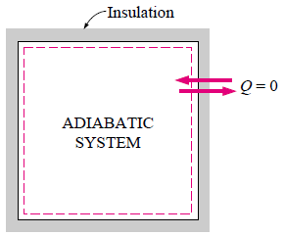
3-1 Heat (3)
A process during which there is no heat transfer is called an
adiabatic process.
Unit : kJ ( or Btu)
( 1 Btu = 1.055 kJ )
The amount of heat transferred
from states 1 to 2 : Q₁₂ or Q
per unit mass
Path functions have inexact differentials designated by symbol δ
(ฟังก์ชันทางเดิน) (อนุพันธ์ไม่ตายตัว)
(kJ/kg)

Slide 5
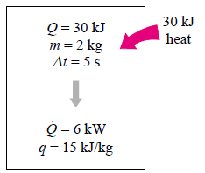
3-1 Heat (4)
Heat transfer rate :
Unit : kJ/s = kW
The amount of heat
transfer during a process :
or
,where

Slide 6
3-1 Heat (5)
Example 3.1
ภายใต้กระบวนการสมดุลเป็นช่วง ให้ความร้อนแก่แก๊สภายในภาชนะ
โดยที่ δQ ในระหว่างกระบวนการเขียนเป็นสมการได้ดังนี้
เมื่อ θ = T/100 และ T เป็นอุณหภูมิของแก๊สที่มีหน่วยเป็นเคลวิน (K)
จงคำนวณหาปริมาณความร้อน ที่จะถ่ายเทให้แก่แก๊สในระบบ เพื่อให้มี
อุณหภูมิเพิ่มขึ้นจาก 300 K เป็นอุณหภูมิ 400 K (P.57)

Slide 7
3-2 Work (1)
Work, like heat, is an energy interaction between a system
and its surroundings.
Energy can cross the boundary of a closed system in the
form of heat and work.
If the energy crossing the boundary of a closed system is
not heat, it must be work.
An energy interaction that is not caused by a temperature
difference is work.
Work is the energy transfer associated with a force acting
through a distance.

Slide 8
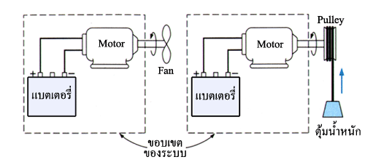
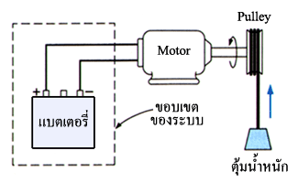
3-2 Work (2)

Slide 9
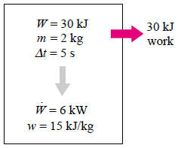
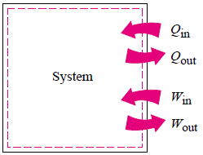
3-2 Work (3)
Work done during a process between states 1 and 2 :
per unit mass : (kJ/kg)
per unit time : (kJ/s) = (kW)
(+)
(-)
(-)
(+)
heat transfer to a system and work done by a system are positive;
heat transfer from a system and work done on a system are negative

Slide 10
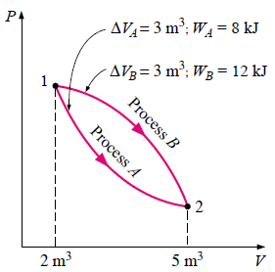
3-2 Work (4)
Similarities between heat and work
1) Both cross the boundaries of a system.
2) Systems possess energy, but not heat or
work.
3) Both are associated with a process,
not a state. Unlike properties, heat
or work has no meaning at a state.
4) Both are path functions.
Path functions have inexact differentials designated by symbol δ
(ฟังก์ชันทางเดิน) (อนุพันธ์ไม่ตายตัว)
Point functions have exact differentials designated by symbol d
(ฟังก์ชันจุด) (อนุพันธ์ตายตัว)

Slide 11
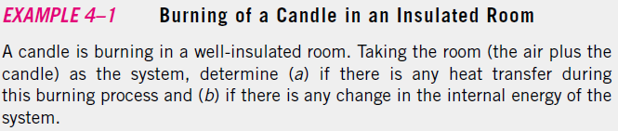
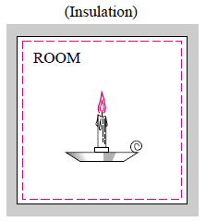
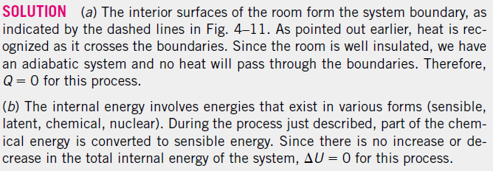
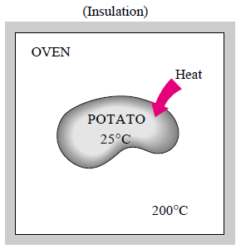
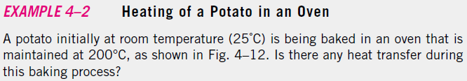
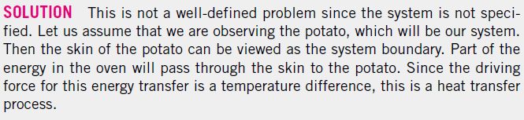

Slide 12
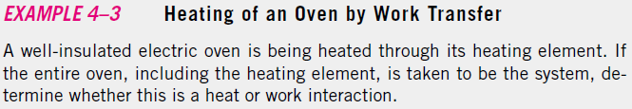
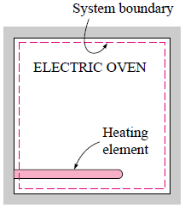
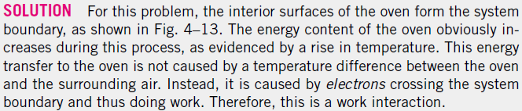
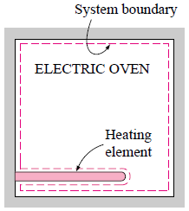

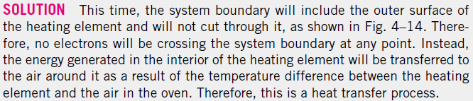


Slide 13
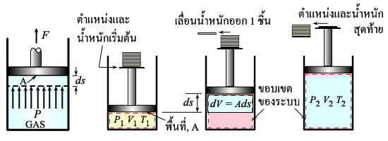
3-3 Work in Compressible System (1)
Consider the gas enclosed in the piston-cylinder device.
Initial state : P, V, A.
If the piston is allowed to move a distance ds in a quasi-equilibrium
manner, the differential work done during this process is
or per unit mass

Slide 14
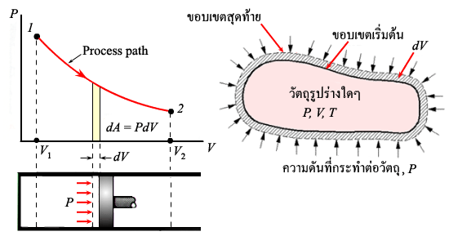
3-3 Work in Compressible System (2)
The differential work from
the initial state (1) to the
final states (2)
On this diagram,
The differential area: A
Area under the process curve on a
P-V diagram is equal to the work
done during a quasi-equilibrium
expansion or compression process
a closed system.
(kJ)
Expansion process (+)
Compression process (-)

Slide 15
3-3 Work in Compressible System (3)
Example 3.2
A gas is compressed from an initial volume of 0.42 m³ to a final volume 0.12 m³ . During the quasi-equilibrium process, the pressure changes with volume according to the relation
P = aV+b, where a = -1,200 kPa / m³ and b = 600 kPa.
Calculate the work done during this process (p.77)
(a) by plotting the process on a P-v diagram and finding the area under the process curve and
(b) by performing the necessary integrations

Slide 16
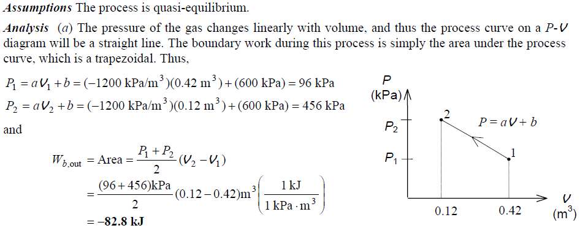
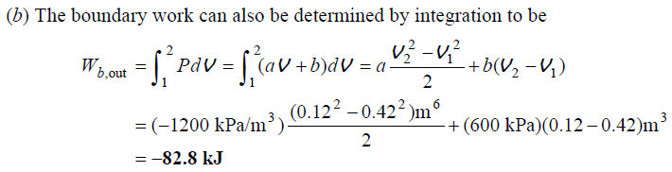

Slide 17
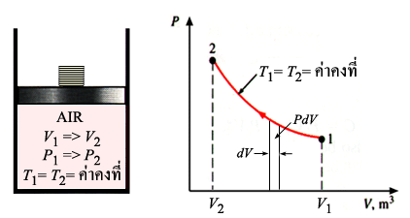
3-3 Work in Compressible System (4)
a) Isothermal Process ( T = constant)
From ideal gas equation,
where,
= const.

Slide 18
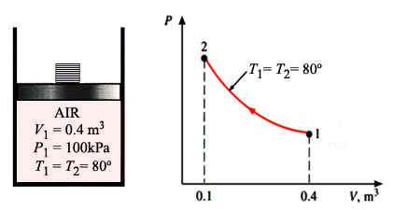
3-3 Work in Compressible System (5)
Example 3.3 A piston-cylinder device initially contains 0.4 m³ of air at 100 kPa and 80ºC. The air is now compressed to 0.1 m³ in such a way that the temperature inside the cylinder remains constant. Determine the work done during this process. (p.64)

Slide 19
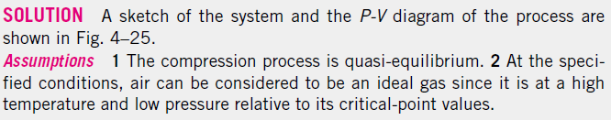
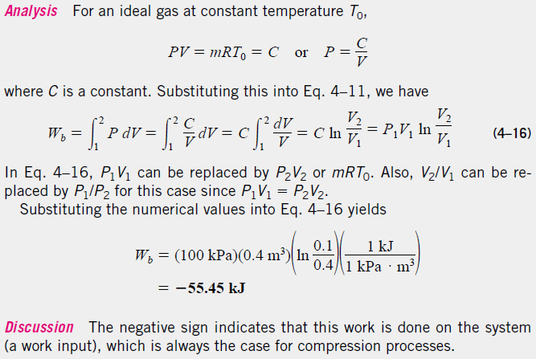

Slide 20
3-3 Work in Compressible System (6)
Example 3.4 A mass of 1.2 kg of air at 150 kPa and 12ºC is contained in a gastight, frictionless piston-cylinder device. The air is now compressed to a final pressure of 600 kPa. During the process heat is transferred from the air such that the temperature inside the cylinder remains constant. Calculate the work done during this process.(p.76)
Example 3.5 Nitrogen at an initial state of 300 K, 150 kPa, and 0.2 m³ is compressed slowly in an isothermal process to a final pressure of 800 kPa. Determine the work done during this process. (p.77)

Slide 21
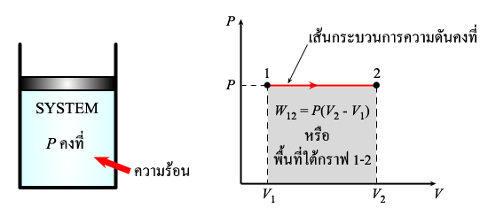
3-3 Work in Compressible System (7)
b) Isobaric Process ( P = constant)

Slide 22
3-3 Work in Compressible System (8)
Example 3.6 A mass of 5 kg of saturated water vapor at 300 kPa is heated at constant pressure until the temperature reaches 200ºC. Calculate the work done by the steam during this process.

Slide 23
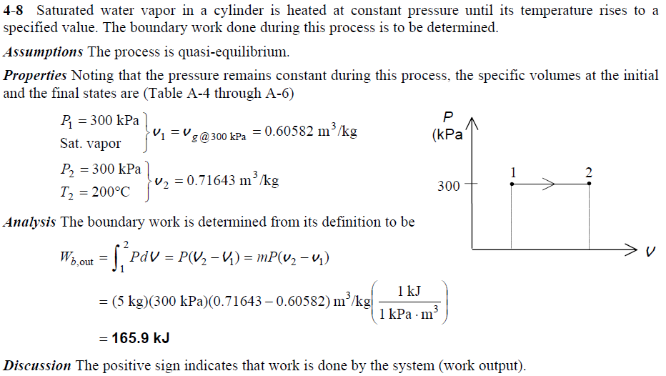

Slide 24
Example 3.7 A frictionless piston cylinder devic initially contains 200 L of saturated liquid refrigerant-12. The piston is free to move, and its mass is such that it maintains a pressure of 800 kPa on the refrigerant. The refrigerant is now heated until its temperature rises to 50ºC. Calculate the work done during this process. (p.75)

Slide 25
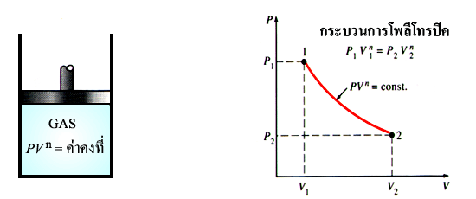
3-3 Work in Compressible System (9)
c) Isometric Process ( V = constant)
d) Polytropic Process ( )

Slide 26
3-3 Work in Compressible System (10)

Slide 27
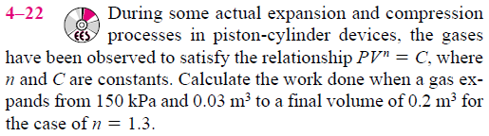
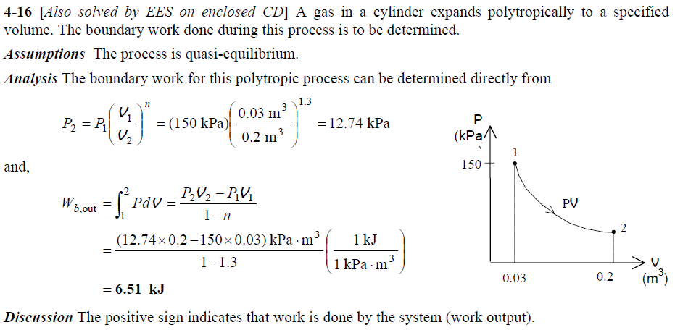

Slide 28
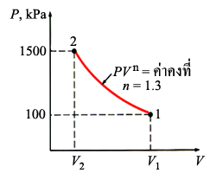
3-3 Work in Compressible System (11)
Example 3.8 A piston-cylinder device initially contains 100 kg of air at 100 kPa and 300 K. The air is now compressed slowly according to the relation PV^{1.3} = constant until it reaches a final pressure of 1500 kPa. Determine the work done during this process. (R = 0.287 kJ/kg.K) (p.66)

Slide 29
3-3 Work in Compressible System (12)
Example 3.9 A frictionless piston device contains 2 kg of nitrogen at 100 kPa and 300 K. Nitrogen is now compressed slowly according to the relation PV^{1.4} = constant until it reaches a final temperature of 360 K. Calculate the work done during this process. (p.79)
Example 3.10 Determine the power required to acceleration
a 9 kg car shown in figure from rest to a velocity of 80 km/h
in 20 s on a level road. (p.69)

Slide 30
3-4 Gravitational Work
Work done by gravitational acceleration
Work done for lifting object
from level Z₁ to Z₂
Z₂
Z₁
สมการการเปลี่ยนแปลงพลังงานศักย์
Z=0
งานที่ทำโดยระบบ (ระบบตกลงมา) เครื่องหมาย บวก (+)
งานที่ให้แก่ระบบ (ระบบถูกยกขึ้น) เครื่องหมาย ลบ (-)

Slide 31
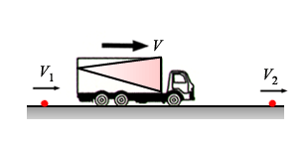
3-5 Acceleration Work
Consider mass m moves with the initial velocity V₁ and final
velocity V₂
,
สมการการเปลี่ยนแปลงพลังงานจลน์
งานที่ทำโดยระบบ (ระบบมีความเร็วมากขึ้น) เครื่องหมาย (+)
งานที่ให้แก่ระบบ (ระบบมีความเร็วลดลง) เครื่องหมาย (-)

Slide 32
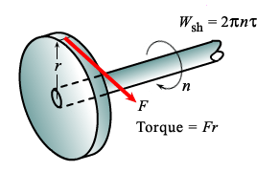
3-6 Shaft Work
A force F acting through a moment
are r generates a torque τ
This force acts through a
distance s, s = (2πr)n
Shaft Work: W_{sh}
งานเพลาที่กระทำโดยระบบ เครื่องหมาย บวก (+)
งานเพลาที่กระทำต่อระบบ เครื่องหมาย ลบ (-)

Slide 33
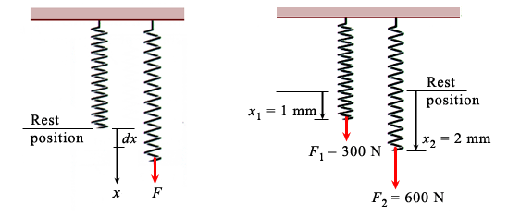
3-7 Spring Work (1)
When the length of the spring changes by a differential amount dx
under the influence of a force F, the work done is

Slide 34
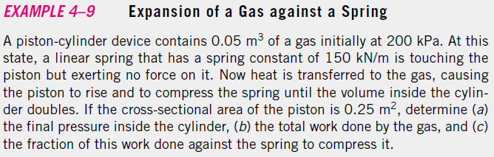
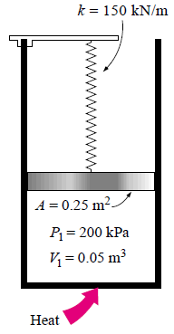
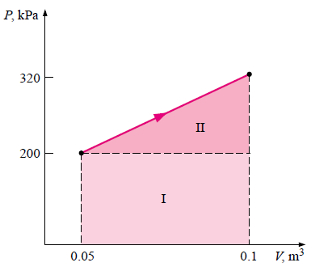

Slide 35
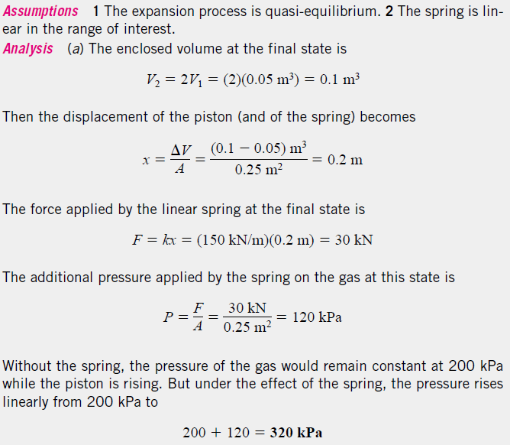

Slide 36
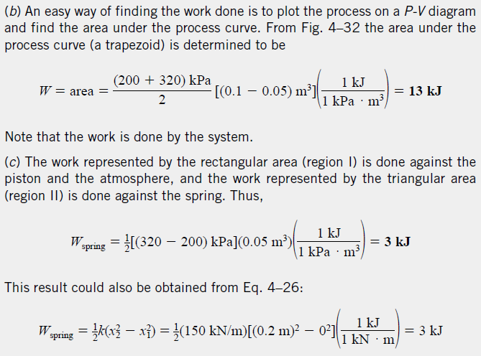

Slide 37
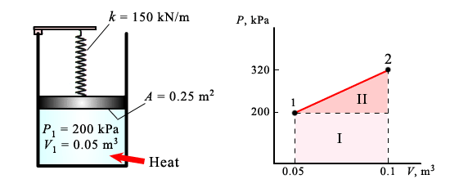
3-7 Spring Work (2)
Example 3.11 A piston-cylinder device contains 0.05 m³ of a gas initially at 200 kPa. At this state a linear spring which has a spring constant of 150 kN/m is touching the piston but exerting no force on it. Now heat is transferred to the gas, causing the piston to rise and to compress the spring until the volume inside the cylinder doubles. If the cross-sectional area of the piston is 0.25 m², determine (a) the final pressure inside the cylinder, (b) the total work done by the gas, and (c) the fraction of this work done against the spring to compress it. (p.71)

Slide 38
3-7 Spring Work (3)
Example 3.12 A piston cylinder device contains 50 kg of water at 150 kPa and 25ºC. The cross-sectional are of the piston is 0.1 m². Heat is now transferred to the water, causing part of it to evaporate and expand. When the volume reaches 0.2 m³, the piston reaches a linear spring whose spring constant is 100 kN/m. More heat is transferred to the water until the piston rises 20 cm more. Determine (a) the final pressure and temperature and (b) the the work done during this process. Also show the process on a P-V diagram. (p.80)

