Slide 1
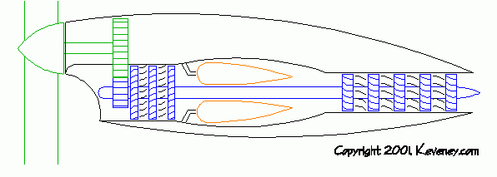
Chapter 8
Gas Power cycle
Part 4
Brayton Cycle: The Ideal Cycle for Gas-Turbine Engines
Assoc.Prof.Sommai Priprem,Ph.D.
Department of Mechanical Engineering
Khon Kaen University

Slide 2
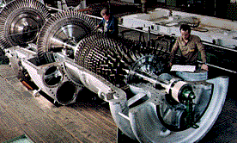
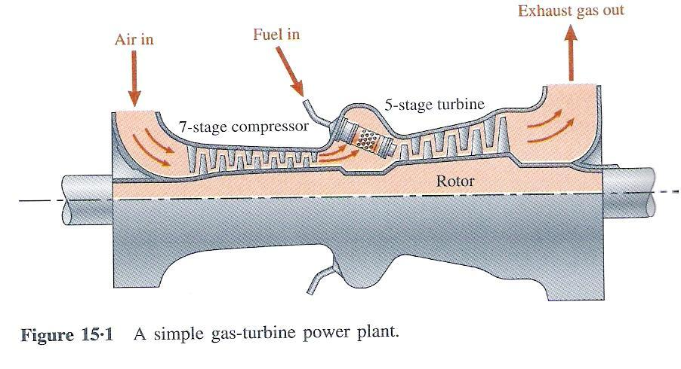
Brayton Cycle
First propose by George Brayton, 1870
It is Ideal Cycle of
  Gas Turbine Power Plant
  Gas Turbine Engine
    Turbojet
    Turbofan
    Turboprop

Slide 3
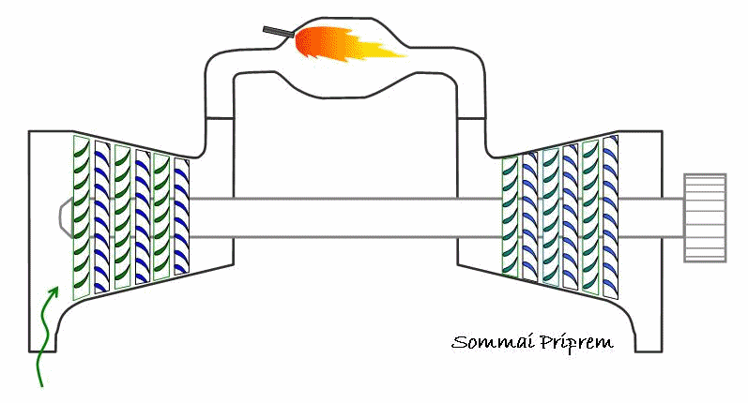
Gas Turbine Engine

Slide 4
Schematic Diagram of a Simple Gas Turbine Power Plant
Combustion
Chamber
Fuel
Electric Power Output
Compressed Air
Combustion Gases
Electric
Generator
Compressor
Turbine
Air Intake
Exhaust Gases

Slide 5
Combined Cycle
Turbine
Condenser
Fuel
Exhaust
Combustion Chamber
Air Compressor
Gas Turbine
Load
Air

Slide 6
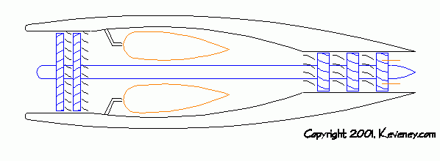
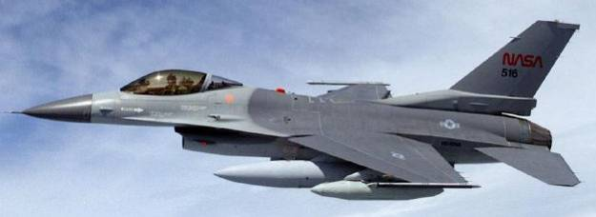
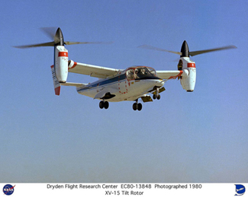
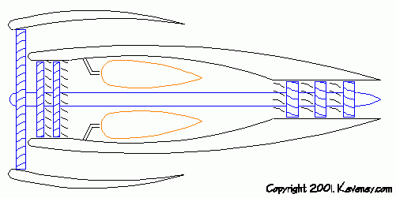

Gas Turbine Engines: Aircraft propulsion
Turbojet Engines
Turboprop Engines
Turbofan Engines

Slide 7
Recalled: Air Standard Assumptions
Working fluid is AIR and is IDEAL GAS.
All PROCESSES are internally reversible.
The combustion process is replaced by HEAT TRANSFER from external source.
The exhaust and intake process are replaced by a HEAT REJECTION which restores the working fluid to its initial state

Slide 8
Air Standard Brayton Cycle
Fuel
Combustion
Chamber
Q_{in}
Heat Exchanger
Compressed Air
Combustion Gases
High Pressure Air
High Temp.Air
Compressor
Turbine
W_{net}
Compressor
Turbine
Heat Exchanger
Air Intake
Exhaust Gases
Q_{out}
Actual Engine
Open cycle
Air Standard Cycle
Closed Cycle

Slide 9
Air Standard Brayton Cycle
Proc. 1-2 Isentropic Compression (in compressor)
Proc. 2-3 P = Constant Heat Addition
Proc. 3-4 Isentropic Expansion in (Turbine)
Proc. 4-1 P = constant, Heat Rejection

Slide 10
Processes on the T-s and P-v Diagrams
T
q_{in}
3
Q_{in}
Heat Exchanger
Back Work Ratio = W_{compressor}
W_{turbine}
P = const. = P₂
2
3
2
4
P = const. = P₁
W_{C}
q_{out}
Compressor
Turbine
1
W_{net}
s
s₁=s₂
s₃=s₄
Heat Exchanger
q_{in}
1
Q_{out}
4
P
2
3
pressure ratio,
r_{p} = P₁/P₂
P₂= P₃
Proc. 1-2 Isentropic Compression (in compressor)
Pv^{k} = c
Proc. 2-3 P = Constant, Heat Addition
Pv^{k} = c
w_{out}
Proc. 3-4 Isentropic Expansion in (Turbine)
Proc. 4-1 P = constant, Heat Rejection
w_{in}
P₁= P₄
1
4
q_{out}
Draw the T-s and P-v diagrams by yourself > 5 times
v₂
v₁
v₃
v₄
v

Slide 11
Some Remarks
η_{th} of Brayton cycle depend on the Pressure ratio, r_{p} of the cycle. (r_{p} = P_{max}/P_{min})
Pressure ratio, r_{p} range from 11 -16
T₃ = T_{max} α r_{p}➔ limit by the turbine blade material & design
At present T_{max} ~ 1425ºC ➔ η_{th} ~ 30%
Back Work Ratio = W_{compressor}/W_{turbine} ~ 0.5 (very high)
Two major used: Aircraft propulsion and Electric power generation
η_{th, gas turbine engine} < η_{th, steam turbine plant}
steam turbine plant start up time ~ 4 hr
gas turbine engine start up time ~ 2 min
gas turbine power plants use to serve ‘PEAK LOAD’
Steam turbine power plants use to serve ‘BASED LOAD’

Slide 12
Summary Review of Relevance Important Equations
Table A-17 Ideal gas properties of AIR
Account for the variation of specific heat with temperature.
เพื่อความง่ายในการคำนวณหาค่าคุณสมบัติที่เปลี่ยนแปลงใน isentropic process of ideal gas จึงได้กำหนดค่า :
Relative Pressure, P_{r}
Relative Volume, v_{r}
T | h | P_{r} | u | v_{r} | sº
Tyyy
T1 | h₁ | P_{r1} | u₁ | v_{r1}
Txxx
T2 | h₂ | P_{r2} | u₂ | v_{r2}

Slide 13
Isentropic Efficiency of Compressors
2
w
Compressor
1
h
P₂
T
P₂
2
2
h₂
T₂
2_{s}
Actual Process
2_{s}
Actual Process
h_{2s}
T_{2s}
w_{a}
Isentropic Process
w_{s}
P₁
Isentropic Process
P₁
h₁
T₁
1
1
s₁=s_{2s}
s₂
s
s₁=s_{2s}
s₂
s

Slide 14
Isentropic Efficiency of Turbines
1
T
P₁
Isentropic Process
1
T₁
Actual Process
w
Turbine
P₂
T₂
T_{2s}
2
2_{s}
2
s₁=s_{2s}
s₂
s

Slide 15
Example 8.4 A stationary power plant operating on an ideal Brayton cycle has a pressure ratio of 8. The gas temperature is 300 K at the compressor inlet and 1300 K at the turbine inlet. Utilizing the air-standard assumptions and accounting for the variation of specific heats with temperature, determine ( a) the gas temperature at the exits of the compressor and the turbine, (b) the back pressure ratio, and (c) the thermal efficiency.
Q_{in}
Heat Exchanger
2
3
W_{C}
Compressor
Turbine
W_{net}
Heat Exchanger
1
Q_{out}
4
Back Work Ratio = W_{compressor}
W_{turbine}
q_{in}
Given:
r_{p} = 8.
T₁ = 300 K
T₃ = 1300 K
variation of specific heats
Determine:
(a) T₂ and T₄
(b) the back pressure ratio
(c) the thermal efficiency.
T
P
2
3
q_{in}
3
P₂= P₃
pressure ratio,
r_{p} = P₁/P₂
Pv^{k} = c
P = const. = P₂
Pv^{k} = c
w_{out}
2
4
P = const. = P₁
w_{in}
q_{out}
P₁= P₄
1
4
q_{out}
1
s₃=s₄
s
v₂
v₁
v₃
v₄
v
s₁=s₂

Slide 16
(a) Find P and T at each state point, Using
  Ideal gas equations.
  Isentropic Process of Ideal gases.
  use P_{r} and v_{r} in Table A-17
  T₂ = 540 K, T₄ = 770 K
(b) Apply 1st law SSSP process
  cv. Compressor ➔ w_{comp}
  cv. Turbine ➔ w_{turbine}
  Back Work Ratio = 0.402
(c) Apply 1st law SSSP process
  cv. Heat exchanger 1 ➔ q_{in}
  cv. Heat exchanger 2 ➔ q_{out}
  η_{th} = w_{net}/q_{in} ................ w_{net} w_{turbine} – w_{compressor} (magnitude)
  η_{th} = 0.448
Back Work Ratio = W_{compressor}
W_{turbine}

Slide 17
Example 8.5 Assuming a compressor efficiency of 80 percent and a turbine efficiency of 85 percent, determine (a) the back pressure ratio, and (b) the thermal efficiency.( c) the exit temperature of the gas turbine power plant discussed in example 8.5.
η_{comp}= 80% η_{turb} = 85 %
Actual cycle
Ideal cycle
T
q_{in}
3
Repeat calculation as Ex 8.5 but using NEW State Points
(a) Back Work Ratio = 0.592
(b) ηth = 0.266
(c) T4 = 853 K
compare these values with Ex. 8.5
P₂
2
2s
4
P₁
4s
q_{out}
1
s₃=s₄
s
s₁=s₂

Slide 18
Gas Turbine Engines: Aircraft propulsion
Turbojet Engines
Turboprop Engines
Turbofan Engines

Slide 19
The Air standard Cycle for Jet Propulsion
Turbine work = Compressor work
Exhaust pressure from turbine >> P_{surr} , expand in Nozzle to P_{surr}
Very high velocity of gases leave the ‘Nozzle’
Change in momentum gives ‘Thrust’ which pushes the aircraft.
T
Q_{in}
q_{in}
3
Burner
Turbine
1
2
3
4
5
P₂
4
Compressor
Turbine
2
Nozzle
P₁
5
q_{out}
1
s₃=s₄=s₅
s
s₁=s₂

Slide 20
Thrust = Propulsive Force
F = (mV)_{exit} - (mV)_{inlet}
F = m(V_{exit} - V_{inlet} ) N
where, m = mass flow rate, V = Velocity (relative to aircraft velocity)
Propulsive Power = Propulsive Force x Distance/time
Wp = (F)V_{aircraft}
Wp = m(V_{exit} - V_{inlet} )V_{aircraft} kW
Propulsive Efficiency: (Desired output/Required Input)
η_{P} = Propulsive Power = W_{P}
energy Input Rate Q_{in}

Slide 21
Example 8.6 Consider an ideal jet propulsion cycle in which air enters the compressor at 0.1 MPa, 15 ºC. The pressure leaving the compressor is 1.0 MPa and the maximum temperature is 1100 ºC. The air expands in the turbine to the pressure at which the turbine work is just equal to the compressor work. On leaving the turbine, the air expands in a nozzle to 0.1 MPa. The process is reversible and adiabatic. Determine the velocity of the air leaving the nozzle. (use constant specific heat at 300K)(Van Wylen)
1. Find T₂
  Ideal gas equations.
  Isentropic Process of Ideal gases.
  T₂ = 556.8 K,
2. Apply 1st law SSSP processuse
use C_{p} at 300 K, T₃ = T_{max} = 1373.2 K
  cv. Compressor ➔ w_{comp}
  cv. Turbine ➔ w_{turbine} and w_{comp}
  ➔ T₄ = 1104.6 K and P₄ = 0.4668 MPa
3. Proc 4-5 isentropic ➔ T₅ = 710.8 K
4. cv.Nozzle ➔ V₅ = 889 m/s answer

Slide 22
Gas-Turbine (Brayton) Cycle
7-51C Why are the back work ratios relatively high in gas-turbine engines?
7-52C What four processes make up the simple ideal Bray ton cycle?
7-53C For fixed maximum and minimum temperatures, what is the effect of the pressure ratio on (a) the thermal efficiency and (b) the net work output of a simple ideal Bray ton cycle?
7-54C Why are gas turbines operated at very high air-fuel mass ratios?
7-55C Should the processes that make up the Bray ton cycle be analyzed as closed-system or steady-flow processes? Why? ,
7-56C What is the back work ratio? What are typical back work ratio values for gas-turbine engines?
7-57C How can the irreversibilities in the turbine and compressor of gas-turbine engines be properly accounted for?
7-58C How do the inefficiencies of the turbine and the compressor affect (a) the back work ratio and (b) the thermal efficiency of a gas-turbine engine?

Slide 23
7-59 A simple ideal Bray ton cycle with air as the working fluid has a pressure ratio of 10. The air enters the compressor at 300 K and the turbine at 1200 K. Using constant specific heats at room temperature, determine (a) the air temperature at the compressor exit, (b) the back work ratio, and (c) the thermal efficiency.
7-60 Air is used as the working fluid in a simple ideal Bray ton cycle that has a pressure ratio of 12, a compressor inlet temperature of 300 K, and a turbine inlet temperature of 1000 K. Determine the required mass flow rate of air for a net power output of 30 MW, assuming both the compressor and the turbine to be isenropic. Assume constant specific heats at room temperature, answer 150.7 kg/s
8-78 A stationary gas-turbine power plant operates on a simple ideal Brayton cycle with air as the working fluid. The air enters the compressor at 95 kPa and 290 K and the turbine at 760 kPa and 1100 K. Heat is I transferred to air at a rate of 50,000 kJ/s. Determine the power delivered by this plant, (a) assuming constant specific heats at room temperature and (b) Accounting for the variation of specific heat with temperature

Slide 24
8-79 Air enters the compressor of a gas-turbine engine at 300 K and 100 kPa, where it is compressed to 700 kPa and 580 K. Heat is transferred to air in the amount of 950 kJ /kg before it enters the turbine.For a turbine efficiency of 86 percent, determine (a) the fraction of the turbine work output used to drive the compressor and (b) the thermal efficiency. Assume variation of specific heat for air.
8-81 A gas-turbine power plant operates on a simple Bray ton cycle with air as the working fluid. The air enters the turbine at 1 MPa and 1000 K and leaves at 125 kPa and 600 K. Heat is rejected to the surroundings at a 1 rate of 7922 kJ / s, and air flows through the cycle at a rate of 25 kg/s. Assuming a compressor efficiency of 80 percent, determine the net power output of the plant. Account for the variation of specific heat with temperature.
Jet-Propulsion Cycles
8-107C How does the ideal jet-propulsion cycle differ from the ideal Brayton cycle?
8-108C What is the function of the nozzle in turbojet engines? 8-109C What is propulsive power? How is it related to thrust?
8-110C What is propulsive efficiency? How is it determined?
8-111C Is the effect of turbine and compressor irreversibilities of a turbojet engine to reduce (a) the net work, (b) the thrust, or (c) the fuel consumption rate?

Slide 25
8-112 A turbojet aircraft is flying with a velocity 280 m/s at an altitude of 6100 m, where the ambient conditions are 48 kPa and -13°C. The pressure ratio across the compressor is 13, and the temperature at the turbine inlet is 1300 K. Assuming ideal operation for all components and constant specific heats for air at room temperature, determine (a) the pressure at the turbine exit, (b) the velocity of the exhaust gases, and (c) the propulsive efficiency. Answers: (a) 374.3 kPa, (b) 933.6 m/s, (c) 26.9 percent
8-113 Repeat Prob. 8-112 accounting for the variation of specific heat with temperature.
8-114 A turbojet aircraft is flying with a velocity 320 m/s at an altitude of 9150 m, where the ambient conditions are 32 kPa and - 32°C. The pressure ratio across the compressor is 12, and the temperature at the turbine inlet is 1400 K. Air enters the compressor at a rate of 40 kg/s, and the jet fuel has a heating value of 42,700 kJ/kg. Assuming ideal operation for all components and constant specific heats for air at room temperature, determine (a) the velocity of the exhaust gases, (b) the propulsive power developed, and (c) the rate of fuel consumption.

Slide 26
End of Part 4
End of Chapter

