Slide 1
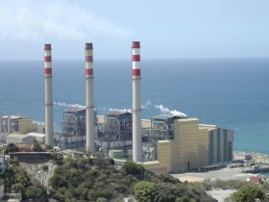
Chapter 9 Vapor Power cycle
Assoc.Prof.Sommai Priprem,Ph.D.
Department of Mechanical Engineering
Khon Kaen University

Slide 2
Vapor Power Cycle:
  Steam Power Plant
  Cogeneration Cycle
  Binary cycle
  Combined Gas-Vapor Cycle
In this course only the Rankine Cycle, ideal cycle for Steam Power Plant, is introduced.

Slide 3
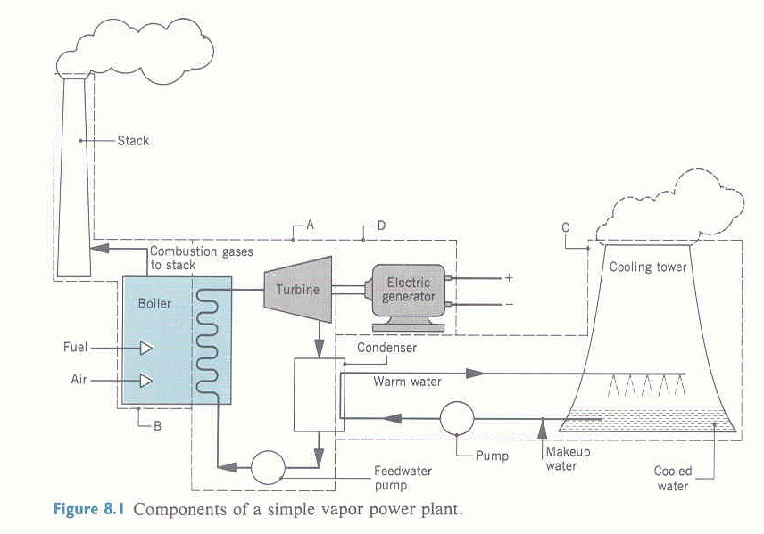
Component of a simple vapor power plant

Slide 4
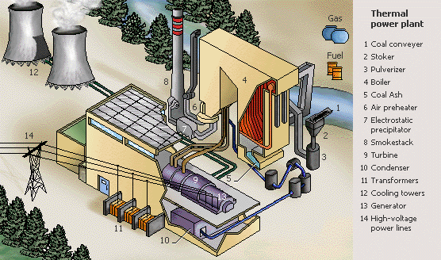
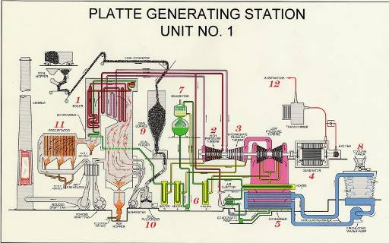

Slide 5
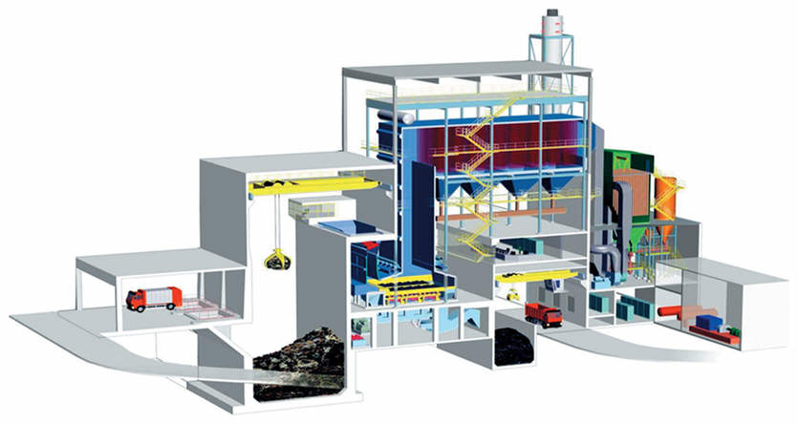
โรงไฟฟ้าเชื้อเพลิงขยะ

Slide 6
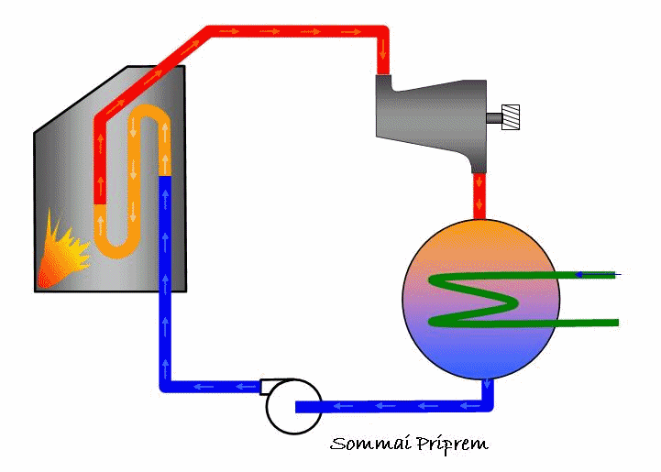
Simple Rankine Cycle

Slide 7
T
1
2
Carnot Cycle Process:
Reversible Isothermal Heat addition
Isentropic Expansion
Reversible Isothermal Heat Rejection
Isentropic Compression
4
3
s
Carnot Vapor Cycle
Possible
Applicable
T
T
Carnot 4
P2
P1
Carnot 1
Carnot 3
Carnot 5
Carnot 2
s
s
Practical: Isothermal heat transfer → during phase change → P = const. also

Slide 8
Simple Rankine Cycle vs Carnot Cycle
Improvement of Rankine Cycle
T
T
3. Rankine Cycle with Superheat Steam
1. Carnot Cycle
P2
P2
P1
P1
s
s
T
T
4. Supercritical Pressure Rankine Cycle
2. Simple Rankine Cycle
P2
P2
P1
P1
s
s

Slide 9
Effect of Temperature and Pressure on Cycle Thermal Efficiency
T
T
T
Tsteam = 600 ºC
Tsteam = 600 ºC
Tsteam = 350 ºC
Pboiler = 3 MPa
Pboiler = 3 MPa
Pboiler = 15 MPa
ηth = 33.5 %
ηth = 37.3 %
ηth = 43.0 %
Pcondenser = 10 kPa
Pcondenser = 10 kPa
Pcondenser = 10 kPa
s
s
s
Increasing thermal efficiency:
Lowering the condenser pressure.
Superheating the steam to high temperature.
Increase the boiler pressure.
Reheat (but mainly to reduce moisture content at final expansion)
Regenerative → Feed water heater

Slide 10
Simple Rankine Cycle
Processes:
1-2 Isentropic expansion in turbine ➔ work out [P drop ]
2-3 P = const. heat rejection in condenser
➔ mixtures condense to sat. liquid, Qout
3-4 Isentropic compression in pump ....... → work in
compressed liquid raise pressure from Pcondenser to Pboiler
4-1 P = const. heat addition in boiler ➔ liquid → vapor, Qin
1
T
1
P2
qin
Turbine
wout
P1
wt
4
Boiler
2
QB
3
qout
2
Pump
Condenser
4
Qc
Wp
s
3

Slide 11
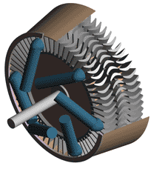
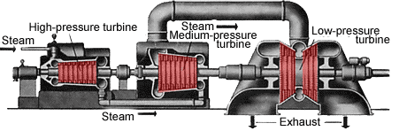
Turbine:
Convert energy in high pressure steam to work
Pressure reduces from Pboiler to Pcondenser
Control Volume: Turbine
Typical Assumptions:
Isentropic (ideal)
  SSSF Process
  ΔKE =0, ΔPE = 0 ; q = 0
Analysis
1st law SSSF Proc. q + h1 = w + h2
wT = h1 – h2
Working fluid : Steam (Water)
state 1 ➔ h1 = h @ T1 and P1 ➔ steam table
state 2 ➔ normally mixture@ P2 , h2 = hf + x2 hfg
Picture / Drawing
Schematic diagram
Steam
P1,T1
1
Turbine
w
T
Process diagram
q=0
2
1
P2
P2 .x2
P1
2
2s
s

Slide 12
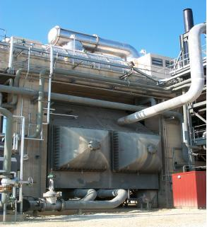
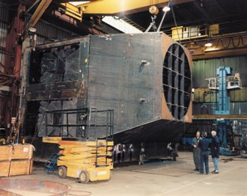
Condenser:
Condensing steam by reject heat from it.
Pressure is constant.
Create vacuum or low pressure at Pcondenser
Liquid leave as SATURATED LIQUID
Control Volume: Condenser
Assumptions:
  Constant Pressure
  SSSF Process and
  ΔKE =0, ΔPE = 0 ; w = 0
  state 3 = sat. liquid
Analysis:
1st law SSSF Proc. q + h2 = w + h3
qC = h3 – h2
Working fluid : Steam (Water)
state 2 ➔ mixture@ P2 , h2
state 3 sat. liq. ➔ h3 ~ hf @ P3
Schematic Diagram
2
Condenser
3
T
Process diagram
Qc
P2
P1
3
2
s

Slide 13
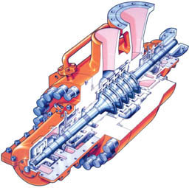
Pump (Feedwater Pump):
Increase pressure of steam from Pcondenser to Pboiler
Consume power.
Control Volume: Pump
Assumptions:
  Isentropic Process (ideal)
  SSSF Process and ΔKE =0, ΔPE = 0 ; q = 0
  Compressed liq. ➔ v = v3= constant
  Constant temperature process
Analysis:
1st law SSSF Proc. q + h3 = w + h4
wp = h3 – h4 = v(P3-P4)
Working fluid : liq. water
state 3 ➔ v3 ~ vf @ T3
(or use approximation for liq.
h ~ hf @T + vf (P - Psat )
and in this case T = constant
then h3 – h4 = vf (P3 - P4)
4
Pump
Wp
3
T
Process diagram
P2
4
P1
3
s

Slide 14
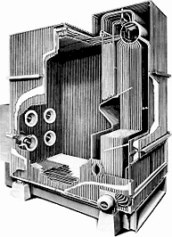
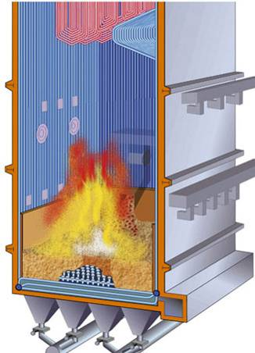
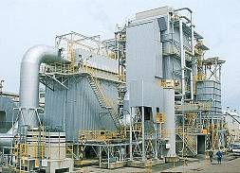
Boiler (steam Generator):
Input heat energy to high pressure feed water to be steam
Pressure constant at high pressure, Pboiler
Picture / Drawing
1
Typical Assumptions:
  Constant Pressure Process
  SSSF Process
  ΔKE =0, ΔPE = 0 ; w = 0
Boiler
T
Process diagram
4
1
P2
QB
Schematic diagram
P1
4
s

Slide 15
Example 9.1 Consider a steam power plant operates on the simple Rankine Cycle , the steam enters the turbine at 3 MPa and 350ºC and is condensed in a condenser at a pressure of 75 kPa. Determine efficiency of this cycle.
1
T
1
P1 = 3MPa
T1= 350 C
Turbine
qin
wout
wt
4
P2 = 75 kPa
Boiler
2
QB
Pump
Condenser
3
2
qout
4
Qc
Wp
3
s
Solution ηth = wnet/qin
wnet = wout - win
or wnet = qin - qout
cv. turbine → win
cv. pump → wout
cv.condenser → qout
cv. Boiler → qin

Slide 16
Solution concept
Control Volume: each equipment : Turbine, Condenser, Pump and Boiler, one at a time.
Assumptions:
  1. SSSF Process and ΔKE =0, ΔPE = 0
  for all equipments and:
  2. Turbine : q = 0, Isentropic → s2 = s1
  3. Condenser: w = 0
  4. Pump: q=0, Isentropic → s2 = s1 ,
  Liquid ➔ v = constant
  5. boiler: w = 0, No pressure drop
Solution: apply 1st law SSSF Proc.
q + h1 = w + h2
and get properties from steam table

Slide 17
1. Control Volume: Turbine
Assumptions:
  SSSF Process
  and ΔKE =0, ΔPE = 0 ;
  q = 0, s2 = s1
1st law SSSF Proc.
q + h1 = w + h2
wT = h1 – h2
Steam
P1= 3 MPa
T1= 350º
1
Turbine
w
q=0
2
P2= 75 kPa
x2= ?

Slide 18
Steam
P1= 3 MPa
T1= 350º
Working fluid : Steam (Water)
state 1
h1 = h @ T1 and P1
steam table.. h1 = 3115.3 kJ/kg
state 2 ➔ P2 , s2 = s1 ➔ Mixture
s2 = sf + x2 sfg ➔ x2
h2 = hf + x2 hfg
h2 = 2403.2 kJ/kg
wT = h1 – h2 = 712.1 kJ/kg
1
Turbine
w
q=0
2
P2= 75 kPa
x2= ?

Slide 19
2
2. Control Volume: Condenser
Assumptions: SSSF Process
and ΔKE =0, ΔPE = 0 ; w = 0
1st law SSSF Proc. q + h2 = w + h3
qC = h3 – h2
Working fluid : Steam (Water)
state 2 ➔ mixture@ P2 , h2 already known
state 3 Saturated liq. ➔ h3 = hf @ P3
= 348.39 kJ/kg
Condenser
Qc
3

Slide 20
P4=P1 = 3 MPa
3. Control Volume: Pump
Assumptions:
  SSSF Process and
  ΔKE =0, ΔPE = 0 ; q = 0,
  Compressed liq. ➔ v = v3= constant
  Isentropic Process, s3 = s4
1st law SSSF Proc. q + h3 = w + h4
wp = h3 – h4 = v(P3-P4)
Working fluid : liq. water at state 3 ➔ v3 ~ vf @ P3
wp = v(P3-P4) = (0.001037 m³/kg)(3,000 – 75)kPa
= 3.03 kJ/kg
h4 = h3 + wp = 348.39 + 3.03 = 387.42 kJ/kg
4
Pump
P1 = 75 kPa
Wp
3

Slide 21
4. Control Volume: Boiler
Assumptions:
  SSSF Process and
  ΔKE =0, ΔPE = 0 ; w = 0
Solution:
1st law SSSF Proc. q + h4 = w + h1
qB = h1 – h4 = (3115.3 - 387.42) kJ/kg
= 2727.88 kJ/kg
wnet = wout – win = wturb – wpump
= (712.1 -3.03) kJ/kg = 709.07 kJ/kg
ηth = wnet/qin = 709.07/2727.88
= 0.260 (or 26.0%) answer
1
QB
Boiler
4

Slide 22
Deviation from Ideal Cycle
1. Friction → Pressure drop in Piping, Condenser, Boiler
2. Heat loss → Piping ,etc
3. Irreversibility of Turbine and Pump → Isentropic efficiency < 100%
4. Power consumed by auxiliary equipment ie., fans

Slide 23
Example 9.2 A steam power plant operates on the Rankine Cycle shown . If the adiabatic efficiency of the turbine is 87 % and the adiabatic efficiency of the pump is 85 %, determine (a) the efficiency of the cycle and (b) the net power output of the plant for the mass flow rate of 15 kg/s.
15.2 MPa, 625ºC
T
4
5
15 MPa, 600ºC
4
Turbine
5
QB
ηt = 87 %
wt
2
Boiler
6
10 kPa
16 MPa
3
15.9 MPa, 35ºC
3
2
Condenser
6
Pump
Qc
1
ηp = 85 %
Wp
1
9 kPa, 38ºC
s

Slide 24
Solution
(a) ηth = wnet/qin
wnet = wturb - wpump
wturb = ηturb(h5-h6s) = 0.87(3582.3-2115.7) = 1275.9 kJ/kg wpump = ws/ηp = v1(P2-P1)/ηp
= [(0.001008 m³/kg)(16,000-9)kPa]/0.85
= 19.0 kJ/kg
qin = qboiler = (h4-h3) = (3645.7-146.7)kJ/kg
= 3499.0 kJ/kg
wnet = 1275.9 – 19.0 = 1259.9 kJ/kg
ηth = wnet/qin = (1259.9 kJ/kg)/(3499.0 kJ/kg)
= 0.359 or (35.9%)
(b) Net Power produce = mdot*wnet = (15 kg/s)*(1259.9 kJ/kg)
= 18,854 kW
= 18.85 MW

Slide 25
Reheat Rankine Cycle
Processes:
1-2 Isentropic expansion in turbine 1st stage turbine
(High Pressure Turbine, LPT) ➔ wHPT
2-3 Reheat: P = const. heat addition in boiler
3-4 Isentropic expansion in turbine 2nd stage turbine
(Low Pressure Turbine, LPT) ➔ wLPT
4-5 P = const. heat rejection in condenser
➔ mixture condenses to sat. liquid, Qout
5-6 Isentropic compression in pump ....... → work in
compressed liquid raise pressure
from Pcondenser to Pboiler
6-1 P = const. heat addition in boiler ➔ liquid →
vapor, Qin

Slide 26
Reheat Cycle
Schematic diagram
T
Process diagram
1
2-Stage Turbine
1
HPT
LPT
wt
Boiler
P3
6
3
2
4
P2
2
Reheat
P1
3
5
4
QB
Pump
Condenser
6
Qc
Wp
s
5

Slide 27
Analysis Technique: in Turbine
Method A. Control Volume: Turbine
1st law SSSF Proc.
Q + Σmihi = W + Σmehe
m1 = m2 = m3 = m4 = m, w = W/m
w = (h1 – h2) + ( h3 – h4) ....................(A)
3
1
HPT
LPT
wt
2
4
Method B. Separate Control Volume: HPT and LPT
1st law SSSF Proc.
q + hi = w +he
wHPT = (h1 – h2)
wLPT = ( h3 – h4)
wturbine = wHPT + wLPT
= (h1 – h2) + ( h3 – h4) .........(B)
3
1
HPT
LPT
wHPT
wLPT
2
4

Slide 28
Analysis Technique: in Steam Generator
1
Method A. Control Volume: Steam generator
1st law SSSF Proc.
Q + Σmihi = W + Σmehe
m1 = m2 = m3 = m4 = m, q = Q/m
qin = (h1 – h2) + ( h3 – h4) .............(A)
2
6
3
qin
1
Method B. Separate Control Volume:
Boiler section and Reheat section,
1st law SSSF Proc.
q + hi = w +he
qboiler = (h1 – h6)
qreheat = ( h3 – h2)
qin = qboiler + qreheat
= (h1 – h6) + ( h3 – h2) ....(B)
6
qboiler
Boiler section
Reheat Section
2
qreheat
3

Slide 29
Example 9.4 Consider a steam power plant operates on the ideal reheat Rankine Cycle , the steam enters the high pressure turbine at 15 MPa and 600ºC and is condensed in a condenser at a pressure of 10 kPa. If the steam is reheated to the steam inlet temperature of the high pressure turbine, and the moisture content of the steam at the exit of the low pressure turbine is not exceed 10.4 %, determine (a) the pressure at which the steam should be reheated and (b) the thermal efficiency of this cycle.
Schematic diagram
T
Process diagram
1
2-Stage Turbine
1
HPT
LPT
wt
P3
Boiler
6
3
2
4
P2
2
Reheat
P1
3
5
4
QB
Pump
Condenser
6
Qc
Wp
s
5

Slide 30
State 4, x4 = (1 – 0.104) = 0.896,
and P4 = 10 kPa → s4 = 7.370 kJ/kg-k
State 3, s3 = s4 and T3 = T1 = 600 ºC
→ P3 = 4.0 MPa answer
(b) ηth = wnet/qin
wturbine = wHPT + wLPT
= (h1 – h2) + ( h3 – h4)
wp = v1(P2-P1)
qin = qboiler + qreheat
= (h1 – h6) + ( h3 – h2)
h1 = 3582.3 kJ/kg, h2 = 3154.3 kJ/kg, h3 = 3674.4 kJ/kg,
h4 = 2335.8 kJ/kg, h5 = 191.83 kJ/kg, h6 = 206.94 kJ/kg,
wturbine = wHPT + wLPT = 1766.6 kJ/kg
ws = v1(P2-P1) = 15.11 kJ/kg
qin = qboiler + qreheat = 3895.46 kJ/kg
ηth = wnet/qin = 0.450 ( 45.0 %) answer

Slide 31
9-11C How do actual vapor power cycles differ from the idealized ones?
9-12C Compare the pressures at the inlet and the exit of the boiler for (a) actual and (b) ideal cycles.
9-14C Is it possible to maintain a pressure of 10 kPa in a condenser which is being cooled by river water entering at 20°C?
9-15 A steam power plant operates on a simple ideal Rankine cycle between the pressure limits of 3 MPa and 50 kPa. The temperature of the steam at the turbine inlet is 400°C, and the mass flow rate of steam through the cycle is 25 kg/s Show the cycle on a T-s diagram with respect to saturation lines, and determine (a) the thermal efficiency of the cycle and (b) the net power output of the power plant.
9-16 Consider a 300-MW steam power plant which operates on a simple ideal Rankine cycle. Steam enters the turbine at 10 MPa and 500°C and is cooled in the condenser at a pressure of 10 kPa. Show the cycle on a T-s diagram with respect to saturation lines, and determine (a) the quality of the steam at the turbine exit, (b) the thermal efficiency of the cycle, and (c) the mass flow rate of the steam.
Answers: (a) 0.793, (b)40.2 percent, (c) 235.4kg/s

Slide 32
9-18 A steam power plant operates on a simple ideal Rankine cycle between the pressure limits of 9 MPa and 10 kPa. The mass flow rate of steam through the cycle is 60 kg/sec The moisture content of the steam at the turbine exit is not to exceed 10 percent. Show the cycle on a T-s diagram with respect to saturation lines, and determine (a) the minimum turbine inlet temperature, (b) the rate of heat input in the boiler, and (c) the thermal efficiency of the cycle.
9-19 Repeat Prob. 9-18 assuming an adiabatic efficiency of 85 percent for both the turbine and the pump.
9-20 Consider a coal-fired steam power plant which produces 300 MW of electric power. The power plant operates on a simple ideal Rankine cycle with turbine inlet conditions of 5 MPa and 450°C and a condenser pressure of 25 kPa. The coal used has a heating value (energy released when the fuel is burned) of 29,300 kJ/kg. Assuming that 75 percent of this energy is transferred to the steam in the boiler and that the electric generator has an efficiency of 96 percent, determine (a) the overall plant efficiency (the ratio of net electric power output to the energy input as fuel and (b) the required rate of coal supply, in t/h
[1 metric ton (t) = l000 kg]. Answers: (a) 24.6 percent, (b) 150.1 t/h
9-21 Consider a solar-pond power plant which operates on a simple ideal Rankine cycle with refrigerant-12 as the working fluid. The refrigerant enters the turbine as a saturated vapor at 1.6 MPa and leaves at 0.7 MPa. The mass flow rate of the refrigerant is 6 kg/sec Show the cycle on a T-s diagram with respect to saturation lines, and determine (a) the thermal efficiency of the cycle and (b) the power output of this plant.

Slide 33
Home Work
9-14c

Slide 34
End of Chapter 9
ทำโจทย์เยอะๆ จะช่วยให้เข้าใจได้ลึกซึ้งยิ่งขึ้น

