Slide 1

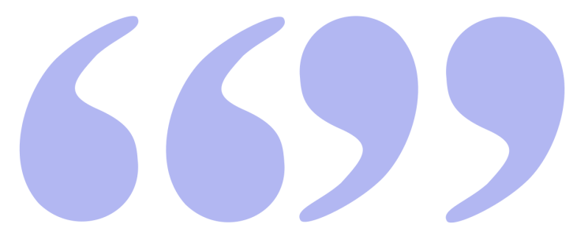
Direct
and
Indirect
quotation

Slide 2

Direct vs Indirect quotation
David said, “I like this girl.”
David said that he liked that girl.

Slide 3
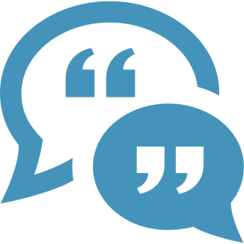
Direct quotation
Using what someone wrote or said without any changes.
Using quotation marks to indicate what the person wrote or said.
Using the exact words of the person.

Slide 4

Indirect quotation
Reporting a fact stated by the source.
Clarifying a quote that is too long.
Do not use quotation marks in indirect quotation.
Changing tense in the sentence.

Slide 5
Direct vs Indirect quotation
Direct
David said, “I like this girl.”
Indirect
David said that he liked that girl.

Slide 6

Direct
Today
Yesterday
Tomorrow
Ago
This
These
Next week
Time phrases
Indirect
That day
The day before
The next day
Before
That
Those
The following week

Slide 7
Direct
Can
Will
Should
Must
May (possibility)
May (permission)
Shall (suggestion)
Shall (future)
Modal verbs
Indirect
could
would
should
had to
might
could
should
would

Slide 8
Direct
Present Simple
Present Con.
Present Perfect
Past Simple
Past Con.
Future (will)
Tense
Indirect
Past Simple
Past Con.
Past Perfect
Past Perfect
Past Perfect Con.
Conditional (would)

Slide 9
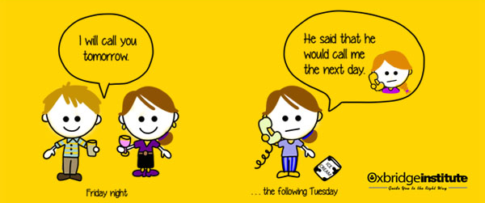
Direct vs Indirect quotation

Slide 10
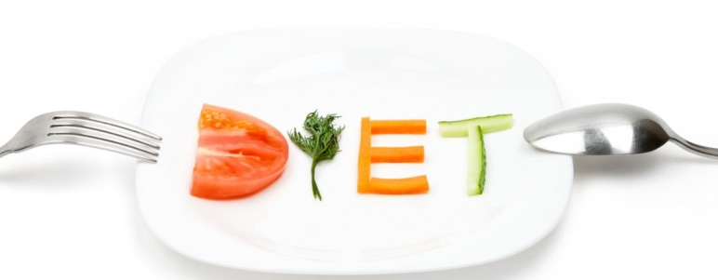
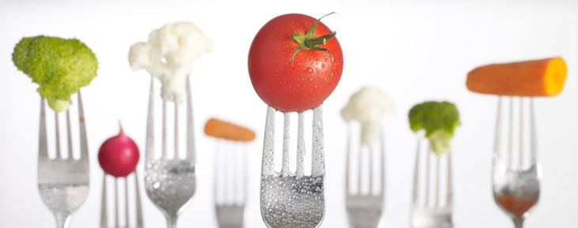
Can diet foods aid weight loss?
Herron, 2014
The good news
Many diet products tend to be highly processed, salty, sugary treat foods with little nutritional value. From jams and biscuits to salad dressings, they're foods you'd assume a dieter should avoid, even with reduced kilojoules. So do these products have a useful role as part of a balanced diet of fresh fruit and vegetables, wholegrains, lean meat and low-fat dairy?
"Diet foods can provide a less harmful alternative for people who are dedicated to losing weight, particularly if they're looking for a treat," argued Professor John Funder, executive chair of Obesity Australia. There's good data, he says, to show that if people know upfront how many kilojoules they're eating, they can end up eating about 200kJ fewer across a day.
The bad news
Nutritionist Dr. Joanna McMillan agreed that diet foods can "hold your hand" while you're trying to lose weight – being able to swap your favorite rich foods with "diet" versions means you don't have to go cold turkey on treats - but she believes they can also lull dieters into a false sense of security.
"People may think, 'I've eaten something low kilojoule, so I've got some credits to eat something extra', and they end up overeating," she said. "Strict kilojoule counting is not always a practical, healthy option, and women in particular can be obsessive about it – and this can be in addition to a poor body image and the habit of swinging between loving and hating food."

Slide 11
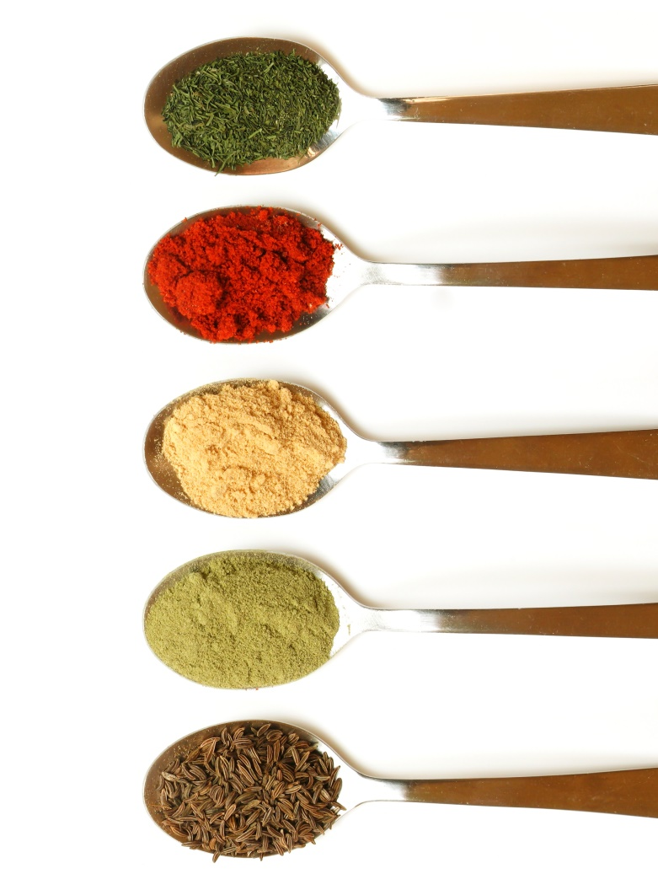
Can diet foods aid weight loss?
Herron, 2014
Many diet products tend to be highly processed, salty, sugary treat foods with little nutritional value. From jams and biscuits to salad dressings, they're foods you'd assume a dieter should avoid, even with reduced kilojoules. So do these products have a useful role as part of a balanced diet of fresh fruit and vegetables, wholegrains, lean meat and low-fat dairy?
Herron (2014) assumed, “many diet products tend to be highly processed, salty, sugary treat foods with little nutritional value. ” ………………………………………..… ……………………………………………………………………………………………………………………………………………………………………………………………………
Herron (2014) assumed that many diet products tended to be highly processed, salty, sugary treat foods with little nutritional value. .………………………………………. ……………………………………………………………………………………………………………………………………………………………………………………………………

Slide 12
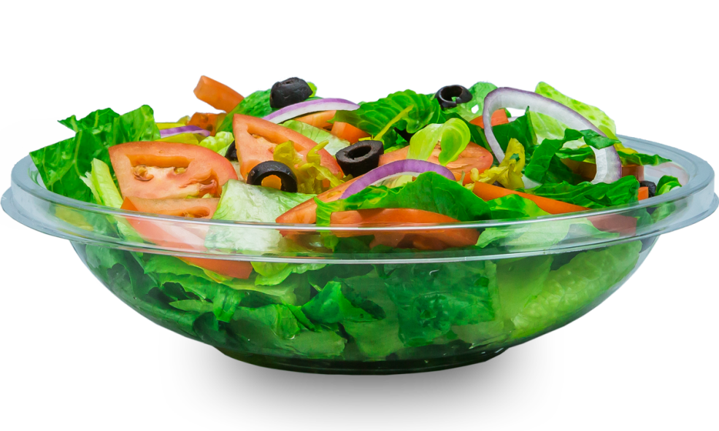
Can diet foods aid weight loss?
Herron, 2014
"Diet foods can provide a less harmful alternative for people who are dedicated to losing weight, particularly if they're looking for a treat," argued Professor John Funder, executive chair of Obesity Australia. There's good data, he says, to show that if people know upfront how many kilojoules they're eating, they can end up eating about 200kJ fewer across a day.
Professor John Funder, executive chair of Obesity Australia , argued that diet foods could provide a less harmful alternative for people who are dedicated to losing weight, particularly if they're looking for a treat. .……………………………………….…………… ……………………………………………………………………………………………………………………………………………………………

Slide 13
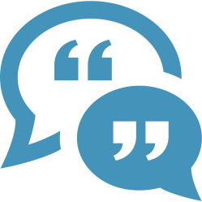
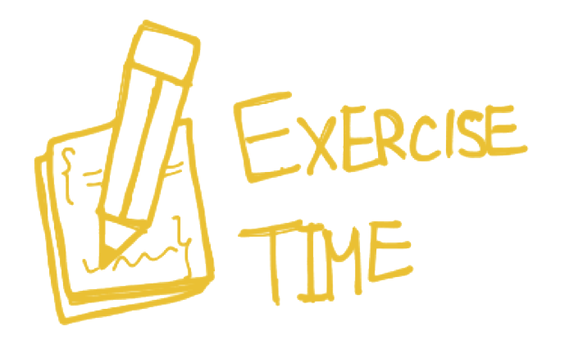
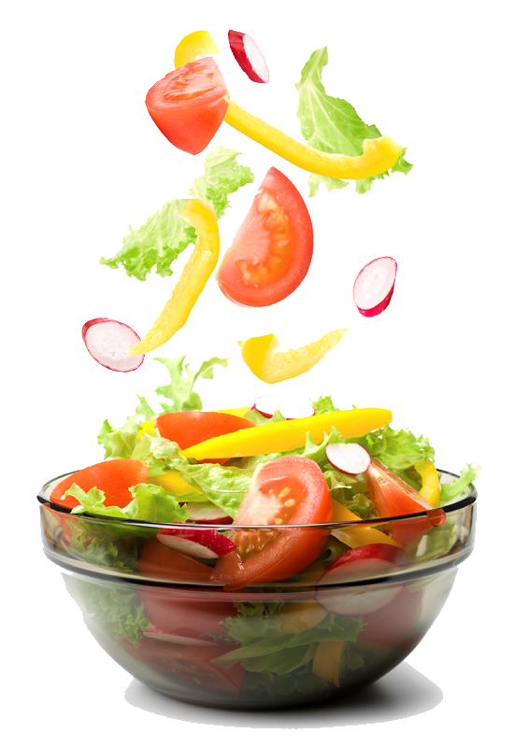

Slide 14

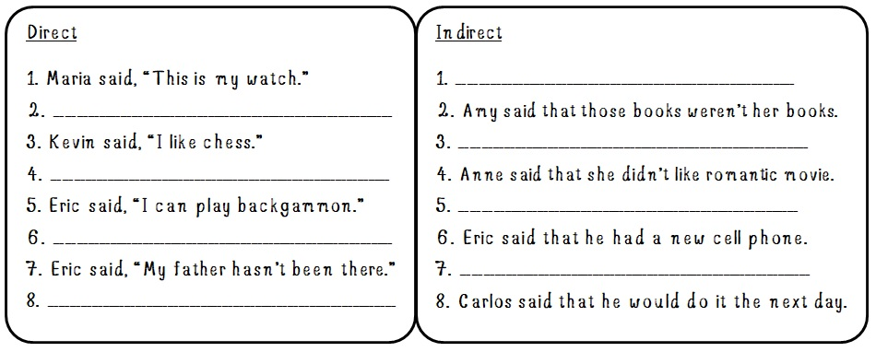

Slide 15
Answer
Direct
Maria said, “this is my watch.”
Indirect
Maria said that that was her watch.

Slide 16
Answer
Direct
2. Amy said, “These aren’t my books.”
Indirect
2. Amy said that those books weren’t her books.

Slide 17
Answer
Direct
3. Kevin said, “I like chess.”
Indirect
3. Kevin said that he liked chess.

Slide 18
Answer
Direct
4. Anne said, “I don’t like romantic movie.”
Indirect
4. Anne said that she didn’t like romantic movie.

Slide 19
Answer
Direct
5. Eric said, “I can play Backgammon.”
Indirect
5. Eric said he could play Backgammon.

Slide 20
Answer
Direct
6. Eric said, “I have a new cell phone.”
Indirect
6. Eric said that he had a new cell phone.

Slide 21
Answer
Direct
7. Eric said, “my father hasn’t been there.”
Indirect
7. Eric said that his father had not been there.

Slide 22
Answer
Direct
8. Carlos said, “I will do it tomorrow.”
Indirect
8. Carlos said that he would do it the next day.

Slide 23


