Slide 1

Reporting verbs
and
Signal phrases

Slide 2

Why writer needs reporting verbs and Signal phrases?
In academic writing, it is important to present an argument logically and cohesively. You may be required to:
comment on someone’s work
agree or disagree with someone else’s study
evaluate someone’s ideas

Slide 3
Reporting verbs
accept
acknowledge
add
advise
agree
argue
claim
clarify
confirm
find
indicate
justify
maintain
note
points out
realize
remark
report
reveal
show
state
suggest
think
etc.

Slide 4
Signal phrases
Signal phrases make the distinction between writer and source clear for the audience.
According to ……………..,
In the word of ……………,
In a recent study by ………,
From a book of ………….,
The following table of ………,
As …………...,

Slide 5
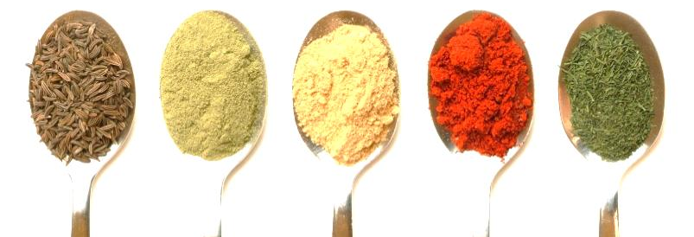
Organic food (Kathy, 2015)
Organic fruit and vegetables Organic food is very popular these days. It can also be very expensive. Some organic food costs twice as much as non-organic food. Parents of young children, and even some pet owners, will pay high prices for organic food if they think it's healthier. But many others think organic food is just a waste of money.
There is one main difference between organic and non-organic food. Organic farms do not use agricultural chemicals such as pesticides that stop insects from damaging crops. In many countries foods that claim to be organic must have special labels that guarantee they're grown organically.
Is organic food safer and more nutritious? This is an important part of the debate. Many farmers and consumers believe it is. They think agricultural chemicals can cause serious illnesses like cancer, but there isn't much evidence proving this is true. However recent studies have shown that eating organically-grown produce reduces your chances of developing heart disease. Many doctors think it's more important to stop dangerous bacteria from contaminating foods. These bacteria can contaminate both organic and non-organic fruit and vegetables, and doctors recommend washing produce carefully before eating it. Meat, fish and chicken can also become contaminated, so washing your hands before handling these foods is also very important.
Many doctors also believe we should reduce the amount of sugar in our diets, and there is a lot of evidence to support this idea. They recommend carefully checking the list of ingredients on processed food and drinks for all the words that really mean sugar, like glucose, sucrose and fructose. And they remind us that the aim of most big food companies is to make lots of money, even if they damage our health while doing so. This means processed foods that are called "organic" can also be very unhealthy if they contain lots of sugar.

Slide 6
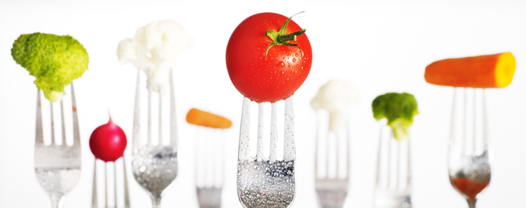
Organic food
(Kathy, 2015)
Organic fruit and vegetables Organic food is very popular these days. It can also be very expensive. Some organic food costs twice as much as non-organic food. Parents of young children, and even some pet owners, will pay high prices for organic food if they think it's healthier. But many others think organic food is just a waste of money. (p.20)
Kathy (2015) explained, “parents of young children, and even some pet owners, will pay high prices for organic food if they think it's healthier” (p.20). …………………… ……………………………………………………………………………………………………………………………………………………………………………………………………
According to Kathy (2015), she explained that there many people pay for organic food in order to take care their family and pet (p.20). .………………………………………. ……………………………………………………………………………………………………………………………………………………………………………………………………

Slide 7
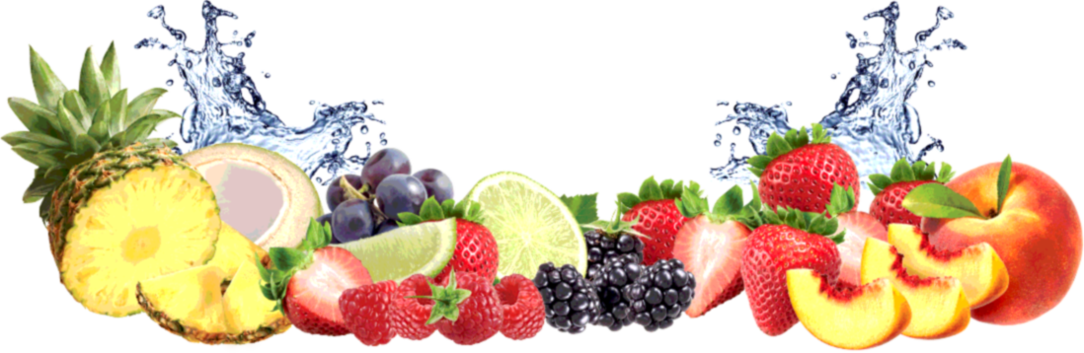
Organic food
(Kathy, 2015)
There is one main difference between organic and non-organic food. Organic farms do not use agricultural chemicals such as pesticides that stop insects from damaging crops. In many countries foods that claim to be organic must have special labels that guarantee they're grown organically. (p.21)
Kathy (2015) assumed, “In many countries foods that claim to be organic must have special labels that guarantee they're grown organically” (p.21). On the other hand, David (2013) found that ……………………..…………..…………………………………… ………………………………………………………………………………………………………………………………………….

Slide 8
Organic food
(Kathy, 2015)
Is organic food safer and more nutritious? This is an important part of the debate. Many farmers and consumers believe it is. They think agricultural chemicals can cause serious illnesses like cancer, but there isn't much evidence proving this is true. However recent studies have shown that eating organically-grown produce reduces your chances of developing heart disease. Many doctors think it's more important to stop dangerous bacteria from contaminating foods. These bacteria can contaminate both organic and non-organic fruit and vegetables, and doctors recommend washing produce carefully before eating it. Meat, fish and chicken can also become contaminated, so washing your hands before handling these foods is also very important. (p.22)
Kathy (2015) described, “many farmers and consumers think agricultural chemicals can cause serious illnesses like cancer, but there isn't much evidence proving this is true” (p.22). ……………………………………………………………………………………………………… Moreover, David (2013) reported that ……………………..…………..………………………… …………………………………………………………………………………………………….

Slide 9
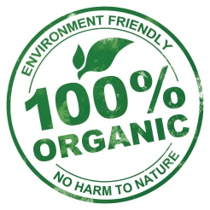
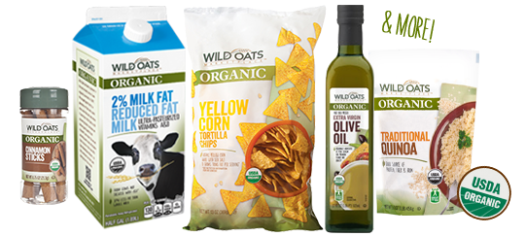
Organic food
(Kathy, 2015)
Many doctors also believe we should reduce the amount of sugar in our diets, and there is a lot of evidence to support this idea. They recommend carefully checking the list of ingredients on processed food and drinks for all the words that really mean sugar, like glucose, sucrose and fructose. And they remind us that the aim of most big food companies is to make lots of money, even if they damage our health while doing so. This means processed foods that are called "organic" can also be very unhealthy if they contain lots of sugar. (p.23)
Kathy (2015) suggested, “many doctors recommend carefully checking the list of ingredients on processed food and drinks for all the words that really mean sugar, like glucose, sucrose and fructose” (p.23). …………………………………………………………………… …………………… ……………………………………….……………………..………….…… ………………………………………………………………………

Slide 10


Slide 11
Answer
1. Arnold Schwarzenegger thought that gay marriage was something that should be between a man and a woman.
2. Marion Barry argued that, if you took out the killings, Washington actually had a very low crime rate.
3. Alan Minter admitted that there had been injuries and deaths in boxing but denied that any of them were serious.

Slide 12
4. Dan Osinski asked the waitress to cut his pizza into six slices because he couldn’t eat eight.
5. Dizzy Dean announced that the doctors had X-rayed his head and found nothing.
6. A GLR broadcaster reported that, for most people, death came at the end of their lives.
7. Greg Norman, Golfer said that he owed a lot to his parents, especially his mother and father.

Slide 13
8. Britney Spears told us that she got to go to lots of overseas places, like Canada.
9. Linda Evangelista insisted that she didn’t diet. She just didn’t eat as much as she’d have liked to.
10. Madonna decided that everyone was entitled to her opinion.

